Slide 1
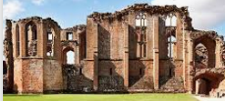
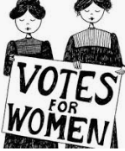
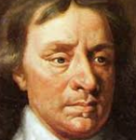
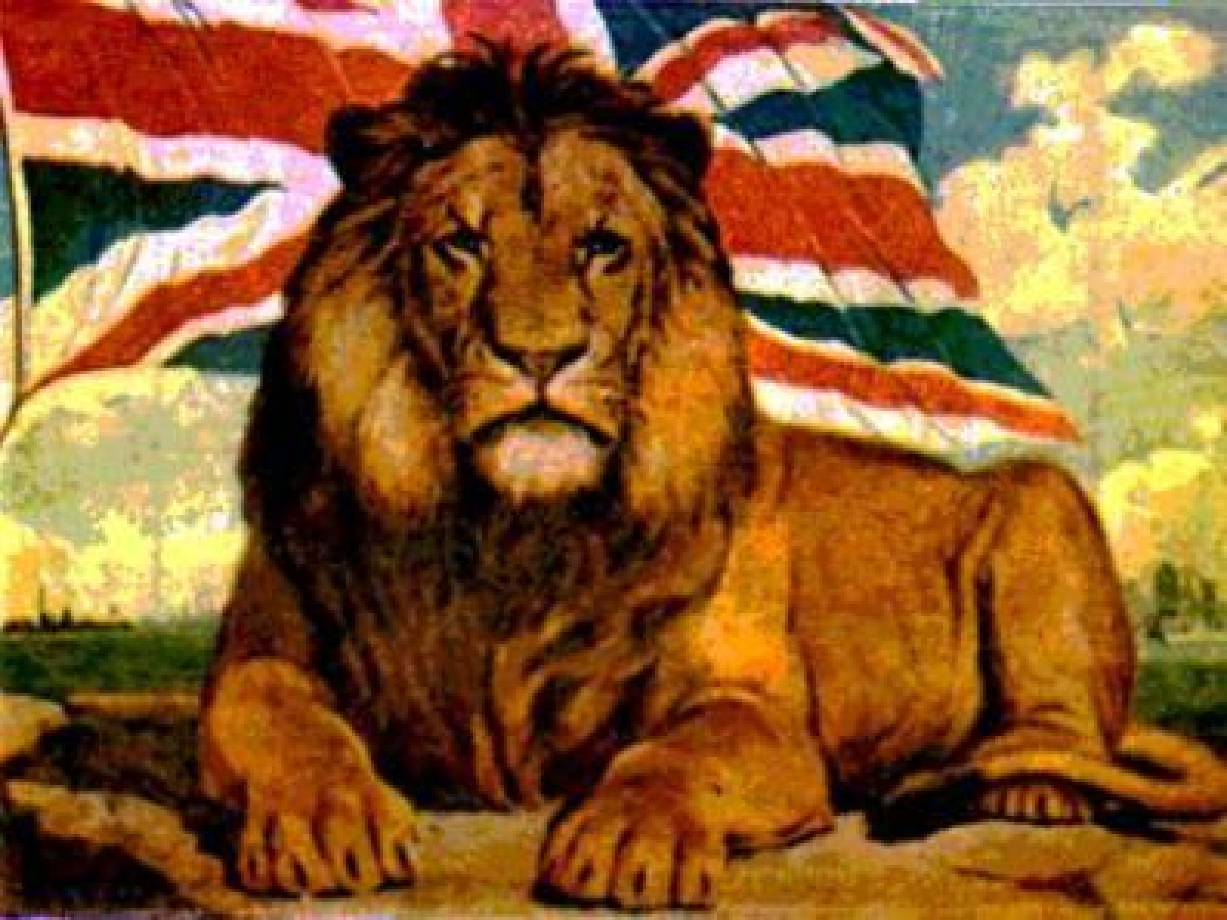
Blackpool Aspire Academy History Dept.
Learning Journey
Paper 2 Revision
Historical Environment
Voyages of Discovery
A Golden Age?
Elizabeth’s early life
GCSE Exams
Paper 1 Revision
Elizabethan England Question Assessment
Court and Parliament
Conflict and Tension exam Question Assessment
Year 11 Entrance Exams- Paper 1
Britain: Health and People
Elizabethan England
Beginnings of change
Response of the allies
YEAR
PPE
11
Causes of
WW2
Medicine stands still
Health and the People Question assessment
A revolution in medicine
League of Nations
Conflict and Tension 1918-1939
Terror and propaganda
Germany and the Depression
Growth and democracy
Road to war
Germany 1890-1945
Conflict and Tension exam Question Assessment
Peacemakers
End of unit assessment
Nazi Germany
Kaiser’s Germany Assessment
YEAR
10
Migration Theme Study
20th Century Migration to Britain
Windrush Time to Shine
American Policy pre 1945.
End of unit assessment
Whole School Assessment
Holocaust Time to Shine
Early Migration to Britain
Changing American Foreign Policy since 1900
American Policy post 1945.
Britain’s Place in the world post 1945.
The Holocaust
WW2
Whole School Assessment
Why did the Second World War happen?
Changing rights and roles of women in Britain
YEAR
Whole School Assessment
9
Atomic Bomb Time to Shine
Women’s Suffrage Time to Shine
Douglas Haig Time to Shine
Empire and Industry
Cotton Mills Time to Shine
Whole School Assessment
What was the Slave trade?
Slavery Time to Shine
How did Blackpool develop?
Whole School Assessment
Tudors and Stuarts Time to Shine
YEAR
8
WW1
How did the
Tudors live?
Political changes in 17th Century England
What was the British Empire?
Whole School Assessment
British Foreign Relations 1745-1900
Henry VIII Time to Shine
YEAR
Tudor Monarchs
7
The Tudors and Stuarts
Medieval Life
Medieval England
Norman Conquest
Historical
Skills
Difficulty is the excuse history never accepts. Edward R. Murrow

