Slide 1

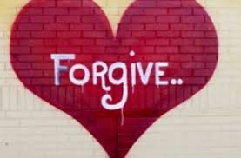


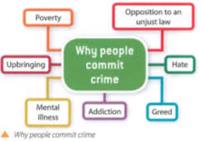



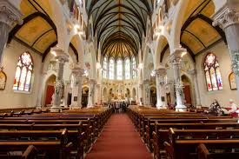
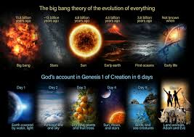



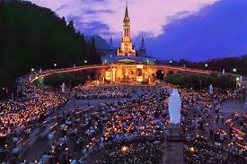



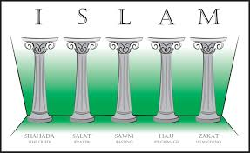
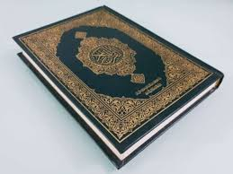

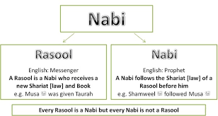

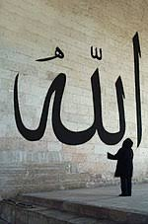

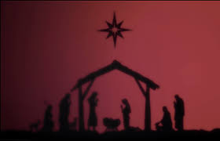
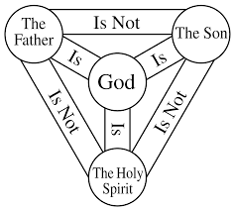

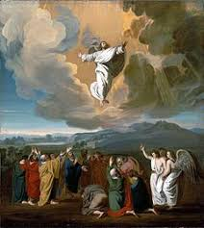

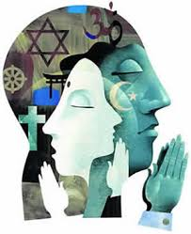
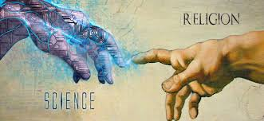
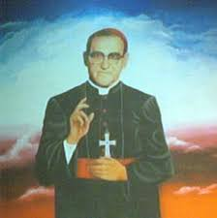


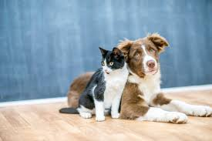
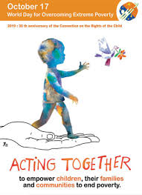
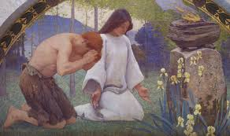
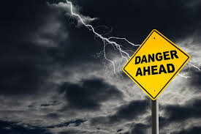






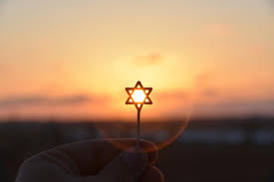

Types of Punishment
Suffering and forgiveness
Reasons for crime
Crime and Punishment;
Aims of punishment
Victims of War
GCSE Exams
Paper 1 Revision
PPE 2
Holy War
Reasons for War
PPE 1- Paper 1
Religion and life
Origins
Environment: Use and abuse
Religion Peace and conflict: Protest
Pacifism
Medical Ethics
The Church
YEAR
PPE 1
11
Pilgrimage
Thematic Units
Christianity and Islam
Festival
Relationships and families
Human Sexuality
Marriage and Divorce
What is Jihad?
End of unit assessment
Family
Life
The Five Pillars
Life after death
Predestination
The Prophets
Sacraments
Holy Books
Angels
Worship
Resurrection and ascension
The nature of Allah
Creation
End of unit assessment
Incarnation
The Trinity
Nature of God
Christianity
YEAR
Religion and young people
Time to shine. End of unit assessment
10
Religion and Science
GCSE; Beliefs and Practices. Christianity and Islam
End of Unit Assessment
Ultimate questions
Time to shine-
End of unit assessment
End of unit assessment
Religion and Social Injustice
Truth and Meaning
End of unit assessment- A time to shine
Animal rights
End of unit assessment
YEAR
Suffering and Evil
9
End of unit assessment
End of unit assessment – A time to shine
Poverty
Where do we belong?
End of unit assessment A time to shine-
End of unit assessment- A time to shine
End of unit test a time to shine
The search for personal meaning
Dangerous World
YEAR
End of unit assessment –
A time to shine
8
Peaceful world
Sikhism
Crime and Punishment
End of unit assessment
Time to shine
End of unit assessment – A time to shine
Islam
Hinduism
YEAR
7
End of unit assessment – A time to shine
Buddhism
End of unit assessment – A time to shine
Judaism
End of unit assessment – Time to shine
Christianity
Beliefs and Practices
‘Aspie not to have more but to be more’ Oscar Romero

