Slide 1
The Aspire Way
Who We Are and What We Do

Slide 2
We are a thriving, confident and friendly Aspire family!
EXCELLENCE
‘Success, nothing less!’
INTEGRITY
PRIDE
RESILIENCE
AMBITION
RESPECT

Slide 3
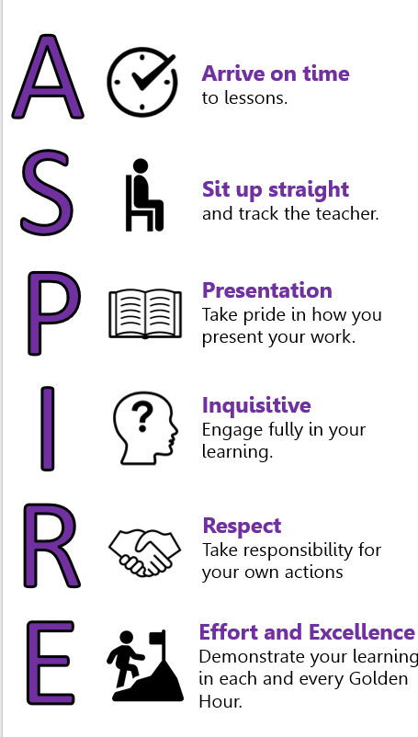
ASPIRE CHARTER- Who We Are

Slide 4
ATTENDANCE
Attendance is important because if you are not in the classroom, you miss out on:
-- new subject content which makes it harder to complete future work.
-- consolidation of previous work to embed your knowledge.
-- the opportunity for your teachers to provide you with support whilst you work.
Ultimately, your chances of success decrease, so get up, get dressed and get in!

Slide 5
PUNCTUALITY
Being on time is important. It says a lot about what type of person you are.
At 08:35 we line up on the yard for the Headteacher's morning address. If the gate is closed you are late.
The Truancy Call has been reduced to 5 mins.
If you are late you will be placed on a 3-5pm detention.
At Aspire, we arrive at our lessons on time.
Notes:
If you are “only 5 minutes” late to your lessons, this equates to over 400 hours of lost learning over 5 years.
If you are “only 2 minutes” late to every lesson for a year, this equates to over 30 hours of lost learning time.

Slide 6
Behaviour – in lessons
We always follow the rules and routines because our behaviour affects:
our learning.
the learning of others.
how effective our teachers can be.
who we are as people.

Slide 7
Behaviour- out of lessons
Outside of the classroom we:
Are kind, respectful and courteous to our peers, staff and visitors ensuring all views and beliefs are valued.
Walk sensibly ensuring our actions are always safe.
Use appropriate language.
Are aware that our actions reflect not just on ourselves but the school as a whole.
Only eat in designated areas – canteen or outside.
Place all litter in the bins.

Slide 8
How we are rewarded
Golden Culture points on a daily basis and these add up over the term.
300 points BRONZE Golden Culture Award
500 points SILVER Golden Culture Award
750 you will get a GOLD Golden Culture Award.
Class charts rewards store.
Weekly prizes for the students with the highest achievement points.
Half Termly pizza for top form in each year group.
Half termly success assemblies for attitude to learning, behaviour and attendance.
Year 11 Golden Graduation Programme.

Slide 9
What happens to those that let us down?
CARELESS: Behaviours such as shouting out, not completing work to an appropriate standard, incorrect uniform, lack of equipment, poor organisation.
These are the ‘nuts and bolts’ of a student coming to school and being ready to learn.
DISRUPTIVE: Continued disruptive behaviours following warnings and C1 such as persistent disruption of learning, constantly turning around and talking or wandering around the classroom.
RUDENESS: Repeated poor behaviour (C1 & C2 issued) and rudeness. This includes any behaviour, whether verbal or physical - words, body language, action or facial expression - that can be interpreted as being rude or defiant. A student’s behaviour can warrant a C3 with no prior warnings (verbally abusive, fighting, damaging property etc.) The consequence for this type of behaviour is 30 mins detention at lunch.
OFFENSIVE: Repetition of poor behaviours within the classroom and incidents such as abuse, aggression etc. Students out of class without permission will be issued a C4. Students will be escorted by On Call to a Faculty remove for the remainder of the lesson.
The consequence for this type of behaviour is a call home (made that day) by the class teacher and the student will be placed in an after school Head Of Year detention for 1 hour.

Slide 10
C5/Behaviour in the Community
Unacceptable/Dangerous: Behaviour that is offensive, aggressive or dangerous and may result in a student receiving a Fixed Term Exclusion.
The safety and wellbeing of our students is of the utmost importance to the school.
Types of behaviour that are categorized as C5 include the following:
Verbal abuse/Physical aggression towards staff/students
Any behaviour that is regarded as bullying any racist incident or incident based on hate or prejudice
Bringing the school into disrepute**
Making a malicious allegation against a member of staff/student
Refusing to follow a staff members instructions when given a sanction
Theft, Criminal damage including Graffiti etc.
Dangerous act, for example, throwing an object over a balcony
**Any incident inside or outside the classroom or outside of school whilst in uniform or on the way to or from Academy that, through its seriousness, can warrant an immediate Fixed Term Exclusion/Placement.

Slide 11
Your education opens doors
“Education is the most powerful weapon you can use to change the world.”
Nelson Mandela
Your time at Aspire is only brief, but what you do with your time here will affect the rest of your lives. It is ok to not know what you want to do when you are older but it is not ok to limit your future opportunities because you didn’t use your time correctly.

