Slide 1
Biology Foundation
Extended year 10

Slide 2
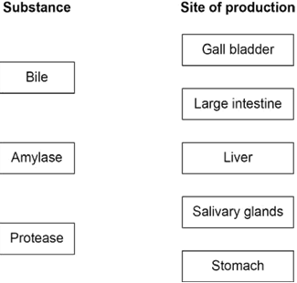

Slide 3
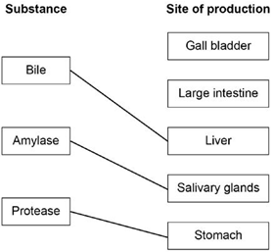

Slide 4
[1 mark]

Slide 8
What colour was the solution after the positive iodine test?
____________________________________________________
[1 mark]

Slide 10
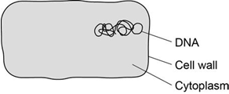
An electron microscope has a higher magnification than a light microscope.
Name one other cell structure you would see in a prokaryotic cell if you used an electron microscope to view the cell.
[1 mark]

Slide 14
Explain one way in which a sperm cell is adapted for its function.
[2 marks]

Slide 16
antibiotics | antibodies | antigens |  | antitoxins |  | painkillers | toxins
The bacteria that cause cellulitis release |  |  |  |  |  |  | ,
which cause a rash on the skin.
Cellulitis can be cured by taking |  |  |  |  |  |  |  | .

Slide 20
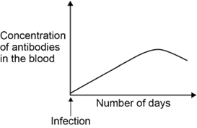
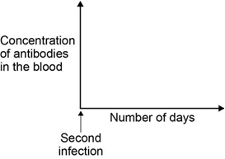
The concentration of antibodies in the blood would change after a second infection with cellulitis.
Sketch a line on Figure 5 to show how the concentration of antibodies would change.
[1 mark]

Slide 21
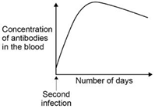
graph should rise faster (and to
a higher level) than Figure 4
ignore drop after the peak

Slide 24
One way to prevent the spread of malaria is to use mosquito nets around beds when people are sleeping.
How does the mosquito net prevent the spread of malaria?
[1 mark]

