Slide 1
Biology Higher Paper 1
Extended

Slide 2
Starch is digested by the enzyme amylase.
A student did an investigation on amylase activity.
This is the method used.
1. Mix amylase solution and starch suspension at 20 °C in a boiling tube.
2. Remove a drop of the mixture every 30 seconds and test it for starch.
3. Continue testing every 30 seconds until no starch is detected.
4. Repeat the investigation at different temperatures.
What apparatus should the student use to control the temperature of the mixture?
____________________________________________________________________________
[1 mark]

Slide 4
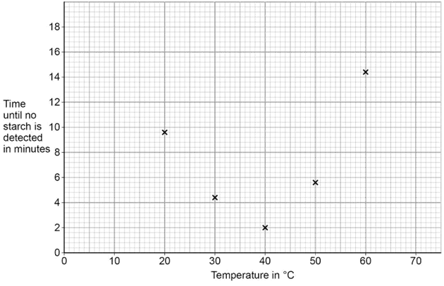
The starch suspension contained 0.8 g of starch.
Calculate the mean rate of starch digested at 33 °C.
[2 marks]
Mean rate of starch digested = grams per minute
Complete Figure 1 by drawing a line of best fit.

Slide 5
appropriate curve of best fit
drawn
do not allow extrapolation to
origin
an answer of 0.2 gains 2 marks
allow ecf from line of best fit in
5.2/1.2
allow 0.24
0.8
3.4
= 0.2

Slide 6
Describe two ways the student could improve the precision of his data.
[2 marks]
1
___________________________________________________
2
___________________________________________________

Slide 7
repeat at smaller temperature intervals (between 30 °C and 50°C)
test at smaller time intervals
allow description of suitable time interval (eg every 10 seconds)
ignore use a more accurate stopwatch/thermometer

Slide 8
Explain why the rate of starch digested per minute at 60 °C is lower than the rate at 40 °C.
________________________________________________________________________________________________________________
[2 marks]

Slide 12
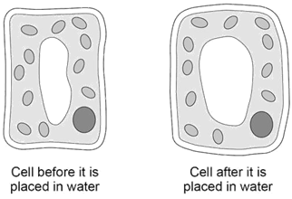
A student investigates what happens to a plant cell when it is placed in water. The student looks at the plant cell through a microscope.
Look at Figure 2.
Explain why the plant cell swells up when the cell is placed in water.
________________________________________________________________________________________________________________________________________________________________________________________________________________________________________________________________________________________________________________________________________________________________________________________________________________________
[4 marks]

Slide 14
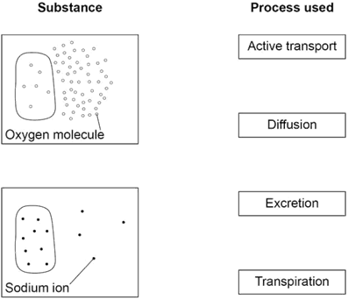

Slide 15
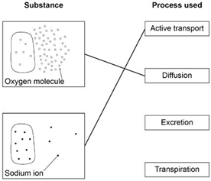
1 mark per line
extra line from
substance negates
the mark for that
substance

Slide 18
Yeast is an organism that respires anaerobically.
Complete the word equation for anaerobic respiration in yeast

Slide 20
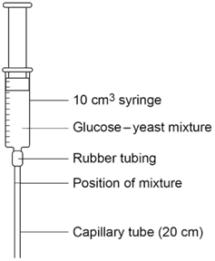
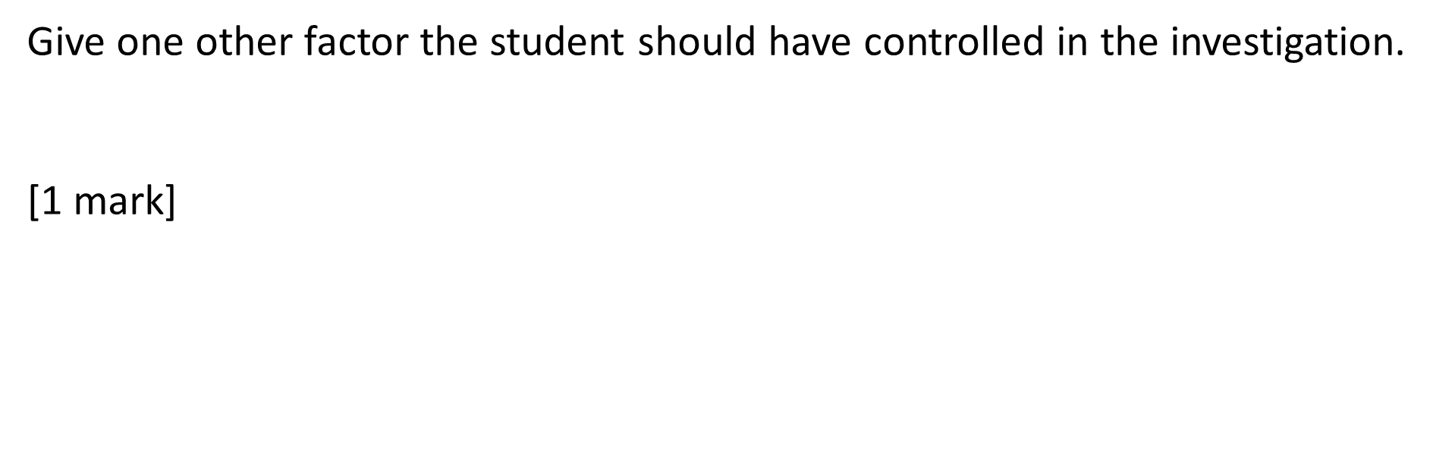

Slide 22
Calculate X in Table 1.
X = cm³
[1 mark]

Slide 24
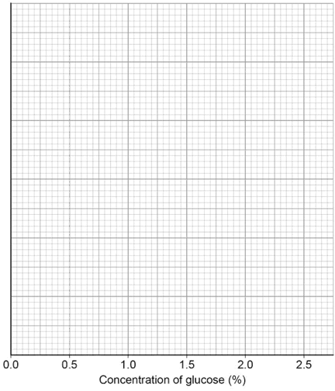
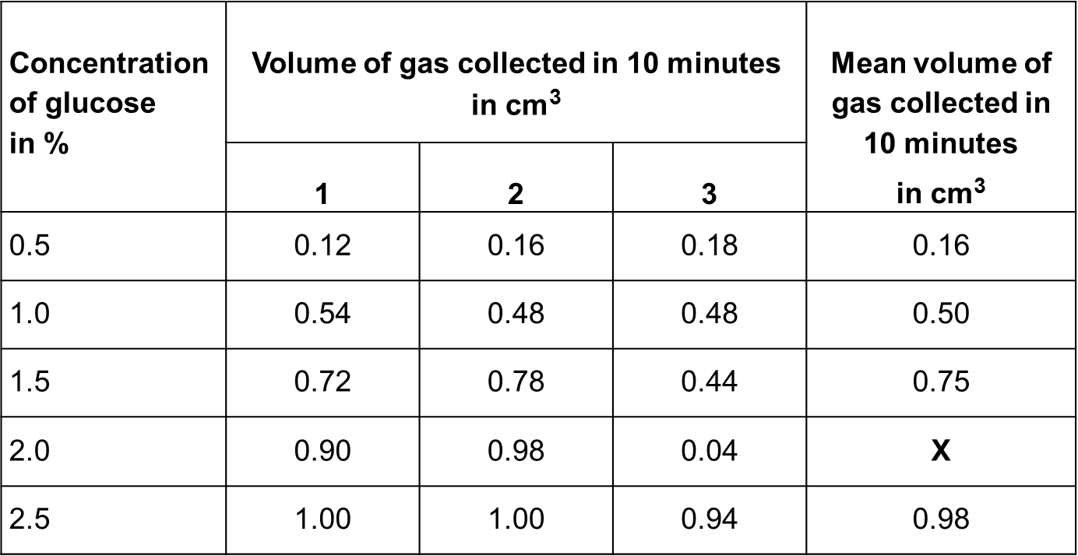
Plot the data from Table 1 on Figure 6.
You should:
label the y-axis
use a suitable scale
draw a line of best fit.
(4 Marks)

Slide 26
Describe the patterns shown in the student’s data.
____________________________________________________________________________________________________________________________________________________________________________________________________________________________________
[2 marks]

Slide 30
Give three other environmental factors that would increase the rate of water loss from plants.
[3 marks]
1
___________________________________________________
2
___________________________________________________
3
___________________________________________________

Slide 32
The movement of water through a plant is called transpiration.
What is translocation?
____________________________________________________________________________________________________________________________________________________________________________________________________________
[1 mark]

Slide 34
1. his heart is beating irregularly
2. fatty deposits are building up inside the walls of his coronary arteries.
The man does not need a heart transplant.
Explain how the two problems could be treated to prevent a heart attack.
[4 marks]

Slide 36
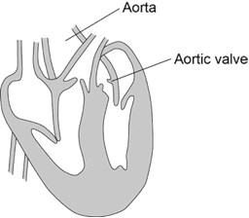

Explain why aortic valve stenosis causes chest pains.

Slide 38
 | VRS | TAVI
Type of anaesthetic | General anaesthetic | Local anaesthetic
used
 | Chest is opened. | A hollow tube (catheter) with a
 | Heart is stopped and a machine | balloon at its tip is inserted into an
 |  | artery in the chest and pushed
How the heart valve | circulates blood around the body.
 |  | through to the valve.
 | Diseased valve is removed and
is accessed |  | The balloon is inflated to open the
 | replaced with the new heart
 |  | new valve inside the diseased valve.
 | valve.
 |  | The balloon is deflated and removed.
Who has this type of | All ages. Not suitable for high-risk | Mostly used for high-risk patients,
surgery | patients due to use of general | eg older patients.
 | anaesthetic.
*Mean percentage of | 2.1% | 5.1%
people who died
whilst in hospital
*Risk of death five | 62.4% | 67.8%
years after surgery
Evaluate the use of TAVI for the woman.
[4 marks]

Slide 40
Explain how the spread of TMV to the other plants could have been prevented.
________________________________________________________________________________________________________________________________________________________________________________________________________________________________________________________________________________________________________________
[3 marks]

Slide 42
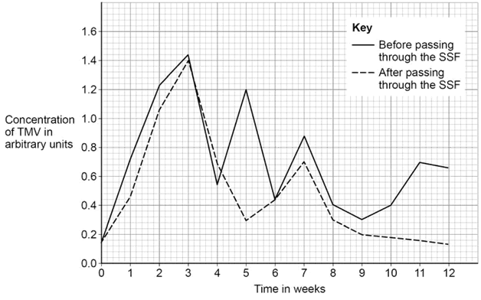

Slide 44
Give two conclusions you can make from the data shown in Figure 8.
[2 marks]
1
2
As soon as the SSF was set up (week 0) the scientists recorded the first set of results.
Why did the scientists record the first set of results as soon as the SSF was set up?
[1 mark]

Slide 46
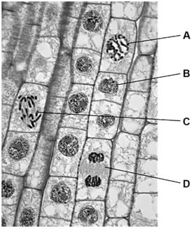
Explain what is happening to the root tip cells in Figure 9.
You should refer to the labelled cells in your answer.
[4 marks]

