Slide 1
The Duke of Edinburgh’s Award at Blackpool Aspire Academy

Slide 2
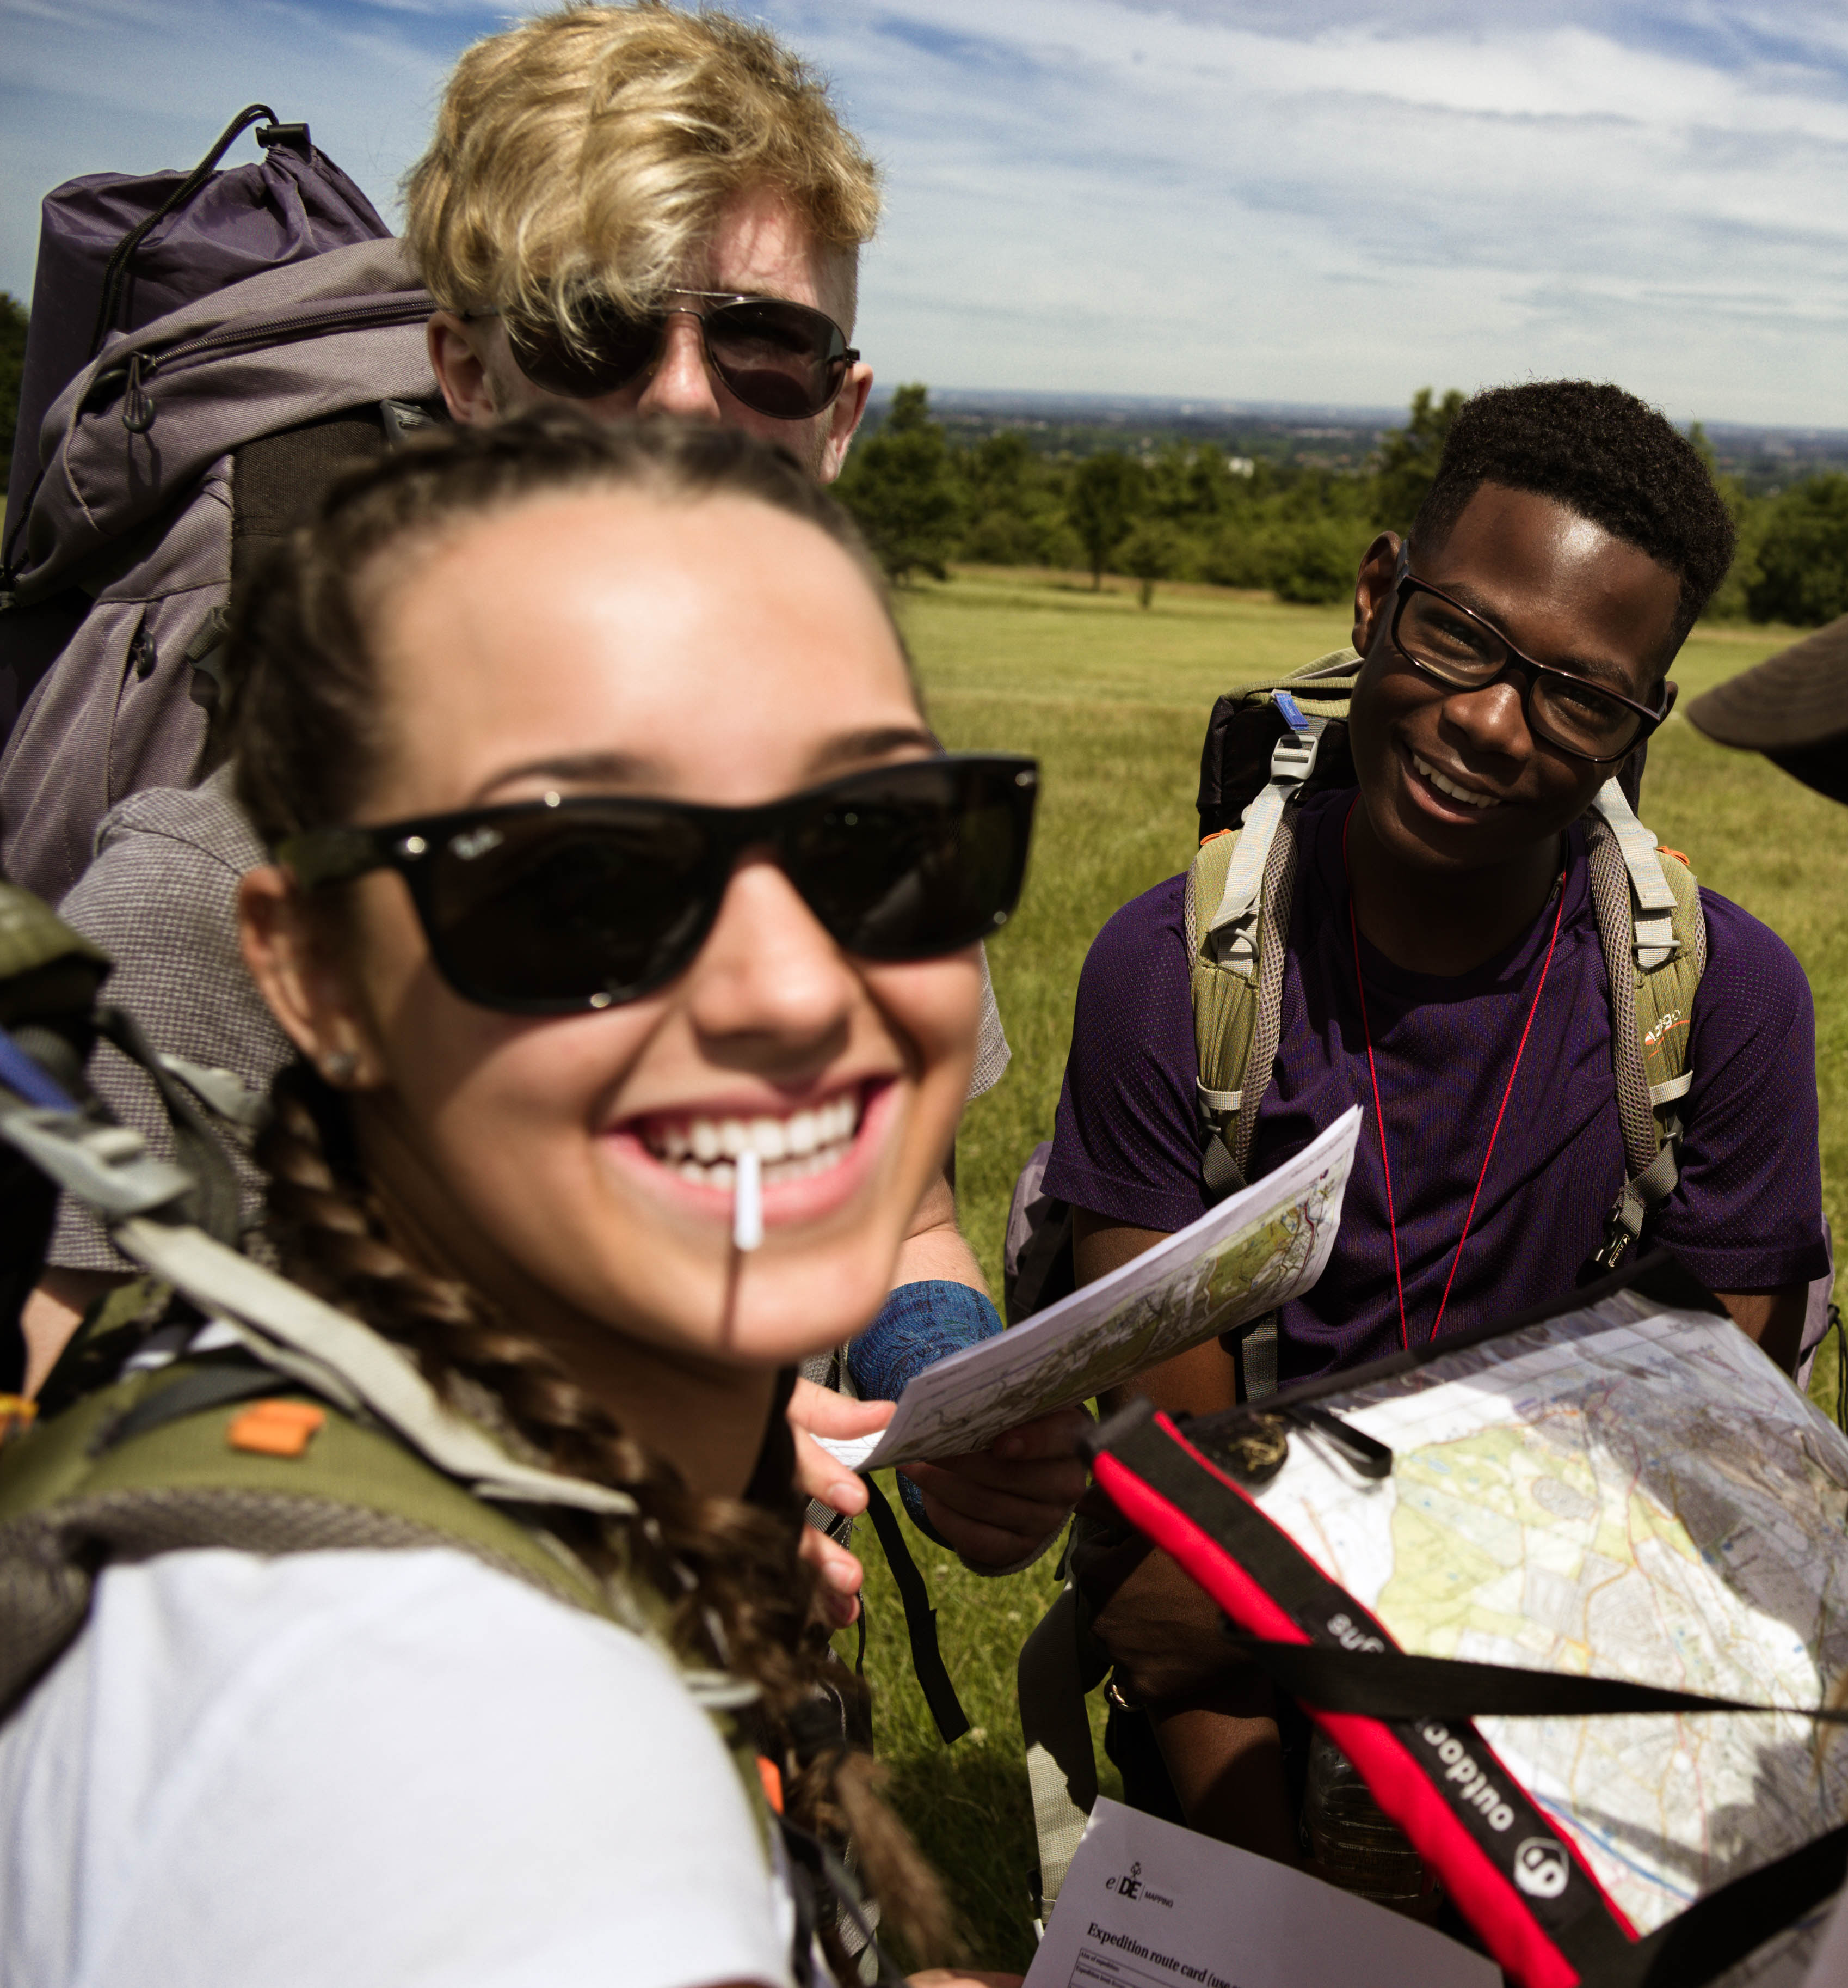
What is the DofE?
The DofE is the world’s leading achievement award for young people.
It’s about going the extra mile ­– learning new skills for work and life, getting fitter, making a difference and broadening your horizons.
Non-competitive
Achievable by all
Voluntary
Personal development
Personalised
Balanced
Progressive
Achievement focused
Demand commitment
Fun

Slide 3
Bronze Award
There’s loads of activities to choose from ­­— most activities can count towards a DofE programme. Take a look at our website for ideas: DofE.org/do/activities.
Activities could be something that young people are already doing or something completely new – and there are lots of possibilities that can be done from home or under social distancing.
Minimum one hour a week per section. A whole programme will take a minimum of six months to complete.
A chosen Assessor will need to write a short statement when they’ve finished each section. This could be a family friend, neighbour, coach or teacher (not a relative).

Slide 4
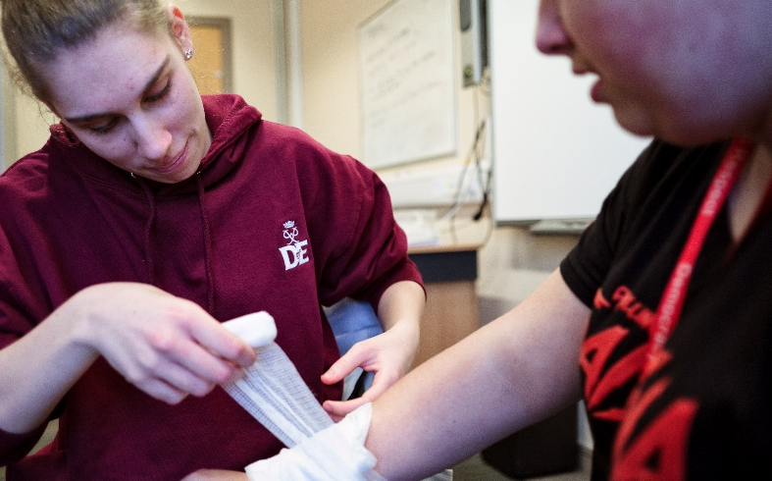
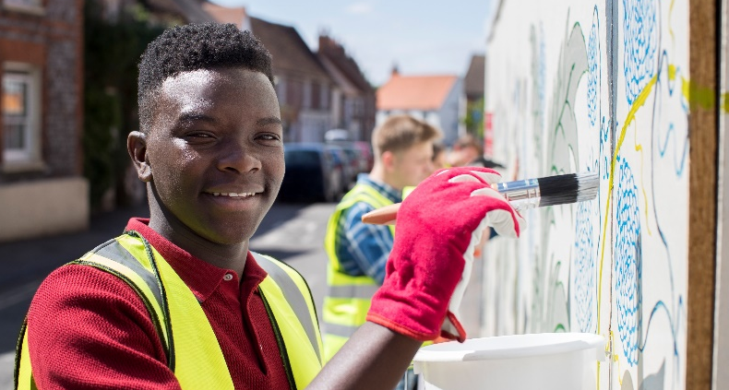
Volunteering
Over
¾
Feel happier
because volunteering
gave them more
confidence
Volunteering’s all about taking action and making a difference to other people’s lives.
From coaching a local football team or collecting for a foodbank to starting a campaign, young people will give up their time to help others and change things for the better.
It’s extremely rewarding, grows confidence and independence — and can enable a young person to experience the world of work too.
Young people must not be replacing paid labour i.e. they cannot volunteer for commercial organisations.
88%
Believe volunteering
helps them feel more
satisfied in life
96%
Say volunteering
gave them a sense
of achievement

Slide 5
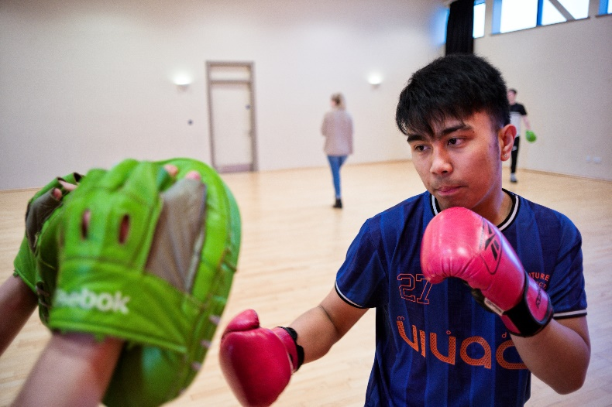
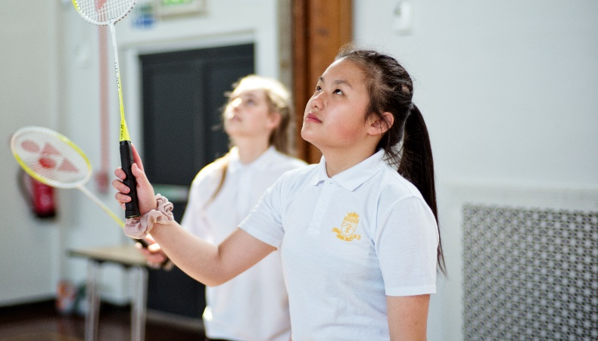
Physical
The Physical section is a chance for young people to focus on their health and fitness – and have fun along the way.
This might be the push needed for a young person to try something completely different or concentrate and improve on something they are already doing.
From yoga to going to the gym, skateboarding to wheelchair tennis­ — almost any dance, sport or fitness activity can count.
And doing more physical activity can help support mental health.
Young people can join a team or do it on their own — it’s up to them!

Slide 6
Skills
From coding to cookery, the Skills section lets young people learn a new talent, develop existing skills and discover new things to love.
By developing practical and social skills and gaining interests and talents, young people will enjoy themselves and get a real sense of achievement.
If they’re interested in a specific field, this could be the perfect chance to do something related to it.
They’ll grow their confidence and show they’re committed, motivated and can rise to a challenge.

Slide 7
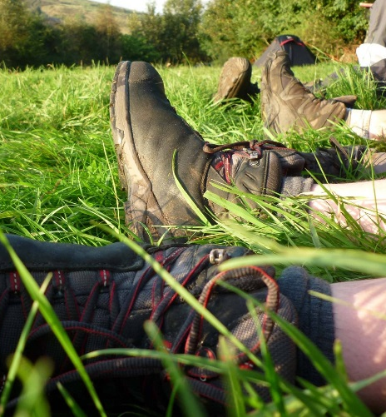
Expedition
Getting into the great outdoors and spending a night away with friends – a DofE expedition will give young people lifelong memories.
As part of a small team, they will plan their aim, choose their location, do some training to make sure they're prepared and know what they are doing — then spend two days and one night away.
The expedition will improve resilience, communication, teamwork and leadership skills.
They might come home with a rucksack full of washing — and experiences they won’t forget.

Slide 8
DofE Certificate of Achievement
Who: Any young person who enrols and completes their Volunteering, Physical and Skill sections between the 1 June 2018 and 31 December 2022.
When: Available until December 2022
What: Participants who have completed Volunteering, Physical, Skill but haven’t been able to do the Expedition and/or Residential.

Slide 9
DofE Certificate of Achievement
Certificates are:
Generated every 2 weeks
Issued to participant email addresses
Can be printed by DofE Managers
The Certificate can act as a talking point on a CV or in a personal statement and help young people to stand out.
And participants can still do their expedition and achieve their Bronze Award.

Slide 10
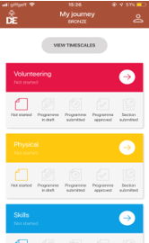
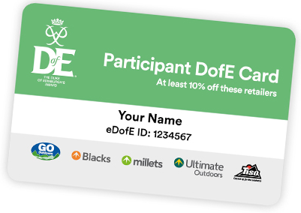
Your Welcome Pack and eDofE
Once you've signed up to do your DofE, you'll get your own eDofE account, so you can start planning your activities online and using the free DofE app.
When you've added your home address, you'll be sent your Welcome Pack – with lots of information and advice, as well as your personalised DofE Card.
Your DofE Card will give you and your family exclusive discounts in the DofE's five fantastic recommended retailers.
eDofE ‘How to' videos available on the DofE YouTube site

Slide 11
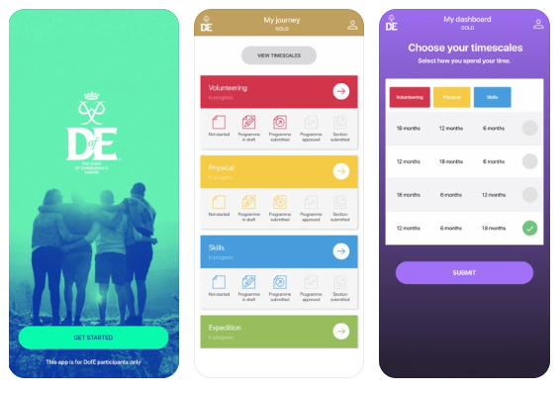
The DofE app
The DofE app is available for free from the App Store on iPhones and Google Play on Android phones.
Participants can use the DofE app to plan activities, get approval from Leaders, record evidence, submit programmes for completion and more.
Plus, it can sync important dates to your phone calendar and add the personalised DofE Card to the digital wallet, so you can make the most of the exclusive discounts.
Notes:
eDofE is the online account participants use to record all their DofE Award. Participants will receive a welcome to DofE email and will need to log on and complete their basic details and change their passwords.
They can then go onto add details about each activity they are undertaking for the different sections, once they have completed the overall timescales.
The first log in must be completed on a computer after this participants can use the mobile site:

Slide 12
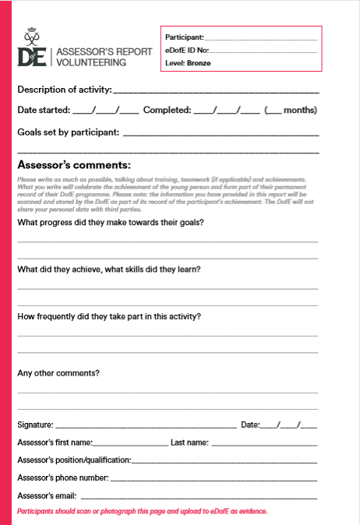
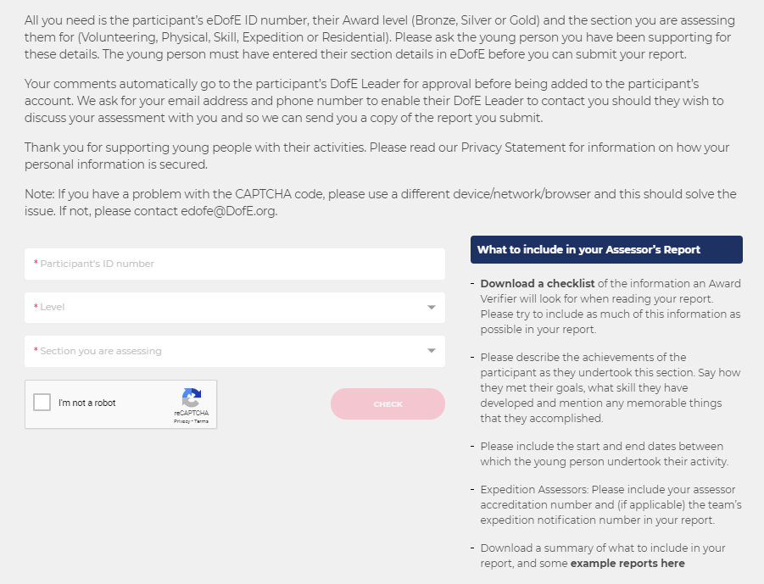
Assessor’s Reports
Welcome Pack
Once a young person has completed their time requirement for a section, they need to obtain an Assessor’s Report.
The Assessor’s Report needs to be completed by the Assessor (e.g. Leader, teacher, coach etc.).
It can be written by hand using the report card in the young person’s Welcome Pack (which they will receive in the post when they first enrol), or via the DofE Assessor portal at DofE.org/Assessor.
Assessor portal

Slide 13
Assessor’s Reports
Welcome Pack
During COVID-19 your DofE Manager can be your Assessor, if you can provide evidence such as photographs to show your progress.
You could also ask a family friend or neighbour, however your assessor cannot be your parent or guardian.
Assessor portal

Slide 14
Q&A

