Slide 1
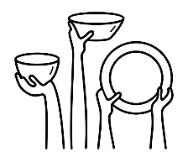
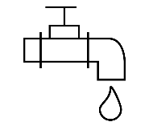
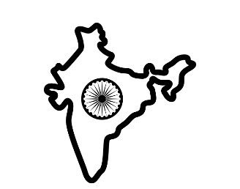
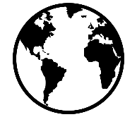
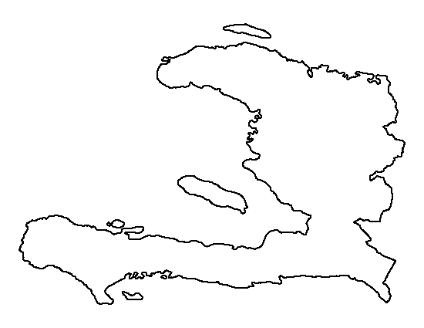
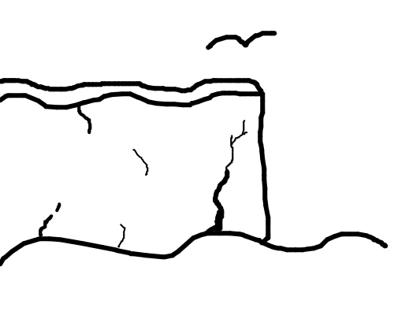
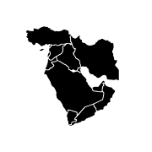
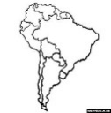
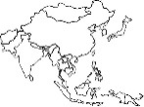
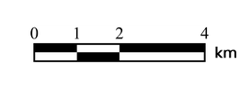
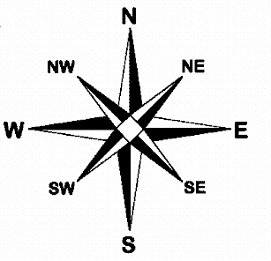
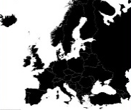
Where are areas of surplus and deficit located globally?
Blackpool Aspire Academy
Geography Learning Journey
How can water be sustainably managed at different scales?
How do we deal with global water insecurity?
How can the development gap be reduced?
What are the challenges and opportunities in Liverpool?
GCSE Fieldwork: How is the human environment of Blackpool changing?
How does a river change from source to mouth?
YEAR
How is the coastline of NE England being managed?
11
How does our use of resources create challenges and opportunities?
How is the UK economy changing?
How is urban growth managed in Rio de Janeiro?
GCSE Fieldwork: How are physical landscapes managed on the Fylde Coast?
How are river landscapes protected from flooding?
Why is the Sahel at risk from an increasing population?
How does the Thar Desert create opportunities and challenges?
GCSE Geography
How are the world’s ecosystems distributed?
Time to Shine ‘Urban Planning Projects’
How can management reduce the effects of tectonic hazards?
How did the Philippines respond to Typhoon Haiyan?
YEAR
10
Why do so many people live in slums?
How and why do tropical storms develop?
How can mitigation and adaptation reduce the effects of climate change?
How can rainforests be managed sustainably?
What is life like in Dharavi, Mumbai?
How do tectonic hazards vary between areas of contrasting wealth?
What are the impacts of deforestation in the Amazon?
Why are cities in poor countries growing so rapidly?
Time to Shine ‘How can water inequality be managed?’
How does food inequality affect people?
What makes one country rich and another country poor?
Time to Shine Flood management strategies
What is extreme weather?
Why are levels of carbon dioxide increasing in our atmosphere?
What is the evidence for climate change?
Why do people live in cities?
How does international aid changing change a country?
What is the development gap?
How do we measure a country’s development?
Why are we experiencing more extreme weather in the UK?
How can climate change be managed?
How is Russia developing?
Time to Shine ‘Pollution in Norilsk’
Where do people work in the UK?
Why did the TVR car factory close in Blackpool?
What is the quaternary sector?
What is climate change?
YEAR
9
What is Russia like?
What are Russia’s natural resources?
What is permafrost?
What is the primary sector?
What is the tertiary sector?
Time to Shine – Industrial location enquiry
Time to Shine What is ecotourism?
Time to Shine ‘How do we stop advancing deserts?’
What are the characteristics of hot deserts?
How are rainforest tribes different to us?
What is desertification?
What are the effects of earthquakes?
How does plate tectonics shape our planet?
What are the causes of rainforest deforestation?
What is a natural hazard?
Time to Shine ‘How do animals adapt to tropical rainforest conditions?
What are the characteristics of tropical rainforests?
What can be done to manage desertification?
How do plants and animals adapt to hot deserts?
Time to Shine ‘How do earthquakes affect Haiti?’
Why do we have earthquakes and volcanoes?
YEAR
How can we test environmental quality?
How does weathering affect our rivers and coasts?
How do waterfalls form on rivers?
8
What are Geographical Information Systems?
What causes erosion on rivers and coasts?
How do maps show mountains and valleys?
Time to Shine ‘Describing a Route’
What are the UK’s physical features?
How does water transport load?
How do headlands and bays form?
Time to Shine ‘How do stacks form on coasts?’
How do glaciers sculpt our landscape?
Why do geographers use symbols on maps?
How can we describe the largest continent in the world?
Time to Shine ‘Investigating Continents’
What are the human and physical features of South America?
What is longitude and latitude?
What happens in the Middle East?
YEAR
7
How do maps show distance?
Why do geographers need a compass?
Australasia or Oceania?
Is there more to North America than the USA?
What makes Europe unique?
What is ‘Africa’?
‘ Geography is the subject which holds the key to our future. ’ MICHAEL PALIN

