Slide 1
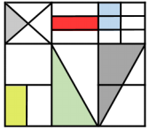
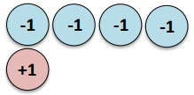
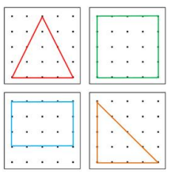
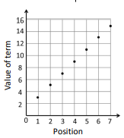
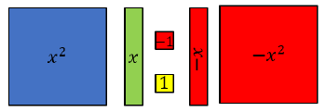
Mathematics - Foundation
Lines and Angles
Constructing, measuring and using geometric notation
Reasoning with Number
Developing number sense
Sets and probability
Prime numbers and proof
Developing statistics
Revision on all topics including averages from tables.
Fractional Thinking
Addition and subtraction with fractions
Reasoning with Proportion
Enlargement and similarity
Solving ratio and proportion problems
Rates
Reasoning with Geometry
Deduction
Rotation and Translation
Pythagoras’ Theorem
Directed Number
Four operations with directed number
Representations
Solving problems using graphs, tables and algebra
Reasoning with Number
Numbers
Using percentages
Maths and money
Developing Geometry
Circles and cylinders.
Similarity and congruency.
Vectors.
Revision and exam practice
Fortnightly exams.
Period 6
Application of Number
Solving problems with addition and subtraction
Multiplication and division
Fractions and decimals of amounts
8
10
Proportional Reasoning
Ratio and scale
Multiplicative change
Multiplying and dividing fractions
Constructing in 2 and 3 Dimensions
Three dimensional shapes
Constructions and congruency
Developing
Algebra
Expanding, factorising.
solving linear equations.
Inequalities.
Sequences.
Straight line graphs.
Working with quadratics.
Place Value and Proportion
Place value
Ordering integers and decimals
Fraction, decimal and percentage equivalence
Developing Ratio
Simplifying, equivalent and 1:n.
Ratio of amounts
Direct proportion
Developing Algebra
Manipulating algebra.
Rearranging equations.
Representations
Working in the cartesian plane
Representing Data
Tables and Probability
Reasoning with Algebra
Straight line graphs
Forming and solving equations
Testing conjectures
Algebraic Thinking
Sequences
Understand and use algebraic notation
Equality and equivalence
Developing Number
Fractions and reciprocals.
Indices.
Standard form.
Developing Statistics
Probability scale.
Theoretical probability.
Probability of events
Statistics and sampling.
Averages
9
Developing Geometry
Angles in parallel lines and polygons.
Transformations
Pythagoras/Trig
Bearings
Construction/Loci
Angles interior/exterior.
Area & volume.
7
11
Algebraic Techniques
Brackets, equations and inequalities
Sequences
Indices
Developing Number
Fractions and percentages
Standard index form
Number sense
Developing Number
Fractions
Decimals
Percentages
Multiplicative reasoning
Developing Geometry
Angles in parallel lines and polygons
Area of trapezia and circles
Line symmetry and reflection
Reasoning with Data
The data handling cycle
Measures of location

