Slide 1
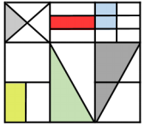
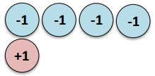
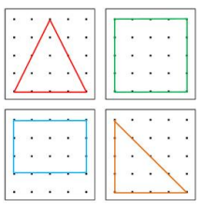
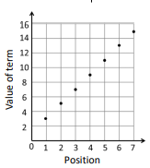
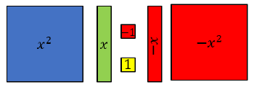
Mathematics - Intermediate
Lines and Angles
Constructing, measuring and using geometric notation
Reasoning with Number
Developing number sense
Sets and probability
Prime numbers and proof
Exam revision
Fortnightly papers.
Period 6
Walking talking mocks.
Fractional Thinking
Addition and subtraction with fractions
Reasoning with Proportion
Enlargement and similarity
Solving ratio and proportion problems
Rates
Reasoning with Geometry
Deduction
Rotation and Translation
Pythagoras’ Theorem
Directed Number
Four operations with directed number
Representations
Solving problems using graphs, tables and algebra
Developing Number
Revision on all topics that have come before.
Reasoning with Number
Numbers
Using percentages
Maths and money
Application of Number
Solving problems with addition and subtraction
Multiplication and division
Fractions and decimals of amounts
8
10
Developing Geometry
Pythagoras/trigonometry.
Circles, arcs & sectors.
Surface area & volume
Congruence/similarity.
Transformations
Vectors
Developing Geometry
Angles in parallel lines and polygons
Area of trapezia and circles
Line symmetry and reflection
Bearings
Developing Stats & Data
Averages from a table.
Scatter Graphs.
Time series graphs.
Sampling
Tree diagrams.
Proportional Reasoning
Ratio and scale
Multiplicative change
Multiplying and dividing fractions
Constructing in 2 and 3 Dimensions
Three dimensional shapes
Constructions and congruency
Place Value and Proportion
Place value
Ordering integers and decimals
Fraction, decimal and percentage equivalence
Representations
Working in the cartesian plane
Representing Data
Tables and Probability
Reasoning with Algebra
Straight line graphs
Forming and solving equations
Testing conjectures
Algebraic Thinking
Sequences
Understand and use algebraic notation
Equality and equivalence
Developing Stats/data
Two way tables.
Frequency trees.
Averages from tables.
Developing Algebra
Linear and non-linear graphs.
Equations and simultaneous equations (non-linear)
Developing Algebra
Solving equations and simultaneous equations.
Manipulating algebra.
Sequences
7
9
11
Algebraic Techniques
Brackets, equations and inequalities
Sequences
Indices
Developing Number
Estimation.
Bounds.
Fractions.
Percentages
Proportion.
Index notation.
Standard form
Developing Number
Fractions and percentages
Standard index form
Number sense
Developing Geometry
Angles in parallel lines and polygons
Area of trapezia and circles
Line symmetry and reflection
Reasoning with Data
The data handling cycle
Measures of location

