Slide 1

PSHE
Department Handbook
‘Children with higher levels of emotional, behavioural, social and school well-being on average have higher levels of academic achievement and are more engaged in school, both concurrently and in later years.’

Slide 2
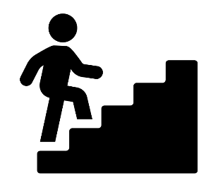






























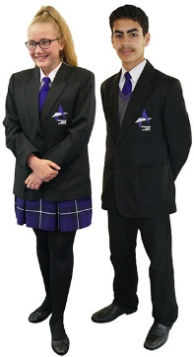




Where are areas of surplus and deficit located globally?
Blackpool Aspire Academy
PSHE Learning Journey
Dangers of Pornography
Indecent images
Gambling
Pregnancy and Parenthood
YEAR
FGM
11
Menopause
Drugs
Health Screening
Unhealthy Relationships
Body Image
Bereavement
YEAR
10
STIs
Murder games
Misogyny
Vaping
Contraception
Drugs, Alcohol and Tobacco
Sleep
Forced Marriage
Online Safety
Youth Produced Sexual Imagery
YEAR
9
Tattoos and Piercings
Firework Safety
Healthy Lifestyle
Consent
Honor Based Violence
First Aid
YEAR
Stereotypes
Water Safety
What is mental health?
8
Gender Identity
Puberty/ puberty Hygiene
Positive Mental Health
YEAR
What is a healthy relationship?
7
Transition
Menstrual wellbeing
Dental hygiene

Slide 3
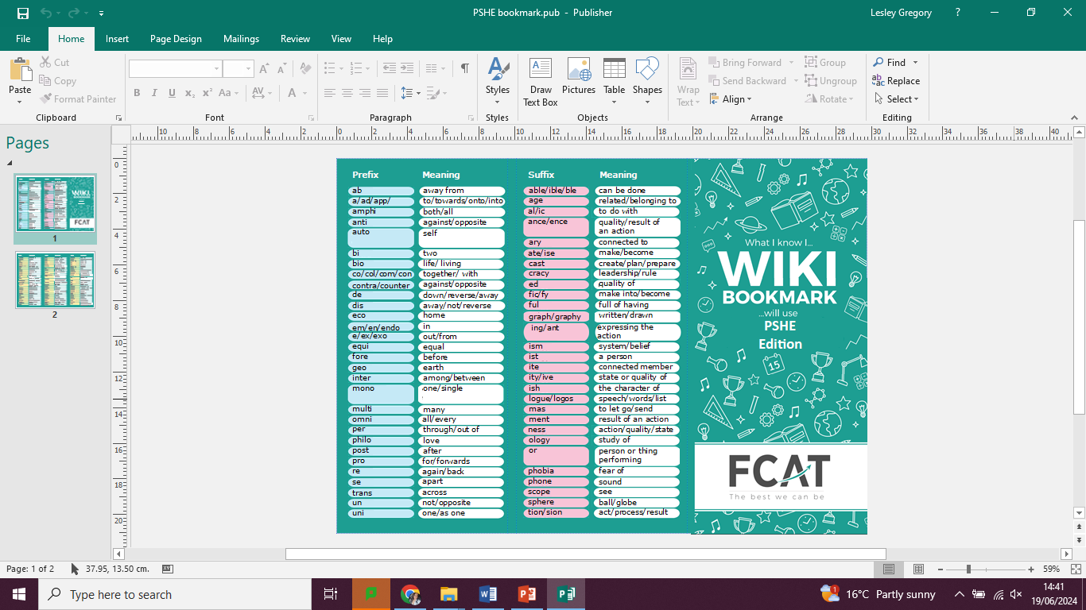

Slide 4
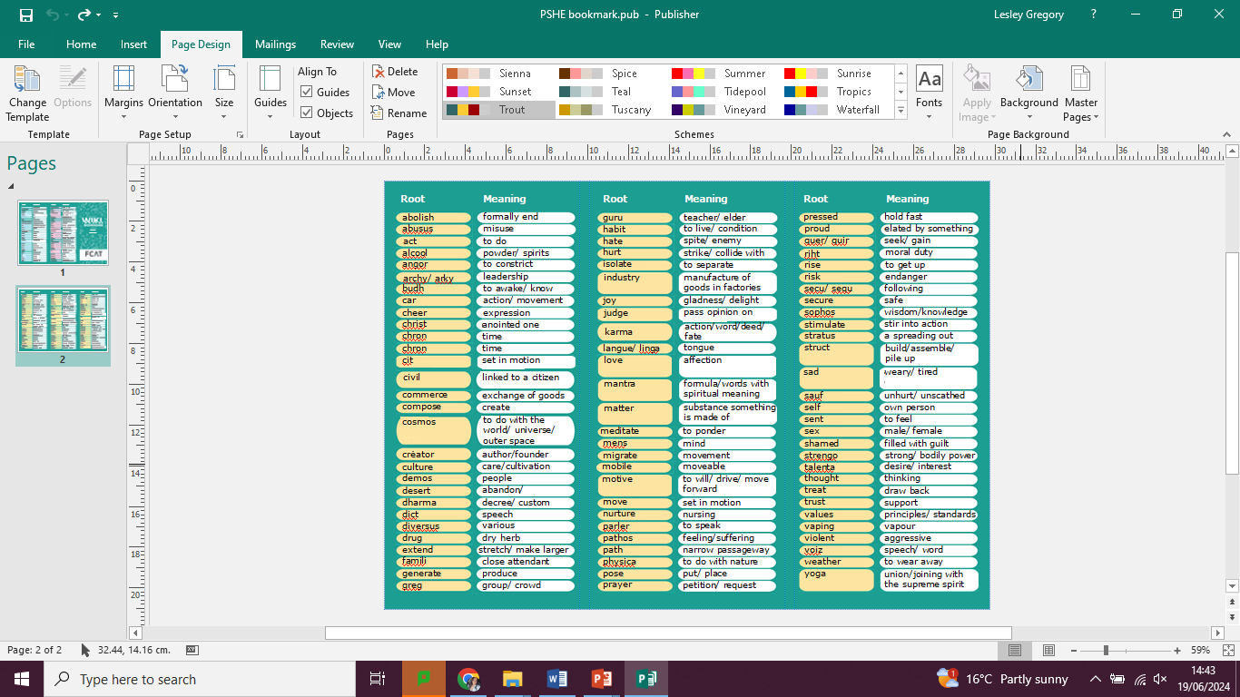

Slide 5
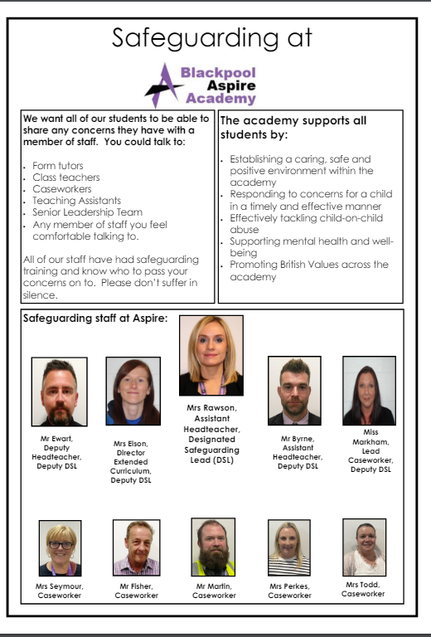

Slide 6
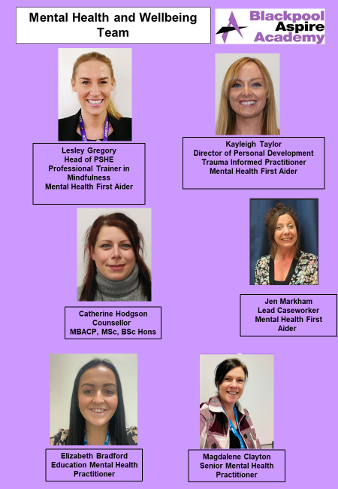

Slide 19
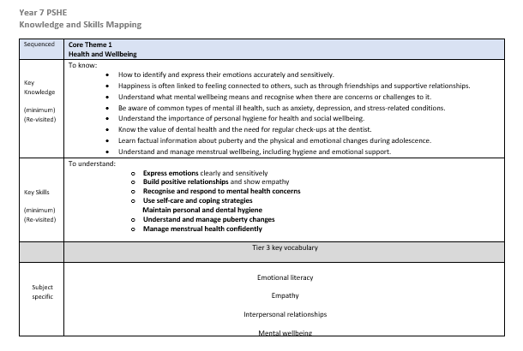
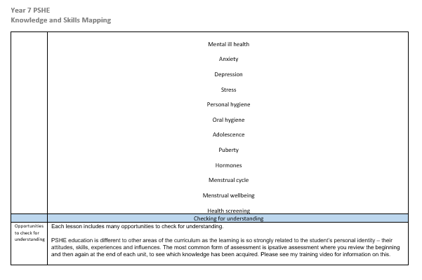
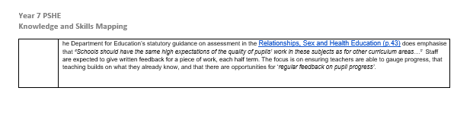

Slide 20
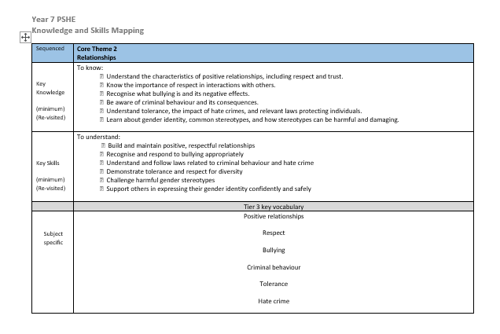
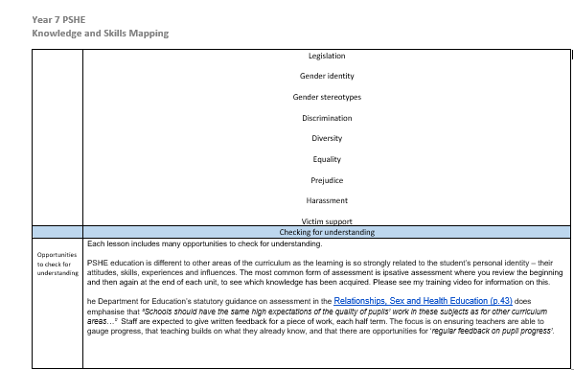

Slide 21
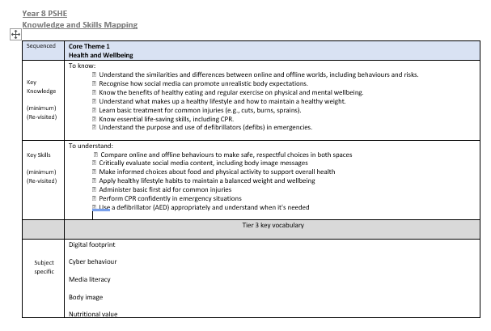
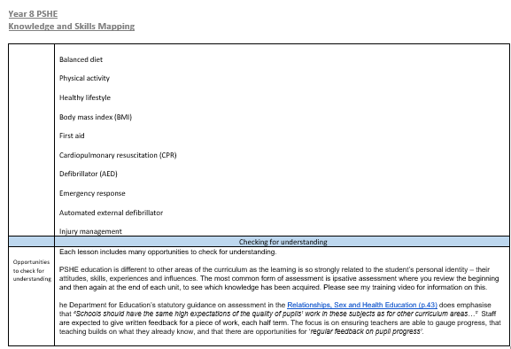

Slide 22
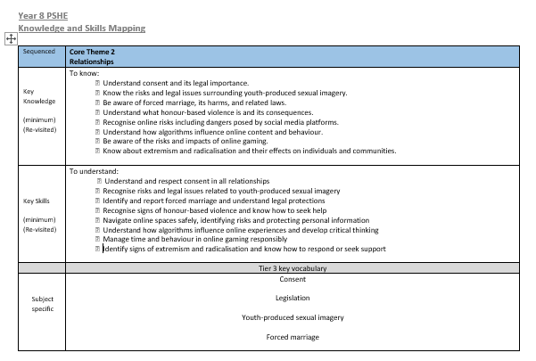
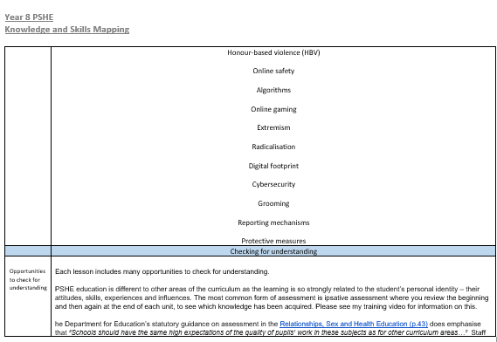


Slide 23
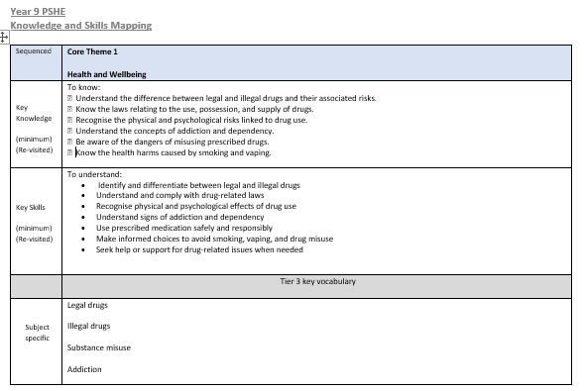
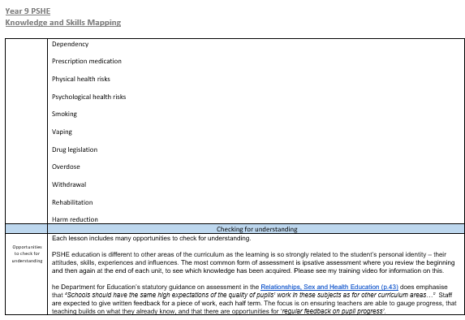

Slide 24
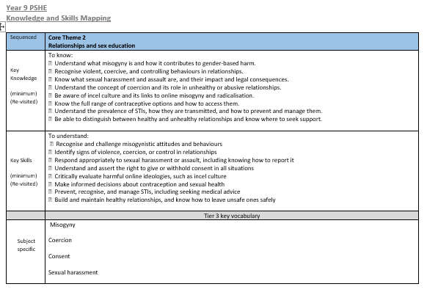
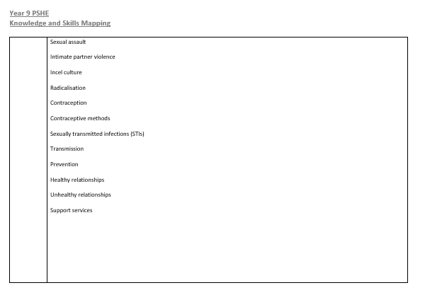
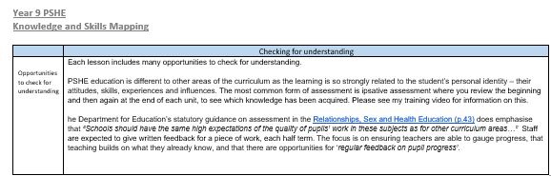

Slide 25
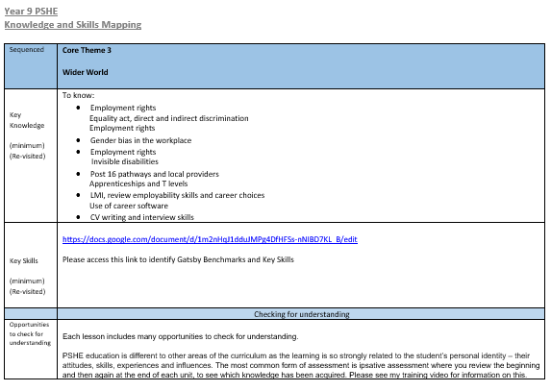
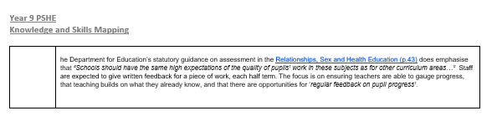

Slide 26
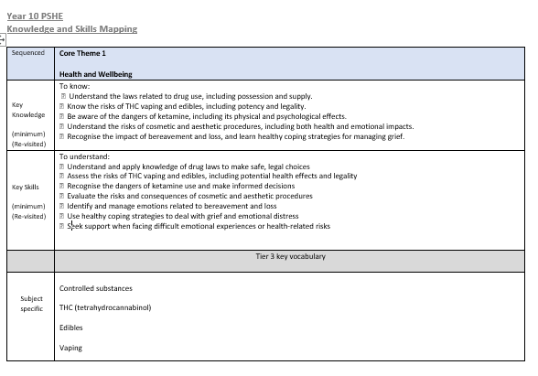
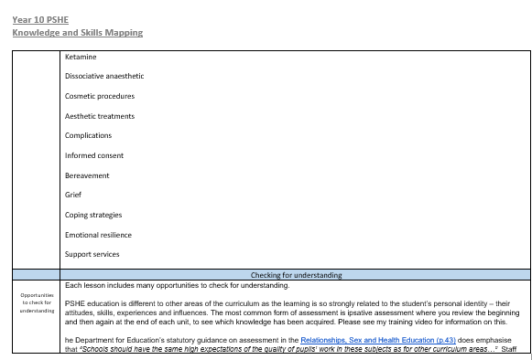
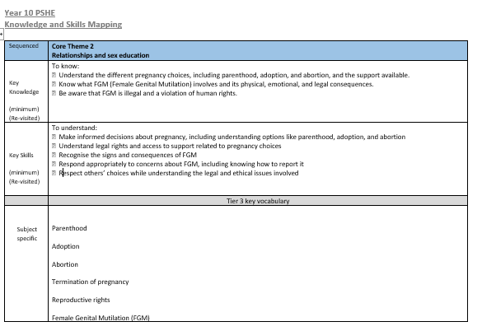

Slide 27
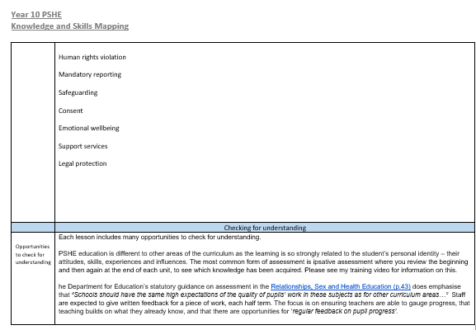

Slide 28
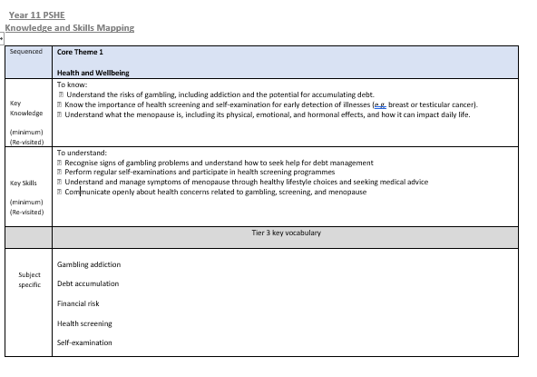
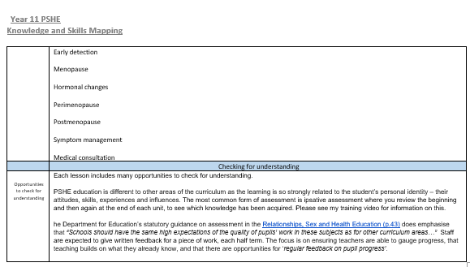

Slide 29
