Slide 1
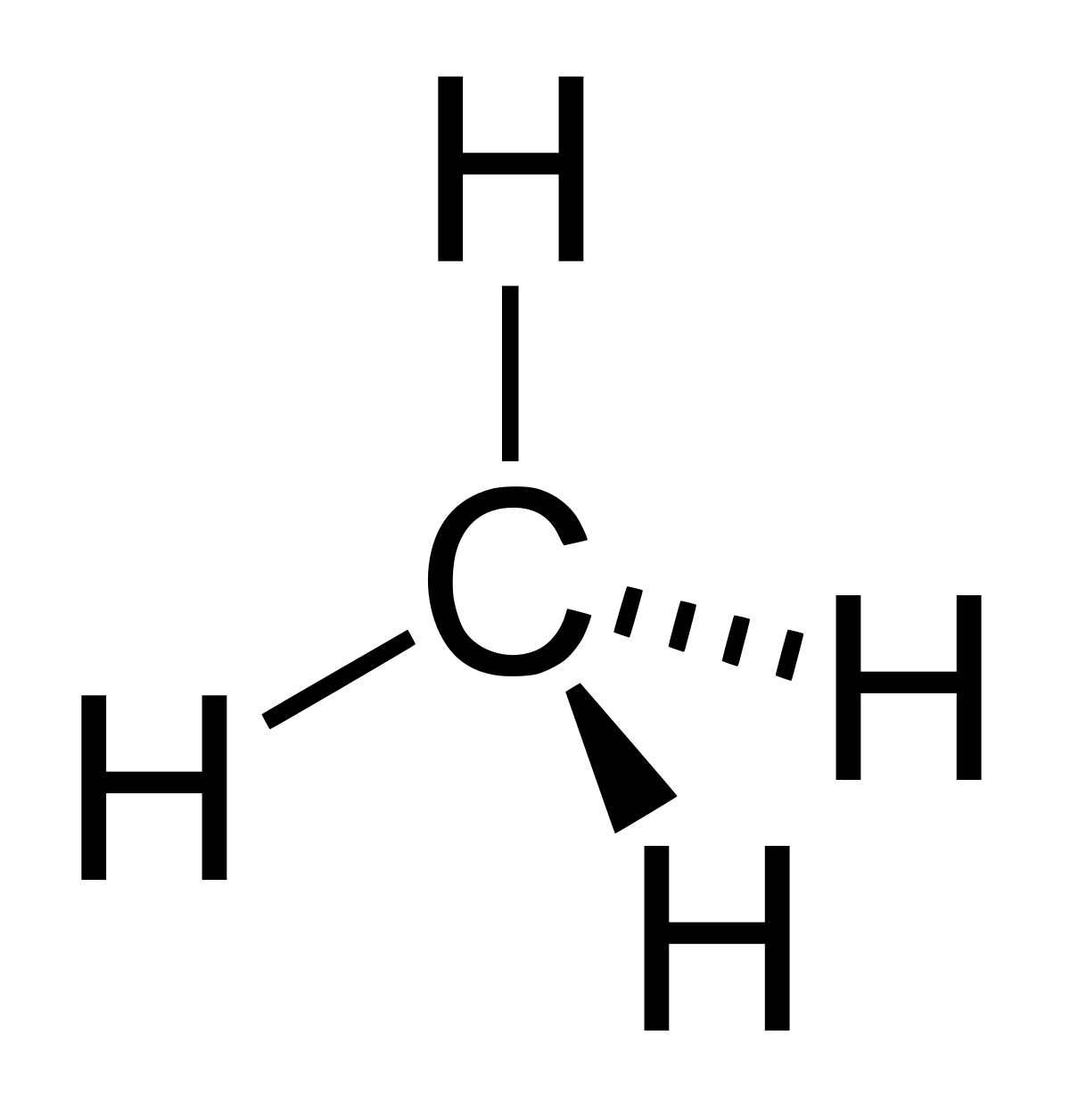
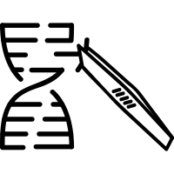
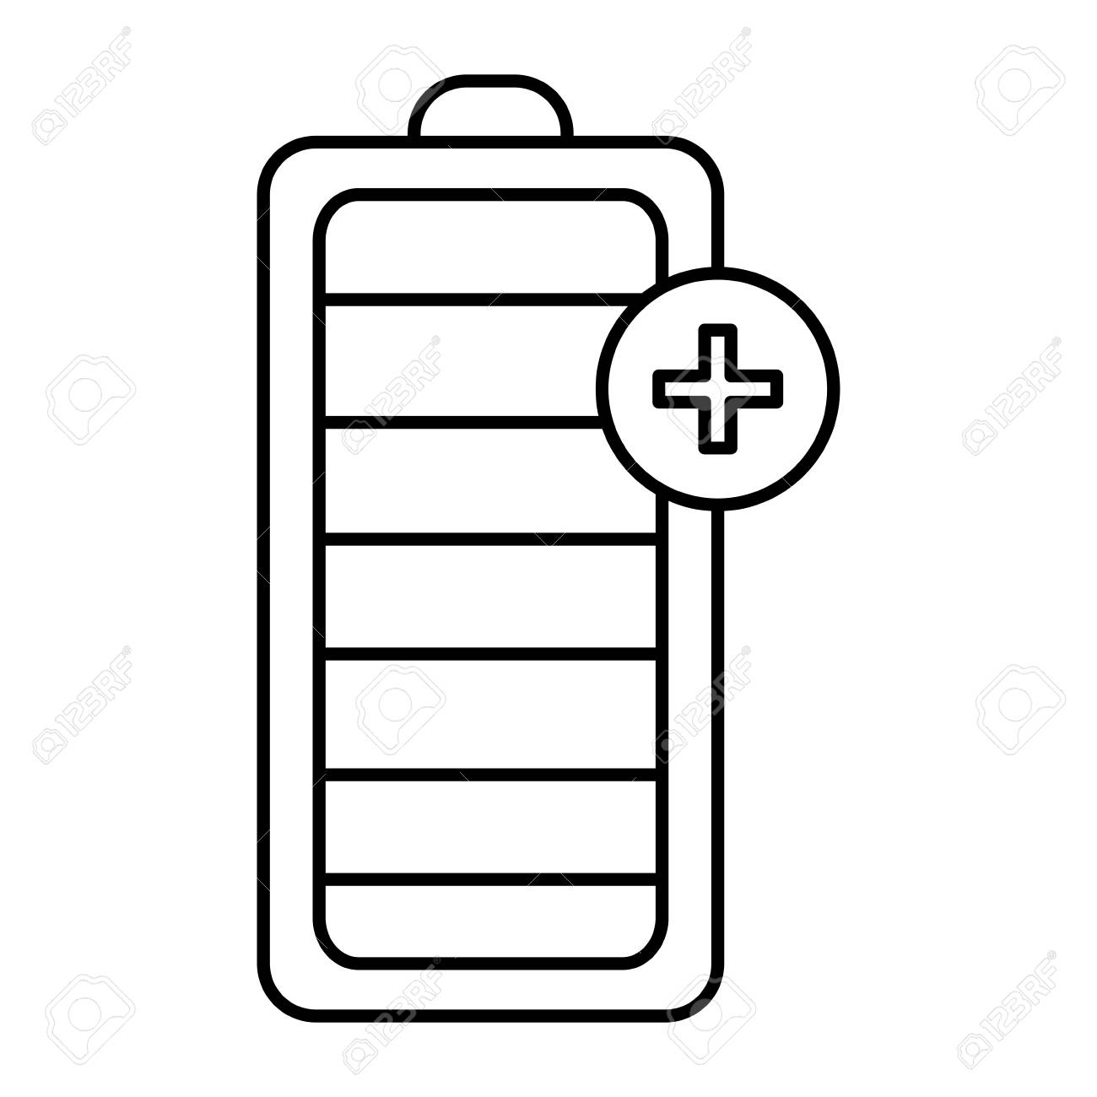
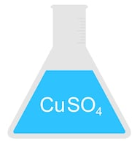
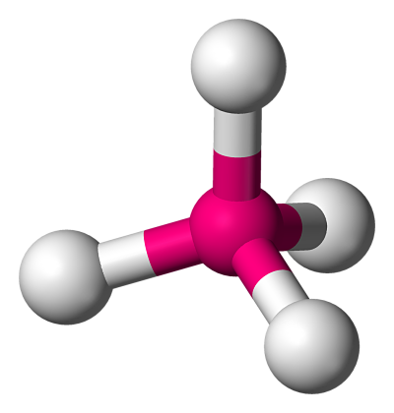
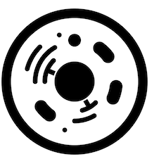
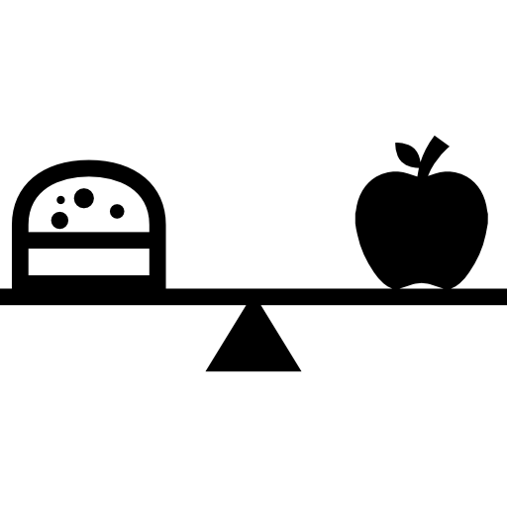
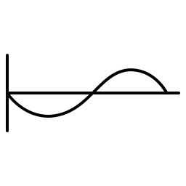
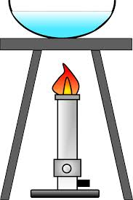
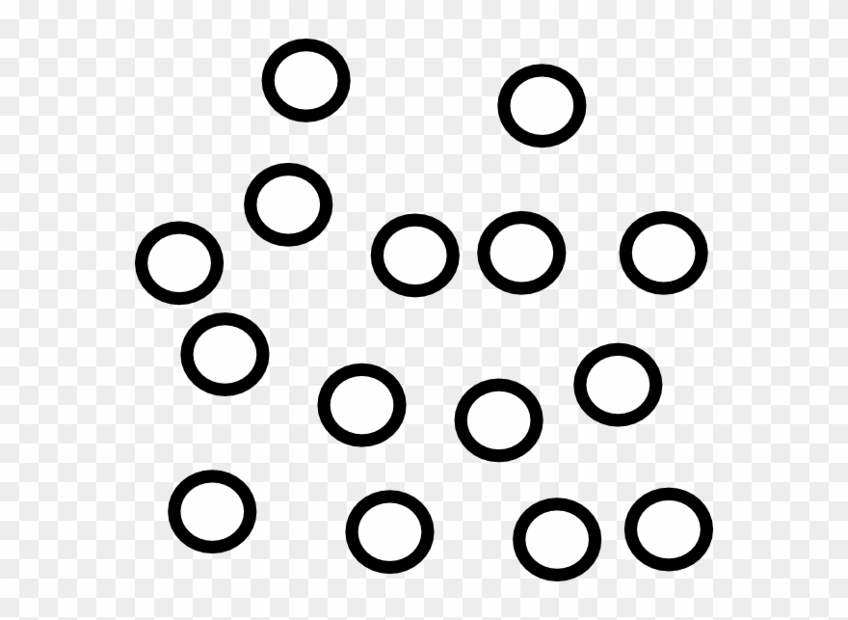
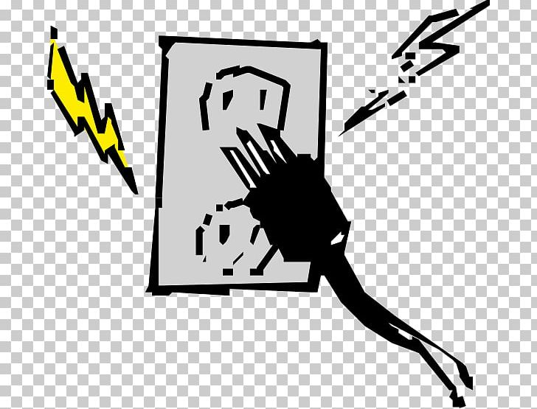
Science Learning Journey
Corrosion & useful materials
Paper 2 Revision
Exam Technique
GCSE Exams
Sustainability & potable water
Paper 1 Revision
Exam Technique
Required Practical Review
GCSE Exams
Required Practical Review
Atmosphere & Climate change
Carbon footprint
& pollutants
Exam Technique
Paper 2 Revision
YEAR
Paper 2 Revision
Paper 1 Revision
11
Required Practical Review
Paper 1 Revision
Biodiversity
The environment
Addition & Condensation Polymers
Red shift and big bang
Life cycle of a star
YEAR
Adaptations and competition
Alkanes & Alkenes
Alcohols, Carboxylic acids & esters
Magnets and electromagnets
11
Fractional distillation
Motors, generators and transformers
Genetic engineering
Crude Oil
YEAR
Selective breeding
Rates of Reaction
Chemical Equilibrium
Fusion and fission
11
Evolution and classification
DNA and inheritance
Collision
Theory
Moles & Titrations
Quantitative Chemistry
Types of radiation
YEAR
Atomic models
Black body radiation
Cell division
Menstrual cycle
Chemical Analysis
10
Light and sound waves
Types of waves and properties
Fighting infections
Homeostasis
Newton’s laws and motion
Respiration and exercise
The brain and eye
Bond energies & fuel cells
Reaction profiles
Momentum
Elasticity in objects
Exothermic & Endothermic reactions
Moments and pressure
YEAR
Disease and infection
Electrolysis
10
Reflexes
YEAR
Plants and Photosynthesis
Making
salts
10
Cancer
pH & neutralisation
Contact and non contact forces
Blood and blood vessels
Metal extraction, displacement & redox reactions
Digestive system and enzymes
Diffusion, osmosis and active transport
Mains electricity
Static electricity
Coronary heart diseases
Links between structure & properties
Chemical structures
Electrical circuits
GPE and kinetic energy
The heart
Specialised cells
Gas pressure
Growing microorganisms
Groups in the Periodic table
Measuring density
Eukaryotic and Prokaryotic cells
Chemical bonds
Temperature changes
Stem cells
Atomic structure & Isotopes
Kinetic theory and particle models
Microscopes and magnification
Energy resources
Electricity & Magnetism
Ecology
Energy from food
Waves
Efficiency
YEAR
9
Specific heat capacity
Chemical Reactions
Inheritance & variation
Photosynthesis
Energy stores and transfers
Keeping Healthy –
Respiration
Muscles &
Skeleton
YEAR
Forces, gravity
& space
The Periodic Table & Reactivity Series
Separation Techniques
Reproduction
Particles, atoms, elements, compounds & mixtures
8
YEAR
7
Fast & Furious Reactions –acids & alkalis
The Earth & its atmosphere
Energy
Cells
e
Albert Einstein – ‘The important thing is to never stop questioning’

Slide 2
c
Biology Learning Journey
Exam Technique
Paper 1 Revision
Paper 1 Revision
Required Practical Review
Paper 2 Revision
GCSE Exams
Paper 2 Revision
Paper 2 Revision
Finals #2
Selective breeding
Genetic engineering
Biodiversity
Finals #1
Paper 1 Mock Exam
YEAR
Paper 1 Revision
11
Evolution and classification
Adaptations and competition
The environment
Cell division
Homeostasis
Disease and infection
Respiration and exercise
DNA and inheritance
Menstrual cycle
The brain and eye
Reflexes
Fighting infections
YEAR
Growing microorganisms
10
The heart
Cancer
Diffusion, osmosis and active transport
Digestive system and enzymes
Blood and blood vessels
Coronary heart diseases
Plants and Photosynthesis
Specialised cells
Eukaryotic and Prokaryotic cells
Photosynthesis
YEAR
Stem cells
9
Inheritance & variation
Microscopes and magnification
Waves
Energy from food
Keeping Healthy –
Respiration
Electricity & Magnetism
Chemical
Reactions
Fast & Furious Reactions –acids & alkalis
YEAR
Ecology
8
Forces, gravity
& space
Muscles &
Skeleton
The Earth & its atmosphere
Energy
Reproduction
Particles, atoms, elements, compounds & mixtures
YEAR
The Periodic Table & Reactivity Series
7
Separation Techniques
Cells
Albert Einstein – ‘The important thing is to never stop questioning’

Slide 3
c
Chemistry Learning Journey
Exam Technique
Paper 1 Revision
Paper 1 Revision
Required Practical Review
Paper 2 Revision
GCSE Exams
Paper 2 Revision
Paper 2 Revision
Finals #2
Addition & Condensation Polymers
Atmosphere & Climate change
Sustainability & potable water
Finals #1
Paper 1 Mock Exam
YEAR
Paper 1 Revision
11
Alcohols, Carboxylic acids & esters
Carbon footprint
& pollutants
Corrosion & useful materials
Fractional distillation
Rates of Reaction
Quantitative Chemistry
Chemical Analysis
Alkanes & Alkenes
Crude Oil
Chemical Equilibrium
Collision
Theory
Moles & Titrations
YEAR
Metal extraction, displacement & redox reactions
10
Making
salts
Reaction profiles
Links between structure & properties
pH & neutralisation
Electrolysis
Exothermic & Endothermic reactions
Bond energies & fuel cells
Chemical bonds
Atomic structure & Isotopes
Photosynthesis
YEAR
Chemical structures
9
Inheritance & variation
Groups in the Periodic table
Waves
Energy from food
Keeping Healthy –
Respiration
Electricity & Magnetism
Chemical
Reactions
Fast & Furious Reactions –acids & alkalis
YEAR
Ecology
8
Forces, gravity
& space
Muscles &
Skeleton
The Earth & its atmosphere
Energy
Reproduction
Particles, atoms, elements, compounds & mixtures
YEAR
The Periodic Table & Reactivity Series
7
Separation Techniques
Cells
‘
Albert Einstein – ‘The important thing is to never stop questioning’

Slide 4
c
Physics Learning Journey
Exam Technique
Paper 1 Revision
Paper 1 Revision
Required Practical Review
Paper 2 Revision
GCSE Exams
Paper 2 Revision
Paper 2 Revision
Finals #2
Fusion and fission
Magnets and electromagnets
Life cycle of a star
Finals #1
Paper 1 Mock Exam
YEAR
Paper 1 Revision
11
Types of radiation
Motors, generators and transformers
Red shift and big bang
Light and sound waves
Newton’s laws and motion
Elasticity in objects
Contact and non contact forces
Atomic models
Black body radiation
Types of waves and properties
Momentum
Moments and pressure
YEAR
Kinetic theory and particle models
10
Temperature changes
Mains electricity
Energy resources
Measuring density
Gas pressure
Electrical circuits
Static electricity
GPE and kinetic energy
Energy stores and transfers
Photosynthesis
YEAR
Specific heat capacity
9
Inheritance & variation
Efficiency
Waves
Energy from food
Keeping Healthy –
Respiration
Electricity & Magnetism
Chemical
Reactions
Fast & Furious Reactions –acids & alkalis
YEAR
Ecology
8
Forces, gravity
& space
Muscles &
Skeleton
The Earth & its atmosphere
Energy
Reproduction
Particles, atoms, elements, compounds & mixtures
YEAR
The Periodic Table & Reactivity Series
7
Separation Techniques
Cells
‘
Albert Einstein – ‘The important thing is to never stop questioning’

