Slide 1
Biology Unit 2
Organisation

Slide 4
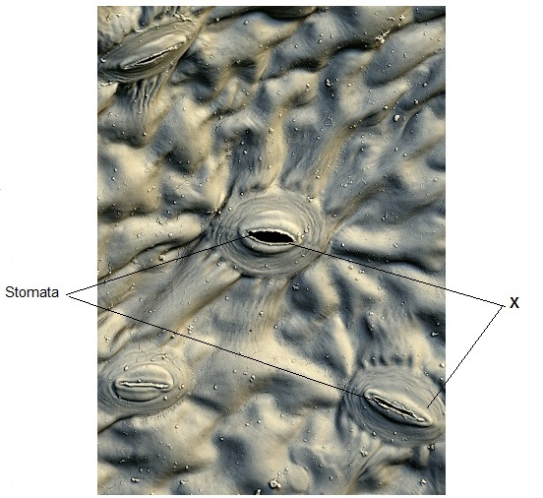

Slide 12
Describe & explain transpiration
From root to leaf
Processes
Explanation as to why it happens.

Slide 13
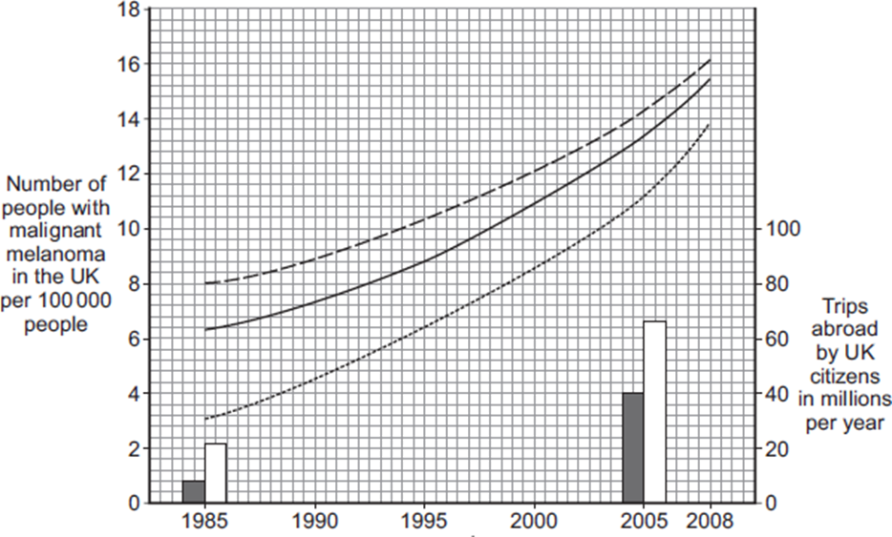
(i) Describe the trends in the number of people with malignant melanoma skin cancer between 1985 and 2008.
..........................................................................
.........................................................................
ii) Use the data about the number of trips abroad to suggest an explanation for the trends you have described in part (c)(i).
.......................................................................
.......................................................................

Slide 21
Remember
This is the same kind of points for lung diffusion.

