Slide 1
Unit 3 – Bonding and structure

Slide 11
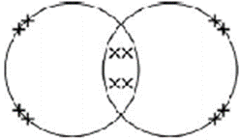

Slide 14
3 marks

