Slide 1
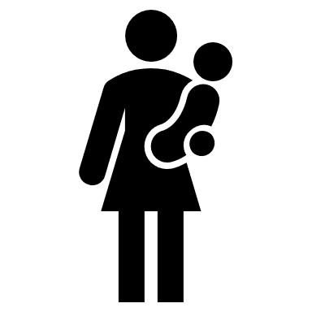
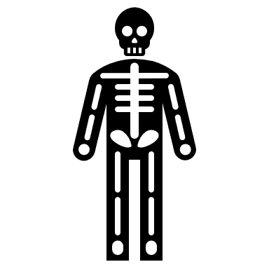
How do I write a personal statement?
Where are areas of surplus and deficit located globally?
What makes you employable?
Blackpool Aspire Academy
PSHE Learning Journey
Assault and rape
Sexual harassment and coercive behaviour
Money stresses
Abortion
Abused by my girlfriend
Gangs and knife crime
What are the challenges of parenthood?
What is teenage pregnancy?
Facing all odds
What is a pay slip?
Consumer rights
YEAR
11
Exam stress and anxiety
Testicular cancer
Forced marriage
County lines
Rights and responsibilities of children
CV writing
Marriage
Breast/ ovarian/ cervical cancer
Rights and responsibilities online
The Equality Act
Modern day slavery
Self harm and suicide
Phone addiction
Pornography
Media sexualization
Challenging discrimination
YEAR
What is positive mental health?
Living in Britain
10
Homophobia
Mental health problems
Pressures and influences
Social media validation
FGM
Unhealthy relationships
Pornography and sexting
Youth produced imagery
Hate crimes
What are STIs?
What is consent?
What is conception?
What is a respectful relationship?
How do I take care of me?
What are some of the mental health conditions?
Hygiene
Domestic abuse
How do people love one another?
Vaping
What are the dangers of cannabis?
Murder games
How to recognise abuse
How do I build positive relationships?
What are drugs and party drugs?
Is commitment important?
What is contraception?
What are parenting skills?
Dangers of alcohol
Instagram generation
What is addiction?
Healthy eating
Grooming
Child abuse
What is love?
Neurodiversity
What do I need to plan for?
What is money?
Drug classifications
YEAR
9
LGBTQ+
Homophobia and challenging it
Cyberbullying/ trolling
County lines
Contraception
How do I save?
How do I improve my prospects?
Nature vs nurture
stereotypes
What is bullying?
Coming out what is it?
Drugs and the law
What pressures do teenagers face?
Mindfulness
Racism/ Hate crime
What does family mean?
Healthy eating
Impacts of drug taking
Self- Esteem
How do I feel about difference?
What is mental health?
Faith and values
How can I contribute to family life?
Menstrual cycle
Happier and healthier
Substance misuse
Body image
Bullying
First aid
Alcohol and safety
YEAR
Community and social media
8
Ganga
Online relationships
Why are boundaries important? ?
What are my aspirations?
Skills and working with others
What is a healthy relationship?
Multiculturism
Vaping
How to be assertive
Getting to know people
What makes a good friend?
Online gaming and grooming
Goal setting and career path
Equality Act 2012
How to stay safe online
Energy drinks
Dental hygiene
How do I manage situations?
What is your identity?
What impacts on our emotional wellbeing?
Feelings and how to manage them
What is resilience?
Dangers of smoking
YEAR
7
How to cope with loss?
Menstrual wellbeing
Puberty/ puberty hygiene
The importance of sleep
Being positive
What is mental health?
Self esteem
‘. ’ MICHAEL PALIN

