Slide 1
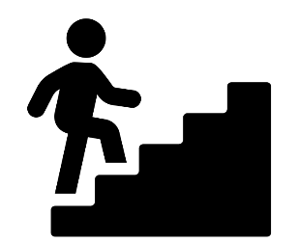




































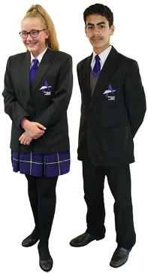





Where are areas of surplus and deficit located globally?
Pornography, Algorithms and Self Esteem
Blackpool Aspire Academy
PSHE Learning Journey
Digital Consent and the Law
Gambling and the Hidden Risks
YEAR
FGM
Pregnancy Choices and The Law
11
The Science of Fertility
Prostate Cancer and Menopause
Health Screening
Parenting and Future Responsibilities
Vaping and Edibles
Aesthetics and Self Esteem
YEAR
Ketamine and Prescription Drugs
10
Bereavement and the 5 Stages of Grief
Sexual Health and Contraception
Sexual Harassment and Boundaries
Knife Crime and the Law
County Lines and Criminal Exploitation
Cannabis an the Developing Brain
Inhalants and Legal Highs
Misogyny, Media and Masculinity
Radicalization and Grooming
Marriage, Family and the Law
The Digital World and the Algorithm
YEAR
Nicotine, Vaping and Alcohol
9
Consent and Healthy Boundaries
Firework Safety
Safety in the Blackpool Context
Healthy Body Healthy Mind
Medical Literacy and Your Rights
The Digital Self
First Aid and Life Saving
Understanding Identity
YEAR
Relationships and Commitment
Diversity and the Law
8
Bullying and the Bystander Effect
Physical and Health Skills
The Changing Body
Puberty/ puberty Hygiene
Mind Matters
YEAR
7
Social and Interpersonal Skills
Transition and resilience
Personal and emotional skills
Menstrual Health and Conditions
Dental hygiene

