Slide 1
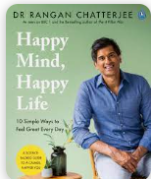
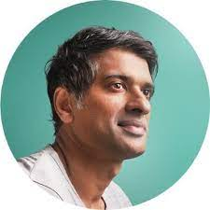
WELL-BEING
The following extracts have been taken from Dr Rangan Chatterjee book, Happy Mind, Happy Life (2022)

Slide 2
Happiness is more than it seems:
This is how it works. When we think negative thoughts and allow the actions of others to influence the way that we feel, we bring stress into our body. And stress is implicated in about 90 per cent of what a Doctor sees in a day, according to Dr Rangan Chatterjee (Happy Mind, Happy Life, 2022). But when we feel calm, content and in control of our lives, the opposite is true: we become healthier. When we feel truly and deeply happy in our lives, the knock – on consequences for our health are profound.
UPSTREAM
How you feel about yourself and the world
Your thoughts and emotions
Your mental health and wellbeing
Your day - to - day behaviours
Your approach to food, movement, sleep and rest
Your physical health
DOWNSTREAM

Slide 3
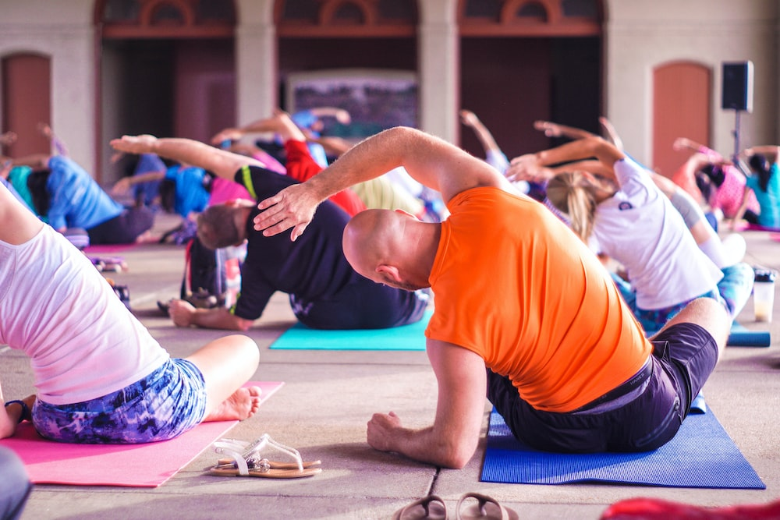
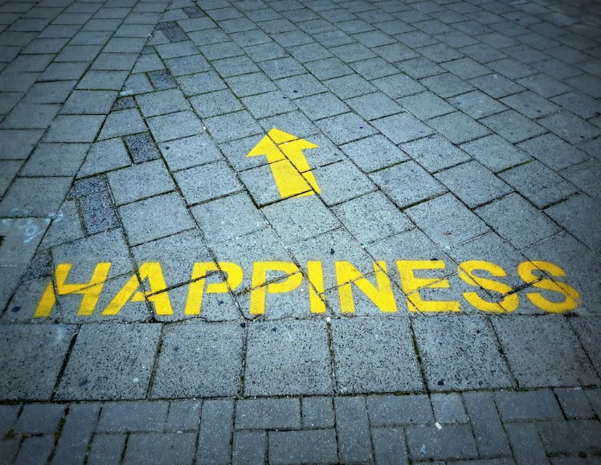
Happiness impacts are health:
Part of the reason that happiness impacts our health so much is that, if your feeling good about your life, you’re more likely to exercise, socialise and avoid comfort foods. That’s pretty obvious. But happiness goes much deeper than this. Incredibly, it’s been found that, even when these kinds of life changes are accounted for, happier people still live longer. One study looked at nun’s, who ate the same diet and took similar amounts of exercise to each other. When these nuns entered service and took their Holly Orders, they all wrote an autobiographical essay. These essays were rated by psychologists, who assessed them for the amount of positive emotion they showed. The researches then separated them into four groups, with the happiest at the top. Of that happiest quarter, 90 per cent of the nuns were still alive at the age of eighty-five. In the unhappiest quarter, just 34 per cent were still alive. (Happy Mind, Happy Life by Ragan Chatterjee 2022).
Come and join us at our ‘Coffee morning Drop –In’ and make us happy

