Slide 1
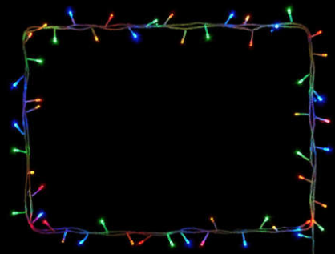
Art at Home
Festive Competition!
We would like to invite our children to enter a festive art competition this year to encourage creativity at home and celebrate the countdown to Christmas!
The competition is open to all ages and there will be a winner and two runners up from each age group including;
Early Years, Key Stage 1, Lower Key Stage 2 and Upper Key Stage 2.
All entries must be photographed and entered online before
Friday 11th of December

Slide 2
Entry Rules
All artwork must be the children’s work however, grown ups can assist our younger children with tricky bits such as cutting.
To bring us all some festive cheer, the theme must be based around Christmas, this could be a snow scene, a portrait of Father Christmas, a colourful collage, a present, a bauble, a Christmas tree, a reindeer, an elf or anything else you can imagine.
Any media can be used such as paint, oil pastels, pencils, pens, tissue paper, felt, wool or even sweet wrappers and of course as much glitter as you like!
All entries must be submitted via email and not be brought into school so we would like you to display the art at home and enjoy it throughout the festive season!
One entry per child.

Slide 3
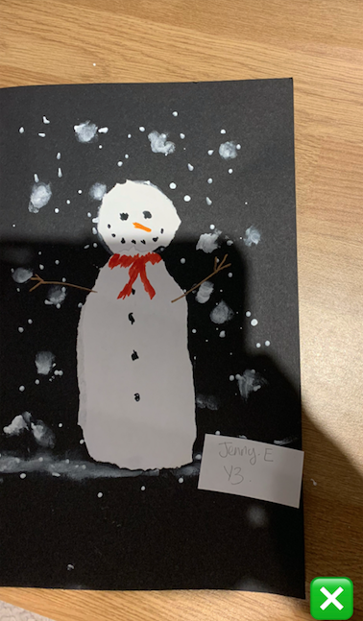
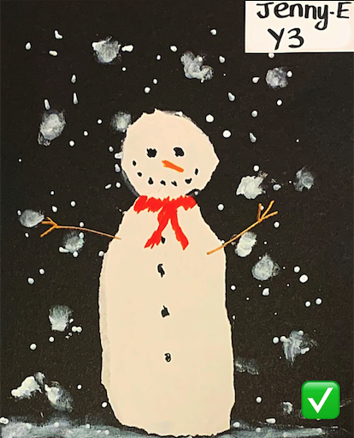
Photographing the work
Taken too far away
Not straight and some of the paper not visible
Can see background
Shadow from holding camera
Poor lighting so colours are not vivid enough
Name written in biro so difficult to see and interfering with artwork
Paper not laid out flat
Taken close up
Screenshotted and cropped to create straight edges
No background visible
No shadow
Bright lighting so colours are vivid Name written in felt tip so clear to see and place where it does not interfere with artwork
Paper laid out flat

Slide 4
Submitting the artwork
All entries must be submitted online by photograph and the photograph must include your child’s year group, their first name and last initial only
PLEASE DO NOT INCLUDE YOUR CHILD’S LAST NAME
Entries must be submitted by
Friday 11th of December
These should be emailed to:
bianca@bolton.cumbria.sch.uk

Slide 5
Prizes!
Winners from each of the four age categories will receive an art themed prize including some snazzy art supplies!
Runners up will each receive a festive chocolate treat!
Thank you for joining in ☺

