Slide 1

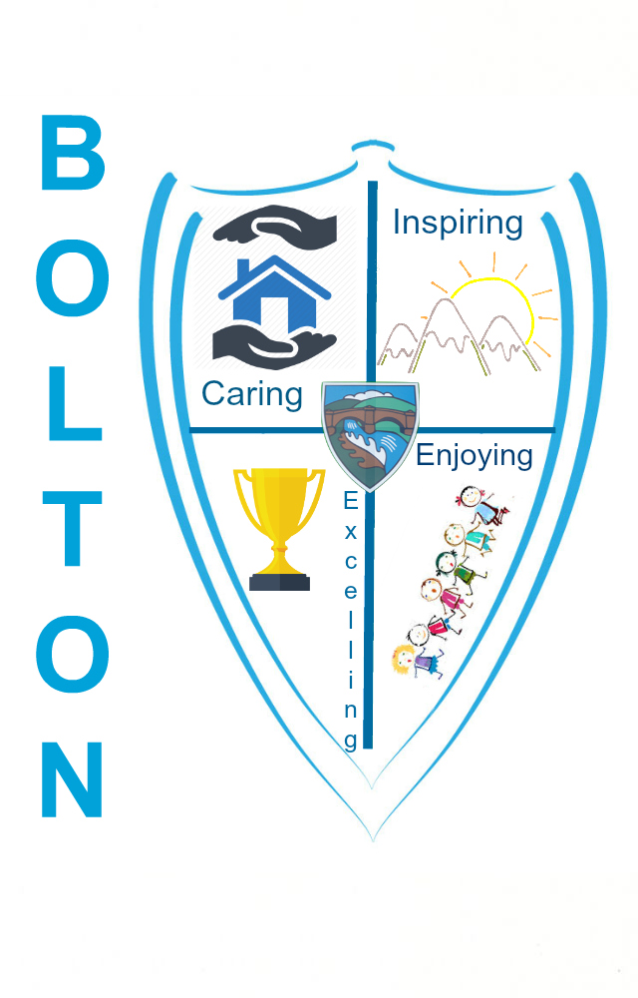
Bulgaria Trip
15th – 22 nd October 2022
Voices of the Erath Project
ERASMUS
Myles, Gabriel, Alice and Lily are going to Bulgaria with Miss Lowthian and Mrs Moody as part of our Erasmus exchange project.

Slide 2
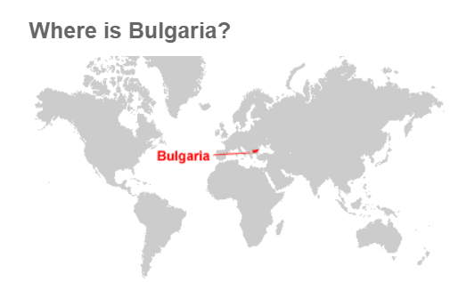
All about Bulgaria

Slide 3
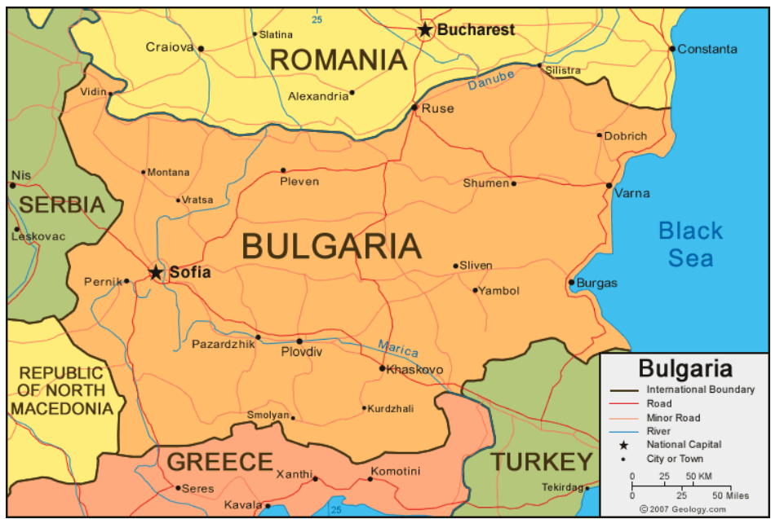
Bulgaria is located in southeastern Europe. Bulgaria is bordered by the Black Sea to the east, Serbia and the Republic of North Macedonia to the west, Greece and Turkey to the south, and Romania to the north.

Slide 4
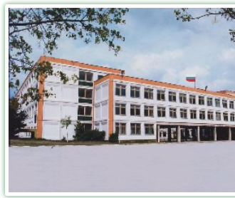
Our Partner School
Nikola Yonkov Vaptsarov
Varna
Bulgaria

Slide 5
There will also be staff and children from our other partner schools.
Escola Els Pins, Spain
Istituto Comprensivo Pascoli Forgione, Italy
Third Primary School of Rhodes, Greece
Kutlukent 80 Yil ilkokulu, Turkey
We have some joint aims with the other schools.

Slide 6
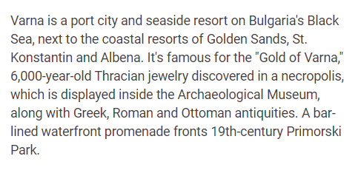
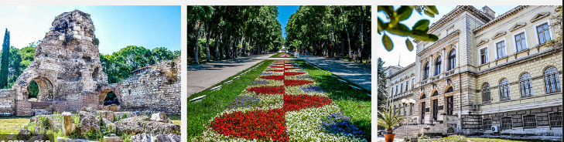
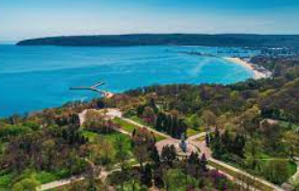
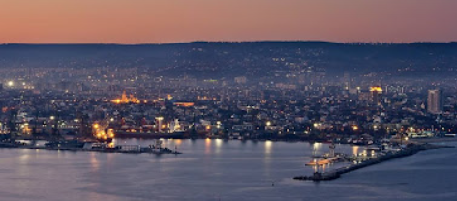
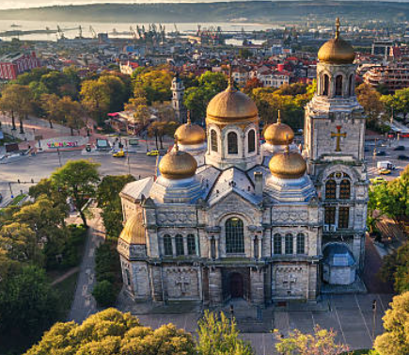
Varna

Slide 7
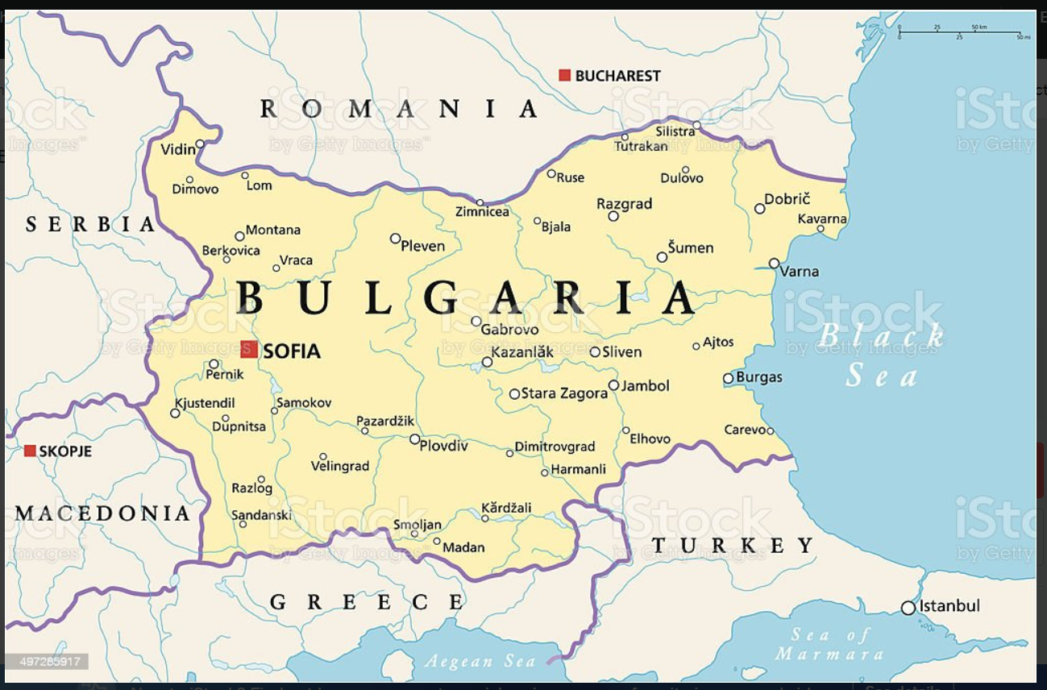

Slide 8
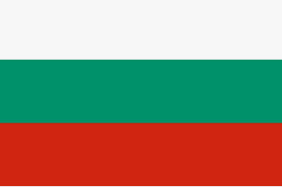
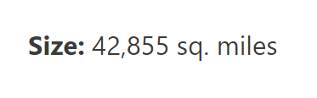
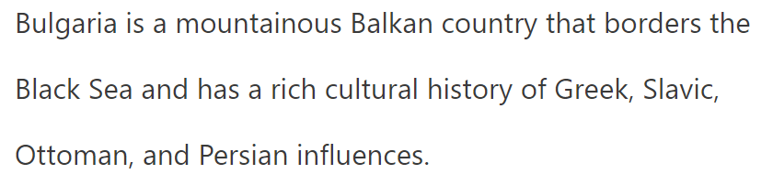

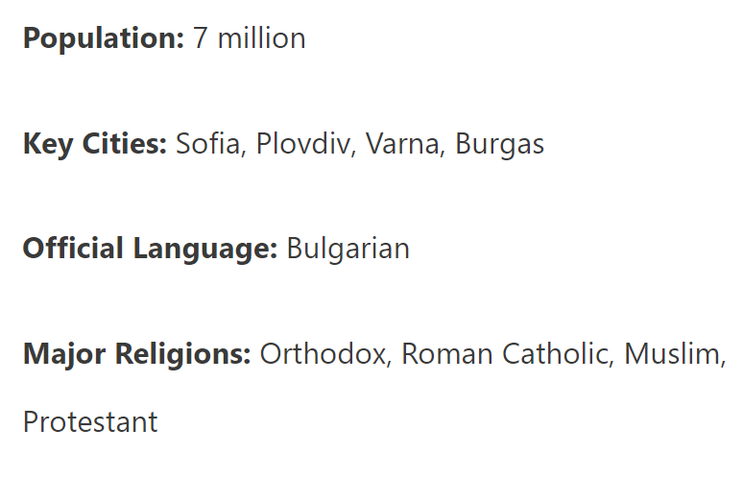
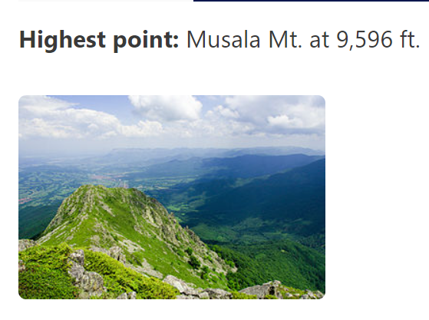
Facts about Bulgaria

Slide 9
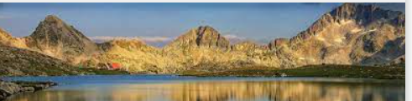
Bulgaria has hot summers and long, cold winters. From December to mid-March, the country gets a lot of snow, especially high in the mountains.
North of the Balkan Mountains, you’ll find the Danubian Plain, which leads down to the legendary Danube River, which forms the country’s northern border with Romania.
The lowlands of southeastern Bulgaria, called the Maritsa Basin, are drained by several small rivers that lead to the Black Sea.
It has very diverse terrain for its size.
The Balkan Mountains pass through the centre of the country, while the Rhodope Mountains are located along the southern border with Greece.

Slide 10
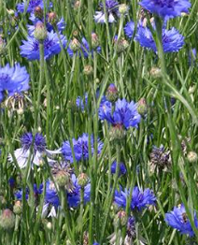
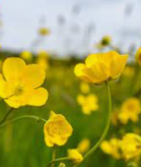
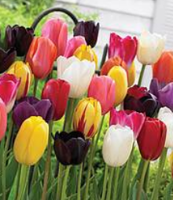
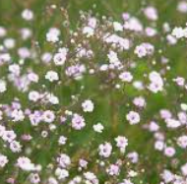
It receives a little less than 30 inches of rain each year, with more rain falling in the mountains and less on the coast. Winter is the driest season, and summer thunderstorms are common.
Bulgaria is home to about 170 plant species that are found nowhere else in the world, including species of tulips, a buttercup, a cornflower, and a baby’s breath.

Slide 11
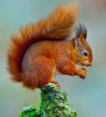
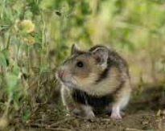
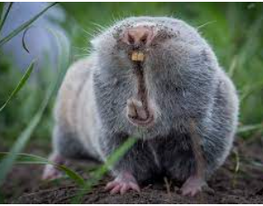
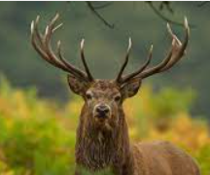
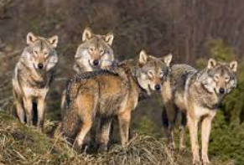
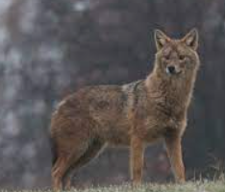
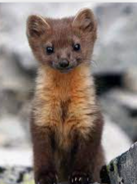
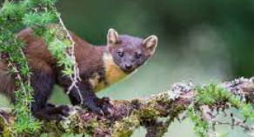
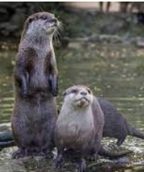
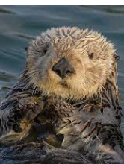
Wildlife
The Balkani Wildlife Society is monitoring 13 mammal species including the red squirrel, European and Dobrudja hamster, lesser mole rat, wolf, jackal, pine marten, otter, wildcat, and red deer.

Slide 12
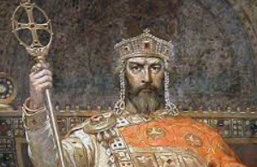
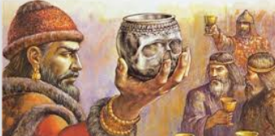
History
Bulgaria’s name comes from the Bulgar people who arrived in the area around 200 AD. Early in the history of the area that is now Bulgaria, the land was settled by the Thracians.
Later, the area was conquered by the famous Macedonian leader Alexander the Great, then by the Roman Empire.
In 681, the first official Bulgarian state was created. This period is sometimes called the Golden Age of Bulgaria because it was a time of wealth, education, art, culture, and literature. But it didn’t last long.

Slide 13
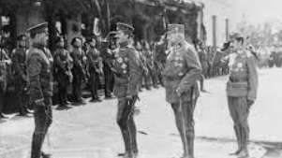

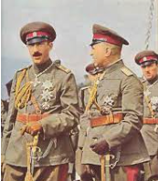
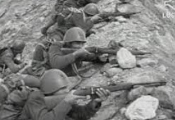
History
In the years that followed, Bulgaria became part of the Byzantine Empire and then the Turkish Ottoman Empire.
The Ottomans had very strict rules, and the Bulgarian people rebelled. However, they couldn’t defeat the powerful Ottoman Empire.
The Treaty of San Stefano, signed at the end of the Balkan War, gave Bulgaria its independence from the Ottomans. The Bulgarians supported Germany during World War I and lost.
In early March 1941, Bulgaria joined the Axis alliance and, in April 1941, participated in the German-led attack on Yugoslavia and Greece. In return, Bulgaria received German authorization to occupy most of Greek Thrace, Yugoslav Macedonia, and Pirot County in eastern Serbia.

Slide 14
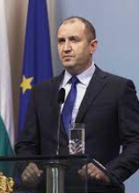
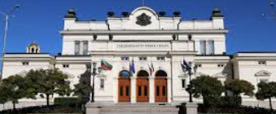
History
After World War II, Bulgaria came under Communist rule and was a satellite of the Soviet Union (what is now Russia).
In 1989, after the fall of the Berlin Wall, the Communist leaders allowed the country to elect leaders of their own choosing. Under the new Socialist leaders, Bulgaria’s economy struggled badly.
In the years since then, Bulgaria has become much more stable, but it’s still one of Europe’s poorest countries. It is governed by a president, prime minister, Parliament, and Council of Ministers.

Slide 15
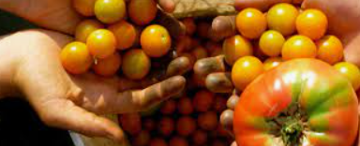
Economy
Bulgaria’s major industries are electricity, gas, water, food and beverages, tobacco, machinery and equipment, chemical products, refined petroleum, and nuclear fuel.
The country’s top agricultural products include wheat, corn, barley, sugar beets, potatoes, sunflower seeds, grapes, and livestock.
Bulgaria is ranked 77th in the world in terms of wealth. Although it’s one of the poorest countries in Europe, it’s still above the world average.
However, studies and surveys have shown that Bulgaria is among the unhappiest countries in Europe, and Bulgarians report a poor quality of life.

Slide 16
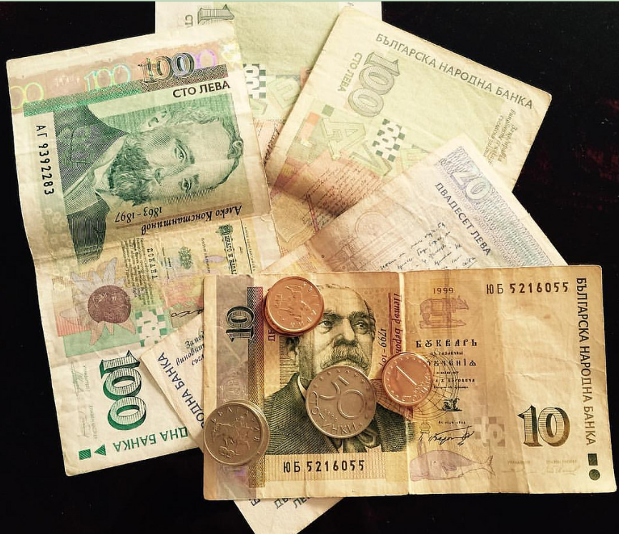
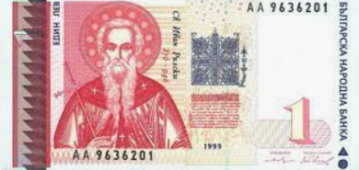
Bulgaria’s currency is the Bulgarian lev.
The lev is the currency of Bulgaria. In old Bulgarian the word "lev" meant "lion", the word 'lion' in the modern language is lаv. The lev is divided in 100 stotinki. Stotinka in Bulgarian means "a hundredth" and in fact is a translation of the French term
Saint John of Rila (Ivan Rilski) is displayed on the one lev banknote. He was the first Bulgarian hermit, pronounced as a saint while still alive. In his honour the beautiful Rila Monastery was build.

Slide 17
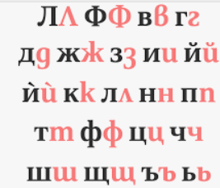
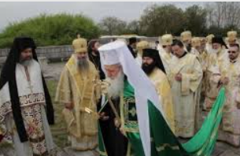
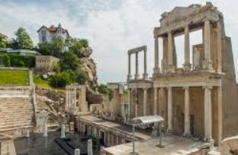
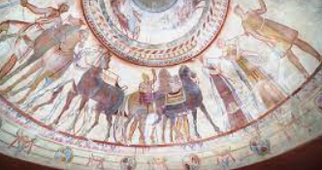
Culture
The majority of Bulgaria’s citizens speak Bulgarian, a language that uses the Cyrillic alphabet. Turkish and Romani are also spoken, along with foreign languages such as Russian, English, Italian, and Spanish.
Bulgarian Orthodox is the main religion in Bulgaria, but the country is also home to Roman Catholics, Muslims (about 12% of the population), Protestants, and Jews.
After Greece and Italy, Bulgaria has the third most valuable archaeological sites in the world, including over 15,000 Thracian tombs.

Slide 18
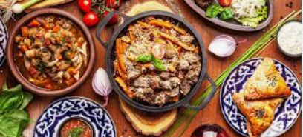
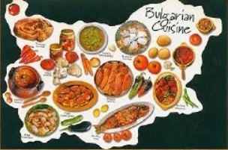
Culture
The nation has a colourful culture of costumes, crafts, and traditional music and dance. It’s a blend of Persian, Slavic, Greek, and Ottoman influences.
Traditional Bulgarian recipes often feature Bulgarian feta cheese, fresh and/or stuffed vegetables, yogurts, and grilled meats (especially lamb, pork, and veal).
Popular dishes include kufte (spicy ground beef and pork formed into grilled patties), banitsa (pastries stuffed with meats and cheeses), and Shopska (the traditional Bulgarian salad of diced onions, tomatoes, cucumbers, and parsley.

Slide 19
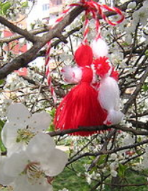
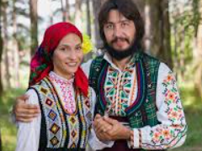
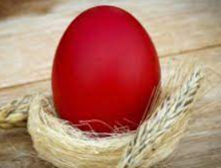
Traditions
To celebrate New Year’s Day in Bulgaria, dancing men dressed in costumes made of goat hair and wooden ram masks wake residents very early.
The costumed men wish the people good health and a good harvest in exchange for small gifts like beans or eggs. Eventually, everyone gathers in the town square for music, dancing, and food.
On Easter (or Velikden), Bulgarians dye bright red eggs and throw them at one another. The last person left with an unbroken egg is believed to have good luck for the year.
Every year on March 1, Bulgarians give each other martenitsas, little crafts made of red and white yarn that are supposed to bring happiness and good health.

Slide 20
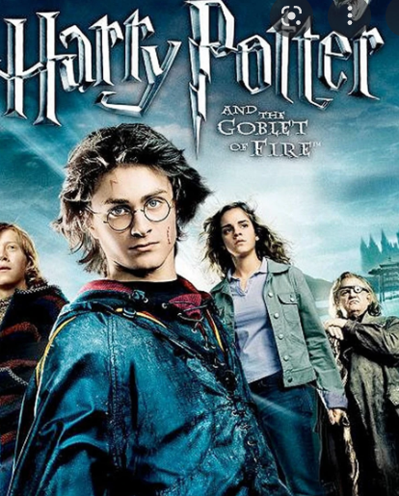
Things to do in Beautiful Varna
https://www.youtube.com/watch?v=hUGqUqPUwkY
Did you know? Bulgaria made an appearance in the international bestseller Harry Potter and the Goblet of Fire when the fictional Quidditch World Cup final took place between Bulgaria and Ireland. (Ireland won, but Bulgaria got the Snitch).

