Slide 1
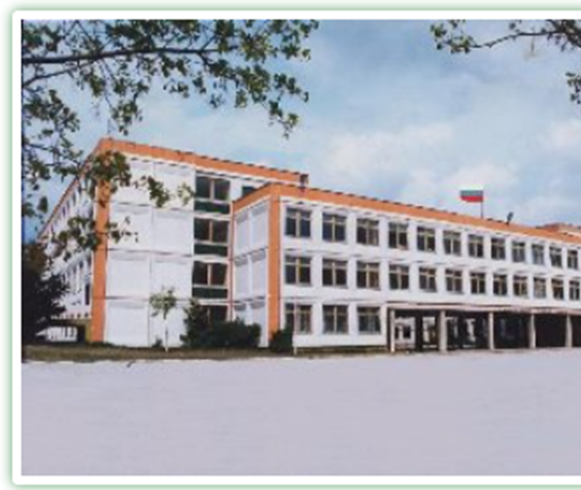


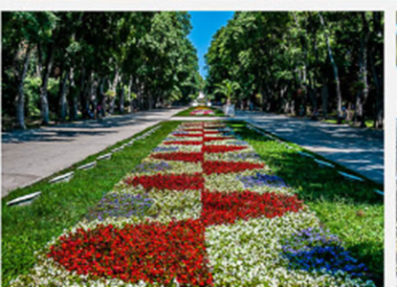
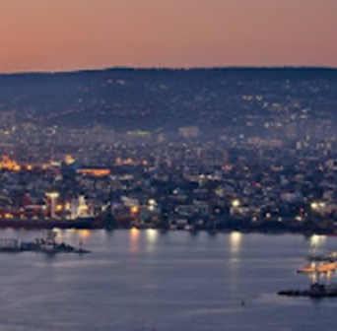
Bulgaria
Erasmus
15th – 22nd October 2022

Slide 2





partner schools

Slide 3
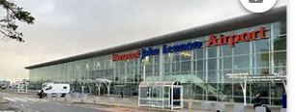
Saturday 15th October
12.30 pm Leave Bolton Primary School by K & B taxis. 4 Children and 2 adults.
14.30 pm Arrive at the airport – Liverpool John Lennon Airport.
17.30 pm Wizz Air Flight W64532 to Varna Bulgaria – flight time 3 hours and 35 mins (+2 hrs time difference)
23.05 Arrive at Varna Airport
Collected from the airport by Bulgarian host team in private cars – 25 mins to hotel.
BRING YOUR PASSPORT TO SCHOOL BY FRIDAY 7TH October – this week!

Slide 4
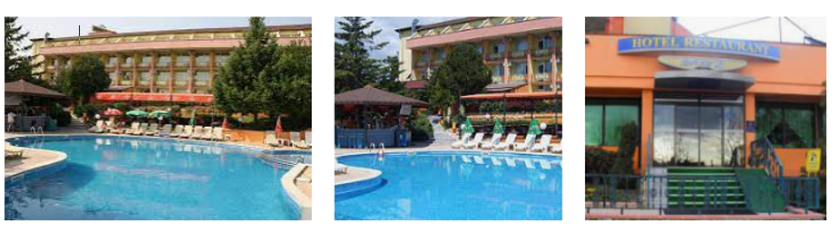
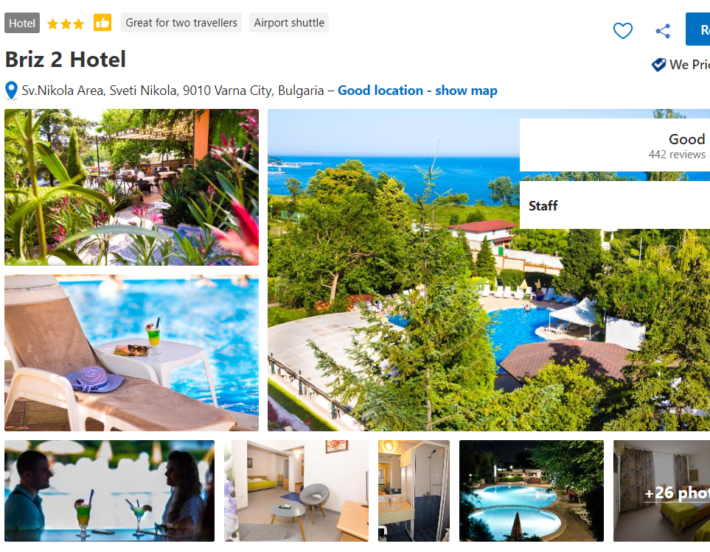
Our hotel! Check it out on Booking.com

Slide 5
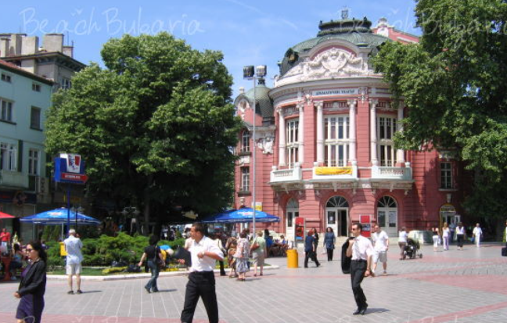
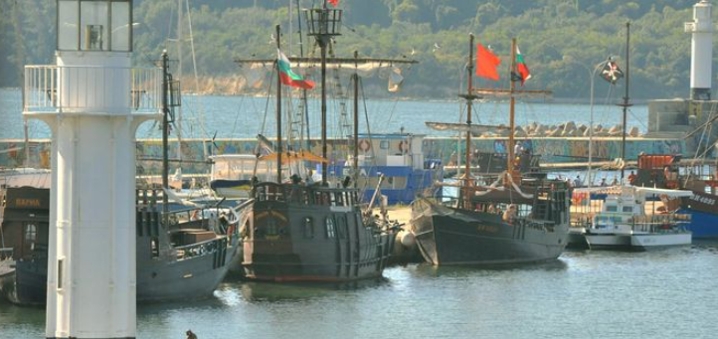
Sunday 16th October
Breakfast provided by the hotel.
Free day to explore the hotel, Varna harbour and city.
Other Erasmus teams will arrive at the hotel at different times during the day.
Lunch out
Meal at the hotel

Slide 6
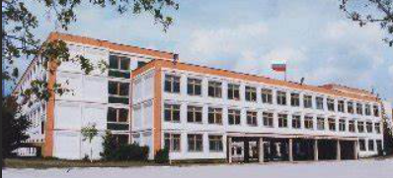
Monday 17th – Thursday 20th October
Programme of events from Bulgaria host country.
See schedule.
School Name: Nikola Yonkov Vaptsarov
Varna
Bulgaria

Slide 7

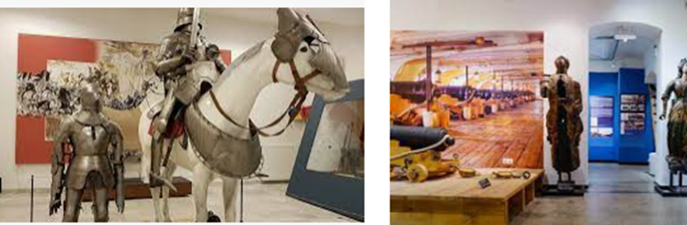
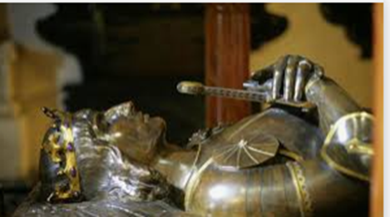
A lot of eating will be done here – it’s one minute away from the school
Vladislav Varnenchik Museum - Monday
Any travel from the hotel to the school or for excursions will mainly be by private coach and depending on the weather. School is about 15 minutes away. (8km)
There will be 34 participants.

Slide 8
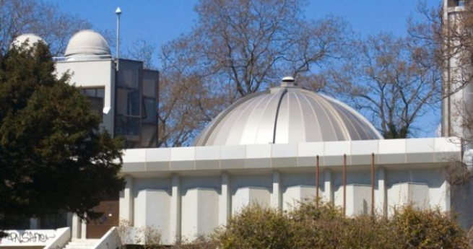
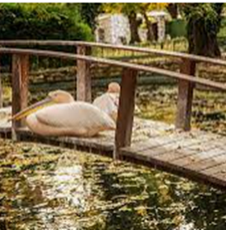
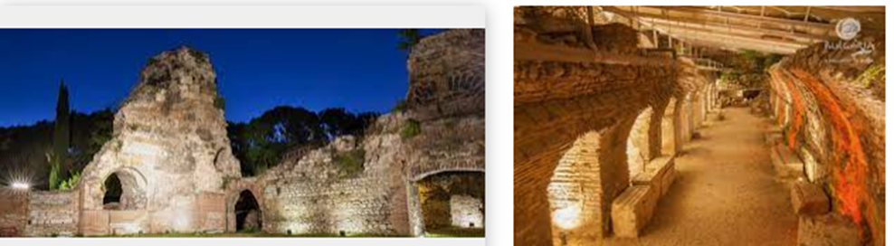
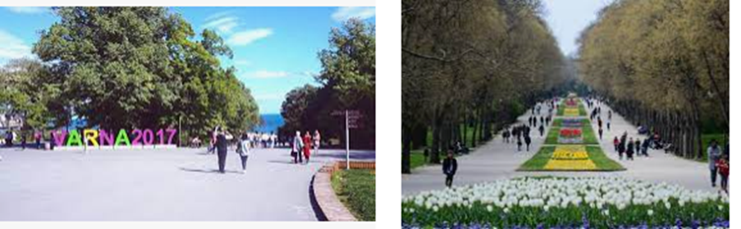
Tuesday
Nicolaus observatory
The Sea Garden of the City
The Roman Baths

Slide 9
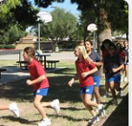
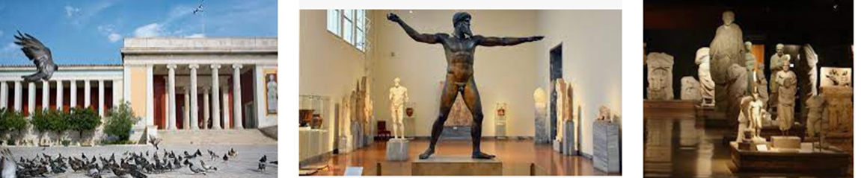
Wednesday
Relays and trash road sport
Archaeological Museum
It houses the oldest gold treasure …

Slide 10
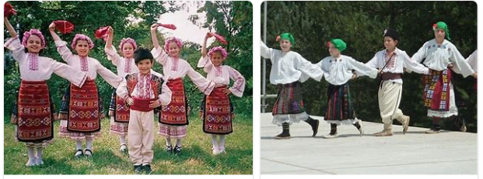
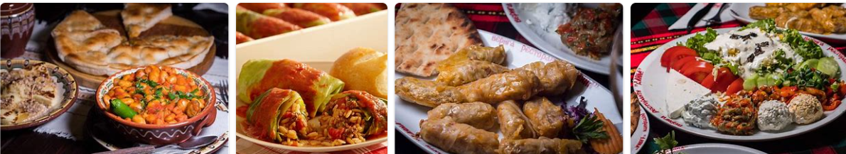
Thursday
Culture, custom and traditions

Slide 11
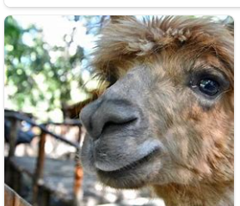
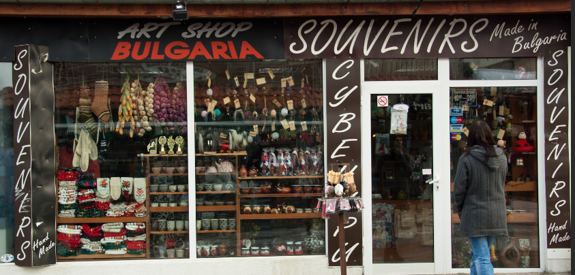
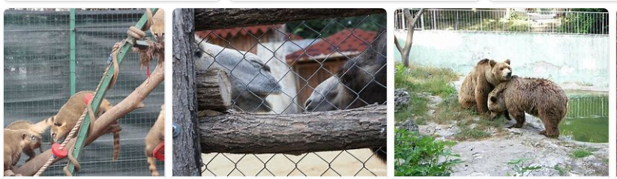

Friday
Free day!

Slide 12
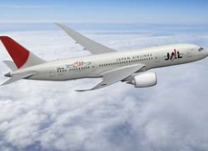
Saturday
12 noon depart the hotel to Varna airport with host in private car.
15.00 Wizz Air Flight W6 4531 to Liverpool (3 hrs 35 mins)
(- 2 hours)
16.55 Arrive at Liverpool Airport
17.45 Taxi will collect from airport to BPS
20.00 Arrive at school – collected by parents

Slide 13
Kit List & Luggage
Each child can have a day bag/ ruck-sac and a small airline wheelie suitcase
Suitcase 55 x 40 x 23
Day bag 40 x 30 x 20
Empty water bottle for drinking on days out
Light/thin waterproof coat
School uniform to wear on 4 days (Wed sports)
Comfy trainers
Comfy casual clothes for evening/ free days/ evenings
Pyjamas
Underwear/ socks
Swimwear
Sunhat/ sunglasses
Small games, cards, books, pen, small notebook
Toothbrush & small toothpaste
swimming towel
Travel size (less than 100 mls) bottles of shampoo/ shower gel. You can have up to 10 of these in a clear sealable plastic bag
Adults will buy sunscreen. Please say if this is a problem and you need to send your own.

Slide 14
Behaviour and Expectations
You are the first group representing our school – impressions will be made.
You are having the opportunity of a life-time – don’t abuse it. We knew that you’d like to be with your friends so prove to us that you deserve that privilege.
Adults are giving up their free-time and weekends to be with you so you can have this experience – be grateful and respectful.
Look after each other – you are the Bolton family. It’s a long time away from home so take care, be kind and be considerate.
Think about what memories you’ll make and how you’ll be remembered on the trip by others.
Is this a holiday? Yes and No…

Slide 15

Contact
Children are NOT allowed phones. There are several reasons for this.
Miss Lowthian and Mrs Moody will keep us posted each day via FB but they won’t always have access to wifi. Please don’t worry if photos and messages don’t appear straight away.
If there is an emergency and it is during school hours – call school and we will help decide the best course of action.
You’ll be given a number to contact out of school hours also – Ruth’s mobile (please don’t use after this period).
We will give you mobile contact of staff HL & AM but these are ONLY to be used in an emergency situation – it is preferred that you contact school or Ruth after school hours.

Slide 16
Check – do you give consent for children to have paracetamol/ calpol?
Children will have a contact card with them at all times with HL/ AM number & hotel.
Any questions?
Spending money – provided by us.

