Slide 1


Erasmus Project 2021
Session 3
January 12th
Y5 & 6
Mrs Elstone

Slide 2

What is Erasmus?
This is a programme that schools can apply to be part of. It means that pupils can take part in exchange visits and go to new places and meet pupils from different countries.
Why do it? It will give you new skills and you’ll find out about new people and places in the world. It will expand your horizons! Hopefully, it will develop your tolerance and respect of other places.
Bolton Primary School applied last summer and we found out that our bid has been successful.

Slide 3





Where are our Partner Schools?
B
A
Bulgaria
Greece
Spain
Turkey
Italy
Can you match the country to its flag?
C
E
D
Send me the answers!

Slide 4

Will we be able to visit other countries and schools with the Pandemic?
Unfortunately, currently we can’t even leave our homes unless it’s an emergency so we won’t be going to Greece…
That’s a shame!
What we can do is prepare for some VIRTUAL tours.
To start with we are going to tell them all about us and our lives in Cumbria.
We will get to know our partner schools by using a padlet.
Padlet is an online virtual “bulletin” board, where students and teachers can collaborate, reflect, share links and pictures, in a secure location.

Slide 5
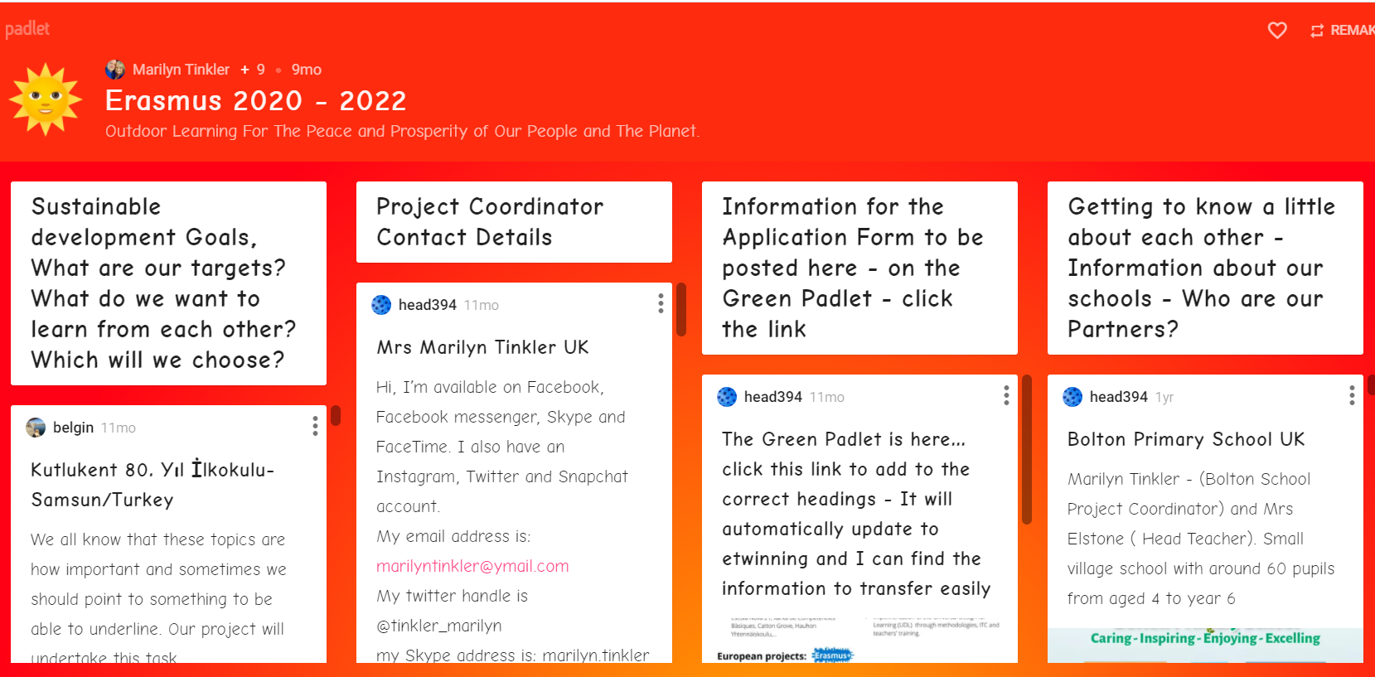
This is our Padlet! (our international project coordinator is Marilyn Tinkler)
AKA Joss’ grandma

Slide 6
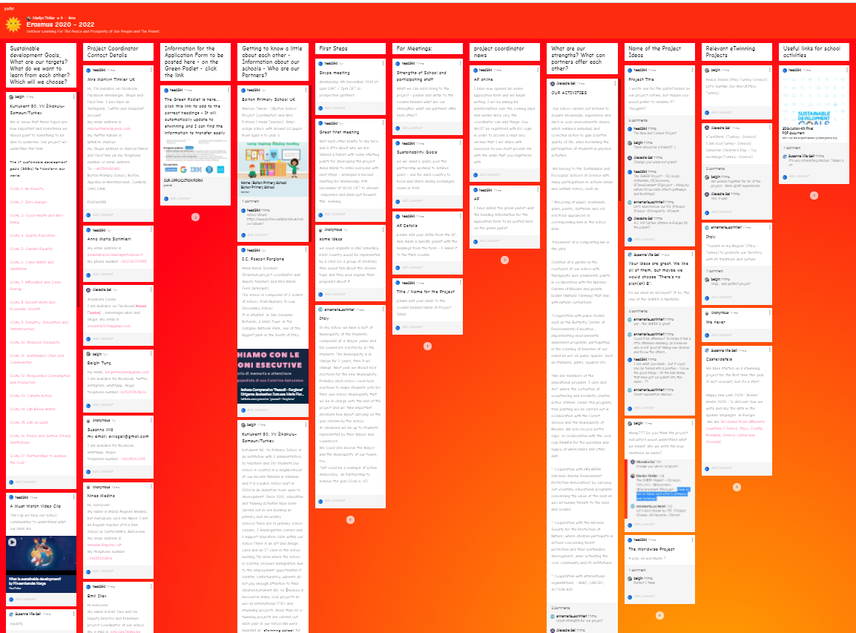
Task: Can I find information from the padlet?
First of all you will need to follow this link:
https://padlet.com/marilyntinkler/erasmus2020to2022
Spend some time navigating yourself around the padlet.
Use the bar along the bottom as there is much more on your right that you can’t see.
Lots of pages to discover…

Slide 7
Class 2 Y5/6 Questions
It will be hard to read some of the padlet so ideally get an adult to help you with this task if you need to.
You will find all the answers to these questions from the padlet.
Write your answers neatly on a piece on paper.
Title – Can I find information from our Erasmus Padlet?
Use your best writing and use the padlet for spelling help.
Q1 Look at Sustainable Development Goals – Name 10 of the 17 goals.
Q2 Which 3 do you think are the most important of the SDGs?
Q3 Project coordinator details – write down the names of ‘all’ the project coordinators?
Q4 Getting to know a little about each other – tell me 3 facts about the school in Italy.
Q5 Sum up how the school is different to ours.

Slide 8
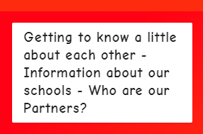
Q6 – Getting to know each other – Tell me three facts about the third primary school of Rhodes (you’ll need to scroll down to find this one). Look for the photo of the children.
Q7 – What can you find out about the Spanish School (underneath the one above). 3 facts please.
Q8 – Getting to know each other – Tell me about the distances that the schools are away from each other (this information is right at the bottom).
Well done!
After looking at the padlet tell me (by writing a comment on GC) which place and school you are most interested in and why?
Have you been on holiday to any of the places? How do you think a holiday is different to living, working or growing up in a place?
Remember to post me a comment and self-assess your work. Thank you!

