Slide 1


ITALY
26TH – 3RD DEC
ERASMUS EXCHANGE PROGRAMME

Slide 2
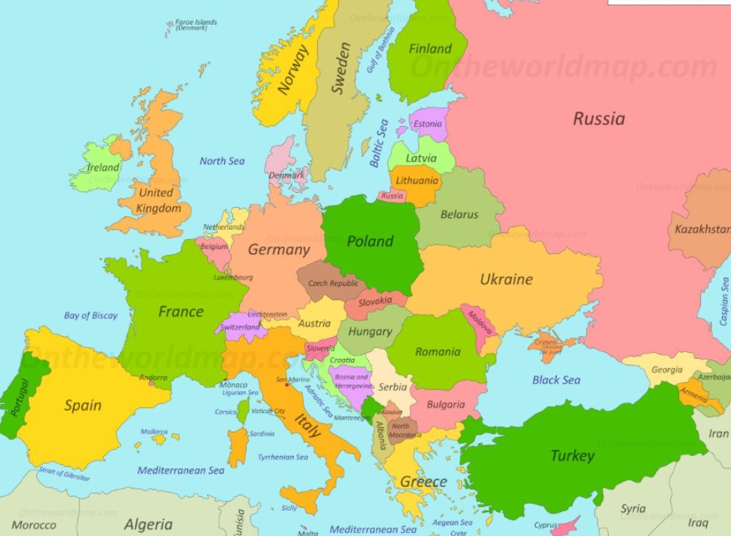
Where is Italy?
It’s 1,134 miles from London to Rome
It looks like a high-heeled boot!
Can you spot it?

Slide 3
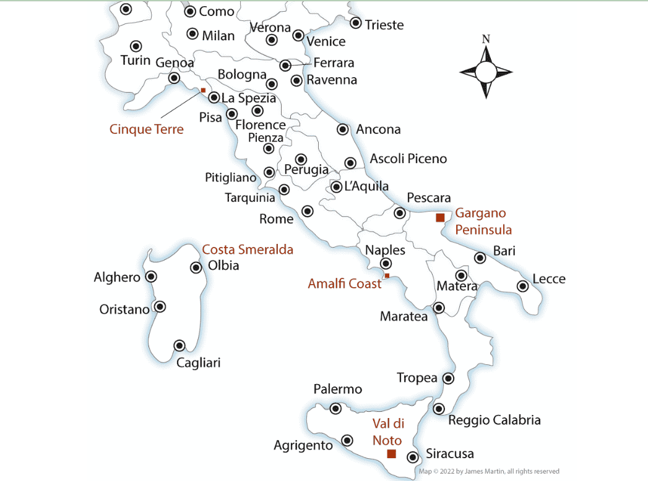
The main cities in Italy

Slide 4
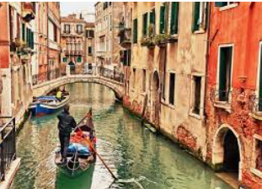
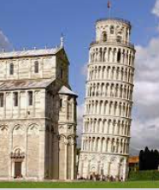
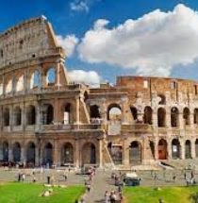
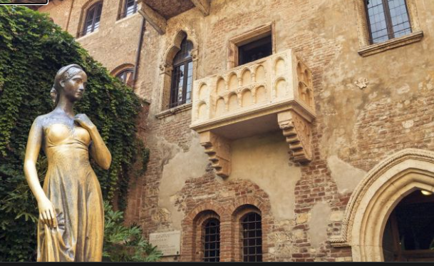
Do you know any of these places?

Slide 5
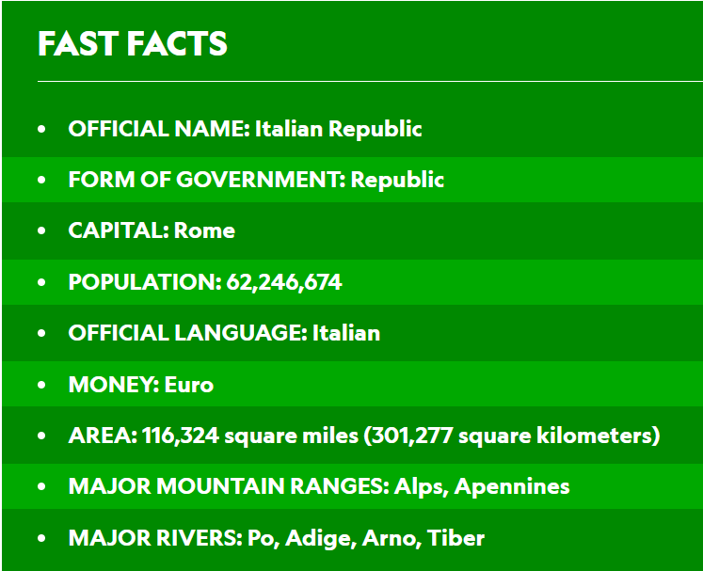
Italy is a boot-shaped peninsula that juts out of southern Europe into the Adriatic Sea, Tyrrhenian Sea, Mediterranean Sea, and other waters. Its location has played an important role in its history.
The sea surrounds Italy, and mountains crisscross the interior, dividing it into regions. The Alps cut across the top of the country and are streaked with long, thin glacial lakes. From the western end of the Alps, the Apennines mountains stretch south down the entire peninsula.
West of the Apennines are wooded hills that are home to many of Italy's historic cities, including Rome. In the south are hot, dry coastlands and fertile plains where olives, almonds, and figs are grown.

Slide 6
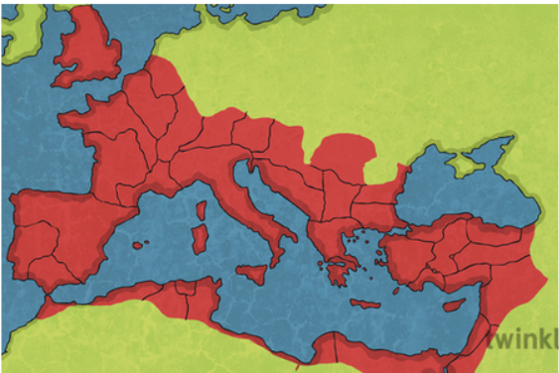
History - The Roman Empire!
The ancient Romans were based in Rome in Italy, but they ruled over land that stretched far beyond the borders of Rome. This was called the Roman Empire, and it covered large parts of land all around the Mediterranean Sea – and even part of Great Britain.
The Romans got this land mostly by fighting battles with other groups of people, like the Celts in Britain – when the Romans won, they’d get more territory to add to the Empire. This meant that Roman culture had a huge influence on other cultures, and it’s why finding Roman artefacts (like coins), and ruins of Roman walls and buildings (like Hadrian’s Wall) is so common in the British Isles today.
The Roman Empire was founded in 27 BC, with Caesar Augustus establishing himself as Rome's first emperor in 31 BC. But the history of the empire spans from the tiny kingdom of ancient Rome, to the fall of Rome in 476 AD.

Slide 7
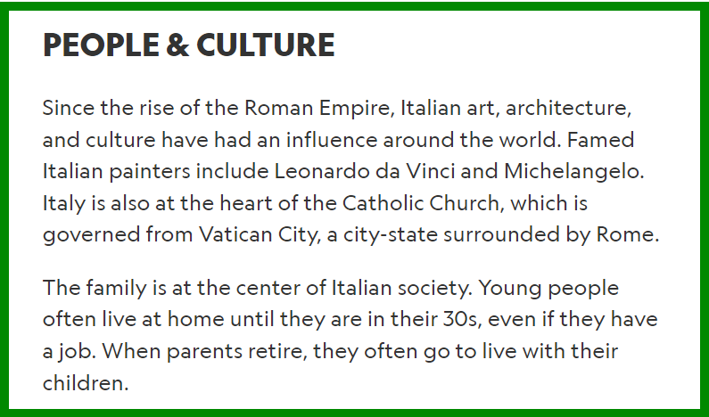
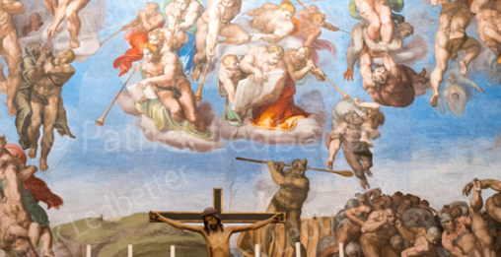
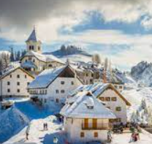
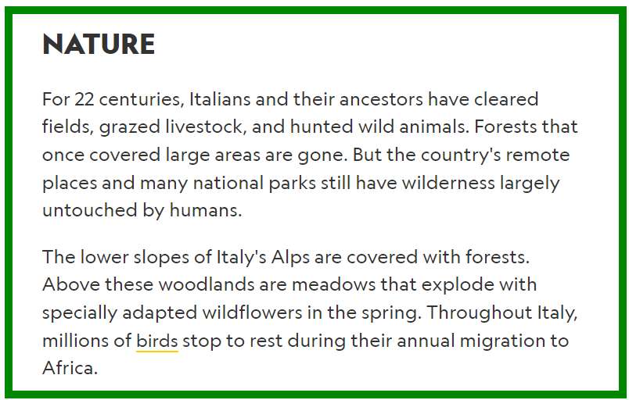
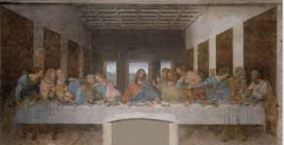
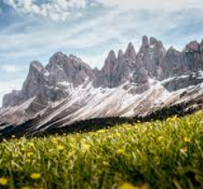
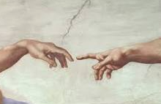
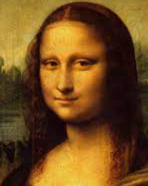

Slide 8
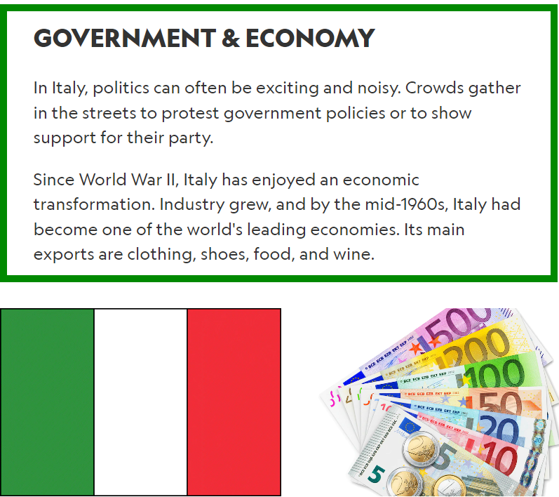
Italy was on the German side of the war. Italy became a war zone. They had a fascist leader called Mussolini.

Slide 9
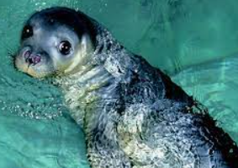
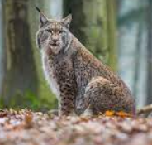
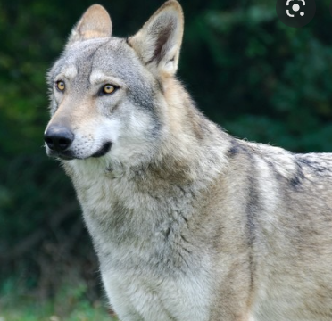
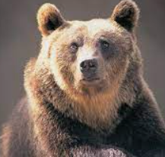
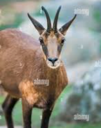
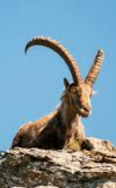
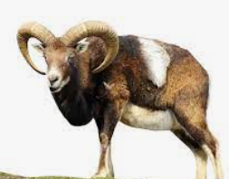
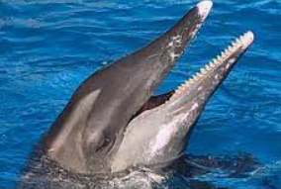
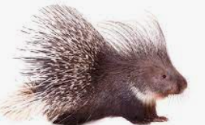
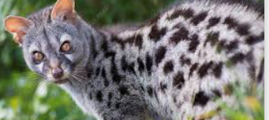
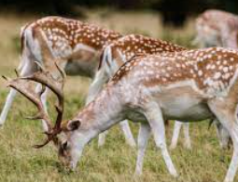
Native Animals
Notable large mammals are the Eurasian lynx, Italian wolf, Marsican brown bear, Pyrenean chamois, Alpine ibex, common genet, fallow deer, mouflon, rough-toothed dolphin, crested porcupine, and Mediterranean monk seal.

Slide 10
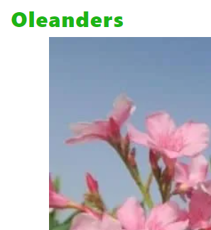
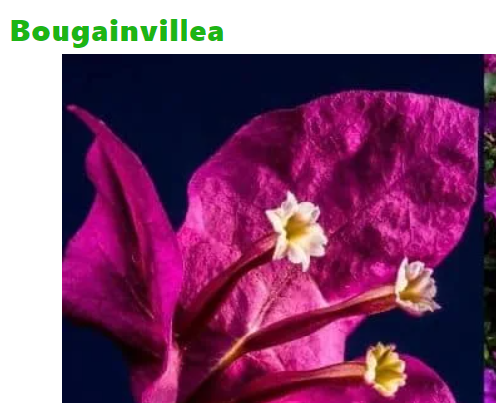
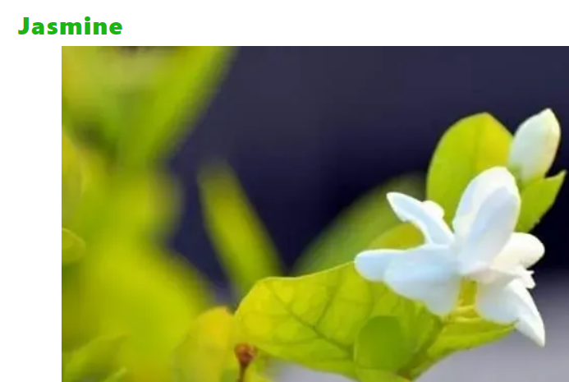
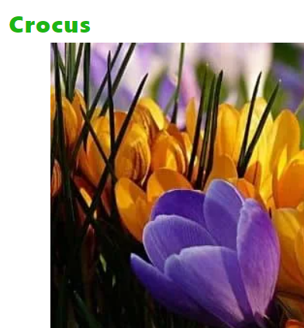
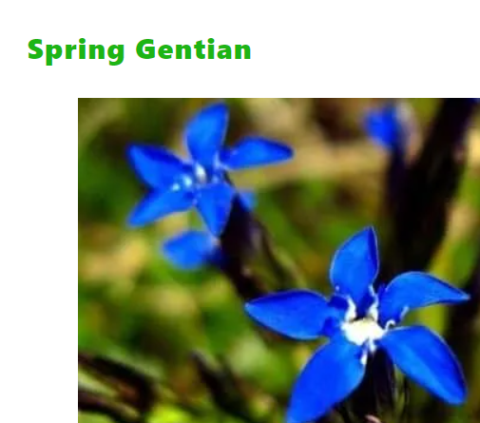
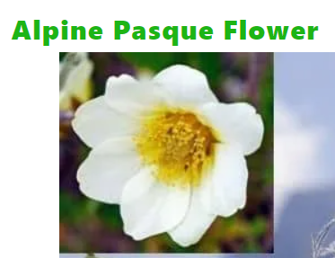

Slide 11
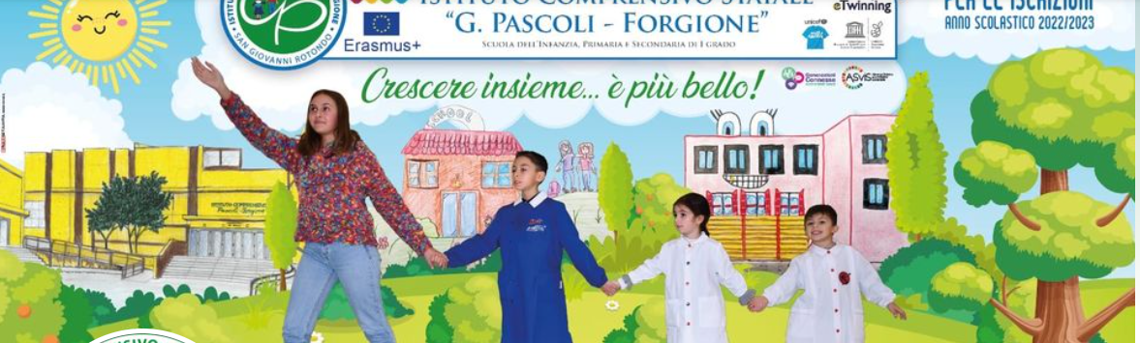
Host school: Pascoli Forgione Via Enrico Medi 7-71013
San Giovanni Rotondo

Slide 12
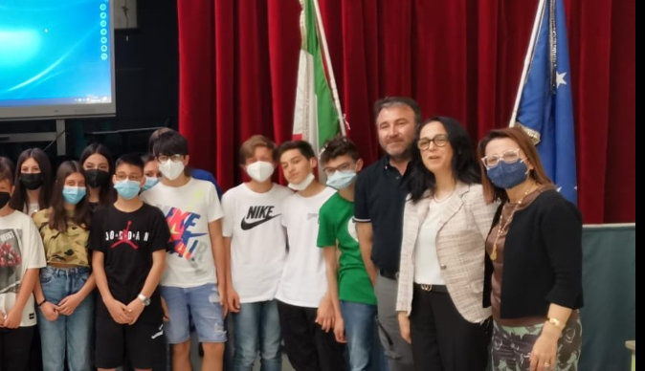
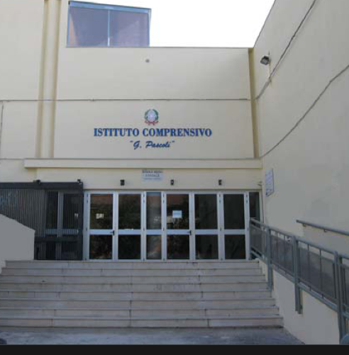
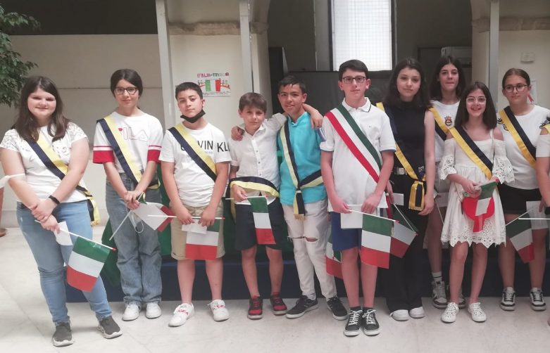
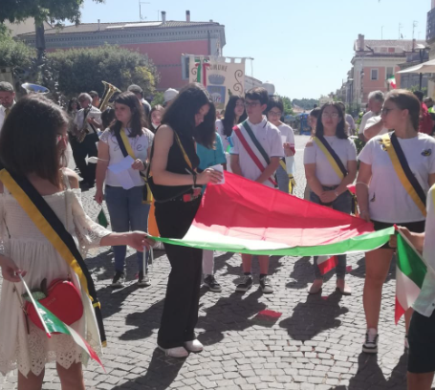
The school

Slide 13
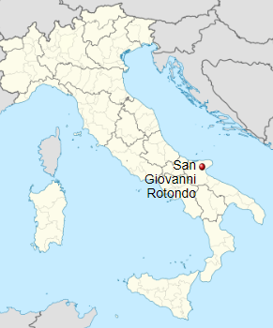
San Giovanni Rotondo
San Giovanni Rotondo is a small town in the central part of the Gargano peninsula, the part raising up to about 700 m above the nearby sea.
Population: 27,156 (2017)
Elevation: 565 m (1,854 ft)

Slide 14
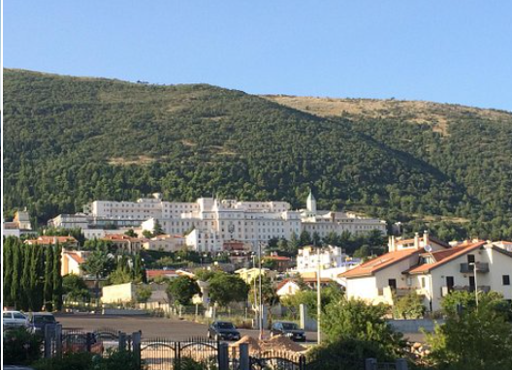
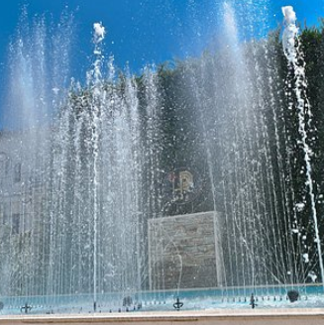
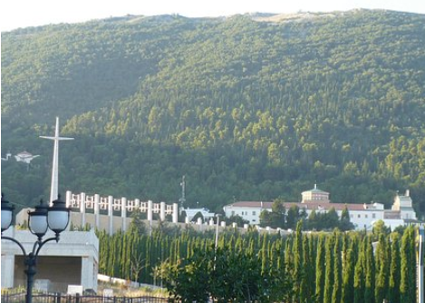
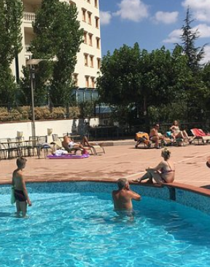
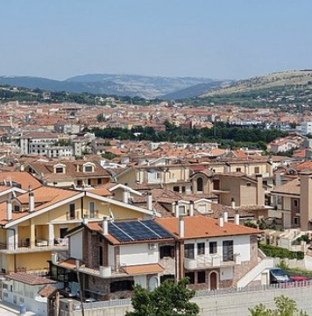
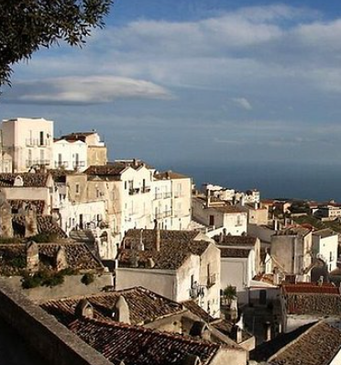
What’s it like in Rotondo?

Slide 15
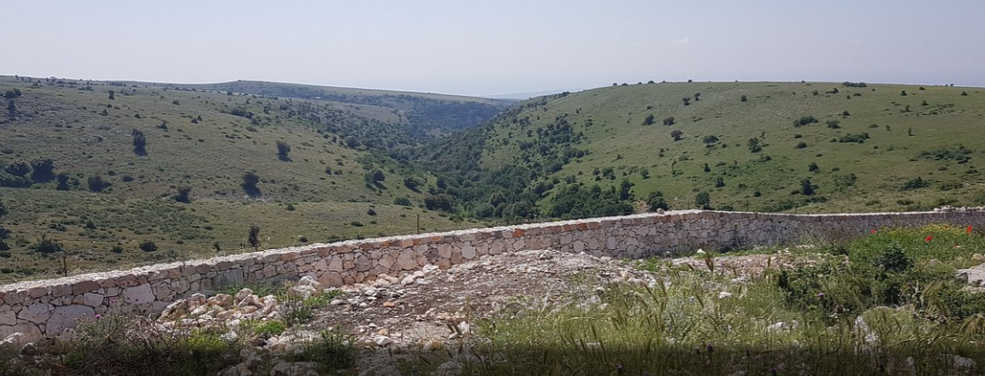
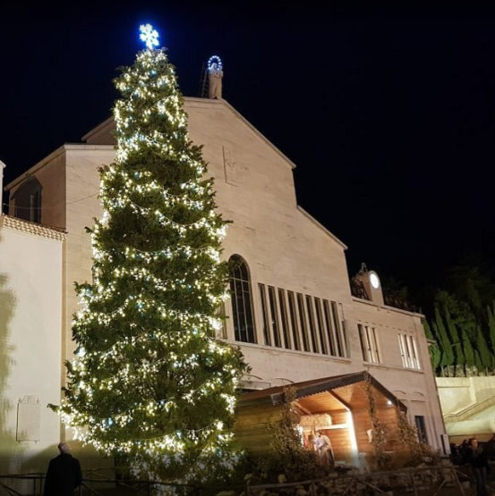
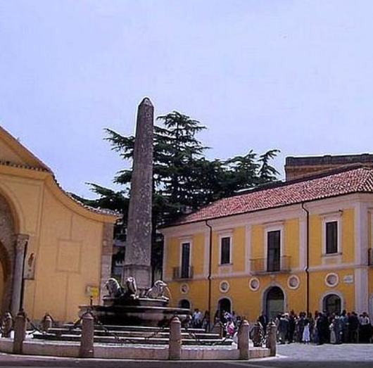
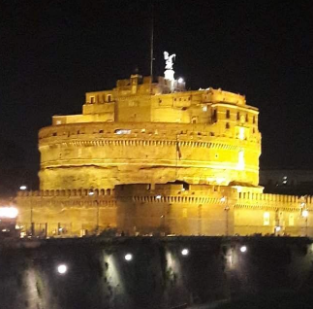

Slide 16




Slide 17

Aims of the project:
To share common goals with children and schools in Europe on the theme of sustainability.
To develop confidence amongst all participants.
Make new friends – develop social skills.
Learn about other cultures and countries.
Come out of your comfort zone and develop independence.
To give you an opportunity to travel and visit a school in Europe.
To try new and different things.
To strengthen friendships and relationships.
To look after each other.
To give opportunities to everyone who wanted to take part for little cost.
We ask you to come back and do an excellent presentation telling us all about it. https://www.youtube.com/watch?v=htcZ2BPMWkM

