Slide 1
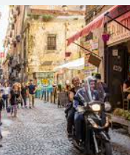

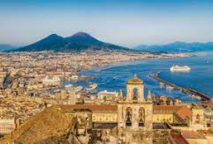

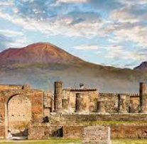

Italian Visit
Erasmus
Saturday 26th November – Saturday 3rd Dec 2022

Slide 2






Partner schools

Slide 3
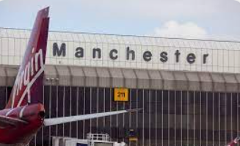
Saturday 26th November
TRAVEL PLANS TO NAPLES
10.30 am Leave Bolton Primary School by K & B taxis. 4 Children and 2 adults.
12.30 pm Arrive at Manchester Airport.
16.30 pm Ryanair flight FR6835 to Naples – flight time 2 hours and 50 mins (+ 1 hr time difference)
20.20 Arrive at Naples Airport
Airport shuttle to Central station (approx. every 10/15 minutes)
Walk to apartment (approx. 4 minutes)
BRING YOUR PASSPORT TO SCHOOL BY FRIDAY – this week!

Slide 4
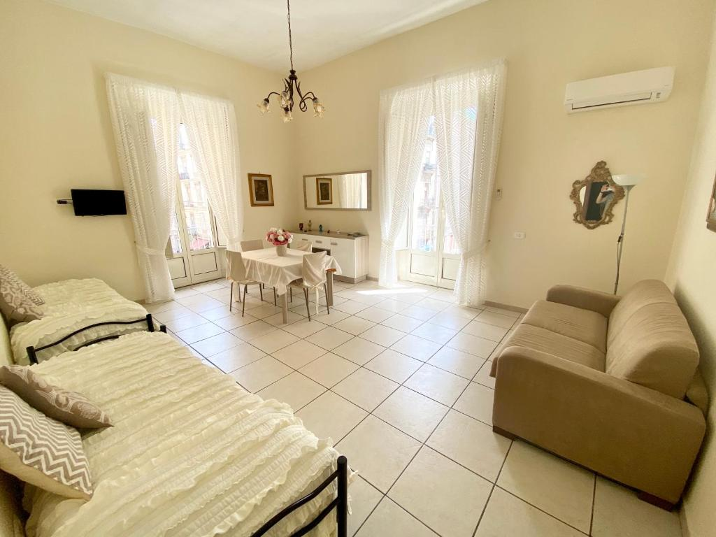
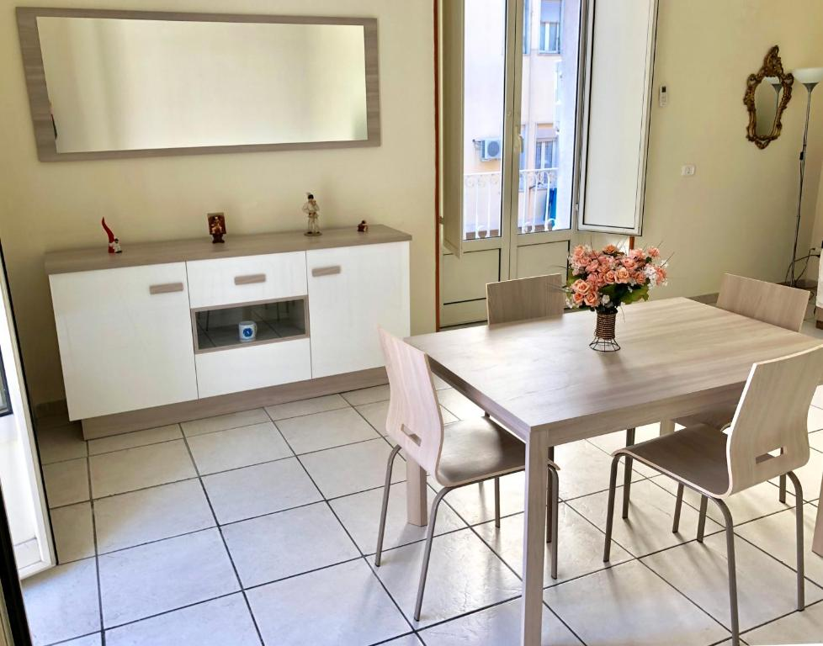
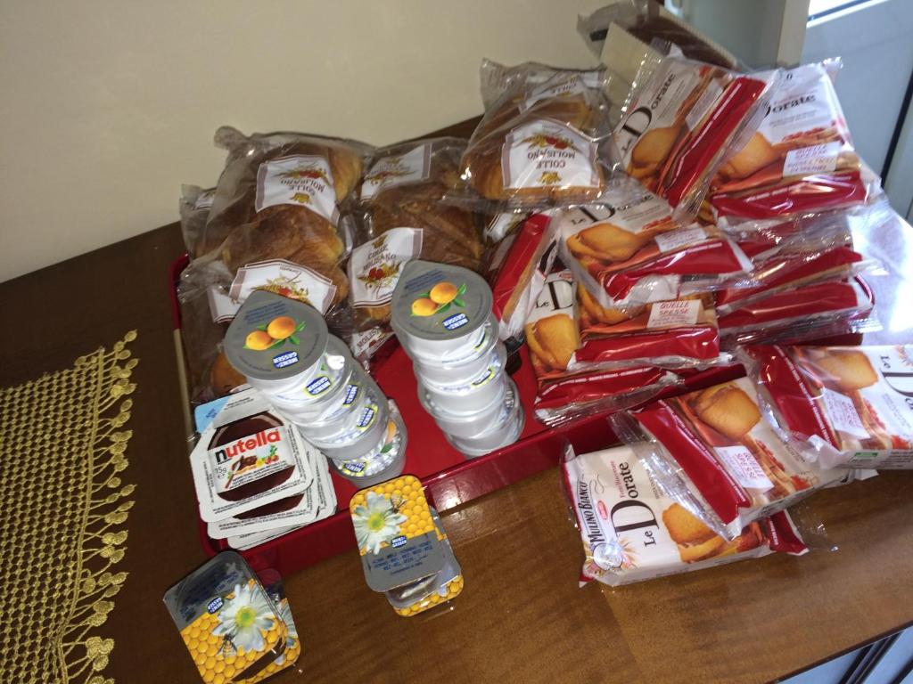
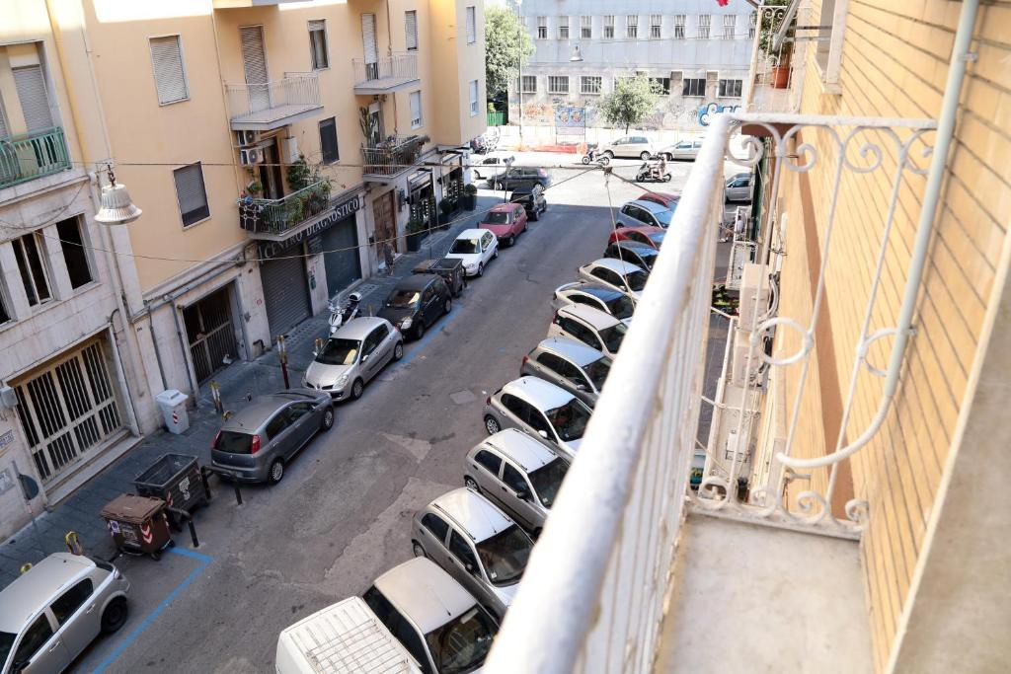
Naples – Overnight in Summerhome Apartment.
VIA PAVIA 8 80143, 80143 Naples, Italy

Slide 5
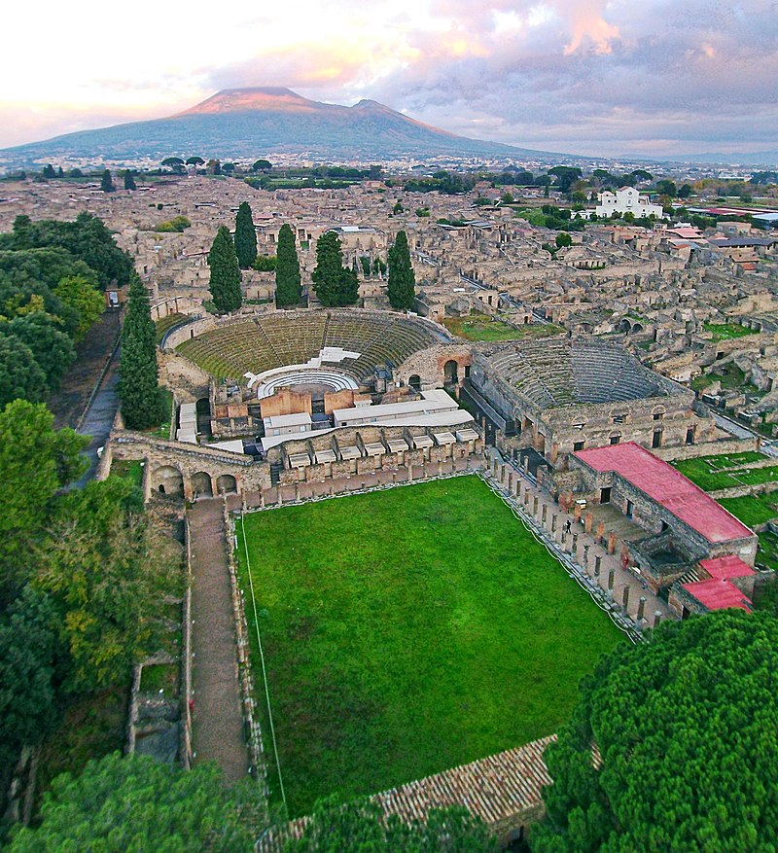
Sunday 27 November – explore Pompeii
Breakfast in apartment
Travel by train to Pompeii
Spend the day exporing the site
Return by train to Naples
Taxi at 6pm from Summerhome apartment to San Giovanni Rotondo

Slide 6
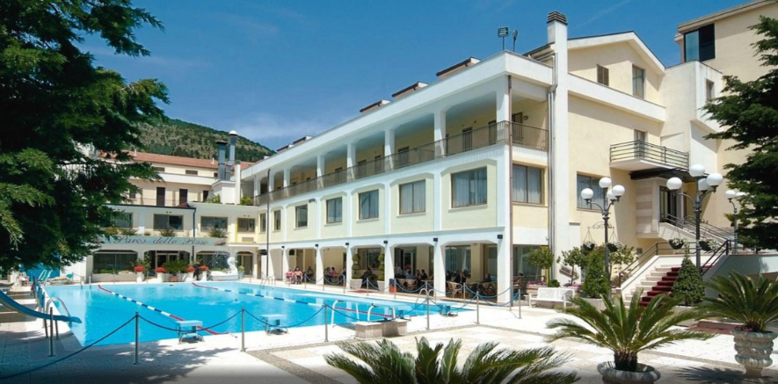
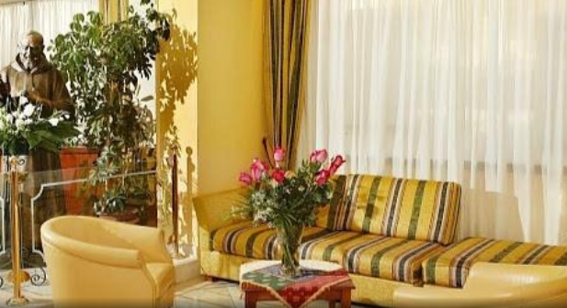
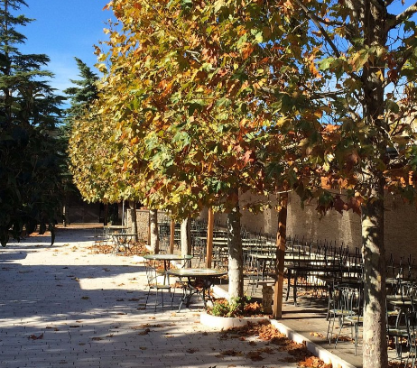
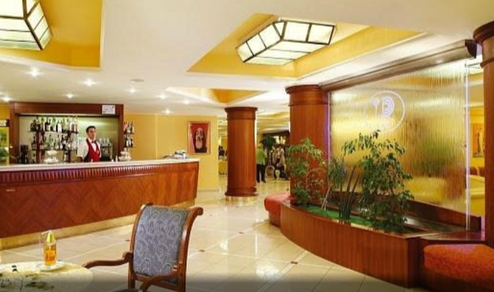
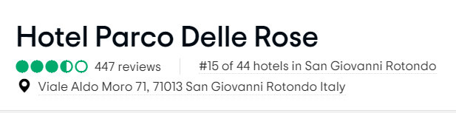
Arrive at the hotel Sunday - meet your new friends
Hotel Parco delle Rose (Viale Aldo Moro, 71, 71013 San Giovanni Rotondo)

Slide 7

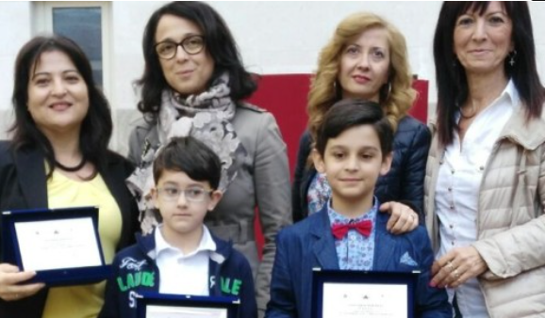
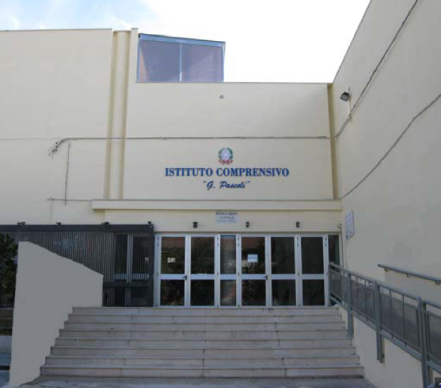
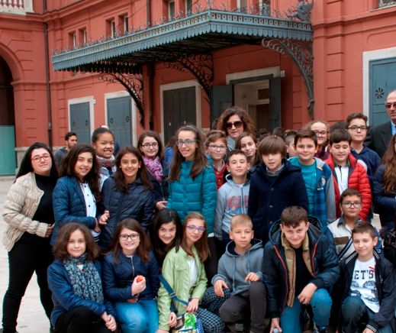

Day 1
28thNovember
See inside your booklet provided by Helen
Walk to school from the hotel

Slide 8
Monday!
Lunch at the primary school
Dinner at the hotel
Museum of Arts and Crafts
Welcome party & school orchestra.
Mini tour of historic city centre.
Sustainable Games – recycling theme.
Italian Folk Lesson
Sharing a dance or song
Body percussion exhibition

Slide 9
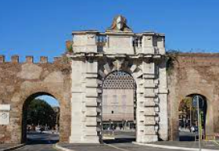
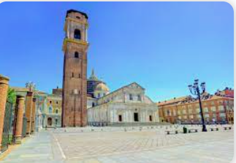
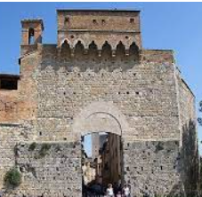
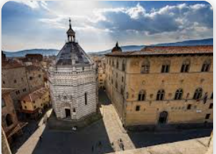
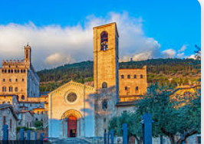
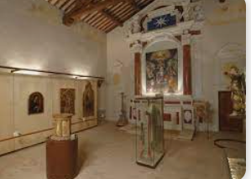
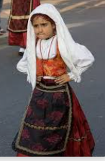
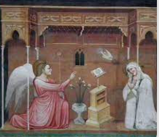
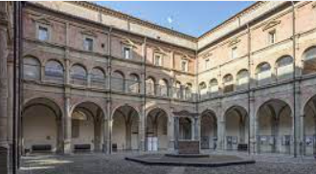
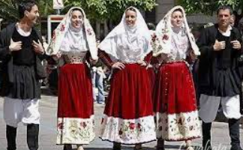
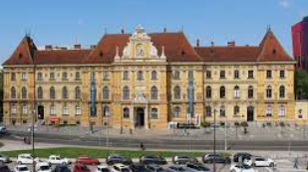

Slide 10
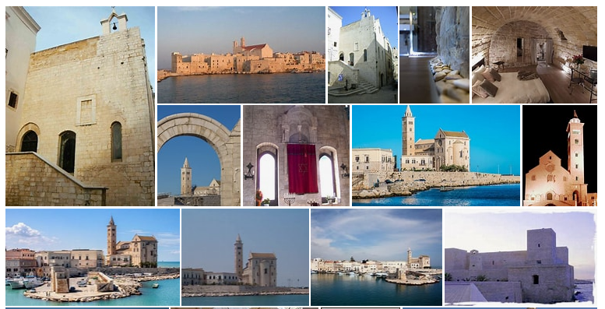
Tuesday!
Spending the day at the Trani - the Jewish Quarters near the walls and port.
Dinner at the hotel

Slide 11
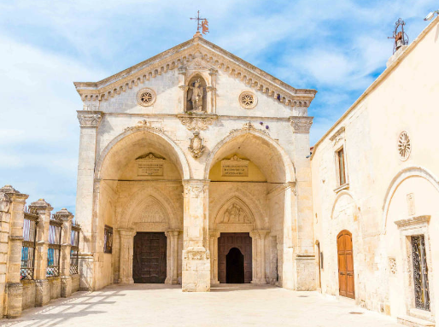
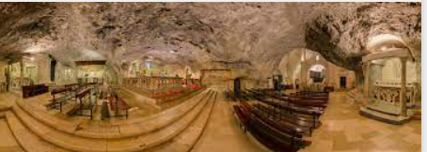
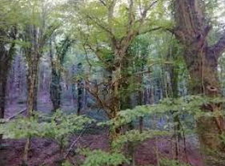
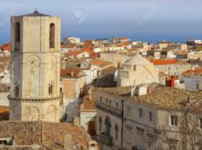
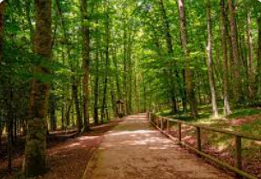
Wednesday Morning
Visit the Basilica San Michele Arcangelo in Monte Sant’Angelo
Visit the town and its surrounding area!
The ancient beech-woods of the Foresta Umbra

Slide 12
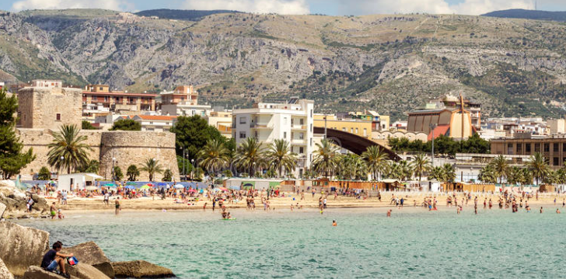
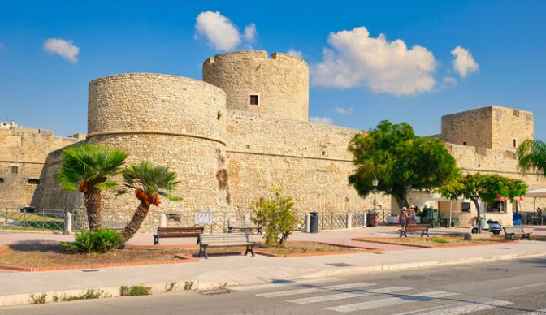
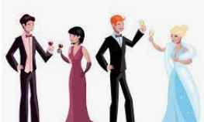
Wednesday continued…
Manfredonia Castle
Manfredonia Seaside
Packed lunch & Free time in Manfredonia!
Evening Event!
Visit from the major at the Hotel to discuss
The Voices of the Earth Project.
Elegant dress code requested…?

Slide 13
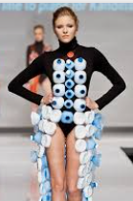
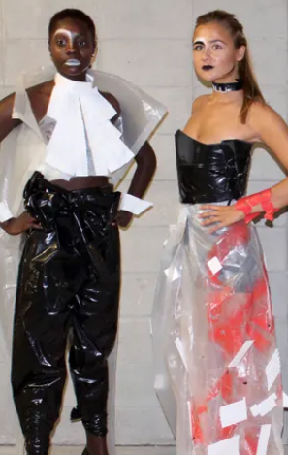


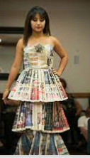
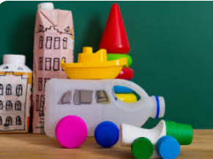
Thursday Morning
Recycling is Better!
Fashion parade made with recycled clothes at the primary school.
Presentation of video/ PowerPoint about recycling.
Exhibition of recycled materials.

Slide 14
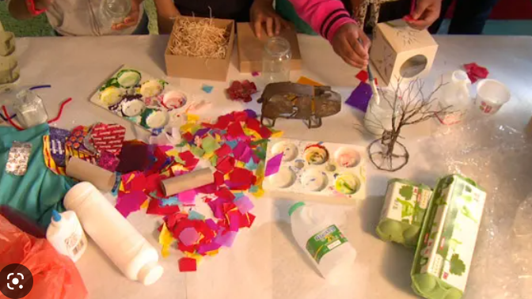
Thursday afternoon
Circle time – Time for Reflection
Workshop with recycled materials!
Being creative …
Highlights of the visit and experience.
Memories and evaluation.
Saying our goodbyes to our new friends.

Slide 15
Friday – Travel to Naples
Early start!
Bus from San Giovanni to Foggia (approx. 45 minutes)
9.00am Bus from Foggia to Naples (approx. 2 hours)
Arrive Naples central station at 11.05 am
Leave bags at Summerhome apartment
Explore Naples for the rest of the day……

Slide 16
Saturday 3 December – Travel home
Breakfast in apartment
Walk to Central station
Approx 10.30am airport shuttle to Naples airport
14.05 Ryanair flight FR6834 from Naples to Manchester
16.05 Arrive Manchester airport (3 hour flight less 1 hour)
17.00 Taxi will collect from airport to BPS
19.00 Arrive at school – collected by parents

Slide 17
Kit List & Luggage
Each child can have a day bag/ ruck-sac and a small airline wheelie suitcase
Suitcase 50 x 40 x 20 (to be checked in)
Day bag 40cm x 20cm x 25cm
Empty water bottle for drinking on days out
Waterproof coat
School uniform to wear on 4 days
Comfy trainers
Comfy casual clothes for evening/ free days/ evenings
Something more formal for evening event.
Pyjamas/ nightwear
Underwear/ socks
Small games, cards, books, pen, small notebook
Toothbrush & small toothpaste

Slide 18
Behaviour and Expectations
You are representing our school – impressions will be made.
You are having the opportunity of a life-time – please don’t abuse it. We knew that you’d like to be with your friends so prove to us that you deserve that privilege.
Adults are giving up their free-time and weekends to be with you so you can have this experience – be grateful and respectful to them at all times.
Look after each other – you are the Bolton family. It’s a long time away from home so take care, be kind and be considerate.
Think about what memories you’ll make and how you’ll be remembered on the trip by others.
Is this a holiday? Yes and No…

Slide 19

Contact
Children are NOT allowed phones. There are several reasons for this.
Miss Dando and Miss Burns will keep us posted each day via FB but they won’t always have access to wifi. Please don’t worry if photos and messages don’t appear straight away.
Class Do-jo may be used also.
If there is an emergency and it is during school hours – call school and we will help decide the best course of action.
You’ll be given a number to contact out of school hours also – Ruth’s mobile (please don’t use after this period).
You won’t have mobile contact of our staff on the residential and there are good reasons for this – Please contact school or Ruth after school hours.

Slide 20
Things to do before the visit:
Sustainable Games to be shared outdoors / traditional games.
A dance to teach to the partner children.
Video/ PPT about the importance of recycling.
Any Questions from parents?

