Slide 1
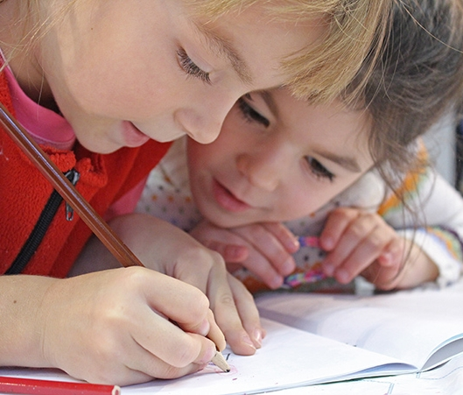
KS1
Writing Workshop
MAY
2022
Bolton’s Wonderful Writers!

Slide 2
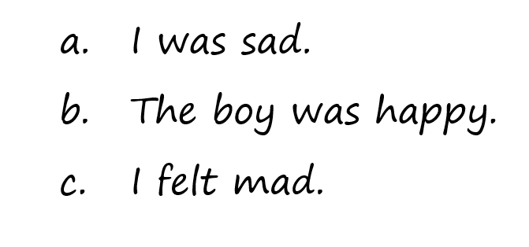
Improve my sentences…

Slide 3
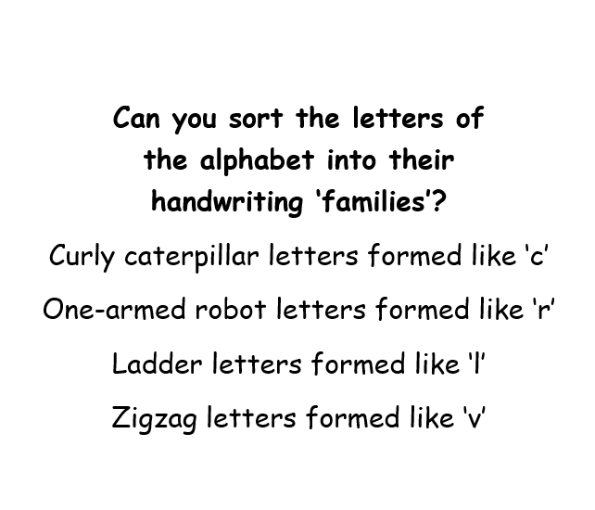
Handwriting
Handwriting families
Letters are formed in four main different handwriting ‘families’.
Whilst there is no expectation of children joining in KS1, when they reach KS2 they will begin joining letters. Correct letter formation early will make this transition much easier.
In order to meet the Working Towards criteria in writing in Year 2, children must be able to form letters correctly.
In order to meet the Expected criteria in writing in Year 2, children must also form capitals and digits in the correct orientation and size.

Slide 4
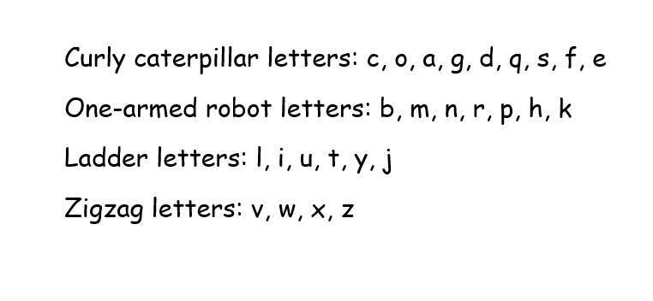
Did you get them right?

Slide 5
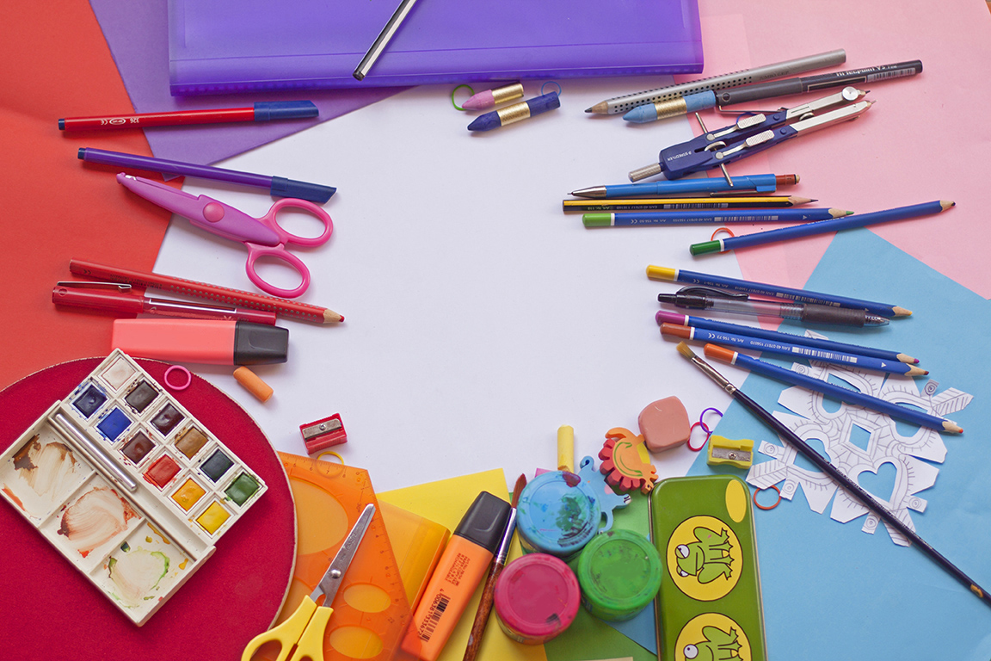
Sentences
Put my
mixed up
sentences
back together!
It’s important children can both write and then read their writing back to themselves and others.
Understanding simple sentence structure is a big part of this process.

Slide 6
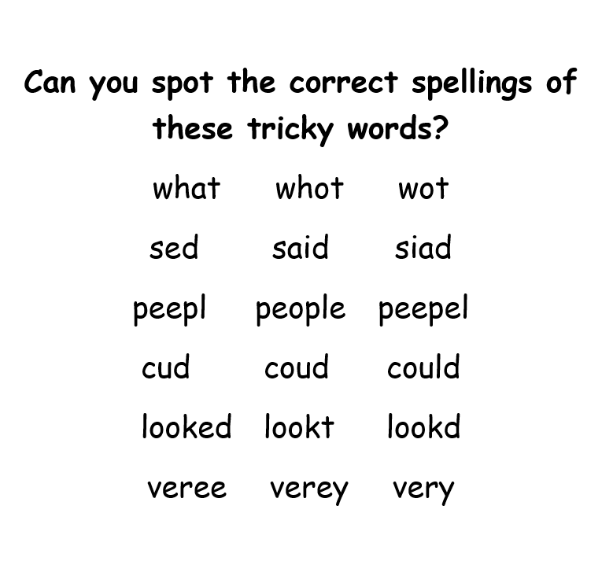
Spelling
100 High Frequency Words
These are the first 100 words and children are expected to be able to read and spell these by the end of Year 2.
It is important that children try to spell these independently.
Children have their own personal writing target sheets in Class 1, including some of the spellings for words they find tricky.
Try to encourage them to use and spell these words independently in weekly writing homework, and fix any mistakes.

Slide 7
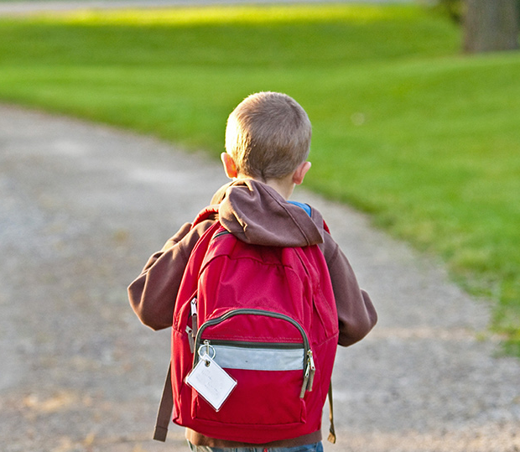
Thank you!
Any questions?

