Slide 1
ERASMUS 2023
RHODES

Slide 2
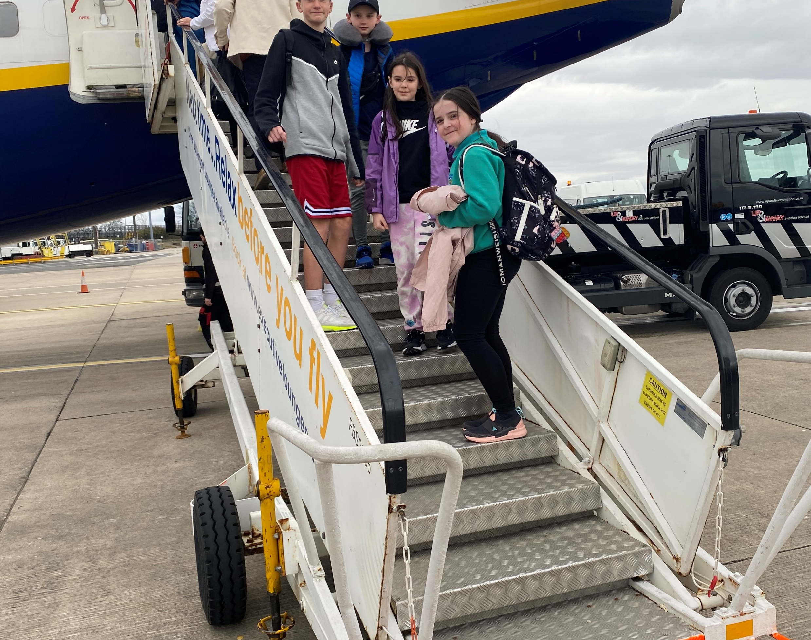
TRAVEL DAY SUNDAY
We said goodbye to our families, and we got on the taxi. We set off for Manchester Airport. Once we got to the Airport, we went through security. we had KFC we all had the colonel's meal.
We went to the boarding area, but the flight was delayed so we had to wait another hour before we could go on the aeroplane. Once we did get finally on the plane we set off for Rhodes.
We entertained ourselves by drawing pictures of each other. It was a four hour fifteen minute flight. Once we got to the Greece Airport we were picked up by a taxi and before we knew it we were at the hotel. We ate tea then went to bed to get up at 07:00 in the morning.

Slide 3
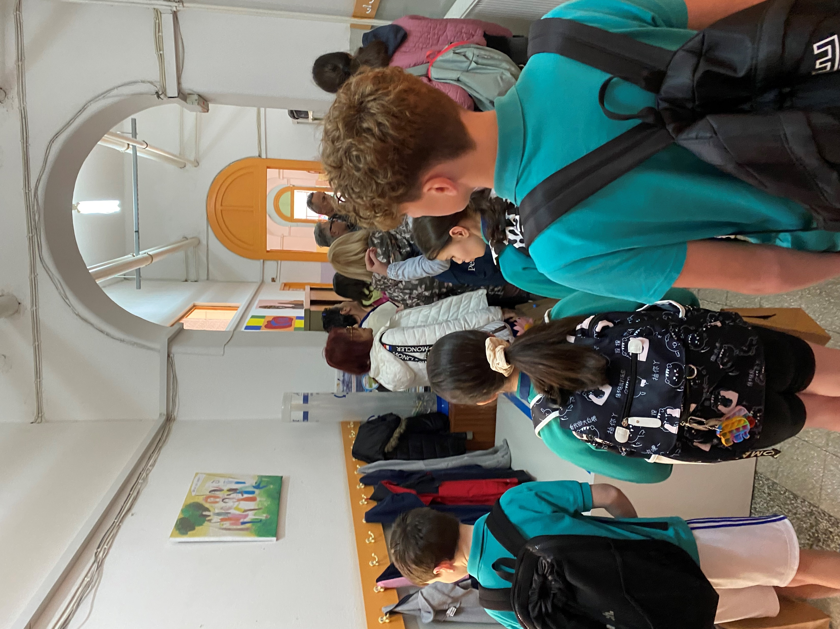
DAY 1 MONDAY
We got woken up at 07:00 O-Clock in the morning. We went for breakfast then we got on the bus to set off for the school. The opening ceremony consisted of them singing traditional songs and playing traditional musical instruments. We all received a gift from the Greek school, it was a bag with a notebook a pen and some cardboard figures.
We then got a tour around the school. It was weird but also fascinating how different the classrooms and hallways were; the halls were covered with art all the students had done. Then we went into the massive sports hall with an enormous basketball pitch in the centre. Every school did a traditional dance; we went last, so we were really nervous. We went on the stage and did the sailor went to sea, sea, sea dance once it was over everyone was doing it. Then we set off for the Town Hall. We got a tour around it; we saw some historical paintings and statues. We then entered the meeting room and sat in the meeting chairs. We then set went to the stadium. We ate our lunch and played handball with the children from the other schools. We played traditional games from the other countries. Shortly after, we got back on the bus and arrived back at the hotel. We then did our diary writing the ate tea and went to bed.

Slide 4
Day 2 and 3
Rhodes

Slide 5
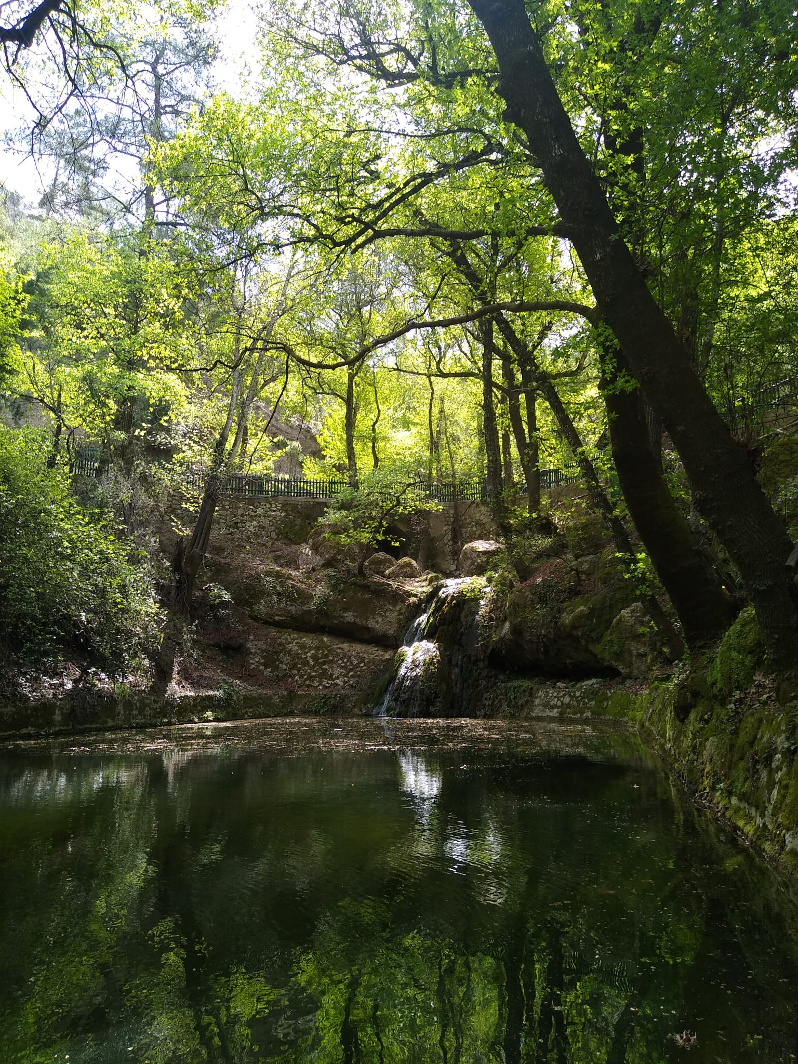
Day 2
Today we went to the Environmental Education Centre which was mostly runes on solar and wind power. A man was making us all rub our fingers on some plants and then smell them.
We then got back on the bus and we went to The Valley of the Butterflies. The views were stunning but there were no butterflies anywhere to be seen.
After being there for a while we went to get lunch in the village of Psinthos. We had a plate of chicken chips and rice.

Slide 6
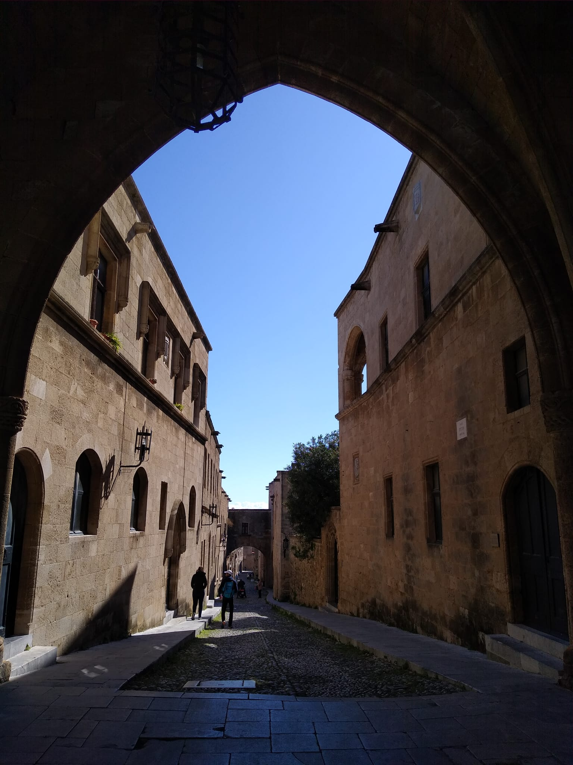
Day 3
Today we went for a scroll to the city centre – Historical buildings. We went to some museums.
one of the museums that we went to was an archaeological museum most of the museum was good but bits were boring.
Then we got a tour to the palace of the knights
After that we went for a scroll around the medieval town. I enjoyed the medieval town.

Slide 7
Day 4 Thursday

Slide 8
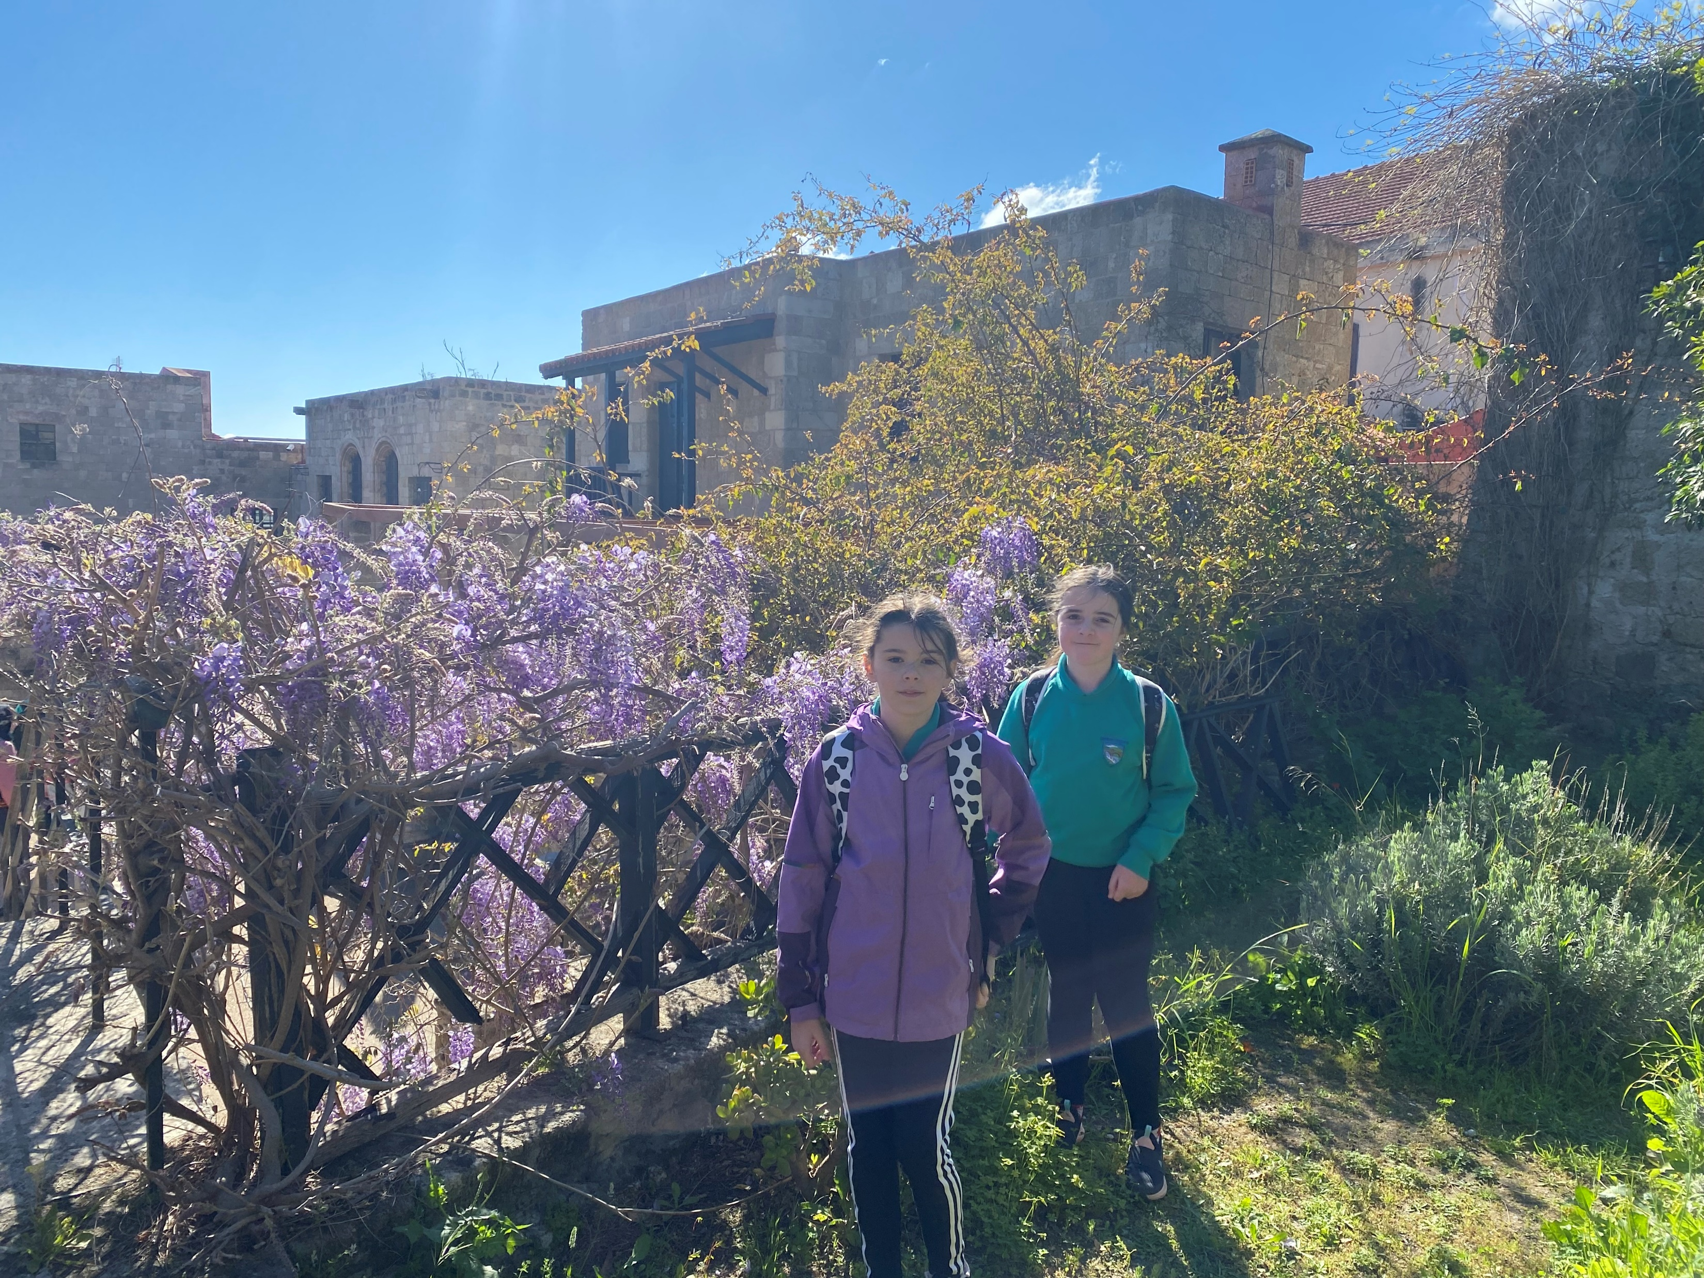
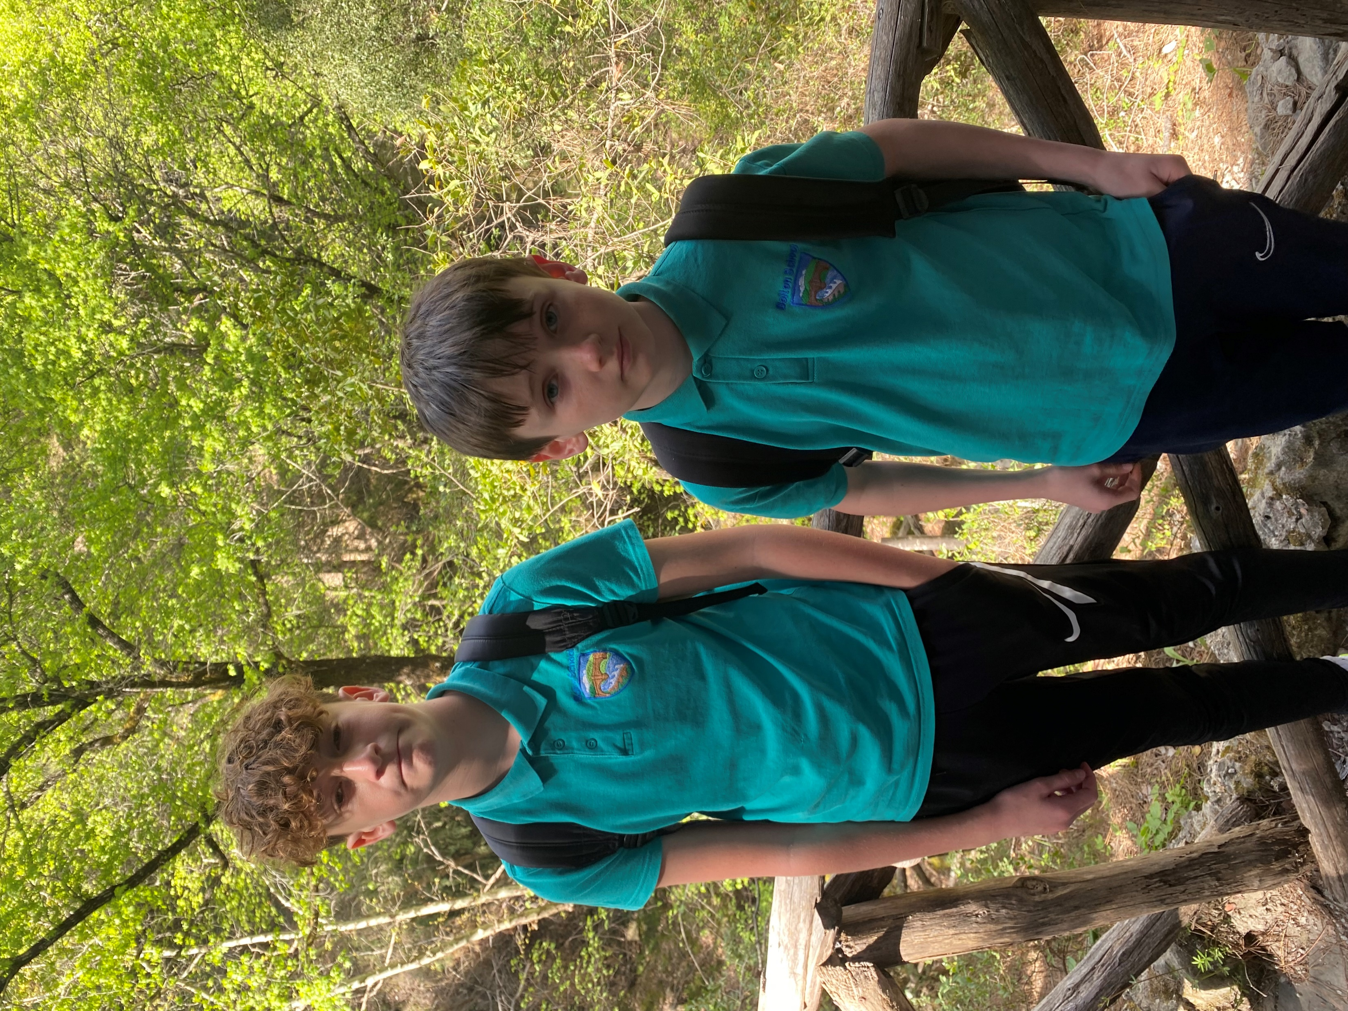
Today we went to visit the old town and I was so excited to see some old artefacts WE saw AN OLD place for fish and fishing rods AS WE PASSED BY. we carried on AND SAW many mayor’s staTUES and it was hot outside.
then we went down the hill and I was confused because there was a boy called olivia (Greek boy) it was also was kind of funny and miss burns agreed too. then it was time to go back to the hotel and we got into our swimming stuff and went into the pool and it was cold. we stayed in the pool for an hour and went back into our rooms and got showered and changed into clothes and had supper it was good! then we got in our pjyamers and went to bed

Slide 9
Day 5 Travel Friday
s

Slide 10
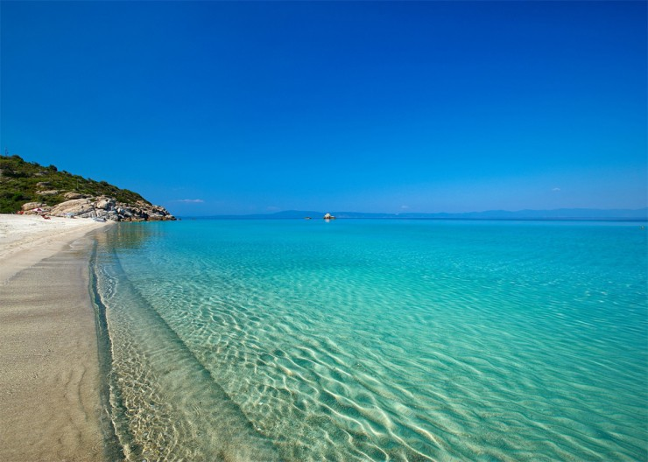
On Friday, we went to the beach and we saw windmills and we saw the sea; so we went down for a walk to look around near the beach and we got slushies.
We went back to the beach with our slushies we saw a lizard and Harry immediately said that he wanted to name it Mike Wazoski but at least we still have a photo with it,
While we were at the beach, Izzy and Miss Dando made an ancient Greek fort (a small one) and we made Rhodes in the sand with little white pebbles, Miss Burns made a heart with stones and it turned out to look very nice.
After that Miss Dando and Mrs Burns went to sit down for a rest, meanwhile we went to the sea and while we stayed there for a while we decided to go back to the sand and we all started to cover our legs in the sand and it was nice and messy too.
We then had a late flight home before the Easter holidays.
We arrived at school at about 3 am.

Slide 11
Highlights…
Izzy: Chips for breakfast!
Harry: Meeting new people
Olivia: Going on the plane.
Niall: Going into the school in Rhodes and seeing a Greek primary school

