Slide 1
SPaG @ BOLTON PRIMARY
S – Spelling
P – Punctuation
G - Grammar
2014 Curriculum changes – emphasis on SPAG - concerns about low level of children's technical ability in writing. The need for Standard English.

Slide 2
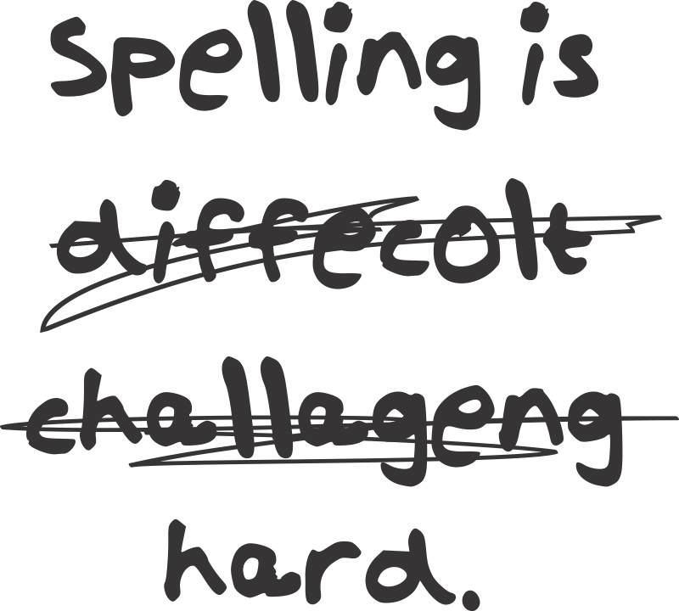
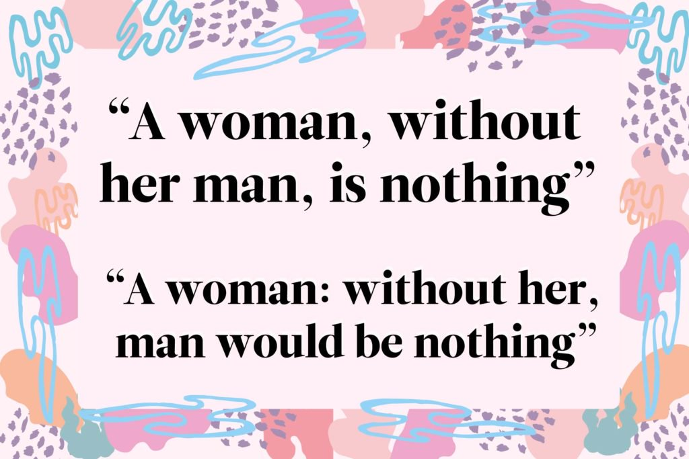
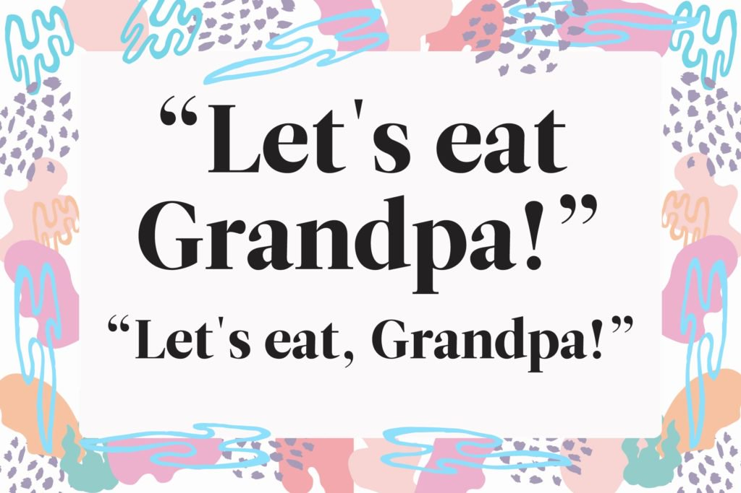
Spelling – phonics, tricky words / exception words, statutory and non-statutory words, root words and adding prefixes and suffixes. See - Spelling Appendix 1 National Curriculum
At Bolton children have weekly tests that tend to focus on ‘patterns’, spelling sessions 4x per week, termly GAPs assessment and 100 – 300 word assessment. Children having difficulties with spelling have support with a HLTA and resources to use in class.
Punctuation – The marks, such as full stop, comma, and brackets, used in writing to separate sentences and to clarify meaning. The full range of KS2 punctuation: full stops, exclamation marks, question marks, capital letters, commas, colons, semi colons, direct speech, apostrophes and dashes.
Children at Bolton have a GAP lesson weekly which will have a grammar or punctuation focus e.g. I can use a semicolon correctly in my writing. Punctuation activities may be on the homework grids.
Grammar - the way words are used to make sentences. Parts of speech (word classes) e.g. adverbs, verbs, nouns, articles, determiner, conjunctions, pronouns, prepositions, adjectives, interjections. Understanding clauses and phrases. Tenses. Children have a weekly GAP lesson where they focus on grammar and punctuation. Grammar activities may appear on the homework grids.

Slide 3
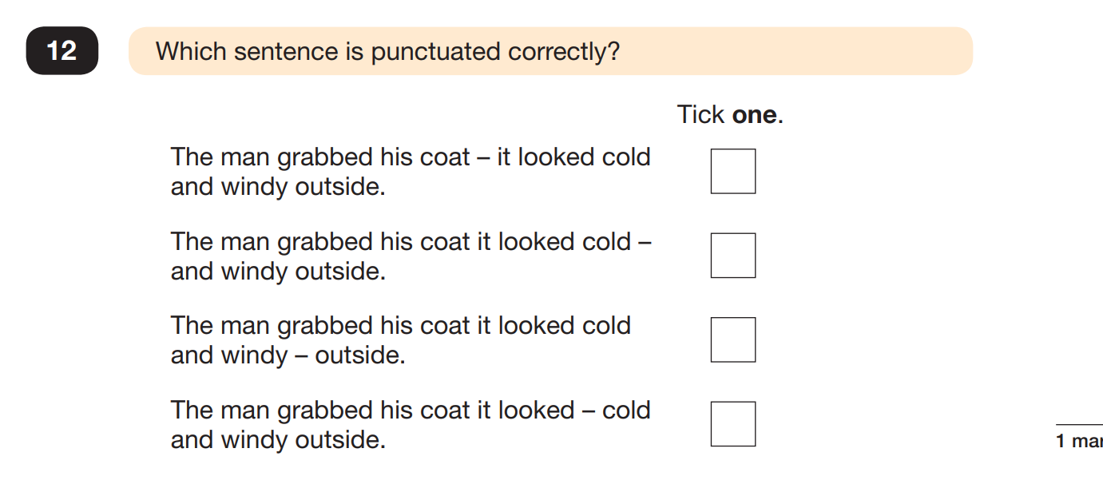
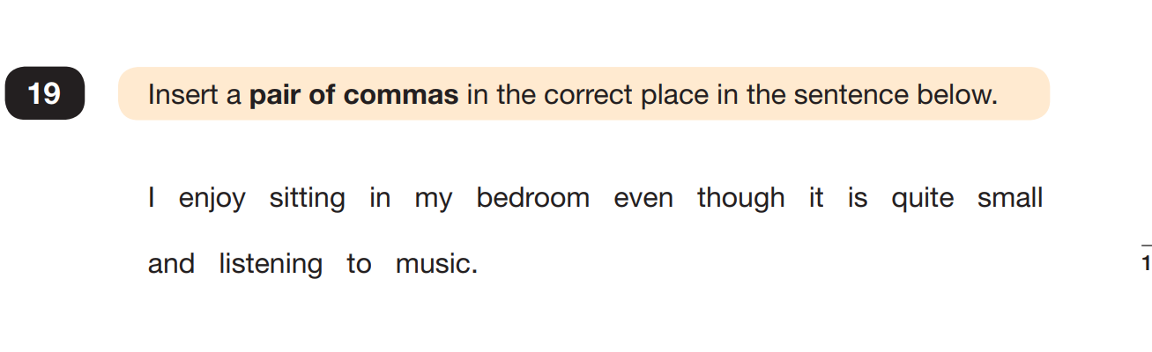
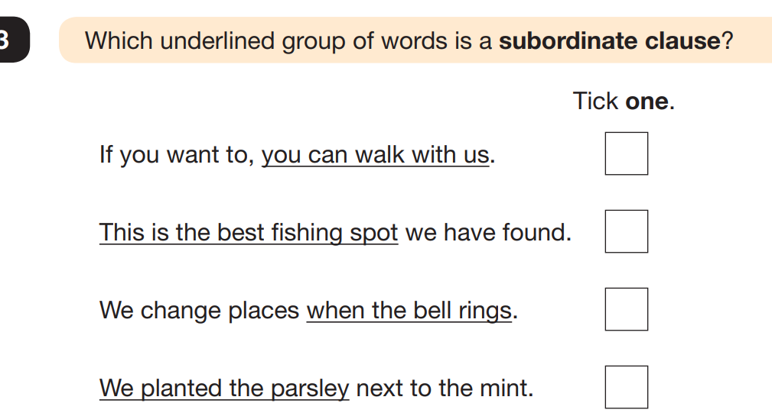
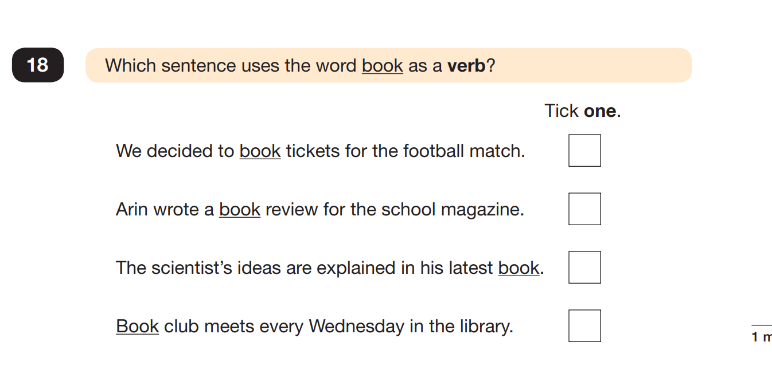
In Y6 the children have a 45 minute GaP test and a 15 minute Spelling test.
Have a go at the sample questions

Slide 4
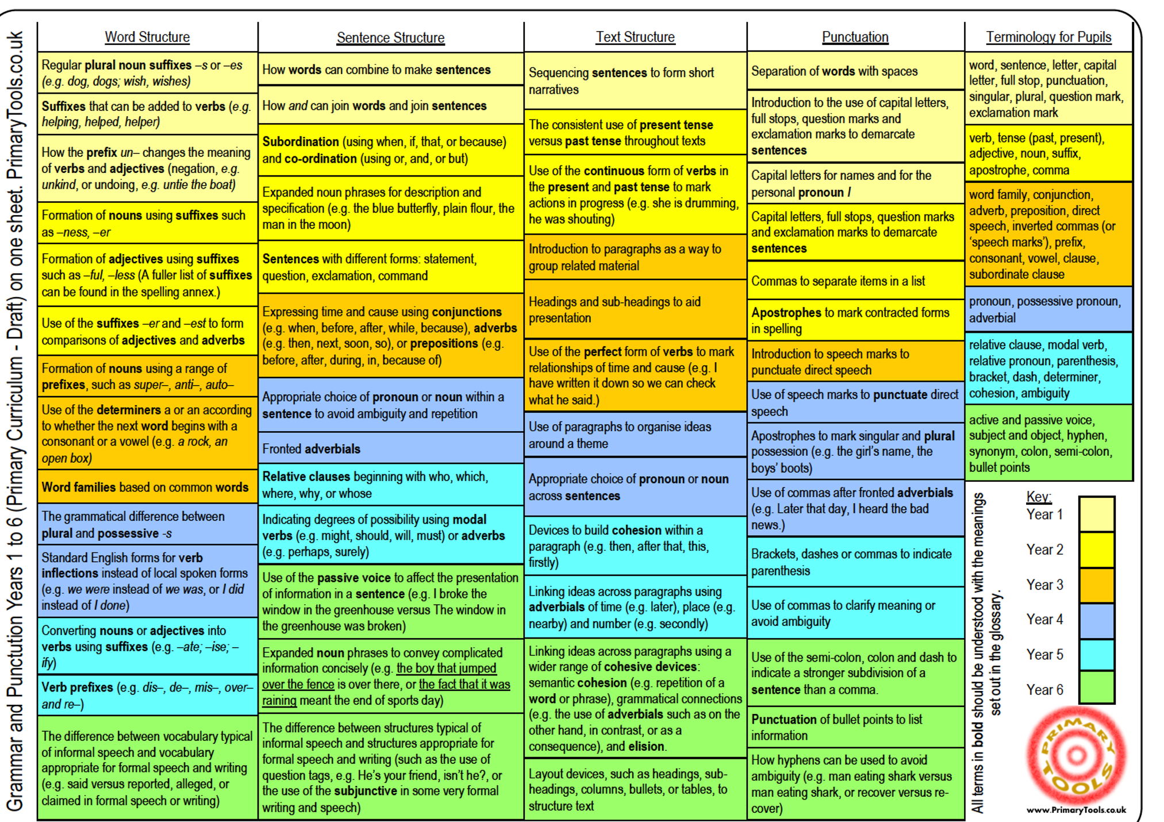
Coverage in Spag – National Curriulum Discuss the Sheet
The National Curriculum coverage of GaP
It is NOT something that we do in Y6. It needs to be built upon year by year.

Slide 5
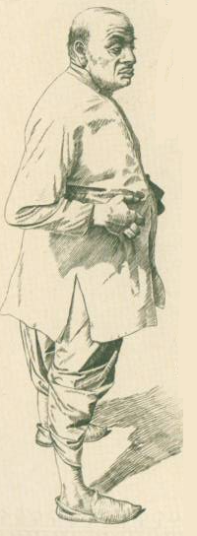
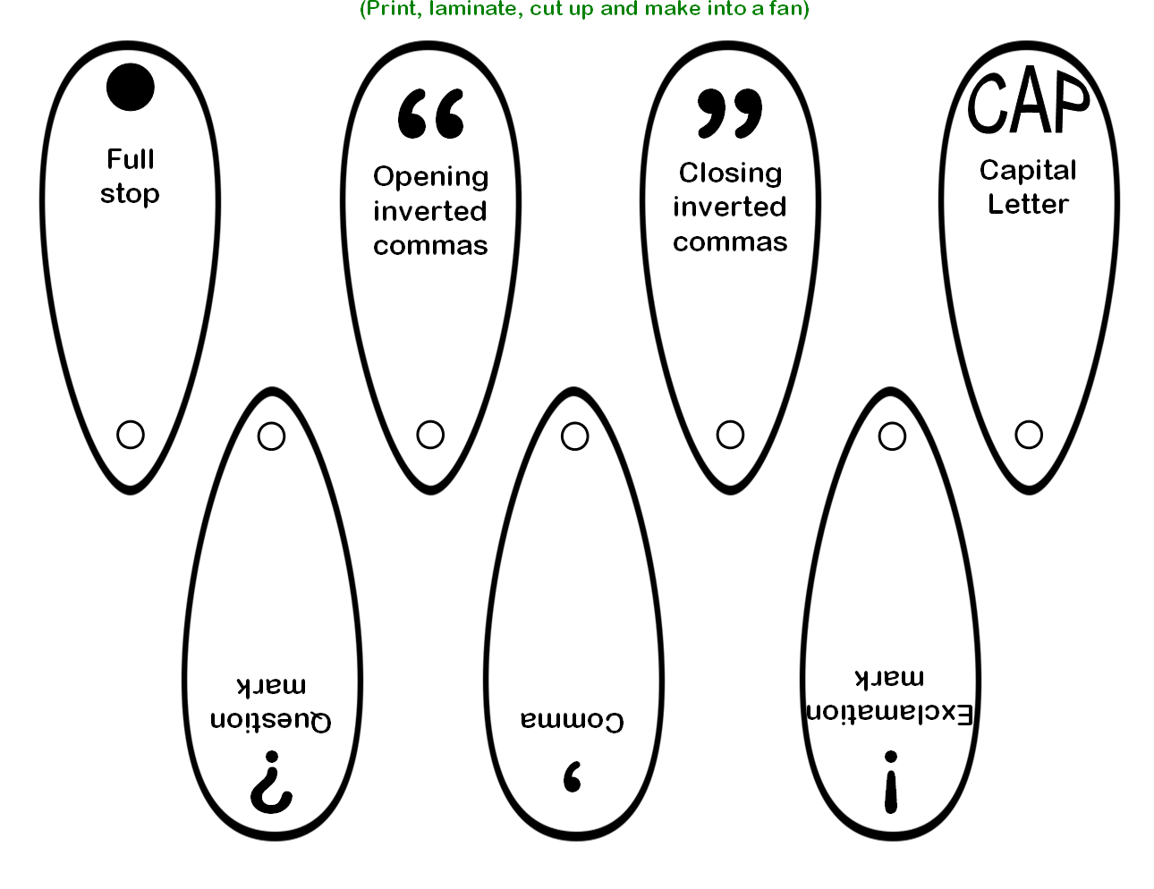
We aim to embed GaP into our genre /unit of learning.
Point and Punctuate
First, try and read the extract below without the punctuation, then take turns to point out to each other where the missing punctuation should go. Your partner should supply the correct punctuation. If you agree, your partner gets a point. Change over and repeat. Remember capital letters!
When Tashi and her mother and the women arrived at the tea plantation the Overseer came out of his hut yawning and scratching his belly he was a bad-tempered man with a beaky nose and eyes like sharp little stones the women stood silently while he told them what they already knew what they had always known to pick only the young leaves and the buds from the tops of each bush then they found
their places and began plucking the tender
leaves and buds and tossing them over their shoulders into their great wicker baskets.
Notes:
5
This can be made simpler by the addition of more punctuation, or by providing the missing punctuation. It can be made more challenging by removing apostrophes and the personal pronoun I.

Slide 6
Sentence/ not a sentence
the familiar sounds of the morning
bowl of sweet tea
Tashi shivered
through the mountains
the dark hillside above her
a light the colour of lemons
the water came to the boil
a cockerel crowed
lamps were being lit in the village
small squares of light
her mother coughed, twice
the air was very cold

Slide 7

Kung-Fu Moves
Full stop – One punch straight forward – ‘Ha!’
Comma – Slashing motion – ‘Shi!’
Question mark – Carve the curve and punch the dot - ‘Shi, Shi,Shi, Ha!
Exclamation mark – Cutting motion, punch to dot - ‘Shiiii Ha’
Apostrophe – bend index finger once above your head - ‘Aiya!’
Colon – can be used to start a list – two punches, one above the other – ‘Ha! Ha!’
Semicolon – can be used to replace a conjunction -one punch, slicing move underneath ‘Ha – Shi!’
Dash – straight line from left to right – ‘shi’
Capital letter – hands together and bow.
Inverted commas – small carve the curve followed by a fast punch x 2 – 66. Punch and curve x 2 - 99. Shi, Ha, Shi Ha, - Ha Shi, Ha shi.
Ellipsis – Ha, Ha, Ha!
Brackets – Shi, Shi, on the left Shi, Shi on the right.

Slide 8
KUNG-FU IT! Punctuate these sentences
school starts at 8:50
today I have bought a banana a milkshake a chocolate bar and a sandwich
tom s homework was very late
I can t believe you did that
what time is assembly
tonight is parents evening

Slide 9
How Can I help at Home?
Reinforce that spelling matters. Ask about scores in spelling tests. Help them to learn their weekly lists – display them, have a mock test, write them in the sky.
Check any writing done at home – focus one or two spelling edits. Insist on ‘given’ words spelt correctly. Nail those high frequency words/ common exception words by the end of Y2. Think about age appropriate spelling – should they know this? Is it a tricky word? Be realistic - most adults are not 100% accurate so don’t expect your 8 year old to be but give out the message that spelling matters. Notice – discuss with your teacher if you feel they are including strange letters, don’t know initial / final sounds etc. All children have dyslexic tendencies up to around 7/8 years. Born/ natural spellers and learned / taught spellers.
3. Use the Homework grid so you can help deepen their learning – weekly spellings is their a pattern – can you help them to make links to other words? SPaG activities – what’s on the grid is usually - what learning we are covering in school. Does your child seem confused? Find more age appropriate samples on the internet / (supervised) You Tube tutorials?
4. Encourage all kinds of writing: diaries, journals, non-chronological reports, biographies, poems, songs, letters, emails - let them go with the ideas – share and enjoy it and then focus on SPaG – two improvements (age-appropriate).
5. Sharing a reading book? Why not have a discussion about an element of SPaG e.g. inverted commas, colloquialisms / non-standard English, use of an apostrophe or a colon…

Slide 10
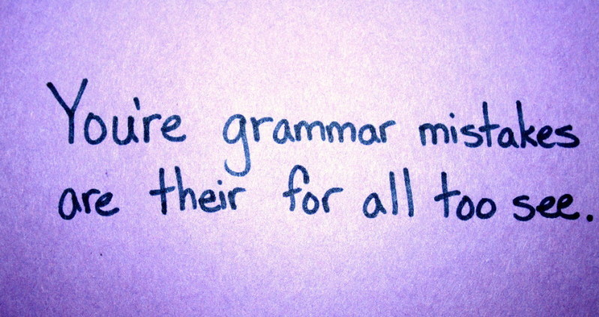

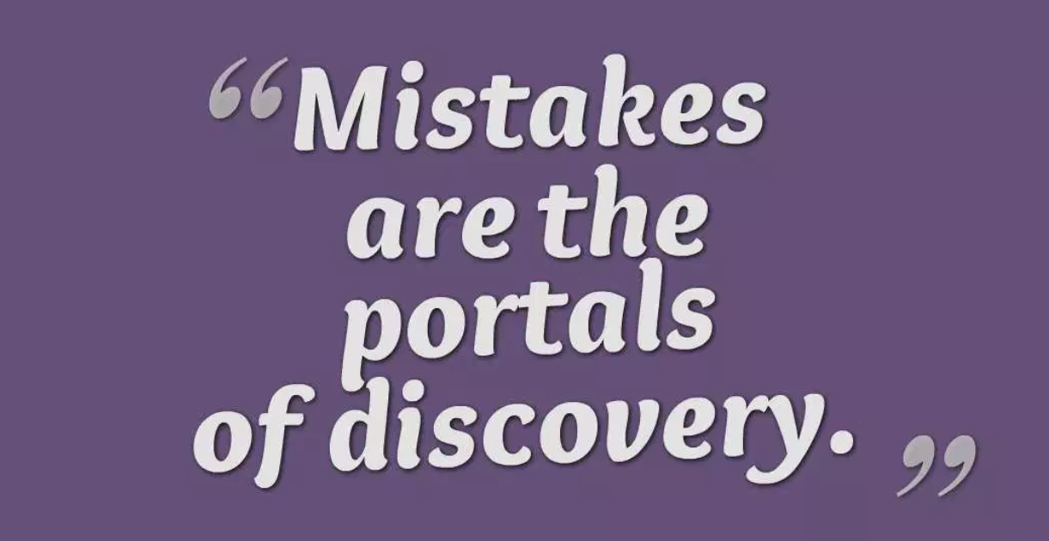
5. Do some Kung-Fu – Do you feel that your child doesn’t punctuate their written work naturally then do some Kung-Fu Punctuation with them. (No writing required).
6. Ask your older children to teach you about punctuation that you’re unsure of and learn with them. IMPROVE YOUR OWN WRITING. Admit it – I’m not sure about this either…Let’s find out.
7. Seek out free resources to help your child with SPaG - Internet resources / YouTube e.g. SATS papers. Ask your 7 year old to help you… MAKE SURE THAT LEARNING IS FUN.
8. Ask them to attend - Clinic and Homework Club… we are here to help! Don’t get bogged down by something challenging – a lot of learning is repeated and reinforced.
https://www.youtube.com/watch?v=YZJbRaA3LUI

