Slide 1

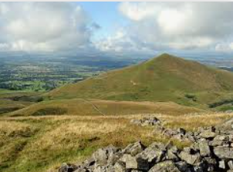
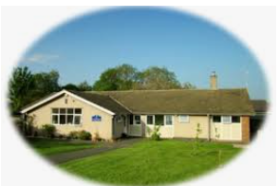

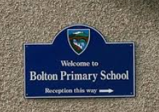
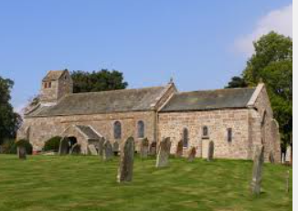
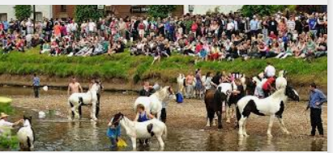
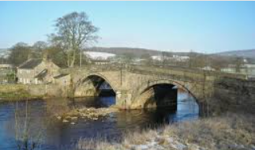
Six Nation Assembly
Hosted by Bolton Primary School 23/03/21

Slide 2
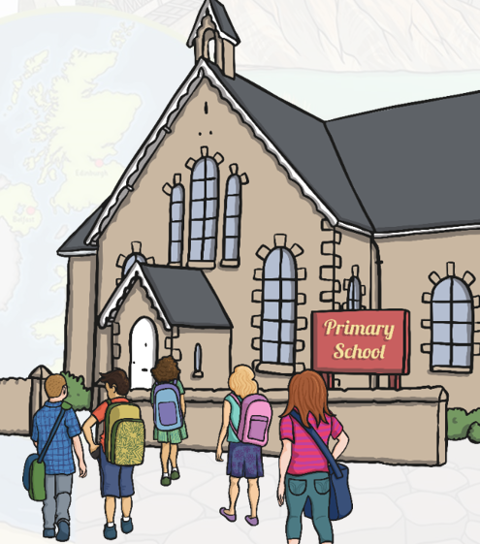
Our School:
We have 59 pupils at our school.
We have boys and girls aged between 4 and 11.
We are organised into three classes.
We have six teachers and two teaching assistants.
Key Stage Two children (7 -11) learn French.
We have a nursery school next door for preschool
We sometimes use the village hall for Physical Education.
Year 5 and 6 learn in Clarinet.
Year 3 and 4 learn the toot.
We have a School Council and students run their own clubs.
Our uniform is jade green.
We join up with other small schools to do sports, activities and residentials in our area.

Slide 3
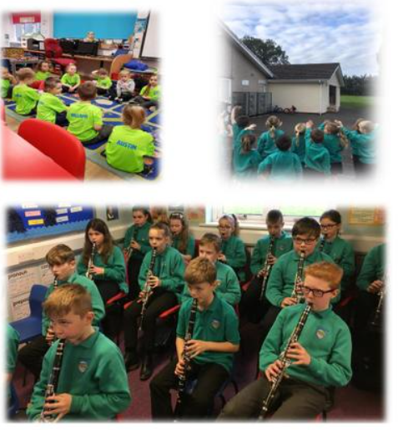

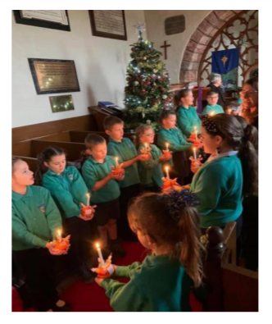
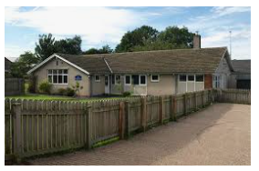
Bolton Primary School

Slide 4
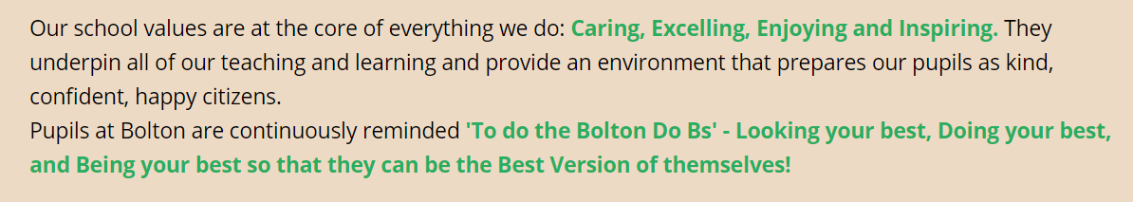

Our Values:
Caring
Enjoying
INSPIRING
Excelling

Slide 5
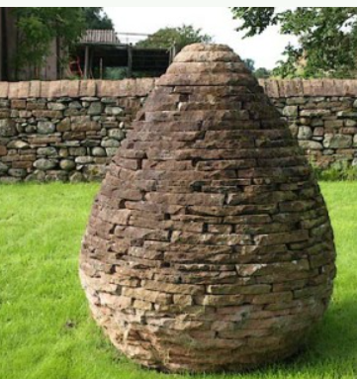
Our Village:
Our village has its All Saints Church dating back to the 12th Century..
We have a pub and restaurant called The New Crown Inn.
Our village is 15 minutes away from the M6 Motorway.
We have a memorial hall where people in the village meet and can play badminton.
We have a fantastic new play park and we are hoping to soon have a pump-track for bicycle riding/ bike skills.
There is also a small chapel.
We are surrounded by land and farms.
The Village Pinfold
Artwork by Andy Goldsworthy

Slide 6
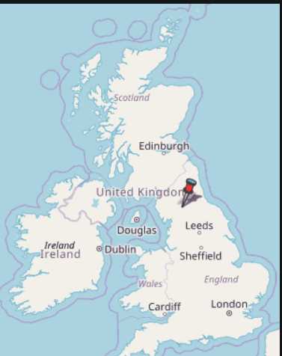
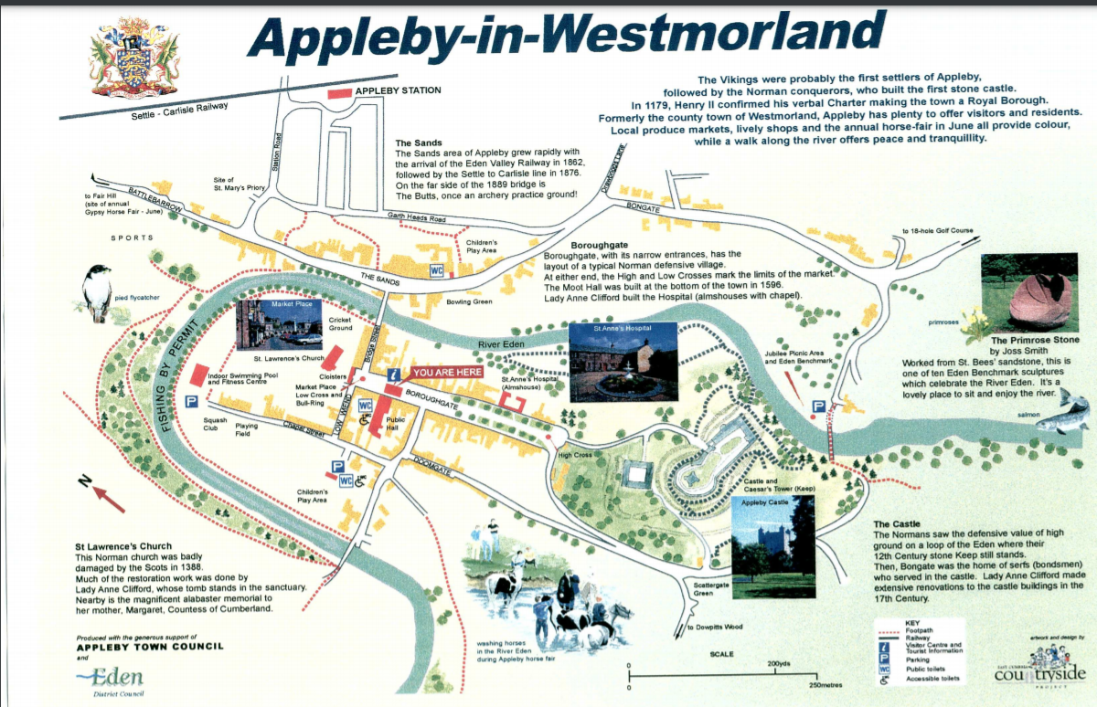
Appleby-in-Westmorland – our school and village is about 3 – 4 miles (5km) from the small historic town of Appleby

Slide 7
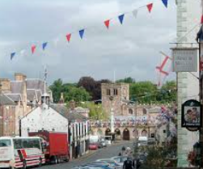
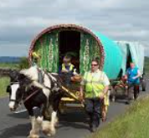
The Town of Appleby-in-Westmorland
The population of Appleby is approximately 3000.
It is famous for the Horse Fair. It attracts about 10,000 gypsies and travellers for one week in the month of June. It has been an annual tradition since about 1685.
The name Appleby comes from the 9th Century when the Vikings were settled here and they named the town after the Norse word meaning – places of apples.
The famous author JK Rowling (Harry Potter) included towns for a book Quidditch through the Ages. She chose Appleby as one of the towns and the team was called Appleby Arrows.

Slide 8
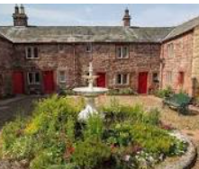
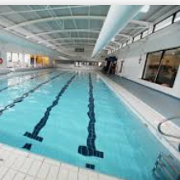
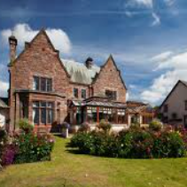
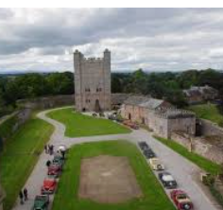
Places to Visit in Appleby
Appleby Castle
St Anne’s Hospital
Appleby Leisure and pool
Appleby Sports Hall
The King’s Head
Appleby Golf Course
Appleby Grammar School – where some of our pupils move to
Appleby Manor Spa
Ashiana’s Indian Restaurant.

Slide 9

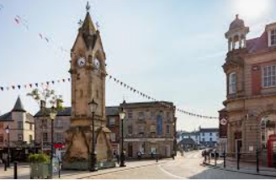
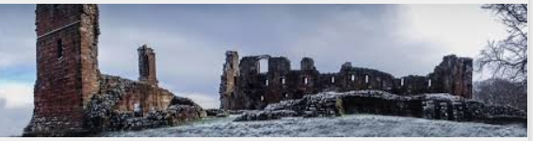
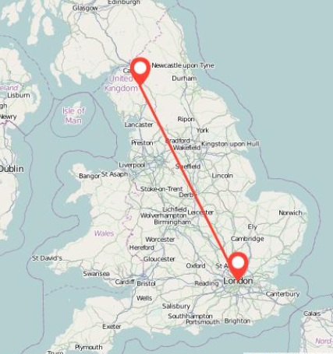
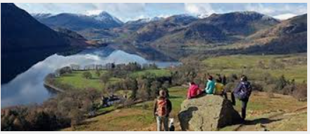
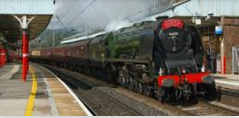
Penrith – our nearest large town

Slide 10
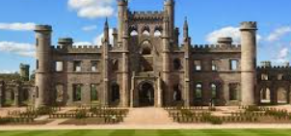
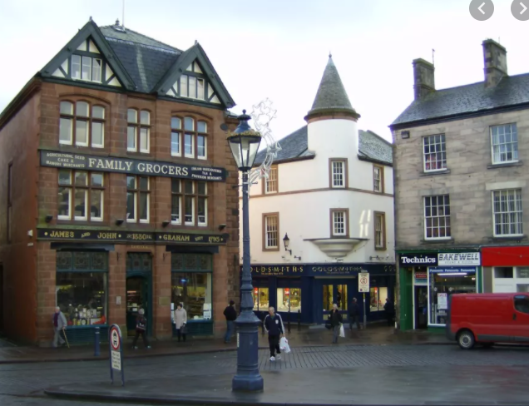
Penrith:
Penrith is about 10 miles from Bolton
The Population is around 15,000
It has an old castle which is now a ruin.
There is a good leisure Centre and pool.
It has a good park with a bowling green and tennis courts.
There is a small cinema and shops and supermarkets.
Our nearest Lake is called Ullswater.
Many of our pupils go to Secondary school in Penrith.

Slide 11
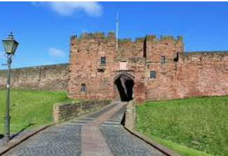
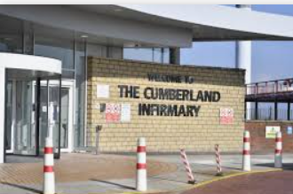
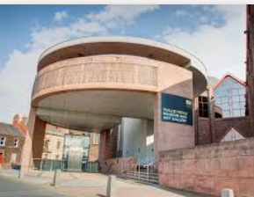
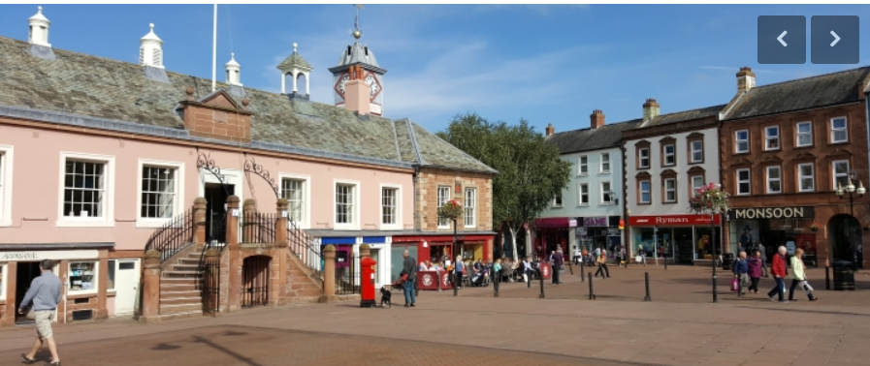
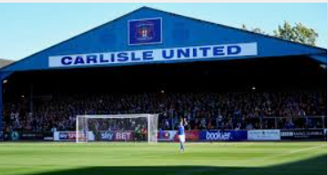
The City of Carlisle:

Slide 12
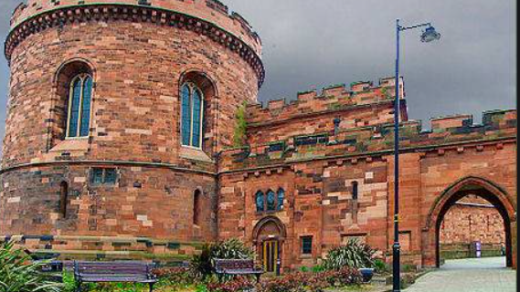
Carlisle – our nearest City:
The population of Carlisle is 75,000
Carlisle – means ‘the walled city’
Carlisle is located where the River Eden, Petteril River and River Caldew join.
Carlisle is 10 miles (16 km) from the Scottish border.

Slide 13
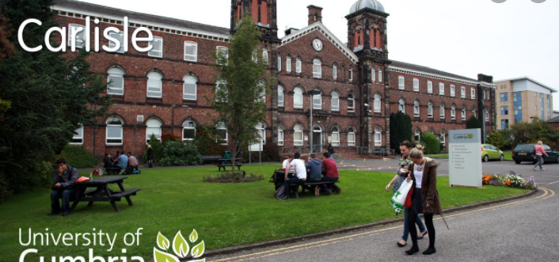
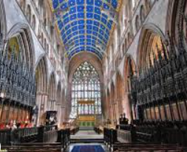
Places to Visit in Carlisle:
Brunton Park – Home of Carlisle United
Tullie House Museum and Gallery
Carlisle Castle
Energi Trampoline Park
Eden Rock
The Lanes Shopping Centre
Multi-cinema
Cumbria University (top right)
Carlisle Cathedral (bottom right)

Slide 14
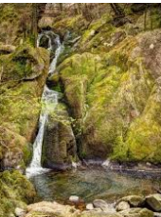
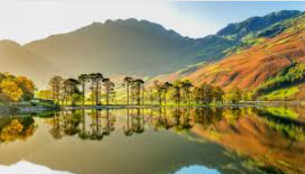
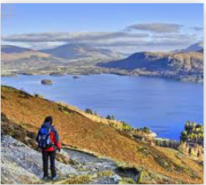
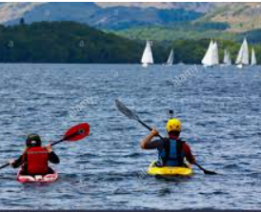
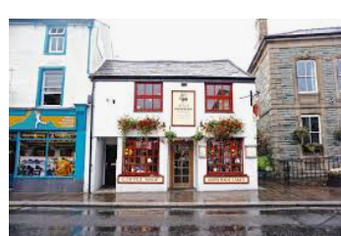
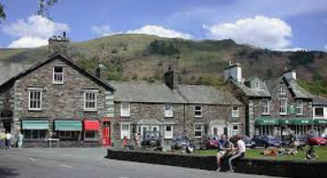
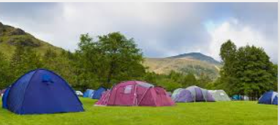
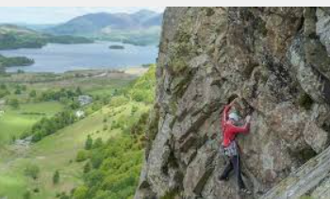
Our region is called - The Lake District:

Slide 15
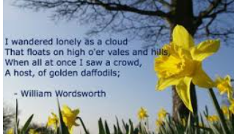
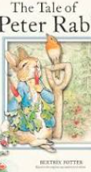
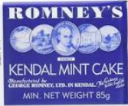
The Lake District:
It is called the Lake District because it has 16 lakes or meres.
Lake Windermere holds 300 billion litres of water!
Windemere is the longest lake – over 10 miles long.
Wast Water is the deepest Lake – 74metres deep…
The highest mountain is Scarfell Pike – it is 978 metres tall.
The area is associated with the poet William Wordsworth and the author Beatrix Potter.

Slide 16
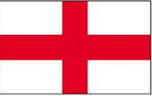
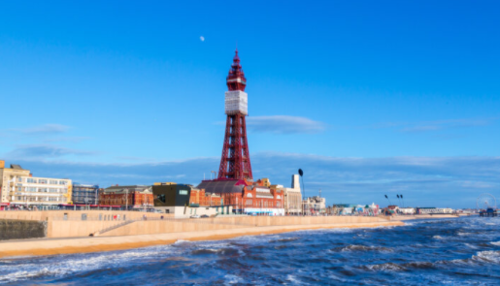
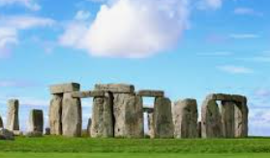
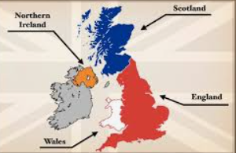



Our Country is England!

Slide 17



England:
England shares borders with Wales to the West and Snowy Scotland in the North.
It is home to the Royal Family’s home – Buckingham Palace.
It is famous for competitive sports.
The flag is called the St.George’s cross.
It’s capital is London.
The currency is ‘sterling’ – pounds and pence.

Slide 18


We live in the UK…
Our flag is called - The Union Jack!

Slide 19


The United Kingdom

Slide 20



Slide 21





The UK’s Seasons

Slide 22

Culture…
Brits love sports – football, cricket, badminton, rugby, horse racing and many more…
Brits like their seaside holidays and visiting the coast even though the weather is not always great.
Many of us love film,TV, music and the performing arts.
Many Brits love the Royal Family and our proud of our history.

Slide 23














Slide 24


British Values

Slide 25




We live in the World; we have friends in Bulgaria, Greece, Italy, Spain and Turkey.
We are promising to take care of the world that we all share.

Slide 26



Thank you!
https://www.youtube.com/watch?v=4-z-JXJFc4w&ab_channel=SarahOShea

