Slide 1


Spain VISIT
23/04/23 – 29/04/23
ERASMUS EXCHANGE PROGRAMME

Slide 2
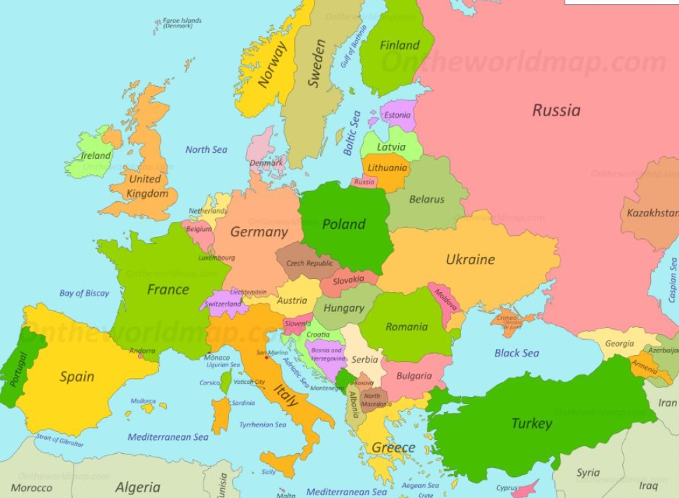
Where is SPAIN?
It’s 785 miles from London to Athens.
Can you spot Spain?
What colour is it on this map?

Slide 3
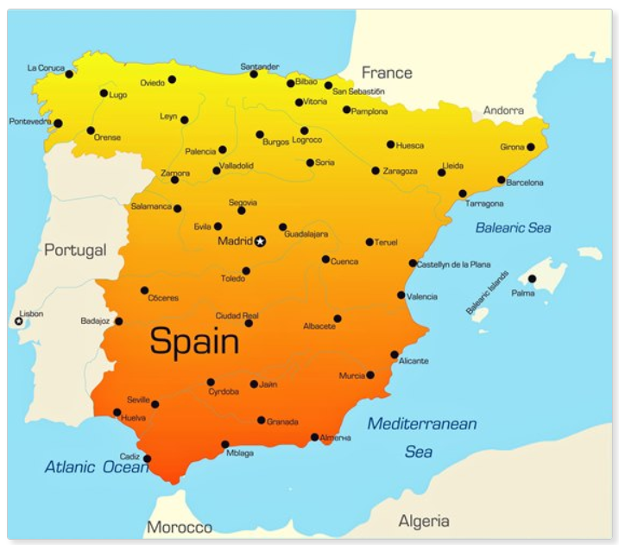
A closer look at Spain…
Barcelona
Can you see the capital city Madrid?
Which countries border onto Spain?

Slide 4
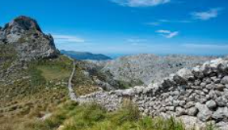
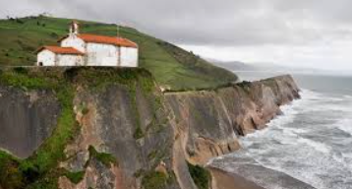
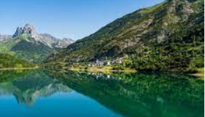
Geographically, what is SPAIN like?
Spain stretches south from the Pyrenees Mountains to the Strait of Gibraltar, which separates Spain from Africa. To the east lies the Mediterranean Sea, including Spain's Balearic Islands.
The interior of Spain is a high, dry plateau surrounded and crisscrossed by mountain ranges. Rivers run to the coasts, creating good farmland. Still, the interior of the country gets very hot in summer and very cold and dry in the winter. Droughts are common.
The southern and eastern coasts of Spain, from the fertile Andalusian plain up to the Pyrenees, are often swept by warm winds called sirocco winds. These winds originate in northern Africa and keep temperatures along the Mediterranean coast milder than the interior.

Slide 5
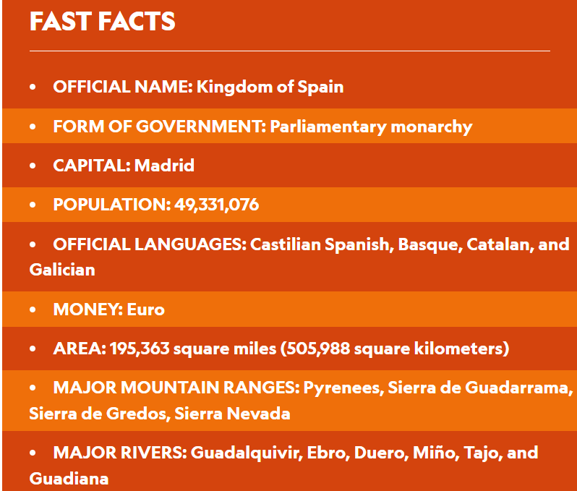
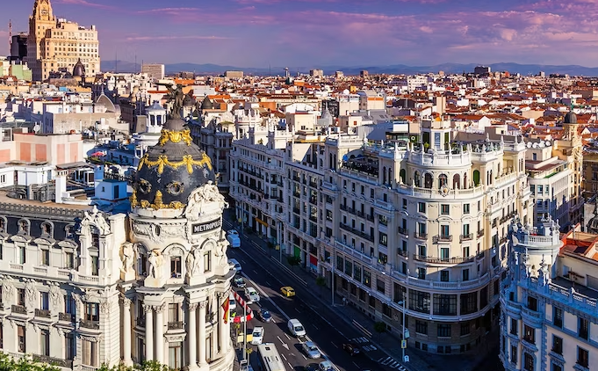
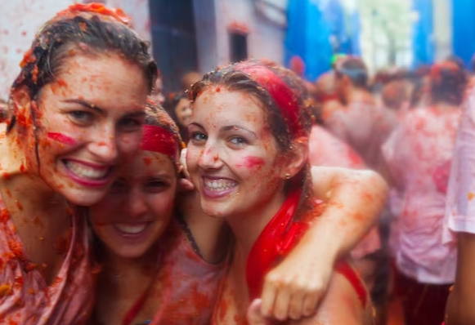

Slide 6
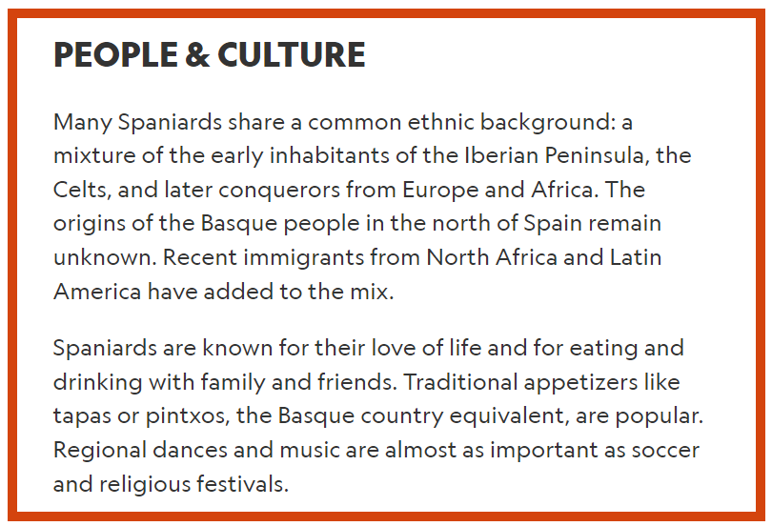
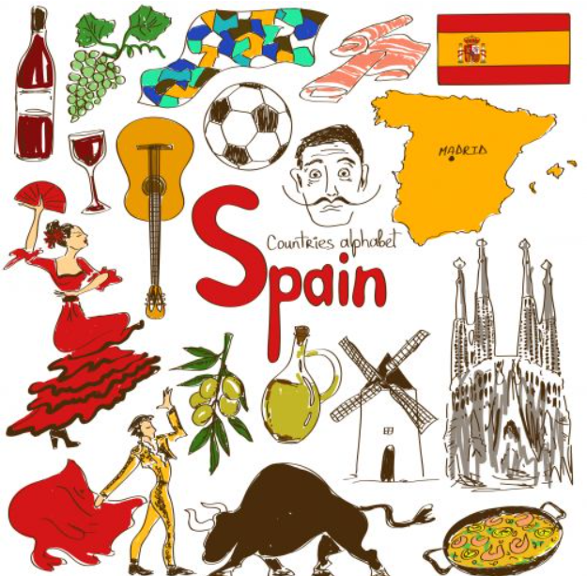

Slide 7
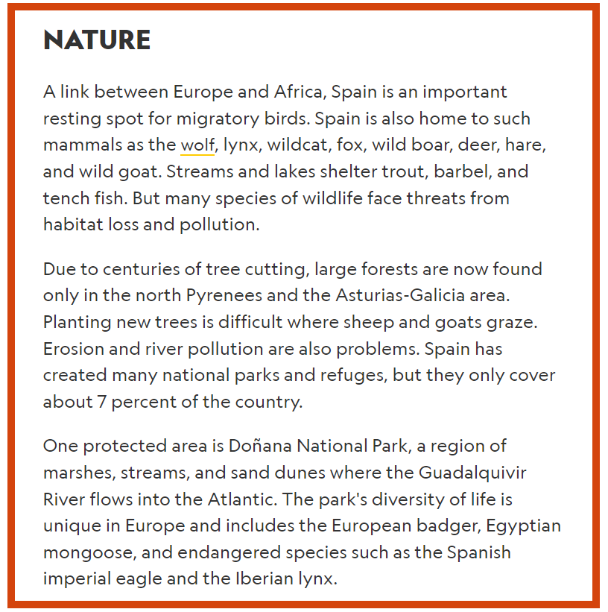
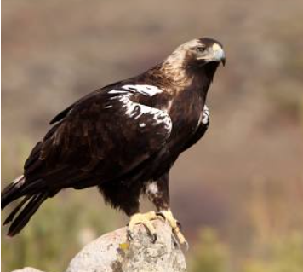
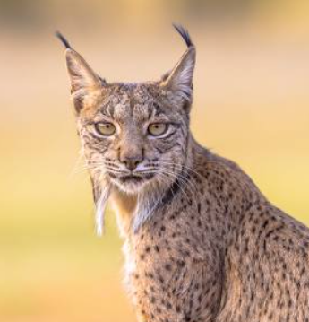
Spanish imperial eagle
Iberian lynx

Slide 8
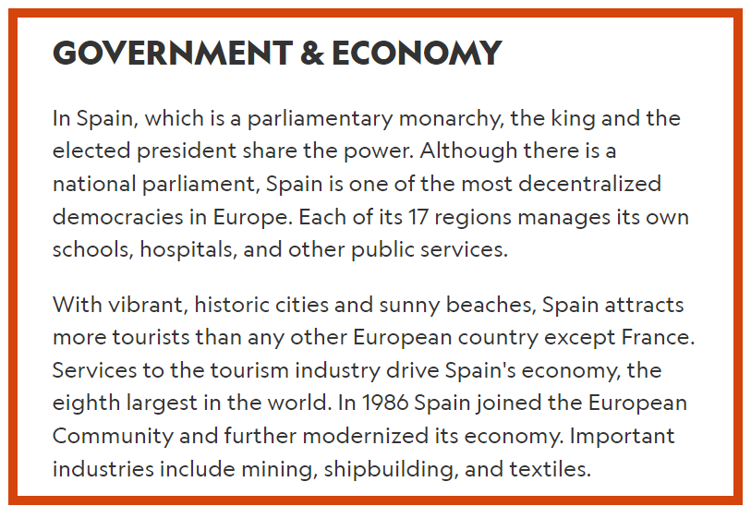
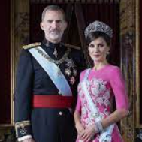
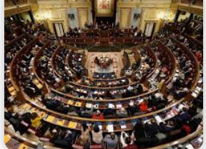
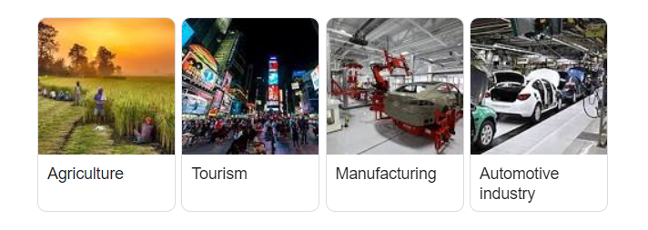
King Felipe VI and Queen Letizia

Slide 9
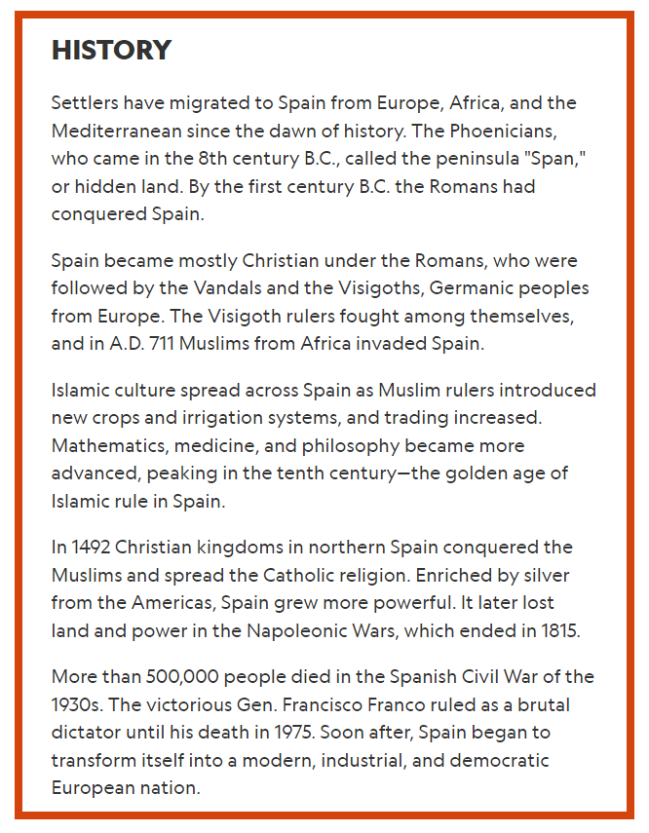
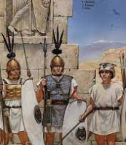
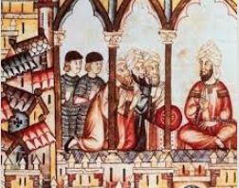
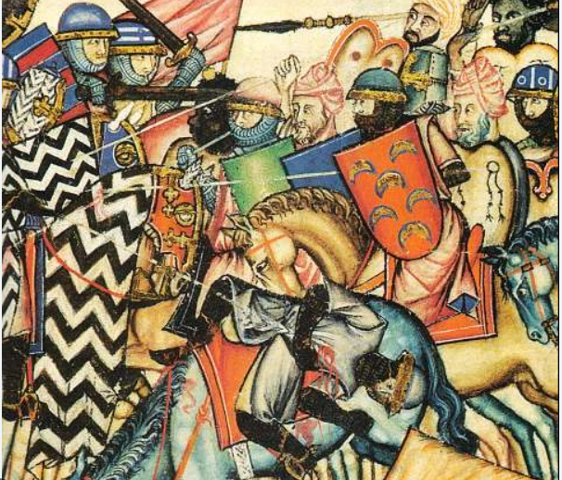

Slide 10
About Barcelona!
1. Barcelona’s beaches are artificial
2. Barcelona is said to be older than Rome
3. Barcelona is one of the world’s most bike-friendly cities
4. Barcelona is the only city in the world awarded a royal gold medal for architecture
5. The busiest pedestrian street in Spain is in Barcelona
6. There are 55 museums in Barcelona
7. Barcelona has the largest metropolitan park in the world
8. There are 68 parks in Barcelona
9. Camp Nou, Barcelona’s football stadium, is the biggest in Europe
10. Barcelona is the biggest city on the Mediterranean sea

Slide 11
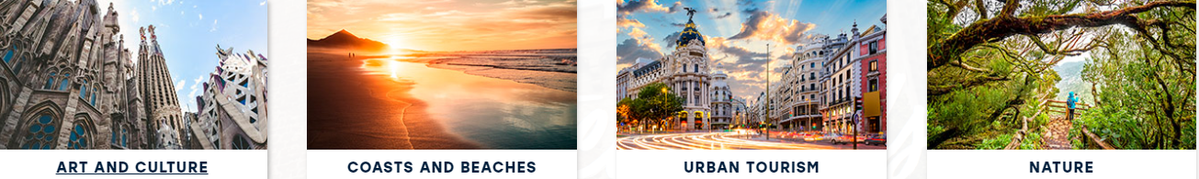
Castelldefels is located between a mountainous landscape and the Mediterranean. More than five kilometres worth of lovely beaches are found there, only a few minutes away form Barcelona and its international airport.
This exceptional location makes it an attractive tourist destination. Visitors will be able to play any water sport in the unbeatable facilities of the marina, including canoeing in the Olympic Canal, built for the 1992 Olympics.
The ancient castle of Fels, which gave this town its name, dominates the coastline of the city. We can also see medieval defence towers, erected in the 16th century, such as the towers of Can Ballester and Barona Tower.

Slide 12
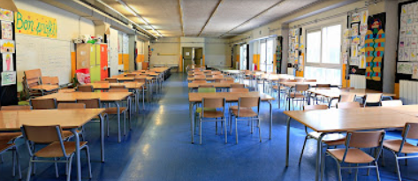

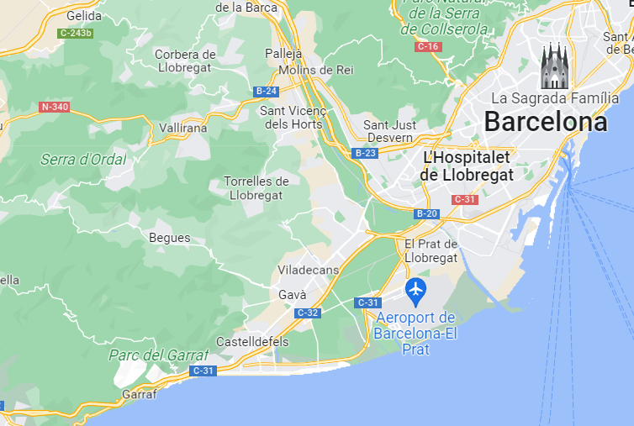
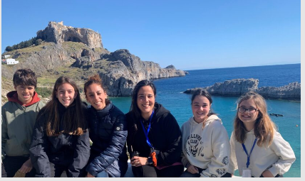
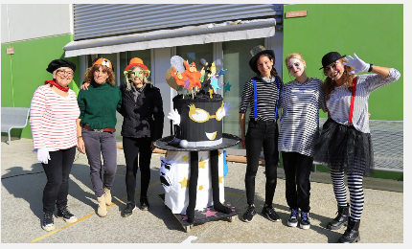
Our Partner school is in spain
Escola Els Pins Castelldefels

Slide 13
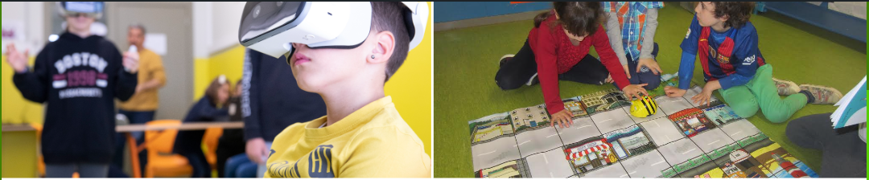
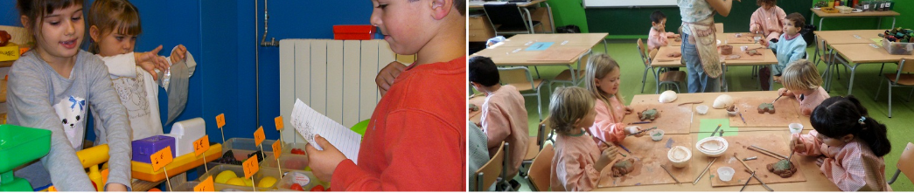
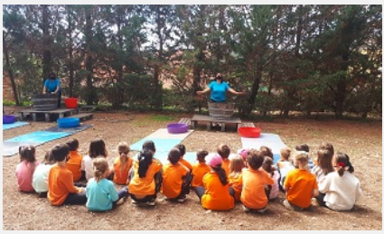
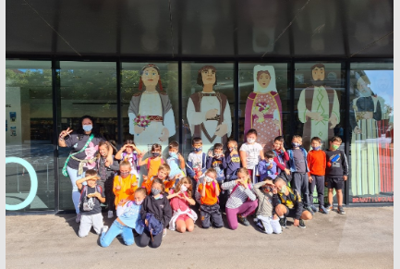
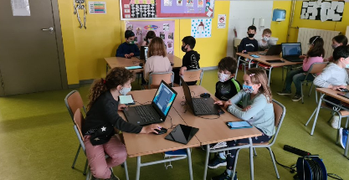
The School

Slide 14

Aims of the project:
To share common goals with children and schools in Europe on the theme of sustainability.
To develop confidence amongst all participants.
Make new friends – develop social skills.
Learn about other cultures and countries.
Come out of your comfort zone and develop independence.
To give you an opportunity to travel and visit a school in Europe.
To try new and different things.
To strengthen friendships and relationships.
To look after each other.
To give opportunities to everyone who wanted to take part for little cost.

