Slide 1


Voices of the Earth Project
Erasmus
What are Sustainable Development Goals?
Session 4
12/01/21
Mrs Elstone

Slide 2
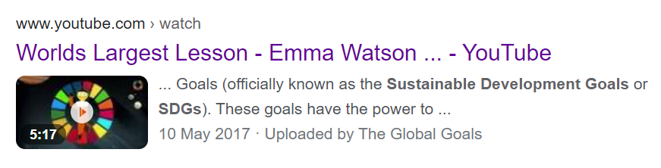
Understanding sustainable development goals
https://www.youtube.com/watch?v=Qx0AVjtdq_Q
Watch the YouTube clip - The World’s Largest Lesson
Discussion:
What’s the key message in the clip? What three important things do we need to tackle?
What 3 ways can you begin to make a difference?
Emma Watson (the presenter) says – this is an enormous task.
How does she suggest that we try to tackle it or even start?
Answers on the next page.

Slide 3

Answers:
The key message is that we all need to work together in the world to reach the same important goals by 2030!
The three things that we need to tackle are inequality, extreme poverty and respecting our planet.
Three ways that you can make a difference is through invention, innovation and/or being a campaigner.
(think about what that means… creating new things to help, thinking of new ways to do old things and by saying when we think things are not making our world a better place).
Emma Watson suggests that we start local and focus on where we live. Have you got any good ideas?
Make global goals a reality by 2030!
Do you think that is possible? How long have we got? Why not watch another clip?
https://www.youtube.com/watch?v=ZZzBbO6Y0uc

Slide 4
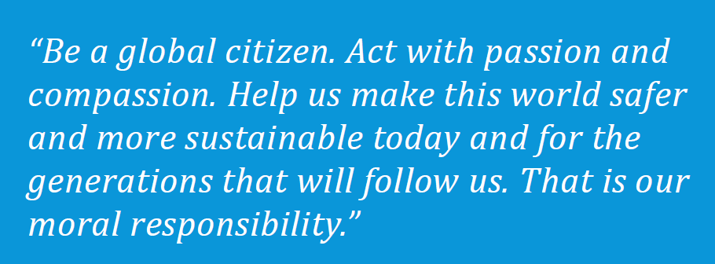

Let’s find out more…
The Sustainable Development Goals (SDGs) are 17 goals defined by the United Nations to tackle the world's biggest problems by 2030.

Slide 5

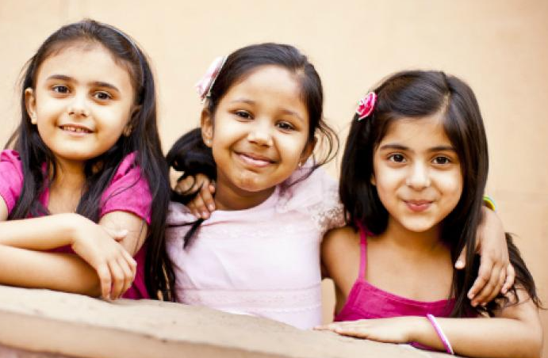
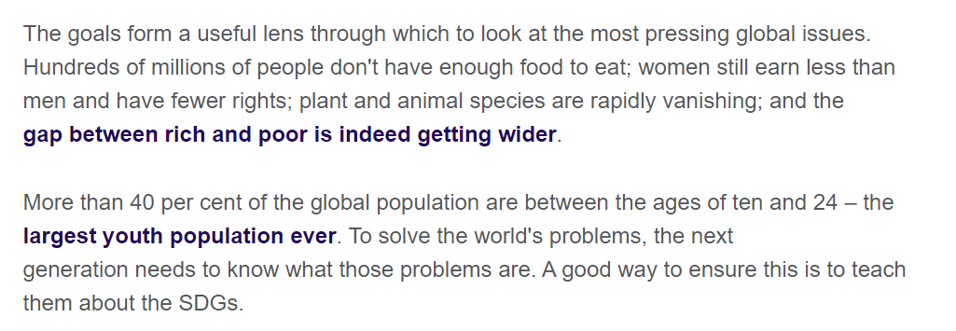

It’s important that you know what the SDGs are…

Slide 6





Slide 7
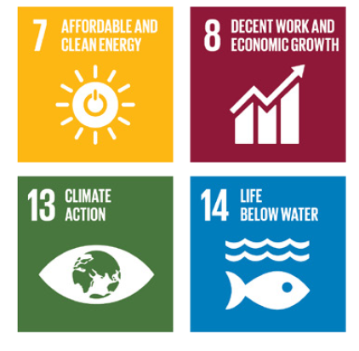



Slide 8
Some of the goals are more easy to understand than others…
Which ones can you remember? What do you think some of them mean? What do you think ‘Life Below Water’ is about?
Which ones are important to you or do you feel most passionate about?
Remember it’s suggested that you start with the ones that you most care about and ones that are most affecting your community.
Start by being a campaigner!

Slide 9
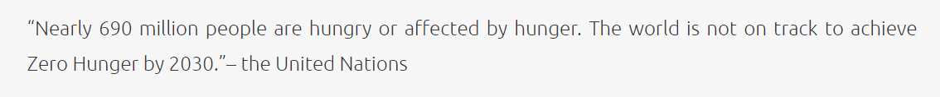
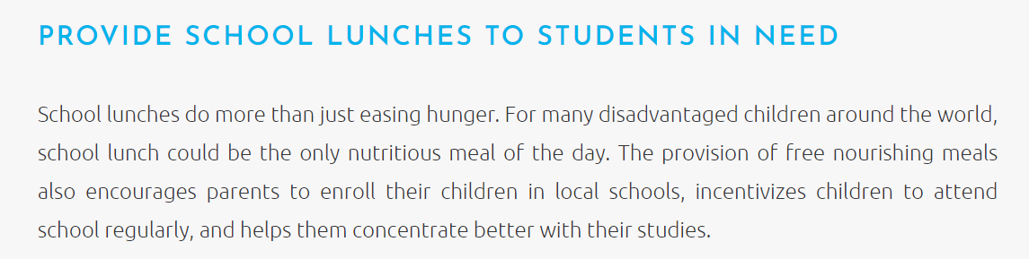
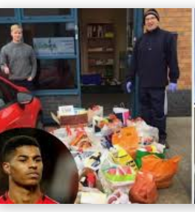
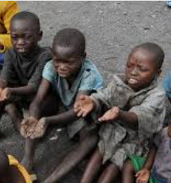
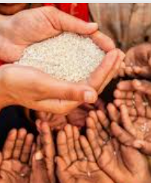
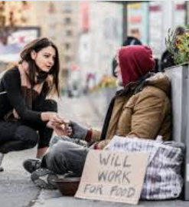

Let’s just think about NO HUNGER!
Talk about what you can see.

Slide 10

Choose one of the goals and make a poster to promote it.
Remember to include a practical idea of how the goal could be met.
Ensure that which SDG you are promoting on your poster is very clear.
This poster can be handmade or done on a computer.
You must PLAN IT first.
It has got to be high quality!

Slide 11

Make sure your poster does this!
1. Promotes one SDG
2. Gives a fact why this is a global problem.
3. Gives a practical tip on how to help reach the goal.
4. Has beautiful clear lettering (not too small for a poster).
5. Has no spelling mistakes.
6. Has an eye-catching images
7. Has the correct balance between information and image
WHAT MAKES A GOOD POSTER?

Slide 12
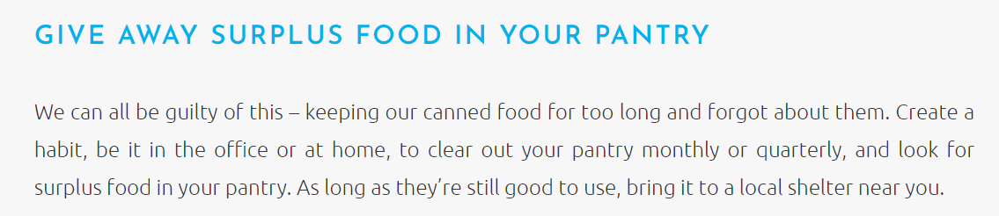
To make your poster good you’ll need to do research.
Get your facts straight – including facts can be very powerful.
Be persuasive – use emotive language – make the reader feel like they have to get onboard.
Remember to think globally – it’s not just us but it’s everyone in the world that needs to meet the SDGs.
Do you like this practical tip for NO HUNGER!

Slide 13
Send a photo or attach your poster.
We are going to use them to make a Super Sustainability Development Goals DISPLAY in school.
Extension – why not read the booklet attached separately to find more information?
Ask for permission to watch more clips about sustainable goals.
Send me a comment and explain in your own words what SUSTAINABILITY means. ENJOY!

Slide 14


Challenge: Get a piece of paper and write as many SDGs as you can remember! Tell me your score…

