Slide 1

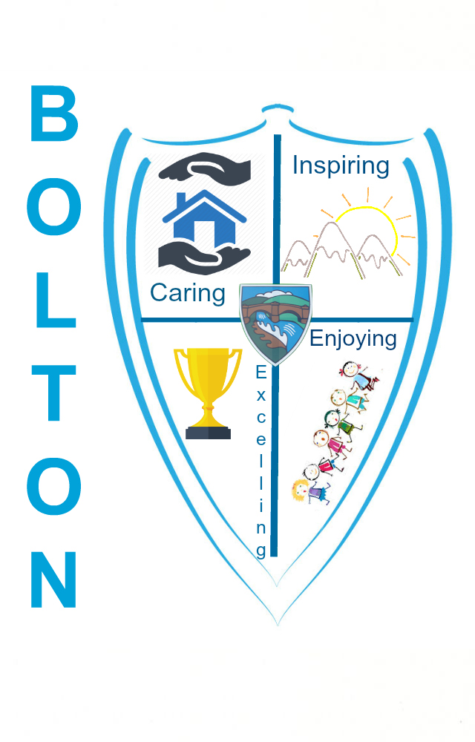

Slide 1
Bolton Primary KS2
Writing Workshop
Notes:
These can be changed to reflect your school’s specific rules.

Slide 2




SILLY SENTENCES ACTIVITY
Task 1 CHILDREN
How silly can you be?
REMEMBER YOUR PUNCTUATION!
Aim for a minimum of ten sentences.

Slide 3
Slide 3
Aims:
Foster writing for pleasure
Give ideas and purpose for writing at home
Give suggestions on how you can improve the standard of writing at home (including speaking and listening)
Guide you on tackling spelling
Explain the role of grammar and punctuation and how to address it
Discuss handwriting and presentation.

Slide 4
The writing journey …
Writing is a unique form of communication. Unlike speaking most of our writing is not meant for reading at the time of writing. We learn as we develop that the audience is likely to read it later, sometimes when the person is not present. When we speak we receive immediate responses and feedback. This changes it and often it is more formal than speech. There is often more editing and drafting than we would ever try to do with our speech.
Just like with reading where there are two parts to it - decoding and comprehension. There are two parts to writing – COMPOSITIONAL and TECHNICAL - that is and the Content and Style and the Grammar and Punctuation.
I’m becoming selective about my choices and I’m deliberately making choices for effect.
Use imitation/ copying ideas
I spell like it sounds
Ideas/ structures that I meet in my reading begin to influence my writing
I can edit/ and rewrite effectively. I want 100% accuracy.
Write like I speak/talk
Write about ME and what I like and know
I am automatically thinking about grammatical aspects and how punctuation affects the composition.
I start to think about the reader and the impact my writing has
I don’t pay much attention to the technicalities it’s all about content. I am unable to edit/ draft effectively.

Slide 5
Fostering - Writing for Pleasure?
Before you can get good writers you need to get writing.
My child doesn’t particularly like writing. They struggle with ideas for writing.
New pens, new notebooks/ journals / diaries
Writing on a laptop or iPad
Do they see you writing for pleasure? What kind of writing do they see you doing?
Many children need ‘real’ purposes for writing - letters, emails, blogs, shopping lists, invitations, cards, texts, WhatsApp’s, topic / research books, fact files, biographies, new endings, film/book reviews, diaries, special events.
Start small – a sentence a day.
Start with their interests – you’ll immediately tap into their expertise. They need to be able to talk confidently before they can write confidently.
Avoid being too critical at the beginning. Celebrate that they are doing any writing at all. Praise! Praise! Praise!
Think CONTENT first – you can always fix up any mistakes later.

Slide 6
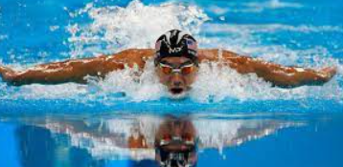
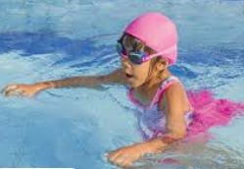
Slide 4
Coach at the right level
Just like with learning to become a competent swimmer, there’s a lot to take onboard and think about. Writing is an extremely complex process. We don’t become Olympians over night and some of us will never be authors but we can all become better through the right kind of practice and encouragement.

Slide 7
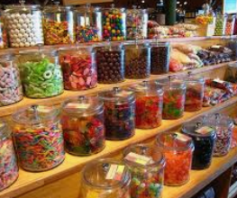
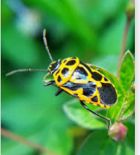
How do I encourage my child to improve their writing?
Fewer than one third
1. Vocabulary / talking - You will make your child a better writer by spending time talking with them.
Task: Choose one of the images.
Activity
Describe what you can see. Use all of your senses – sight, hearing, taste, smell, touch.
*Can you say that in a full sentence, please.
*Can you tell me more details about it (elaboration/ expansion)?
*Can you imagine that you are looking through a magnifying glass?
*What is it made of ? How does it feel? What does it/they smell/ feel like?
*What sounds can you hear?
Expose children to as much vocabulary as you can. Don’t shy away from complex words – children love them… Be prepared to model. Find out about words together.
Discuss shades of meaning and encourage improvements on words e.g. delicious, mouth-watering, delectable, flavoursome.
.

Slide 8
Improving! Where to start? to start?
2 Sentence Doctor Activities - We rarely ask for children to write the first thing that comes into their heads or to write about something that is outside their experience/ interest – usually tasks relate to something that is familiar or important to them. One of the beauties of writing is often you can let your imaginations run away with you and there’s no right or wrong response.
Look at the children’s silly sentences. Enjoy them. Take turns reading them.
Now work on them age-appropriately and improve them using the blocks.
Add an adjective or describing word
Add a conjunction and an extra clause
Use a better word/ synonym
Add an adverb this is a word that tells us more about the verb.
Check that capitals are in the right place and the sentence has end of sentence punctuation.
Change the structure of the sentence. Start with a verb or adverb.
Add some figurative language – simile, metaphor, personification
Show some advanced punctuation
Expand a noun phrase
Add a relative pronoun and a relative clause

Slide 9


Slide 5
One strange summer of my youth, a bizarre, magical lioness strode majestically towards the beach, to read the ancient book of spells that she had guarded for centuries.
Notes:
*Change this verbiage to the language your school uses.

Slide 10
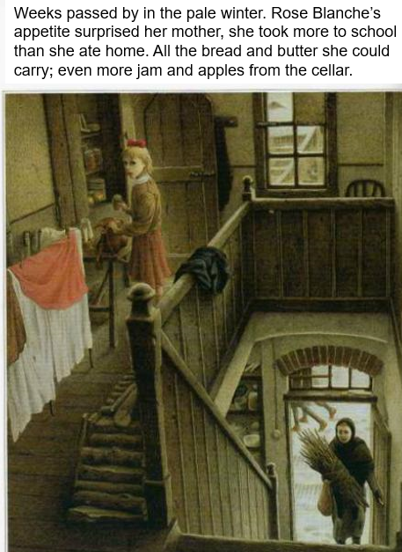
Tapping into their Reading…
How does sentence 1 start? Why what effect does it have? How else could that sentence have been written.?
Start to read like a writer …
Why has Blanche’s got an apostrophe s?
Why does the author use the phrase the ‘pale’ winter? What effect does the writer create?
What’s your ‘appetite’? Can you think of a synonym?
Where has a semi-colon been used and why?
Can you think of your own writing focused questions?
Can you experiment with creating noun phrases?
Identify possible authors e.g. magazine articles, newspapers, instructions, leaflets and their purposes. TAP INTO THEIR INTERESTS …

Slide 11
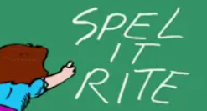
Slide 6
Children to put dots under words that they think are misspelt – activity
Spelling – My child makes lots of spelling mistakes!?
Remember it is always content first. We would never stop a child mid-flow and say that’s a misspelling.
After some writing encourage your child to find any errors themselves. They will probably know what doesn’t look right.
Help them – have conversations like I think it’s an ‘e’ and not an ‘a’ definitatly - explain why.
I think unbelievably drops the ‘e’ - shall we check? Model the strategies that you use. They will be the same ones that we use.
Be age-appropriate with how many spellings you would like them to self-correct and what you would expect them to be able to spell independently. .
Have zero tolerance with any given or available words.
Have zero tolerance with any of the first 300 words (age-appropriately).
Don’t accept misspellings of ‘whith’ and ‘were’ for ‘where’ in Y4/5/6 - think how many times they have seen those words.
Often it is unlearning that needs to take place – when a student has been spelling a word wrong for so long and not been picked up on it.
Suspected dyslexics just have to work harder, I’m afraid.

Slide 12
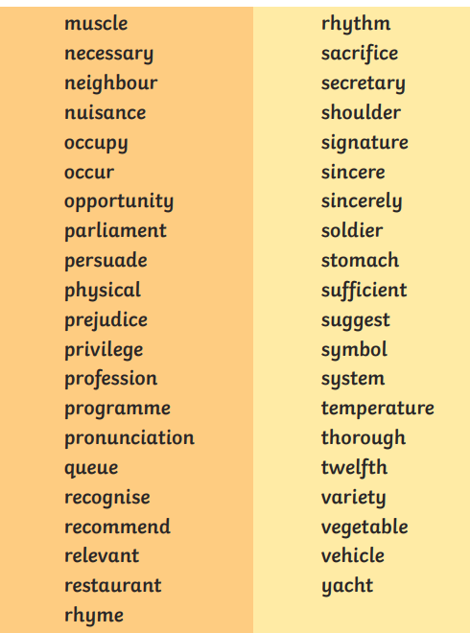
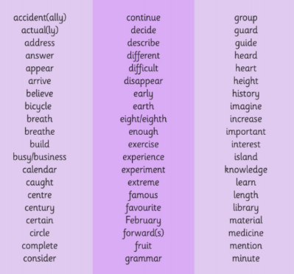
Slide 7
Y5/6 Spelling List
Y3/4 Spelling List

Slide 13
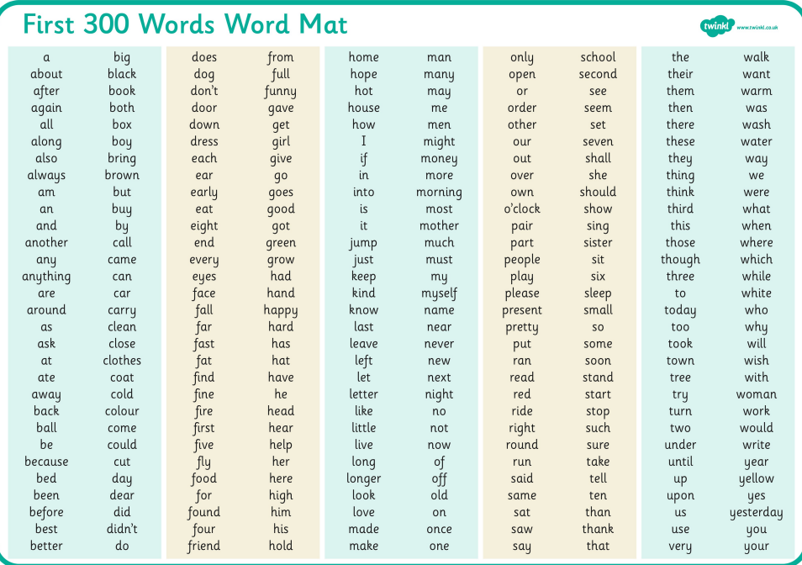
Given words:
On a sheet, in a book, a key topic word, on display, on a game etc

Slide 14
SPAG OR GAPS ??? WHAT’S THE POINT?
It’s unlikely that any of us adults were taught the level that these children are taught when it comes to grammar and punctuation.
We get bogged down and put off by the terminology e.g. relative clauses, modal verbs, passive and active voice.
Don’t get hung up on your ‘prepositions’ or ‘adverbials.’ Have fun experimenting and learning with your child.
There are loads of great tutorials out there to help you.
https://www.youtube.com/watch?v=PJae5sKdw7A
Having good GAPS knowledge gives students the tools to talk and improve their writing.
You can help by helping your child to think about whether their writing is formal or informal. Thinking about standard English and whether it is appropriate.
Can the written message/ information be understood clearly? Showing how the punctuation and the structure helps the reader. As your child develops, they should automatically be considering their GAPS more if they are NOT, then when they call out - I’ve finished! Say you’ve finished the draft – well done. Now the up levelling and improving can take place. Never expect a child to improve everything there is to improve. Start small and start with their weaknesses.
Activity – underline verbs in red, adjectives in blue and nouns in green

Slide 15
Handwriting and presentation
Activity – copy this joined up writing perfectly, using the Penpals styles
At BPS, we use the Penpals scheme. This is done weekly throughout the school.
Aim – by the time all children leave Primary, they have a joined up, legible style.
We know handwriting is not pushed at all at Secondary which is another reason why we like them to have a good legible style by the time they reach Class 3.
Children who find the mechanics of physical writing hard are disadvantaged. Writing is a complex process made more challenging if children are bogged down with trying to write.
It is important that those children that are not fluent or like joining are encouraged to do this out of school.
Praise good legible efforts and like us say if it’s not their best.
Make / create your own handwriting coloured patterns.
Encourage pride in their written work.
Underlining/ setting out/ spacing/ right tools – the psychology of doing a good job.
Set them up to succeed.

