Slide 1
Reading at
Boughton Primary School
Notes:
Welcome to our meeting about reading at Boughton Primary School

Slide 2
Reading is not merely the acquisition of words on a page; it is the gateway to a world of knowledge, imagination, and cognitive growth.
Reading stimulates the brain, fostering critical thinking skills, problem-solving abilities, and creativity. It is an active mental process that engages multiple regions of the brain and contributes to overall cognitive development.
Through literature, children encounter characters from diverse backgrounds and experiences. This exposure cultivates empathy and a deeper understanding of the world, contributing to the development of socially aware and compassionate individuals.
Notes:
Here are a few quotes about the importance of both reading and being read to. This is the most important skill that children will develop during their primary school education.

Slide 3
Phonics
Notes:
The teaching of phonics enables children to begin to read through learning sounds and then blending these together to form words.
Reading from an early age is important as research shows that if children are not secure and fluent readers by Year 2, it is very difficult to then develop a love of reading going forward.
In order to get children fluent in reading, their phonic knowledge must be embedded.

Slide 4
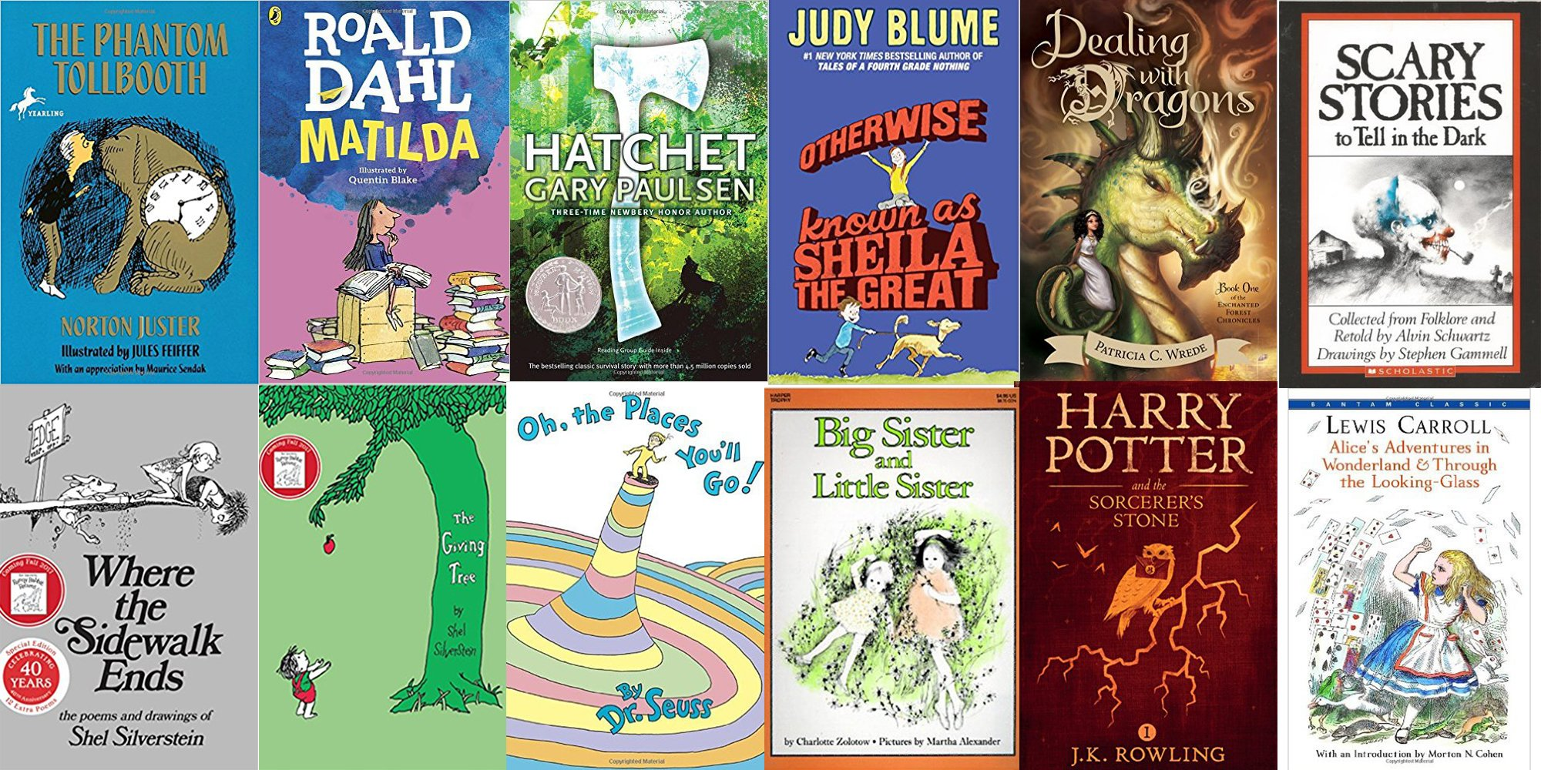
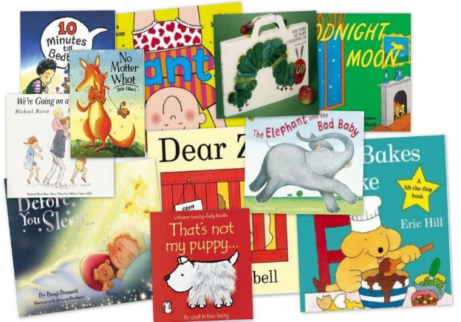
Reading across the school
We prompt reading in a variety of ways from Reception through to Year 6.
1:1 reading
Reading lessons as a whole class
Reading lessons in small groups
Teachers reading to their classes daily
Daily phonics sessions

Slide 5
Reading framework 2023
As pupils gain fluency, their motivation increases: they start to enjoy reading more and are willing to do more of it.
Pupils do not pass through a magic barrier and suddenly become fluent. There is no point in pupils reading speedily if the words they read are wrong – for example, if they read ‘place’ for ‘palace’. Equally, accuracy on its own is not useful, unless they can read at a sufficient rate to support comprehension. Both accuracy and speed are essential.
Notes:
The government has published a reading framework which states…
For a child to be fluent, phonic knowledge is important.
When a child is fluent, we can focus on understanding and comprehension.
When comprehension is secure, the child will enjoy what they read.
Secure phonics and fluency all reduce cognitive load.

Slide 6
What can you do to help your child improve their fluency?
Reading at home at least 5 times a week
Echo reading
Choral reading
Re-reading familiar texts with your child
Asking your child questions about the book they have read

Slide 7
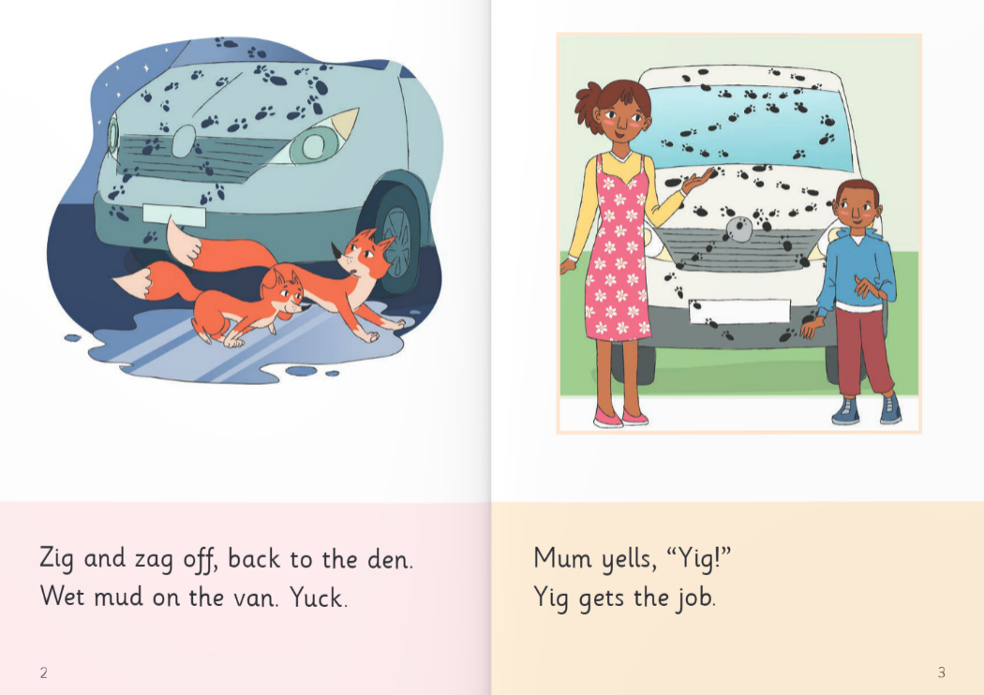
Building fluency
Choral reading
Choral reading is when you read the book together. You may read one line and your child reads the next. This way you are modelling fluency and expression throughout the book.
For example…
Notes:
Model as teachers. Pretend to be a child.

Slide 8
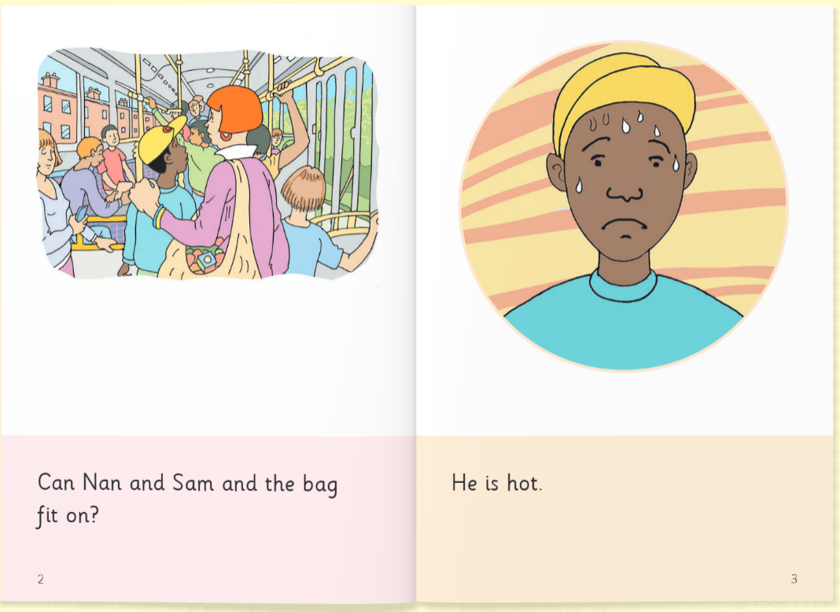
Building fluency
Echo reading
Echo reading or mirror reading is when your child copies the line you have just modelled reading. You read the text line by line and the child should echo your pace, intonation and emphasis.
For example…
Notes:
Model as teachers. Pretend to be a child.

Slide 9
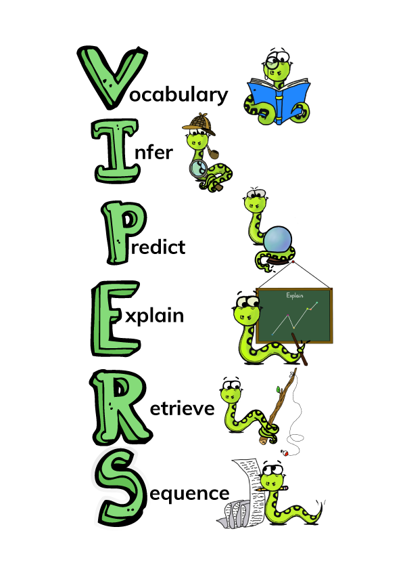
What happens when my child can read fluently?
What is comprehension?
This refers to the understanding of a text.
There are cases of where children are able to read thanks to secure phonics knowledge and the ability to decode but do not understand what they have read.
What can you do to help?
Notes:
This can be taken out for KS1’s PPT if wanted.
These are the comprehension skills we focus on when we are teaching our reading lessons. All KS2 children are familiar with these.
Give parents examples of questions they could ask their child on each skill.
These do appear in our reading records and can be ticked off or highlighted when asked.
Older KS2 children need to be listened to often and lots of questions should be asked to help their understanding and this will also mirror into their tests.
What can you do to help?
Comprehension of the world will develop comprehension in reading.
Ways to develop comprehension –
Talk at home...a lot and about everything
Develop cultural capital by going out (this does not need to cost anything)
Reading together and discussing the book (VIPERS)

Slide 10
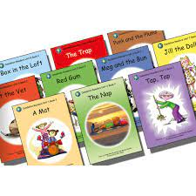
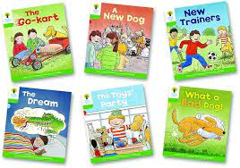
Reading at home
Your child’s reading book
Children will be bringing home one or two books a week. Whilst working on their phonics skills the books will be phonetically
decodable and reflect what the children have learnt so far in phonics.
When the children have gained more confidence, they will bring home books that include new vocabulary and language structures.
Different books allow the children to access a wider variety of texts including non-fiction and work on their
comprehension skills as well as their decoding.
Reading each book at least twice will support your child in decoding and recognising words in their initial read and then re-reading with more understanding and fluency.
Notes:
It is useful to help children get into the habit of reading a sentence before reading the sentence again without having to decode it. Children should be supported in remembering what they have just read. If this is something that they find difficult you may choose to focus on one book and read this more than twice to support fluency.

Slide 11
Reading at home
Help your child to enjoy reading by also sharing books/ non-fiction/ magazines that interest them.
Reading doesn’t need to be for a long time. Short bursts may be better for a child who is reluctant.
Choral or echo reading can take the pressure off your child if they don’t feel confident.
Give your child lots of positive encouragement.
Ask your child questions about the books they are reading.
Notes:
Questions can be vocabulary or comprehension based.

Slide 12
Thank you for your time and support.
Any questions?

