Slide 1
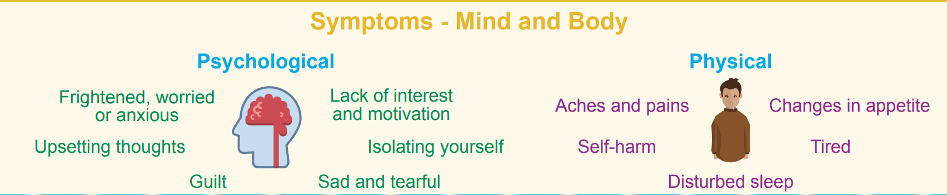
Looking after your own mental health and wellbeing

Slide 2
Watch a movie
Lego
Try to not let your emotions take over
Paint a picture
Decorate something
Build something
Focus on something else
Follow positive influencers on social media.
Take deep breaths
Puzzles
Drawing
Read
During lunch have 1 hour away from your device
Listen to music
Activities to do when away from Teams/Live lessons and how to support your mental health!
Keep your routine
Write your thoughts down
Write a letter
During break stay have 10 minutes off your laptop
Avoid going straight onto computer games
Get into a good sleeping pattern
Complete mindfulness activity
Avoid scrolling through social media
Have a clear out and give to charity
Colour a book
Look after your animal
Go for a walk/run
Relax
Make a story
Stay in touch with people – text, call or facetime
Find things that make you laugh
Talk to a professional
Go somewhere quiet
Meditate
Watch You Been Framed
Speak to your family
Board game
Use the school website
Speak to your friends
Fidget toy
Notes:
Activities to do when away from the computer / supporting your mental health

Slide 3
What to do in your 10 minute break
Go for a walk around your house/flat/room/garden
Get a water
Get a healthy snack
Prepare yourself for your next lesson – pen, paper, book ready.
If you have a puzzle or colour book on the go, spend a couple of minutes adding another section.
Speak to someone at home face to face
Pick up the phone and talk to someone
Go and stand by a window or out the back door to get a little bit of fresh air.
Make a cup of tea
Read
Knitting/craft activity
Put the news channel on to keep updated with current affairs.
Start a new a activity/craft
Check in and support others
Write in your diary

Slide 4
5 - 10 minute Mindfulness Tasks
5 Minute Meditation You Can Do Anywhere
  https://www.youtube.com/watch?v=inpok4MKVLM
10 Minute Meditation for Anxiety
  https://www.youtube.com/watch?v=O-6f5wQXSu8
5 Minute Stress Relief Guided Meditation
  https://www.youtube.com/watch?v=L1QOh-n-eus
5 Minute Mindful Breathing Meditation
  https://www.youtube.com/watch?v=nmFUDkj1Aq0
5 Minute Guided Morning Mindfulness Meditation
  https://www.youtube.com/watch?v=n9ja1Wqkp1U

Slide 5
5 Minute Exercise Session
5 Minute Move – Kids Work Out – Joe Wicks
  https://www.youtube.com/watch?v=d3LPrhI0v-w
5 Minute Cardio for Beginners
  https://www.youtube.com/watch?v=q2NZyW5EP5A
5 Minute Full Body Tabata
  https://www.youtube.com/watch?v=Tz9d7By2ytQ
5 Minute Yoga
  https://www.youtube.com/watch?v=2WE-L8iyu0U
5 Minute full body Yoga
  https://www.youtube.com/watch?v=vSOiKc6m2Qs
5 Minute Yoga for a Relaxing Night’s Sleep
  https://www.youtube.com/watch?v=E9LVKL2pGmo

Slide 6
Relaxing Music
3 Hours of relaxing music
  https://www.youtube.com/watch?v=2OEL4P1Rz04
Beautiful Relaxing Music for Stress Relief
  https://www.youtube.com/watch?v=LXK3sphcbAQ
8 hours of Relaxing Sleep Music for Stress Relief
  https://www.youtube.com/watch?v=1bLTSokZHsU
Beautiful Relaxing Music with Stunning Nature
  https://www.youtube.com/watch?v=TdRRJxK0880

Slide 7
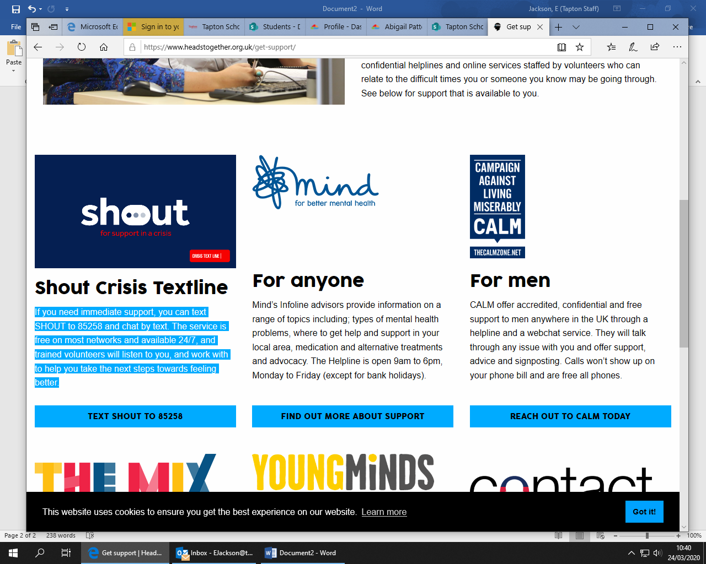
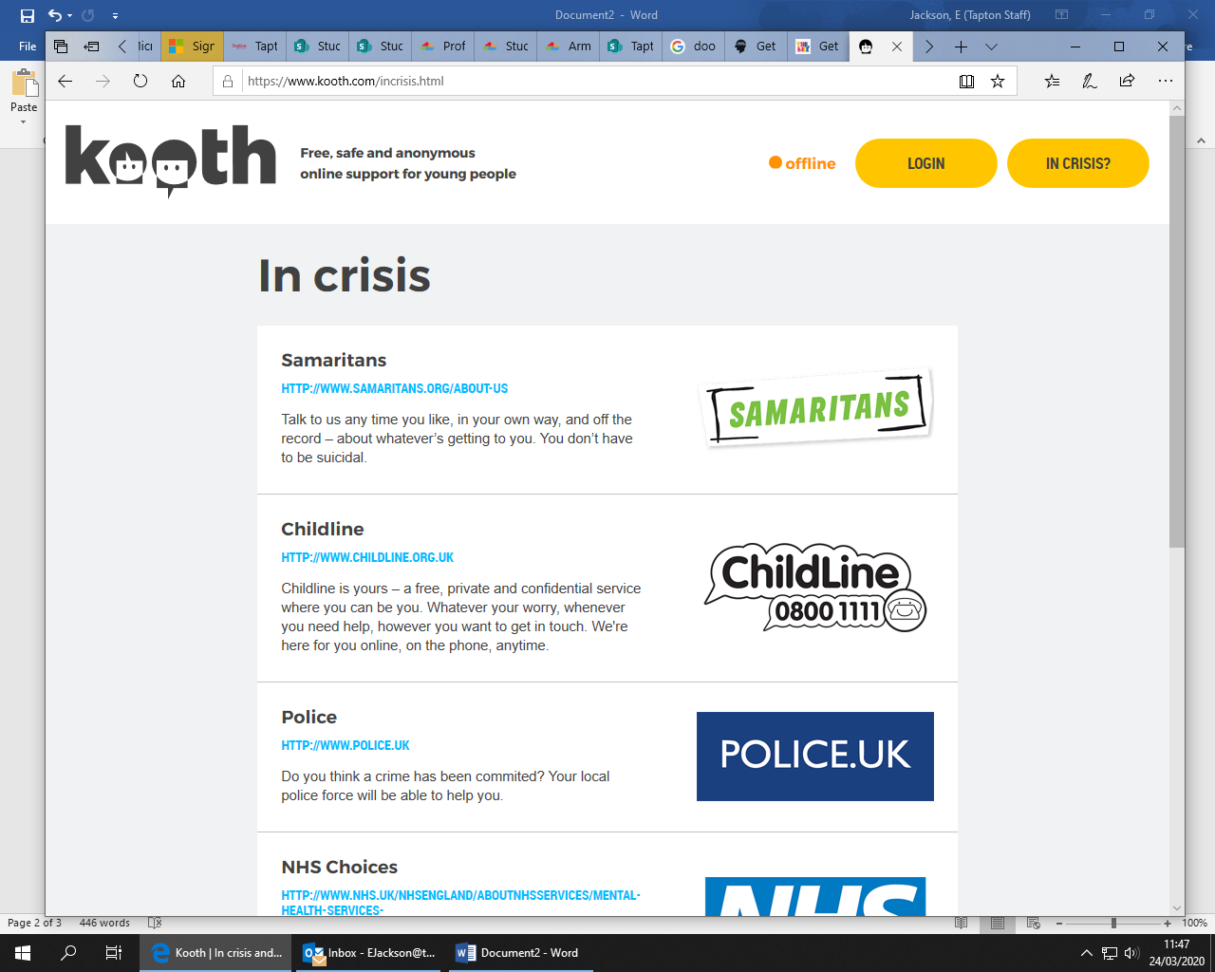
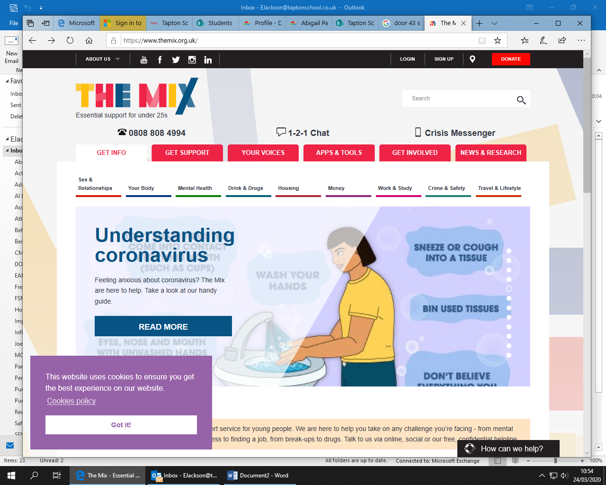
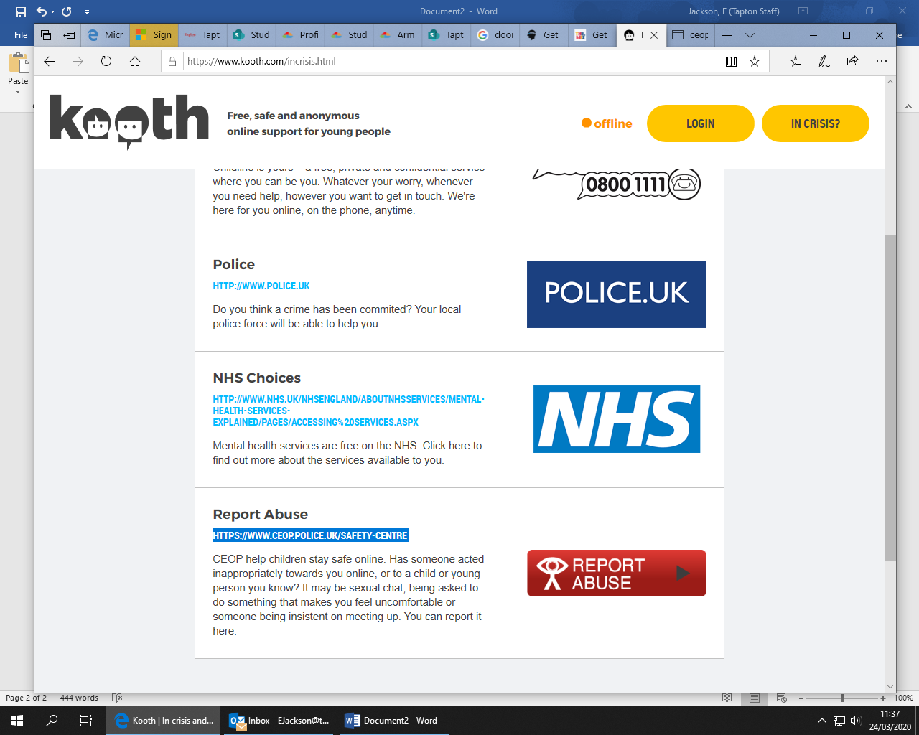
Mental Health for Students
SHOUT Crisis textline - If you need immediate support, you can text SHOUT to 85258 and chat by text. The service is free on most networks and available 24/7, and trained volunteers will listen to you, and work with to help you take the next steps towards feeling better.
Kooth is the UK’s leading mental health and wellbeing service for young people aged 11-25. It offers safe, confidential counselling and advice online. It is completely free and you can log in using your mobile, tablet or desktop computer. Fully trained and qualified counsellors are available to support Monday to Friday from 12 noon until 10pm each night, and weekends from 6pm to 10pm, 365 days per year. For more information, click on the link: https://www.kooth.com/
The Mix offer a free & confidential helpline for young people under 25. Trained supporters are here to help with any issue that is troubling you. They are available 365 days a year via phone, email, one to one live chat or a crisis text message service. Call 0808 808 4994 (open from 4pm to 11pm daily) or click on the following link for more information: https://www.themix.org.uk/get-support
CEOP help children stay safe online. Has someone acted inappropriately towards you online, or to a child or young person you know? It may be sexual chat, being asked to do something that makes you feel uncomfortable or someone being insistent on meeting up. You can report it here: https://www.ceop.police.uk/safety-centre

Slide 8




Mental Health Companies to Support Adults
The NHS has created a website with all the different companies that are there to support adults with their mental health and well being. Please click on the link, it will guide you to their website and you can find a charity/company that will be best to support you.
https://www.nhs.uk/conditions/stress-anxiety-depression/mental-health-helplines/
https://www.rethink.org/aboutus/what-we-do/advice-and-information-service/
https://www.samaritans.org/
https://www.mentalhealth.org.uk/
https://www.mind.org.uk/

