Slide 1

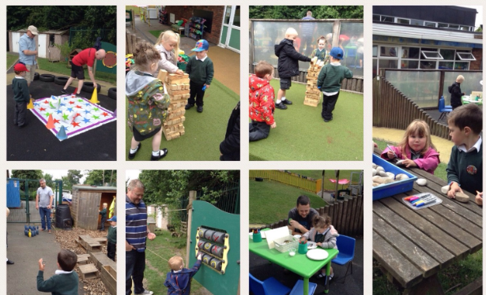

Bradley Green Primary Academy Nursery
Contact us:
0161 368 2166
www.bradleygreen.org.uk
admin@bradleygreen.org.uk
Challenge Confidence Respect Curiosity

Slide 2
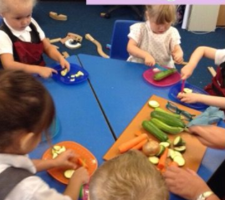
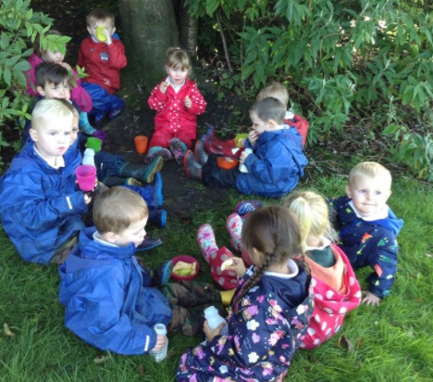
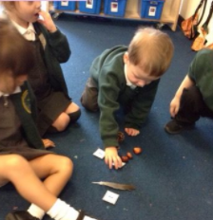
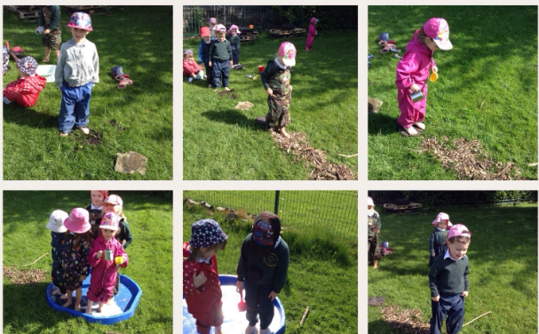
FREE 15 hour and 30 hour places available for 3 year olds (8.30-11.30am or 12.15-3.15pm)
If 30 hours, a home cooked school lunch is available
We believe that every child matters and that every day in school matters.
The children in Nursery have the opportunity to develop and learn in indoor and outdoor environments that ignite interest and a love of learning.
Experienced teacher delivering high-quality outcomes
Forest school approach
Soon to be opening before and after school club
Challenge Confidence Respect Curiosity

Slide 3
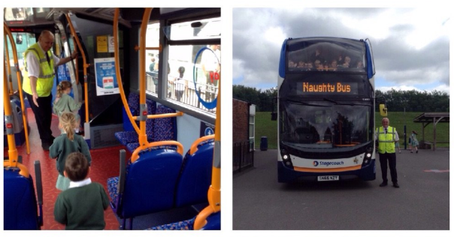
15 hour nursery
Morning Nursery – 8.30am to 11.30am
Afternoon Nursery – 12.15pm – 3.15pm
30 hour nursery
8.30am – 3.15pm
£2 per day (£10 per week) for lunch cover with own packed lunch
£4 per day (£20 per week) for lunch cover with a hot 2 course school dinner
*Payment via Parent Pay
If applying for 30 hours, the code you receive must be sent to the school office before the new term and then reapplied for each term (see next page for how to apply)
An additional afternoon or morning session can be booked (full week only) for £10 per session – payable via Parent Pay
Please contact Mrs Turner or the school office to organise (subject to availability)
Challenge Confidence Respect Curiosity

Slide 4
Are you eligible for 30 hours funding?
You can usually get 30 hours free childcare if you (and your partner, if you have one) are:
in work - or getting parental leave, sick leave or annual leave
each earning at least the National Minimum Wage or Living Wage for 16 hours a week - this is £125.28 if you’re over 25
This earnings limit does not apply if you’re self-employed and started your business less than 12 months ago.
You’re not eligible if:
your child does not usually live with you
the child is your foster child
either you or your partner has a taxable income over £100,000
you’re from outside the EEA and your UK residence card says you cannot access public funds
You can get 30 hours free childcare at the same time as claiming Universal Credit, tax credits, childcare vouchers or Tax-Free Childcare.
If you cannot work
You may still be eligible if your partner is working, and you get Incapacity Benefit, Severe Disablement Allowance, Carer’s Allowance or Employment and Support Allowance.
Apply for 30 hours free childcare
You’ll need your details (and your partner’s, if you have one), including your:
National Insurance number
Unique Taxpayer Reference (UTR), if you’re self-employed
You’ll get a childcare account if your application is successful. You can use it to get your code for 30 hours free childcare.
If you pay for childcare and want to use Tax-Free Childcare to get help with costs, you can also apply using this service.
It usually takes 20 minutes to apply. You may find out if you’re eligible straight away, but it can take up to 7 days.
https://www.gov.uk/help-with-childcare-costs/free-childcare-and-education-for-2-to-4-year-olds
Challenge Confidence Respect Curiosity

