Slide 1
Approach to Phonics
At Bradley Green Primary Academy

Slide 2
Book Progression:
YEAR | MONTH | RWI BOOK BAND
N | April | Start teaching set 1 speed sounds
R | Oct | Sound blending books Know most of set 1B and begin to blend
 | Dec | Sound blending books Know set 1C and blend
 | Feb | Ditties
 | Apr | Red
 | May | Green (Teach set 2)
 | July | Green / Purple
Y1 | Oct | Purple
 | Dec | Pink (know set 2)
 | Feb | Orange
 | Apr | Yellow
 | May | Yellow (know set 3)
 | July | Blue
Y2 | Oct | Grey

Slide 3
Phase 1
The aspects include:
In Nursery children will focus on phase one of Letters and Sounds, incorporating the following aspects…
Environmental Sounds.
Instrumental sounds
Body Percussion
Rhythm and Rhyme
Alliteration
Voice Sounds
Oral segmenting and blending
In the Summer Term in Nursery, the children who are ready will begin Set 1.

Slide 4
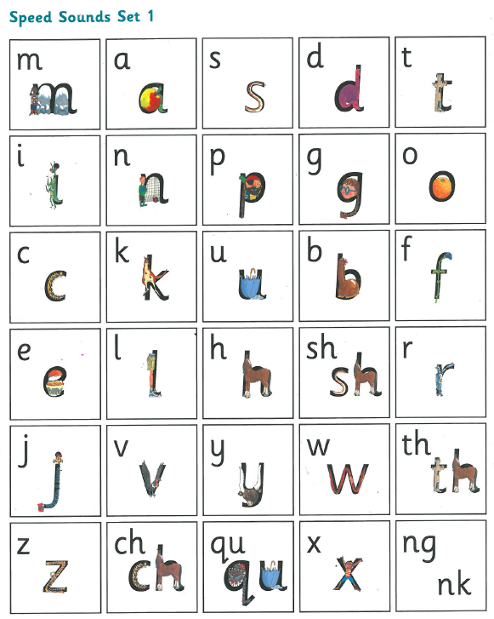
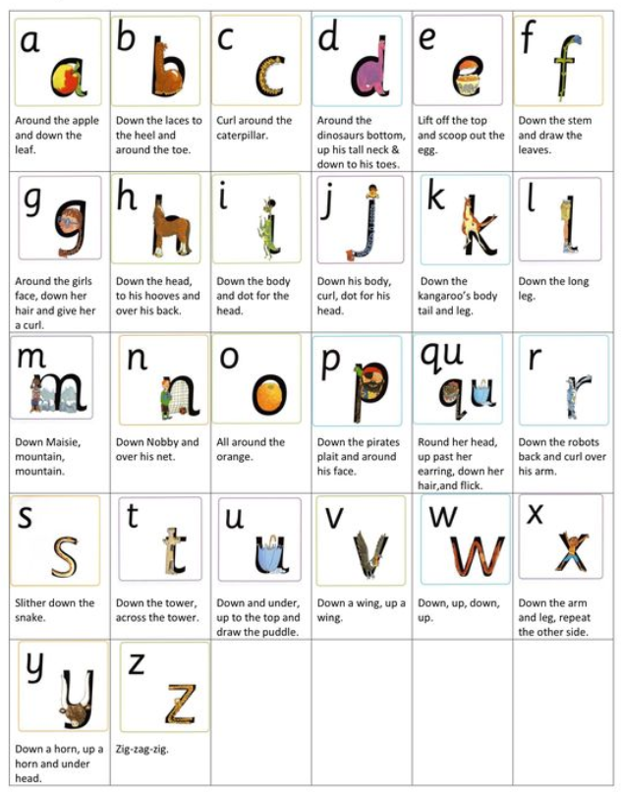
Order the phonemes should be taught.
Rhymes to support letter formation.

Slide 5
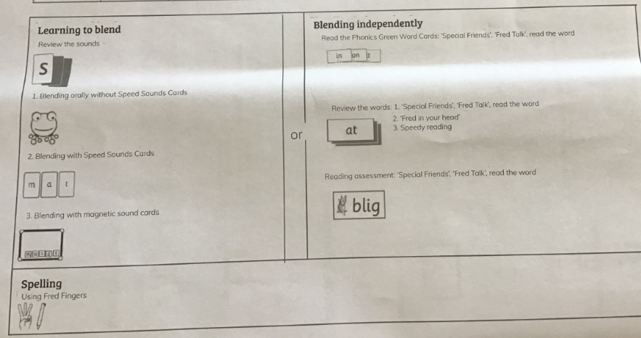
Speed sounds- Lesson Plan

Slide 6
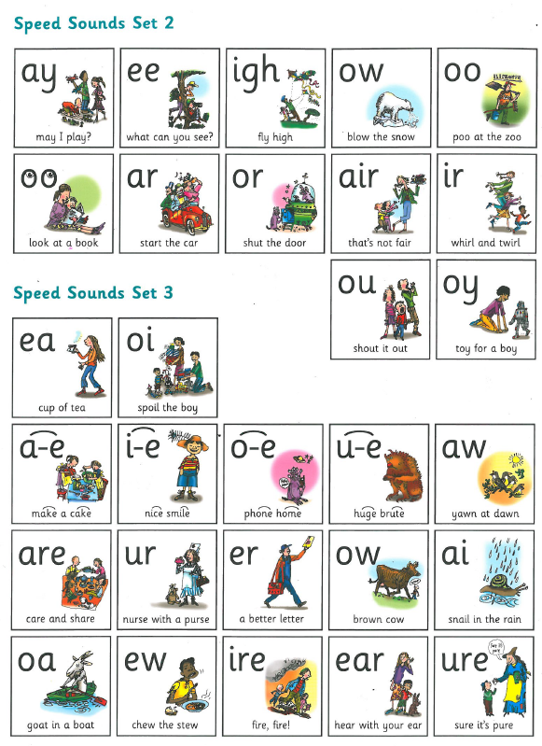

Slide 7
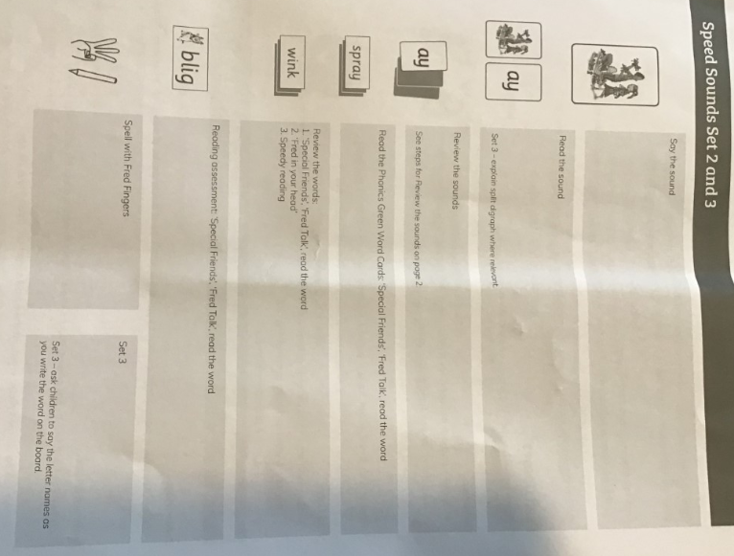
Set 2 and 3

Slide 8
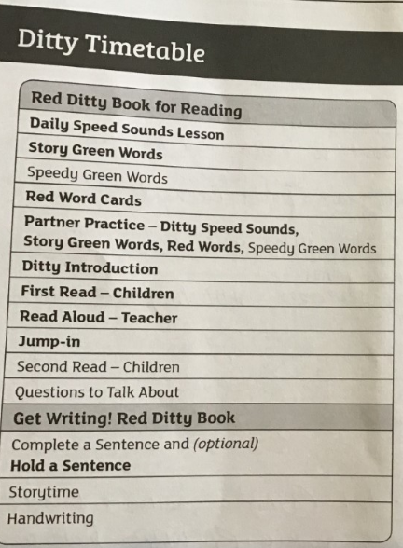
Phase 1
The structure of a lesson when Ditties (photocopiable) and red books are introduced:

Slide 9
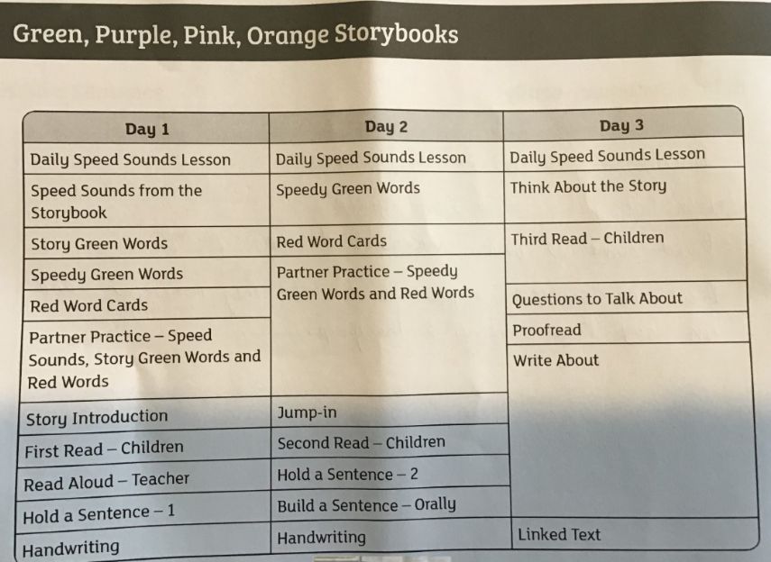
Phase 2
The structure of a lesson to teach when you teach green, purple, pink and orange story books.
Green, purple, pink and orange storybooks

Slide 10
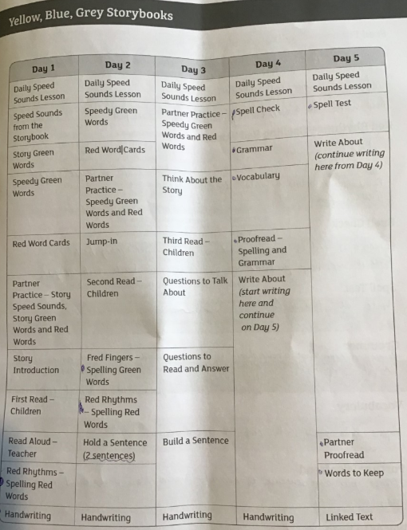
Phase 3
The structure of a lesson to teach when you teach yellow, blue and grey story books.

Slide 11
Behaviour
Pace
Team stop signal
TTYT
TTYP
Handwriting signal
123
Participation
All to participate in MTYT
Sit spot light children where they can be accessed easily.
Select partners to work together
Teacher move around, don’t be a partner to an odd number
Partner discussion
Use TTYP for every question- no hands up.
Use feedback mechanisms
Short responses Choral response, popcorn, word wave
Long responses- choose 2, paraphrase.
Praise phrases
FANtastic!
Hip, hip, horay!
Whooooosh!
Firework!
1,2,3 - Well done me!
Hi 5, scuba drive!
Instructions
Magnet eyes on the board
MTYT – My turn your turn
MTYTTP – My turn your turn together
Super speedy sounds
I can read the sound ‘a’
I can write the sound ‘a’
Fred talk the word
Fred fingers
1,2,3, signal
Fastest finger first

