Slide 1
Welcome to Year 4!

Slide 2
Teachers
Miss Begum is the year 4 class teacher
Mrs Walton is the year 4 teaching assistant
Miss Issatt will be the Year 4 assistant covering for
Mrs Walton
PE lessons will be taught by a specialist PE coach
Mr Morris on Wednesday and by Miss Begum on Tuesday.
Weekly music lessons will be taught by specialist music teacher, Mrs Hind, from Tameside Music Service.

Slide 3
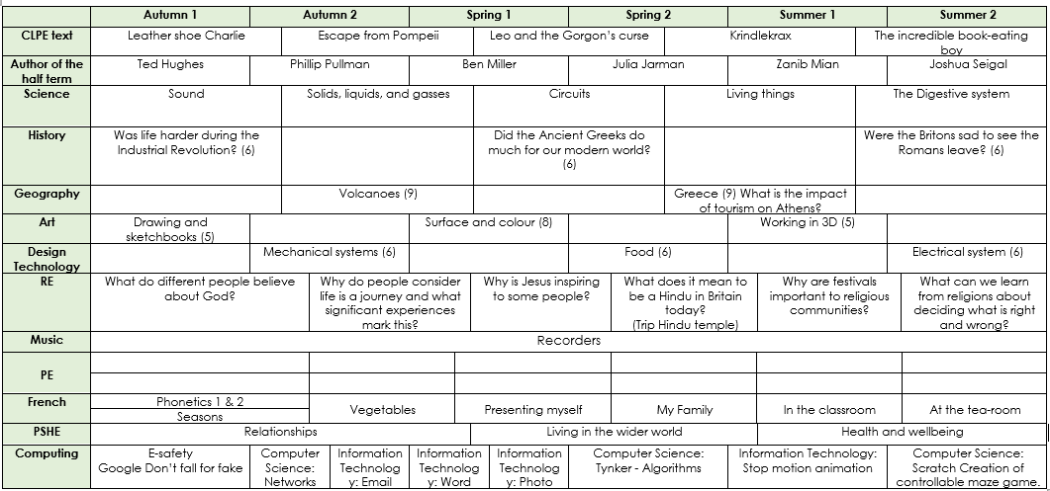
Curriculum - LTP

Slide 4
Books
Amazon wish list – Books https://www.amazon.co.uk/hz/wishlist/ls/CSH6IJG6AY0C?ref_=wl_share
Healthy snack

Slide 5
Maths
Children will receive Maths homework each week on a Monday. The homework challenges will be set on Sumdog. Dojo points will be added for those children who complete this homework on time.
Reading
Children need to read their book to develop fluency.
Log reading on the BoomReader app.
TTRockstars
Children will be set weekly times tables to practise. This is to prepare them for the Year 4 multiplication test which will take place in June.

Slide 6
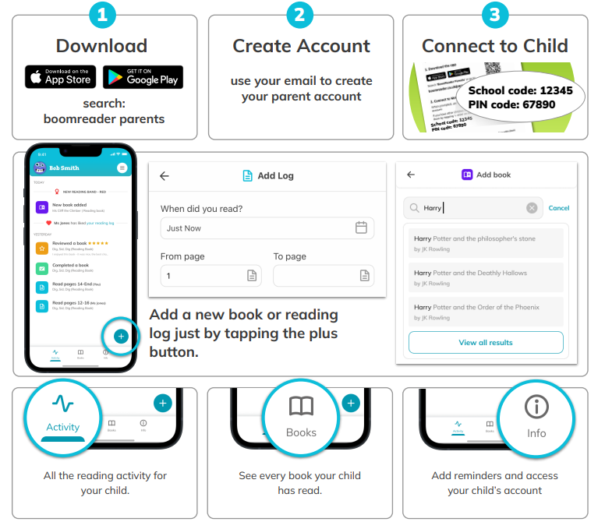
Boom Reader

Slide 7
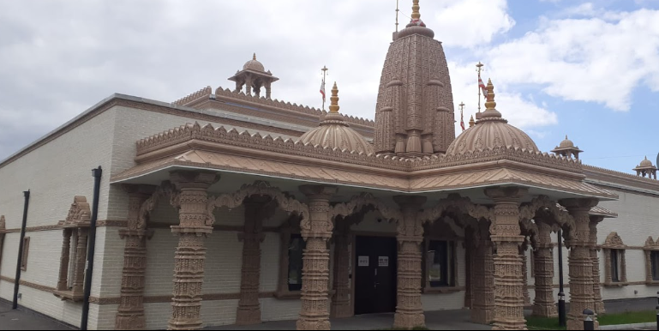
Trips
R.E: Hindu Temple – Thursday 22nd Feb
History: Grosvenor Museum in Chester (June)

Slide 8
Communication
Please make sure that you are signed up to Class Dojo for class and whole school messages!
Half-termly newsletters . Class Twitter page. School website.
If you have any questions, please don’t hesitate to contact me through Class Dojo or come and see me at the door after school.

Slide 9
Any questions?

