Slide 1



Year 11 … being ready for the exams!
Name ___________ _________________
Big picture … brilliant advice …
https://www.youtube.com/watch?v=Wfsm8Id1dVI

Slide 2
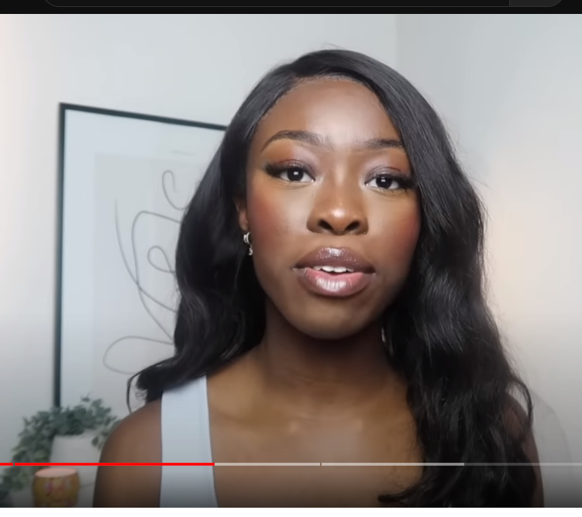
How can I motivate myself to revise when I’m tired (or bored of revision)?
Motivation to revise …
https://www.youtube.com/watch?v=8I7QV59r3kM
Excuses, excuses, excuses … how to stop putting it off …
I’m tired – I’ve been working at school all day
Set boundaries … what not to do (and what to do instead)
It’s boring doing hours of revision …
I’m not self-motivated … help!

Slide 3
How I feel about the subjects I’m doing?
 | Maths | English Language | English Literature | Biology | Physics | Chemistry | Option 1 | Option 2 | Option 3
RAG rate it … Red = Hard Orange = Better Green = Best
Is there a reason why? | ____________________________________ | ________________________________________ | ________________________________________________ | ________________________________________ | ____________________________________________ | ________________________________________ | ________________________________________ | ____________________________________ | ____________________________________
Is there anything I need to do? | ____________________________________ | ________________________________________ | ________________________________________________ | ________________________________________ | ____________________________________________ | ________________________________________ | ________________________________________ | ____________________________________ | ____________________________________
RAG rate it in 4 weeks … Red = Hard Orange = Better Green = Best
What has changed? | ____________________________________ | ________________________________________ | ________________________________________________ | ________________________________________ | ____________________________________________ | ________________________________________ | ________________________________________ | ____________________________________ | ____________________________________

Slide 4
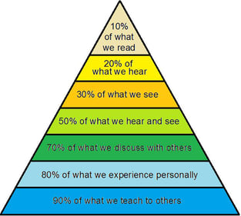
You have to DO revision
… it doesn’t just happen.
It’s not worth spending all that time on revision if it doesn’t stick
Experience … making flash cards, making mind maps, adding little pictures & colour and doing exam questions

Slide 5
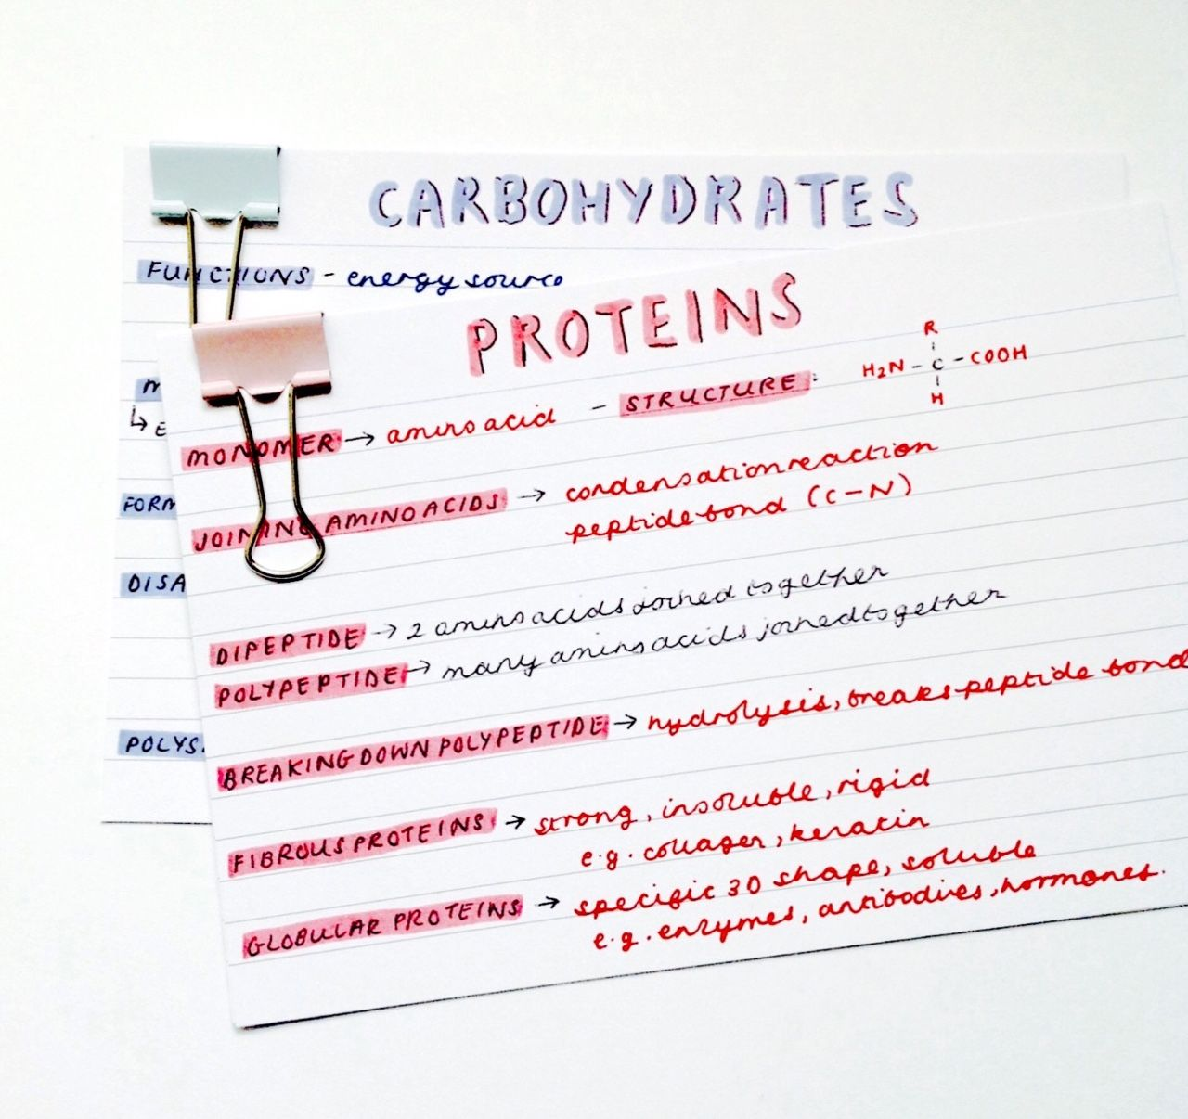




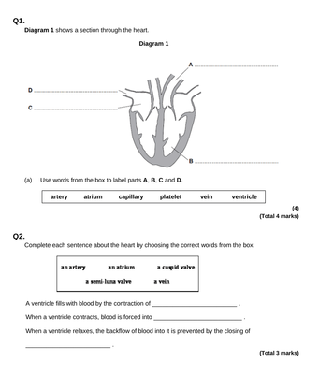
Revision is a 3-step process …
Making …
Your brain remembers the process of making flash cards …
SMALL chunks of info is easier to remember
Colour and pictures make info more memorable for you (it creates mental links!)
Memory joggers for YOU … ‘mnemonics’ e.g. BODMAS / PETAL paragraphs
Remembering …
Explaining to someone else
Learn facts in both directions … date – event – date … character – quote - character …
RAG rate them … for ‘spaced repetition …
red = I need to work hard to learn this
amber (orange) = I sort of know it but need to spend some time on it,
green = I’ve got it!
Checking …
Say /explain what your cards have on them (in both directions) – check as you go along
Do practice Exam questions … no need to do a whole paper … you do that in the mocks … focus on what you find difficult or what you had got wrong … if you’ve got the head space … if not … practice questions you find easier … but remember you have got to do the difficult stuff eventually.
DON’T stop at this stage … it won’t get you the results you want!

Slide 6

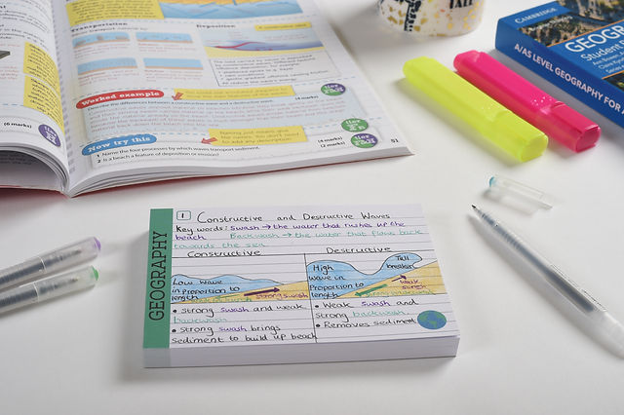
What sort of revision works (for me)?
Revision guides DO have everything in them …
AND they are colourful and have pictures … which makes them memorable
But revision guides are pretty bulky … so you need to CHUNK them into smaller parts …
Small chunks of information won’t overload your working memory
Breaking big bits of info down into smaller chunks makes it easier to remember …
… like FLASH cards!
https://www.youtube.com/watch?v=xrgyr7GXz60
A great tutorial about how to make flash cards
If you can … add question(s) onto the back of the flash card
Which subjects do you think flash cards would work for best?
Are there any subjects they might not be as useful for?

Slide 7

How to make effective flash cards. Smile with Sola
Watch it and note down some top tips here …
https://www.youtube.com/watch?v=xrgyr7GXz60
Flash cards are not the only way of revising … but they are a good way … there are lots of other techniques – just remember ACTIVE revision is more effective … just reading = 20% retention … Reading + coloured notes = 45% … and then ‘teaching’ it to someone else = 80% retention
Have a look at the thinking behind revision timetables here … https://www.youtube.com/watch?v=X0zPAC0iUtQ
Little and often is the key … 20 to 30 mins at a time

Slide 8

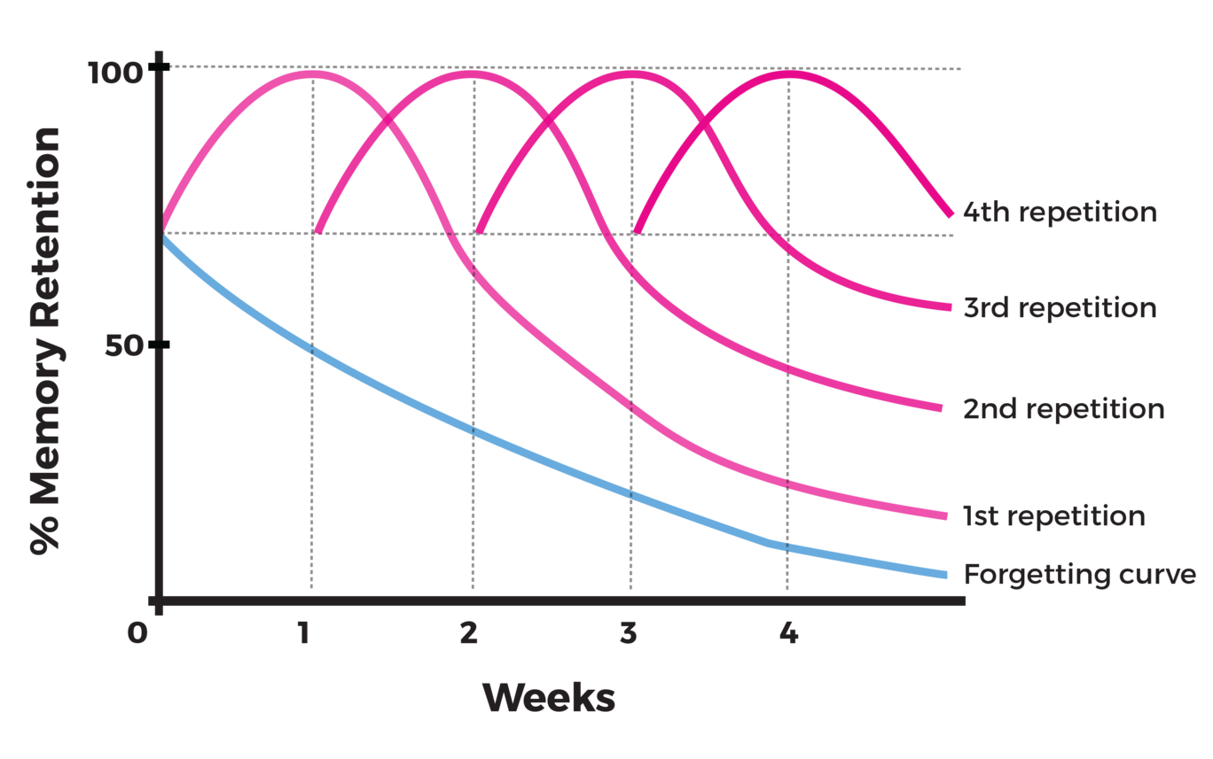
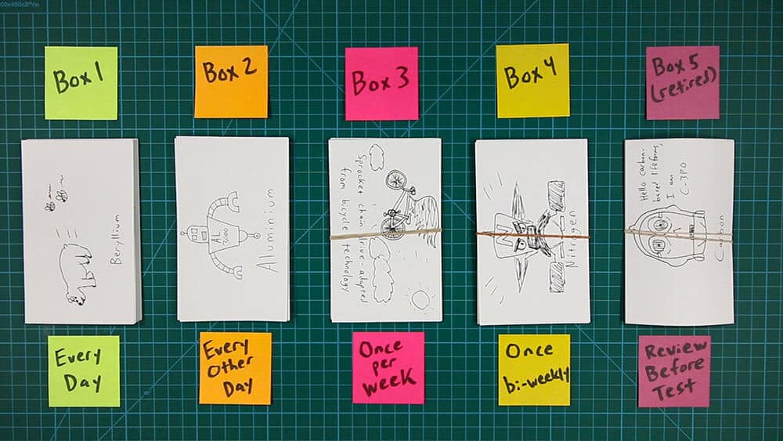
Spaced Revision & The Forgetting Curve
Once you’ve made your flash cards, sort them into 5 groups based on how easy / hard they are to remember
The gap between each revision session depends on how hard you find it each time
The forgetting curve drops off a bit less each time … meaning you remember more each time!
… and then space your revision out like this … you’ll start with lots on the left and finish with most on the right.
Lots here @ the start
Most here @ the end
https://www.youtube.com/watch?v=Bvu74No4q5I

Slide 9

Revision Timetable
 | Monday | Tuesday | Wednesday | Thursday | Friday | Saturday | Sunday
Quick morning ‘flash’ revision
7:00
8:00 | School | School | School | School | School
9:00 | School | School | School | School | School
10:00 | School | School | School | School | School
11:00 | School | School | School | School | School
12:00 | School | School | School | School | School
1:00 | School | School | School | School | School
2:00 | School | School | School | School | School
3:00 | School | School | School | School | School
4:00
5:00
6:00
7:00
8:00
9:00
10:00
It’s not just about working … you need to include
TIME OFF to …
Sleep
Fun
Relaxing
Exercise
Hobbies
Family
Friends
How much time you spend revising depends on how quickly you get bored … in your first few sessions set a timer and see how long you can focus for … don’t waste time trying too hard! Have a break and re-start.

Slide 10
Revision Tally – record every 30 minutes you do
English Lit | English Lang | Maths | Biology | Physic | Chemistry | Option 1 _____________ | Option 2 _____________ | Option 3 _____________

Slide 11
Mini tip … ‘Cheat cards’ / Last minute memory boosters
It’s not actually cheating …
BUT the day before the exam write down
The things you keep forgetting
The things you KNOW are really important in the exam
Key dates / facts / quotes you know you’re going to use
You can look at these just before the exam as last-minute memory joggers …
Bring them to school on the exam day and look at them and nothing else (to avoid stressing you out!)
As it is last minute, DON’T do more than 2 or 3 cards MAXIMUM … otherwise you will panic about how much you need to go through.

Slide 12

Exam papers; love them or hate them…they are really useful! Just like Marmite
Why are practice papers a useful part of revision?
Have you ever done a load of revision and then wondered if it’s ‘gone in’? …
… exam papers give your memory a nudge and show you what you know …
… plus … you need to know what sort of questions come up and how to answer them in the real exams!
Do I have to do a WHOLE paper each time?
NO … you can pick the bits you need more practice on …
… e.g. are you better at short questions than long answers?
… OR is there a unit / topic / subject you need to go over again?
Are timings important when I do a practice paper?
AND … if you only have 15minutes … you can just have a go at a couple of questions – so no time is wasted
Yes … because you do your exams under timed conditions too!
BUT … be flexible to start with … get your answers right first and then get them right on time …

Slide 13
Why do exams worry us?
Before the exams start
I don’t know if I’ve got everything I need.
There’s SO much to revise.
I’m worried I haven’t done enough revision for the exam.
On the day of the exam
Waiting to go into the exam … everyone else seems to know
more than me.
I don’t know what the questions will be … will I be able to answer them?
What if I panic and can’t cope in the exam?
After the exam
Other people gave different answers to me …
Other people found it easier than me …
Try to be organised … ask your teachers for notes & lists of what’s coming up … do lots of little bits of revision in the weeks before the exam …
You can only do what you can do!
No one knows the exams before you … it’s too late to change what you know … All you can do is your best – nothing more.
It’s over and done with … there is nothing you can do to change it … forget about it!
Highlight any of these that worry you …
Why do you think they get to you?
What could you say to yourself to shut this down?

Slide 14
Avoiding ‘silly’ mistakes in the exam …
Think … WHY do we make silly mistakes in exams?
https://www.youtube.com/watch?v=v4HVwUFp3OQ
Double
Check
answers
Flip through
your paper
Make an
educated
guess
Think … have you ever made any silly mistakes in any exams?
NO blank
questions
Don’t
ignore
single
marks
Command
Words
2 minute
De-stress

Slide 15

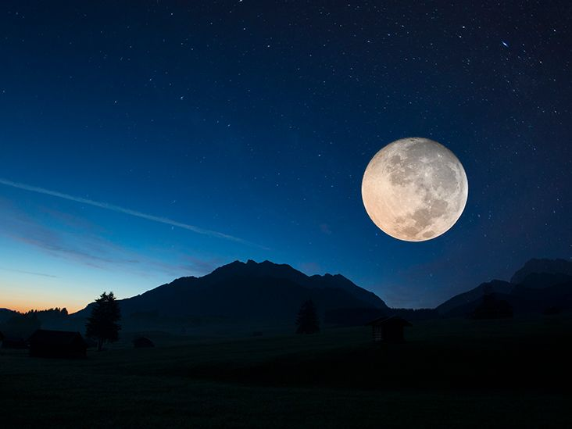





The day / night / morning before an exam …
Keep calm … the exam is going to happen … all you can do is your best … and that is PLENTY …
Sleep Well
Focus on what YOU need to do … not what anyone else is doing …
Don’t put unrealistic pressure on yourself!
Self-belief
= confidence =
success
Blue light and sleep don’t mix well & TikTok is a time waster
Be ON TIME … rushing / being late = STRESS = can’t focus
Food = Fuel = Energy

