Slide 1

How to be an amazing independent learner
LAST WEEK the aim was :
To explore memory skills which can be applied to any piece of information.
To learn about reducing / chunking / blocking of information to make it manageable.
To use memory skills to make a lot of information stick in your memory.
Combining information you need to remember AND a strong visual memory you should be able to remember more information …
This week we’re taking this a step further … but watch the video clip first … it’s about 7 mins or verbal vs visual memory
https://www.youtube.com/watch?v=0nFkQ4cQhME

Slide 2

Know it …
Understand it …
USE it …
Aims for this lesson:
To use visual and experiential memory to remembering LINKED “chunks” of information e.g. key words & meanings or ideas & explanations.
To understand how using information makes it more memorable.
Make it memorable

Slide 3

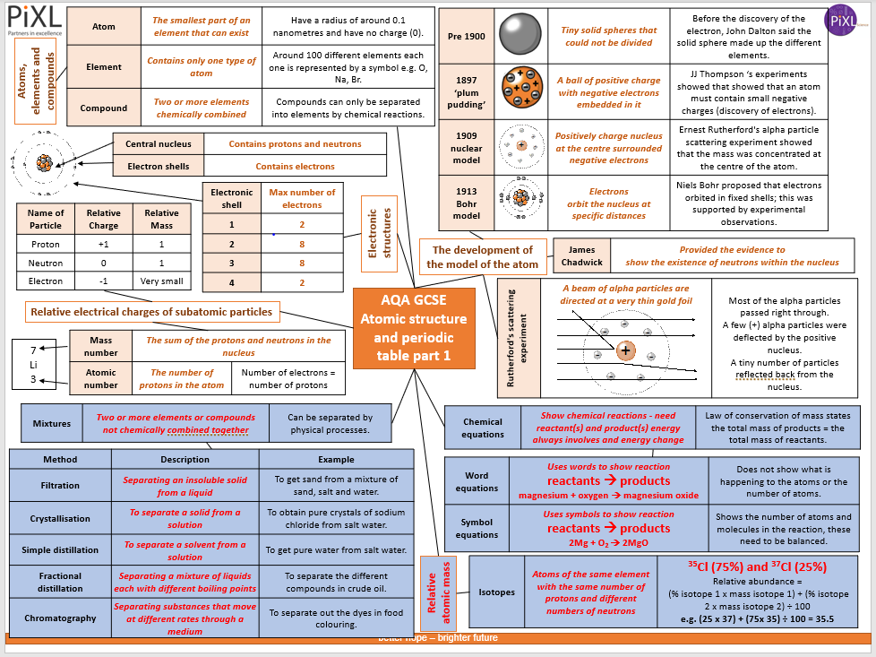
How am I EVER going to remember all of this … let alone use it in an exam?!!?
Make it memorable

Slide 4
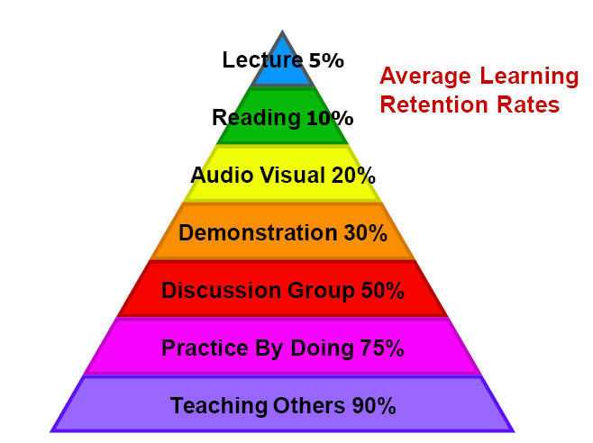
Someone just talks at you … why only 5%???
HOW MANY of you just read the notes you’re given?
Film clips … why only 20 %???
Know it
Sharing opinions … Why is it better than just listening?
Actively having a go … takes more time BUT it means you know it better …

Slide 5
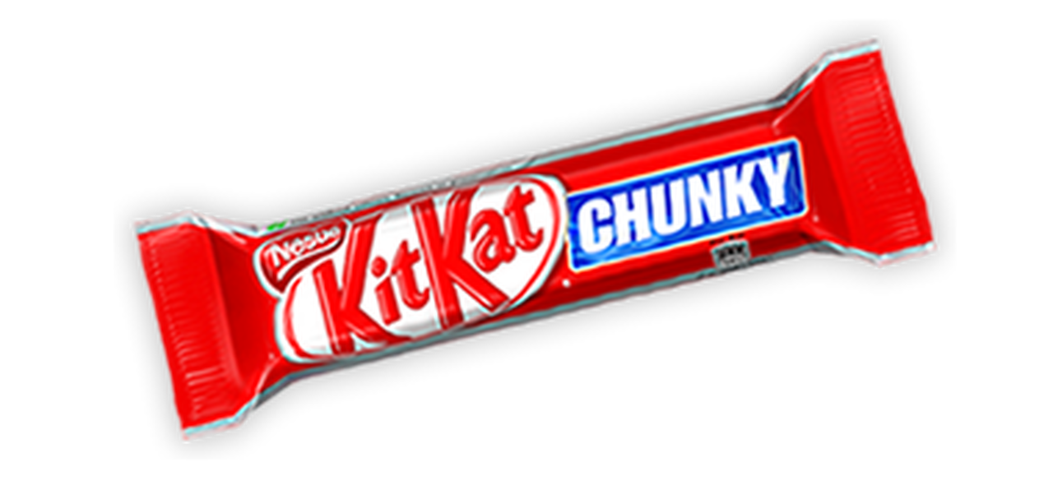
Chunk it … don’t try to learn it all
Pick a section you need to know and focus on that …
First … No writing for 2 minutes … just read it
Then cover up the information … you’ve got 5 minutes to write down as much as you can remember …
Key words
Whole sentences
Bits you remember
Examples
No peeking!
Method | Description | Example
Filtration | Separating an insoluble solid from a liquid | To get sand from a mixture of sand, salt and water.
Crystallisation | To separate a solid from a solution | To obtain pure crystals of sodium chloride from salt water.
Simple distillation | To separate a solvent from a solution | To get pure water from salt water.
Fractional distillation | Separating a mixture of liquids each with different boiling points | To separate the different compounds in crude oil.
Chromatography | Separating substances that move at different rates through a medium | To separate out the dyes in food colouring.

Slide 6

Chunk it … don’t try to learn it all
How much did you get?
Why was it so hard?
What could we have done to make it more memorable? (Remember some of the points from last lesson … )
BUT what else could you do to make it an experience?
Method | Description | Example
Filtration | Separating an insoluble solid from a liquid | To get sand from a mixture of sand, salt and water.
Crystallisation | To separate a solid from a solution | To obtain pure crystals of sodium chloride from salt water.
Simple distillation | To separate a solvent from a solution | To get pure water from salt water.
Fractional distillation | Separating a mixture of liquids each with different boiling points | To separate the different compounds in crude oil.
Chromatography | Separating substances that move at different rates through a medium | To separate out the dyes in food colouring.

Slide 7
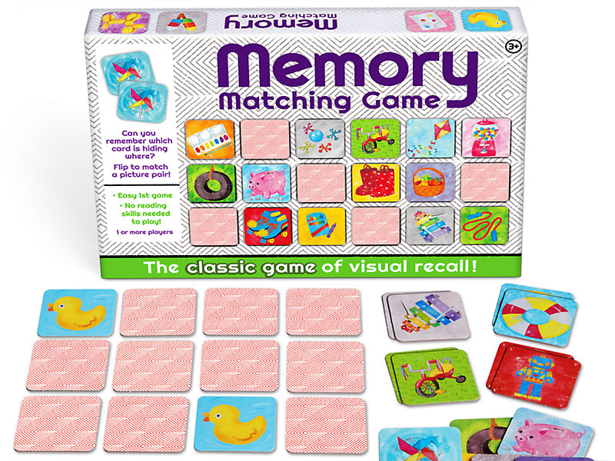

I feel a children’s game coming on!
Did you ever play this game where you put the cards face down and mix them up and they each person can turn two over … if they get a matching pair, they keep it … if not, turn them back over and REMEMBER where they were to help you get a pair next time … BUT how does it work?
Make it memorable
Visual memory & hands on experience
Cut up the table carefully so the edges are neat … then lay them out on the table writing side down … turn over 3 and see if your cards are a set (check on the next slide) …

Slide 8
Filtration | Separating an insoluble solid from a liquid | To get sand from a mixture of sand, salt and water.
Crystallisation | To separate a solid from a solution | To obtain pure crystals of sodium chloride from salt water.
Simple distillation | To separate a solvent from a solution | To get pure water from salt water.
Fractional distillation | Separating a mixture of liquids each with different boiling points | To separate the different compounds in crude oil.
Chromatography | Separating substances that move at different rates through a medium | To separate out the dyes in food colouring.

Slide 9
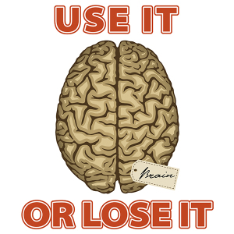


Know it …
Understand it …
USE it …
Have you EVER wondered how your teachers remember SO much information for their subject? … This is the reason why … using the information to teach it to someone else makes it stick in your memory … well 90% of it anyway … SO …
Actively having a go … takes more time BUT it means you know it better …

Slide 10
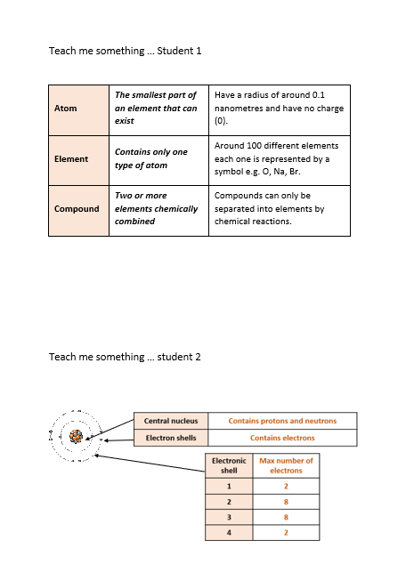
Teach me something you know …
Working in pairs … look at YOUR card … read it, highlight the important bits … THEN explain your bit of information to your partner so you’re teaching them … and then let them teach you … When you teach … you might want to draw things on a piece of paper and add labels to add a visual memory for your student! ☺

Slide 11
Know it …
Understand it …
USE it …
Aims for this lesson were:
To use visual and experiential memory to remembering LINKED “chunks” of information e.g. key words & meanings or ideas & explanations.
To understand how using information makes it more memorable.
Next week …
More ‘experiential’ memory experiences …
Make it memorable

