Slide 1

Know it …
Understand it …
USE it …
Make it memorable
LAST lesson you worked on:
Using use visual and experiential memory to remembering LINKED “chunks” of information e.g. key words & meanings or ideas & explanations.
Understanding how using information makes it more memorable.
This week …
Using memory prompts to secure knowledge in your long term memory
To understand how to retrieve information and apply it to assessment questions

Slide 2
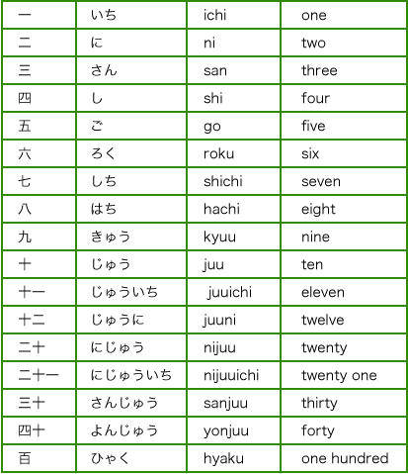
READ this … and learn
how to count to 6 in Japanese

Slide 3
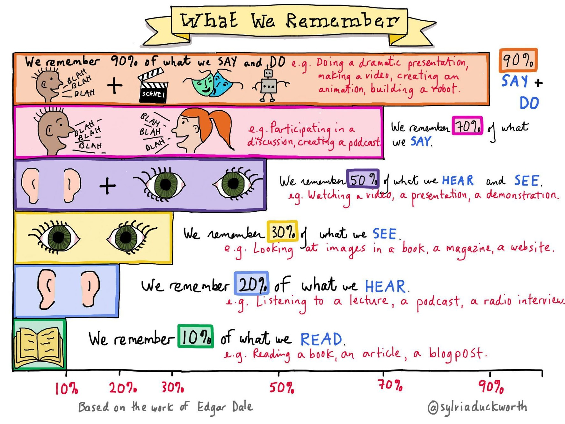
Reading it …

Slide 4
Say this out loud … and learn
how to count to 6 in Japanese

Slide 5
Saying and seeing it …

Slide 6






VISUAL memory
1
2
3
6
X
5
U
A
4
U

Slide 7
Experiential memory … add hand signal
1
2
3
6
X
5
U
A
4
U

Slide 8
How can you make this more memorable?
Energy resource | How it works | Uses | Positive | Negative
Fossil Fuels (coal, oil and gas) | Burnt to release thermal energy used to turn water into steam to turn turbines | Generating electricity, heating and transport | Provides most of the UK energy. Large reserves. Cheap to extract. Used in transport, heating and making electricity. Easy to transport. | Non-renewable. Burning coal and oil releases sulfur dioxide. When mixed with rain makes acid rain. Acid rain damages building and kills plants. Burning fossil fuels releases carbon dioxide which contributes to global warming. Serious environmental damage if oil spilt.
Nuclear | Nuclear fission process | Generating electricity | No greenhouse gases produced. Lots of energy produced from small amounts of fuel. | Non-renewable. Dangers of radioactive materials being released into air or water. Nuclear sites need high levels of security. Start up costs and decommission costs very expensive. Toxic waste needs careful storing.
Biofuel | Plant matter burnt to release thermal energy | Transport and generating electricity | Renewable. As plants grow, they remove carbon dioxide. They are ‘carbon neutral’. | Large areas of land needed to grow fuel crops. Habitats destroyed and food not grown. Emits carbon dioxide when burnt thus adding to greenhouse gases and global warming.
Tides | Every day tides rise and fall, so generation of electricity can be predicted | Generating electricity | Renewable. Predictable due to consistency of tides. No greenhouse gases produced. | Expensive to set up. A dam like structure is built across an estuary, altering habitats and causing problems for ships and boats.
Waves | Up and down motion turns turbines | Generating electricity | Renewable. No waste products. | Can be unreliable depends on wave output as large waves can stop the pistons working.
Hydroelectric | Falling water spins a turbine | Generating electricity | Renewable. No waste products. | Habitats destroyed when dam is built.
Wind | Movement causes turbine to spin which turns a generator | Generating electricity | Renewable. No waste products. | Unreliable – wind varies. Visual and noise pollution. Dangerous to migrating birds.
Solar | Directly heats objects in solar panels or sunlight captured in photovoltaic cells | Generating electricity and some heating | Renewable. No waste products. | Making and installing solar panels expensive. Unreliable due to light intensity.
Geothermal | Hot rocks under the ground heats water to produce steam to turn turbine | Generating electricity and heating | Renewable. Clean. No greenhouse gases produced. | Limited to a small number of countries. Geothermal power stations can cause earthquake tremors.

Slide 9


Make it memorable
From Lesson 1 …
Chunk it … do you need to know it ALL at once or can you learn 4 at a time?
2 Renewables
2 Non-renewables
From Lesson 1 & 2 …
Will it go into your VISUAL memory?
Colour
Pictures
Make it look interesting … not just notes on a page
From Lesson 2 & this one …
Are you ACTIVELY learning it?
Work with a partner … pick different fuels to learn
Explain your fuels to your partner
Include hand gestures
Read it …
Write it …
Draw it …
Colour it …
Say it …
Do it …
TEACH IT …
Remember it
What worked well?
What made it more memorable?
Choose & get what you need in 5 minutes
20 minutes
10 minutes … 5 minutes each

Slide 10
Quick Quiz … check you actually know it …
10 minutes to write this down on some paper
… 3 mins x 3 + 1 minute to check it (!!!)
Energy Source | Advantage | Disadvantage
e.g. Biofuel | Renewable & carbon neutral | Produces Co2 when burned Uses a lot of land = Habitat destruction
Renewable … e.g.
Non-renewable … e.g.
ONE MORE … e.g.

Slide 11
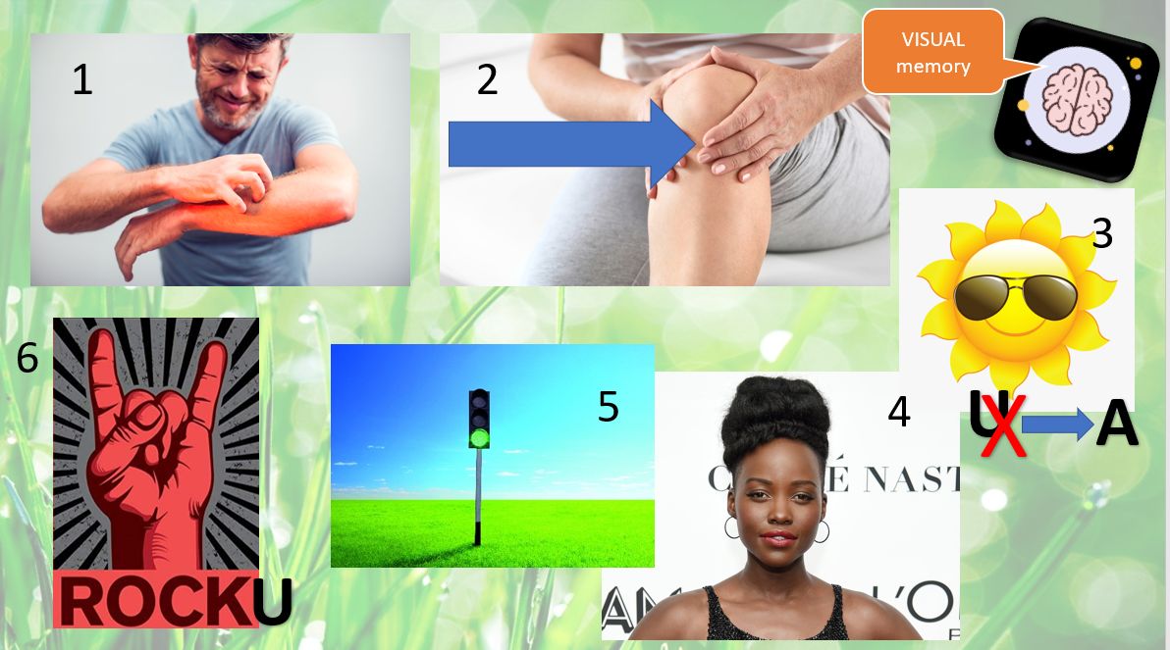
What can you remember?

Slide 12


Next week:
How not to get stressed out by tests / exams / mocks
This week …
Using memory prompts to secure knowledge in your long term memory
To understand how to retrieve information and apply it to assessment questions
Make it memorable

