Slide 1

How to tame exam stress
Or at least make it work for you …

Slide 2
What is stress?
Aims for this week …
To be able to recognise the signs of stress and the causes of stress
To be able to create a personal stress reduction strategy
https://www.youtube.com/watch?v=hnpQrMqDoqE
This explains what stress is and why it happens …
https://www.youtube.com/watch?v=zsFd84C9-vA
A very American ‘movie’ about stress … concentrate … it goes (stressfully) fast but it does explain different types of stress

Slide 3
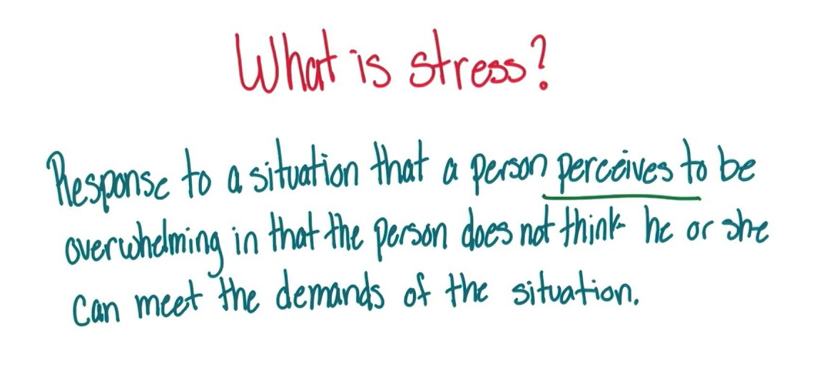
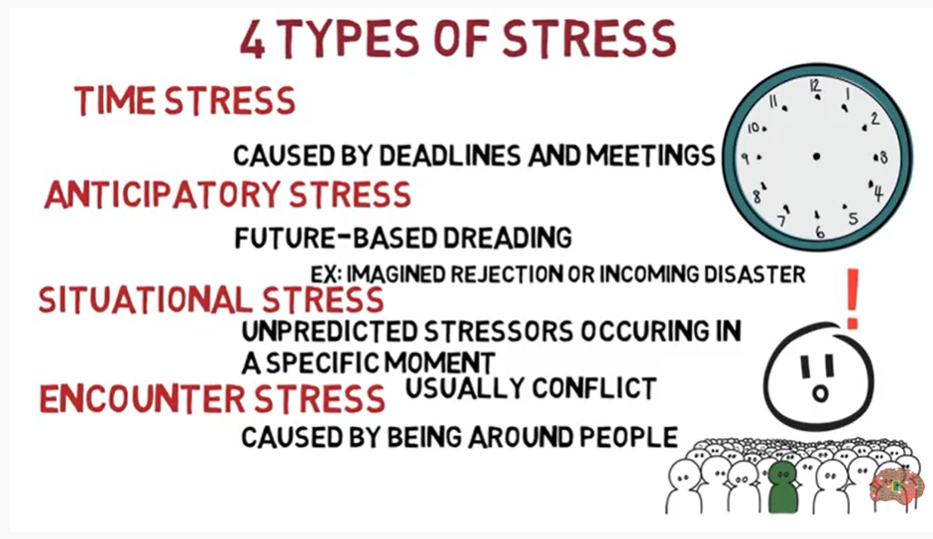
What is stress? What does it do to you?
It’s hard to get a definition of stress … because it’s so personal BUT some things affect most people …
Write down 10 things you find stressful … colour code them
Compare them with the class … what common answers are coming up?

Slide 4
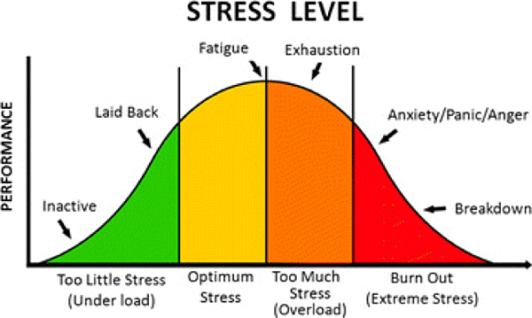
Stress CAN be helpful … believe it or not
Stress CAN be useful because it is a motivator …
HANDS UP …
Have you ever had a piece of work / revision to do and been given it weeks before the deadline and left it to the last minute?
WHY did you leave it to the last minute?
HOW did that make you feel?
Did it affect the quality of your work / the results you got? WHY?

Slide 5
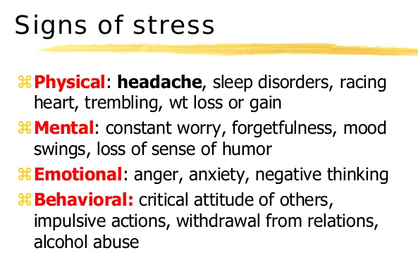
Know yourself … know your signs of stress
Different people react in different ways …

Slide 6
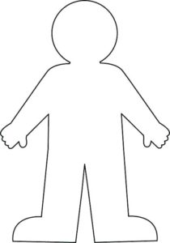
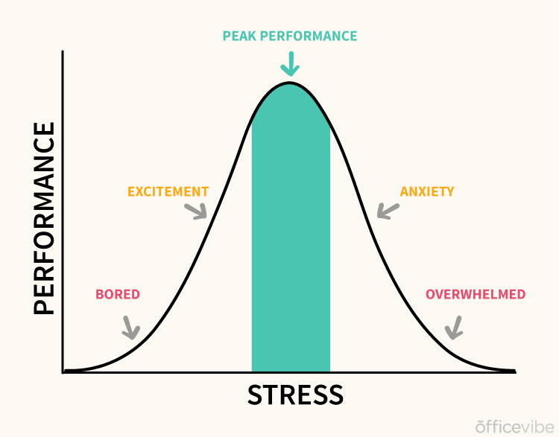
Can you recognise when stress is OK and when it’s too much?
Time for a bit of reflection … you have a copy of this … can you annotate it in two colours …
How you physically feel
Things that get you to this state / level of stress
You can share as much or as little as you want but don’t leave this lying around if you don’t want people to see it OR use codes that mean something to you so it can stay private e.g. don’t name names!

Slide 7

Facing stress can make you feel stressed …
Listen to this …
https://www.youtube.com/watch?v=em2F5J60Lik
Watch this …
https://www.youtube.com/watch?v=Wdbbtgf05Ek

Slide 8
Why does that work?
https://www.youtube.com/watch?v=hKnRKy5Wu7c
Try It again and really focus on it …
https://www.youtube.com/watch?v=Wdbbtgf05Ek
This little meditation makes you focus on your breathing … it makes you aware of the moment you’re in … take time out of your stress and anxiety to slow your body down

Slide 9
So how could you use it?
Picture this … you’ve got an exam coming up … how do you prepare for it?
1 or 2 weeks before the exam I make sure that I have ….
The weekend before the exam I make sure that I have ….
The night before the exam I make sure that I have ….
On the morning of the exam I make sure that I have ….

Slide 10
SO … what do you NEED to do to manage your stress?
… be honest with yourself … sometimes we cause our own stress … have a think … what do you see people doing that causes stress?
Especially work stress …
So if we cause some of our own stress, we could take control of some of the stress we feel … so what do you think you could do?
5 (honest) things I need to do to be less stressed about exams are …
1 ____________________________ because ____________________ _________________________________________________________
2 ____________________________ because ____________________ _________________________________________________________
3 ____________________________ because ____________________ _________________________________________________________
4 ____________________________ because ____________________ _________________________________________________________
5 ____________________________ because ____________________ _________________________________________________________

Slide 11
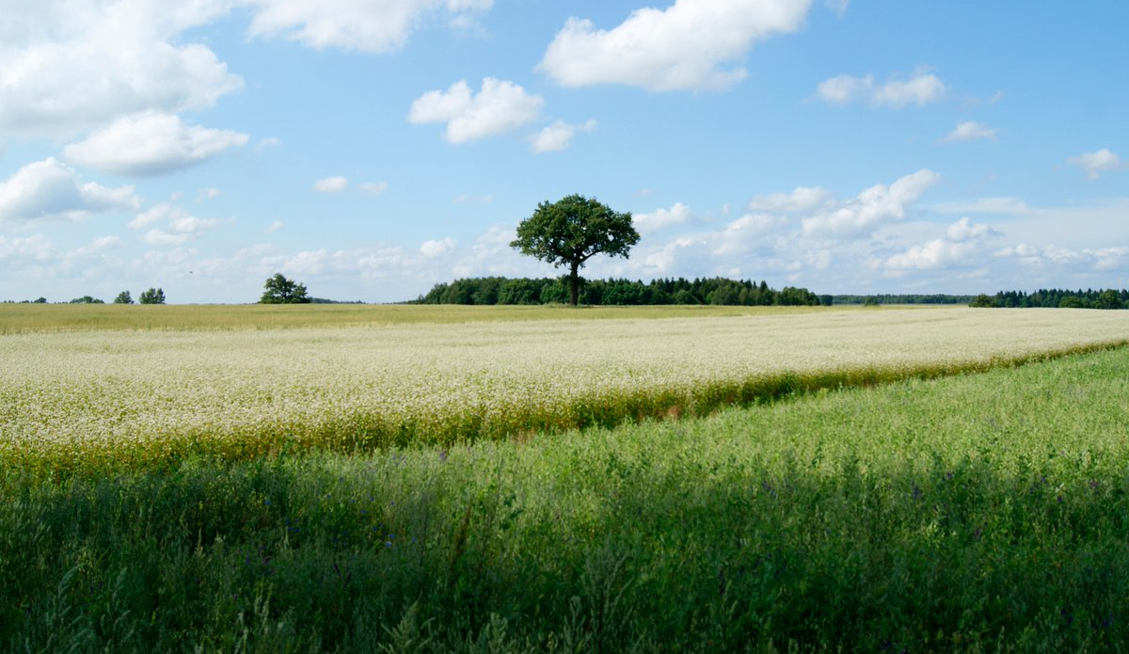

Slide 12
