Slide 1

Mixing Together what you’ve learned so far to make sure you’re ready for an exam …
Aim: This week’s focus is to show you that taking SOME of the stress out of it makes tests easier.
How many methods do you remember?
Can you EXPLAIN what these are?
Chunking knowledge
Visual memory
Colour memory
Experiential memory
Optimal stress
We looked at stress last week to create a gap between this week (when you need to remember it) and the first three week … just like most exams … you have time to forget it …

Slide 2
This week we’re looking at low stakes testing
Can you remember how to count to 6 in Japanese?
Have a chat with your neighbour and see if you can get all 6 between you …
Eek … no pressure … think back to your experiences and actions
That makes it a bit less stressful …

Slide 3
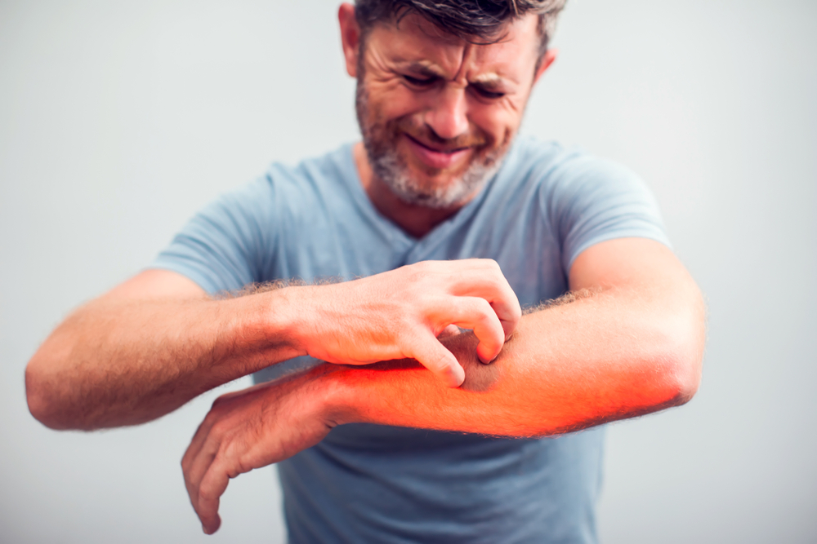
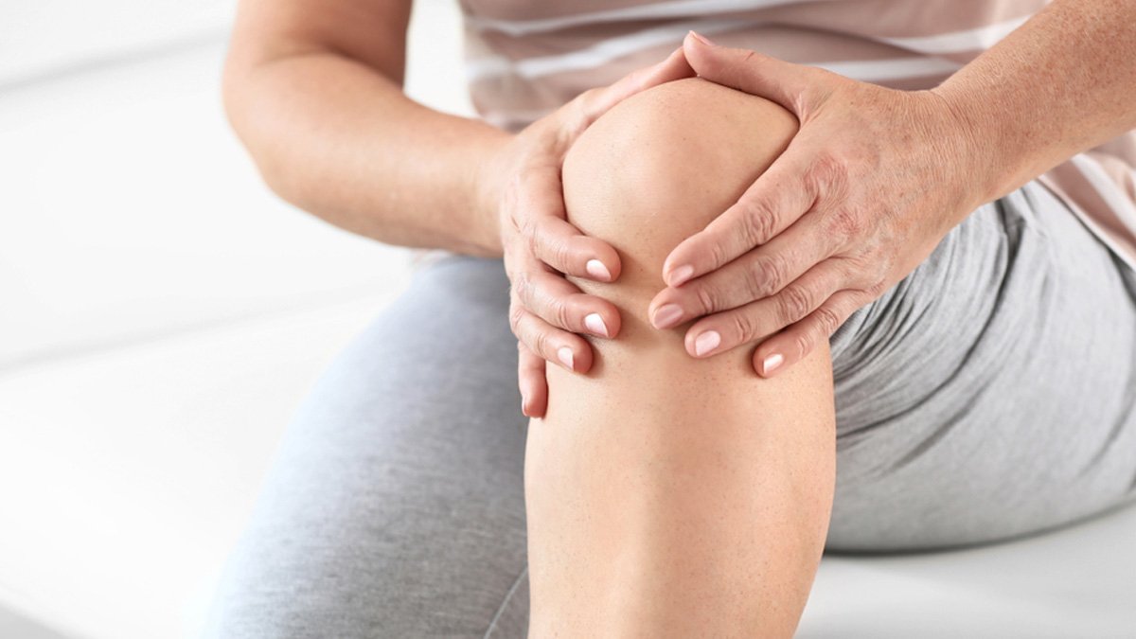
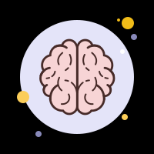




Experiential memory … add hand signal
1
2
3
6
X
5
U
A
4
U

Slide 4
Was that stressful?
WHY?
No one was judging you on the outcome
You had support
Was that stressful?
WHY?
You prepared for it 2 weeks ago
You had a good knowledge of it
You had done lots of things to reduce the pressure on you

Slide 5
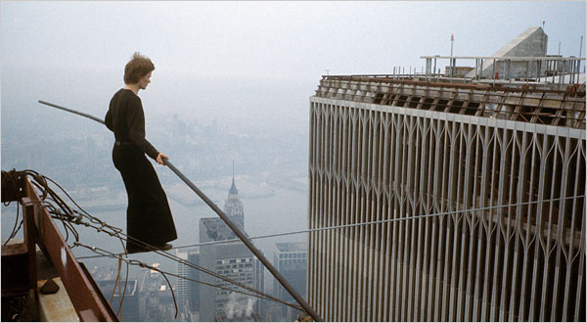

What could possibly go wrong?
Write down a quick list of all the awful things that could go wrong in these images of Philippe Petit in New York …
He walked on a tension wire between the twin towers of the World Trade Centre … and had a lie down in the middle

Slide 6

How would doing this make you feel?
Heart rate
Adrenaline
Muscles
Ability to cope with distractions
Confidence
Anxiety
https://www.youtube.com/watch?v=uwbil5puqng
https://www.youtube.com/watch?v=tynHJqQfXMQ
Does going into an exam make you feel some of these?

Slide 7
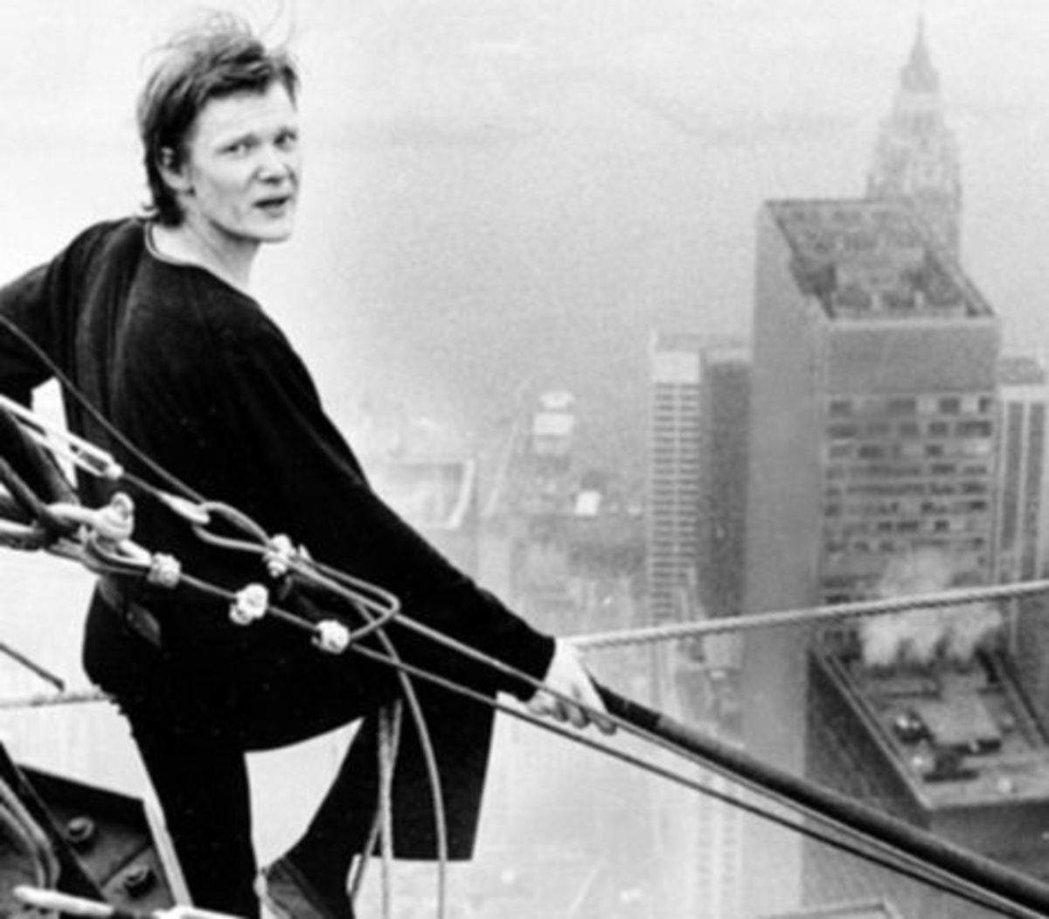
HOW can he do that ??!?!?””??!?*&!>”>££???
Choose to do it
Learn how to do it
PRACTICE
Plan
Take on the challenge
Be ready for the challenge
DO IT
Stay focussed
Survive ☺
You can’t miss out this stage … otherwise you risk failure!
GCSEs are the same (ish)
Choose your options
Put in the work in the lessons
Practice exam questions – learn how
Revise for the exam – be ready
Sit the exam

Slide 8
So get ready to walk the tension wire …
Philippe Petit is still alive (yay) and did those wire walks because he felt confident to do them – in his mind it was ‘low stakes’ when he walked …
‘Low stakes’ means that there isn’t that risks are reduced to a minimum. This allows you to try something without being overly worried about the consequences. It doesn’t mean you don’t care, or that it’s not important.
Coming to school for you was ‘low stakes’ this morning … you made it out of the house fully clothed and ready for the day … you got to school without being hurt (hopefully) … you made it to this lesson without a Sharknado wiping out the school and eating all the students … low stakes. But you or the people around you have made it that way …

Slide 9
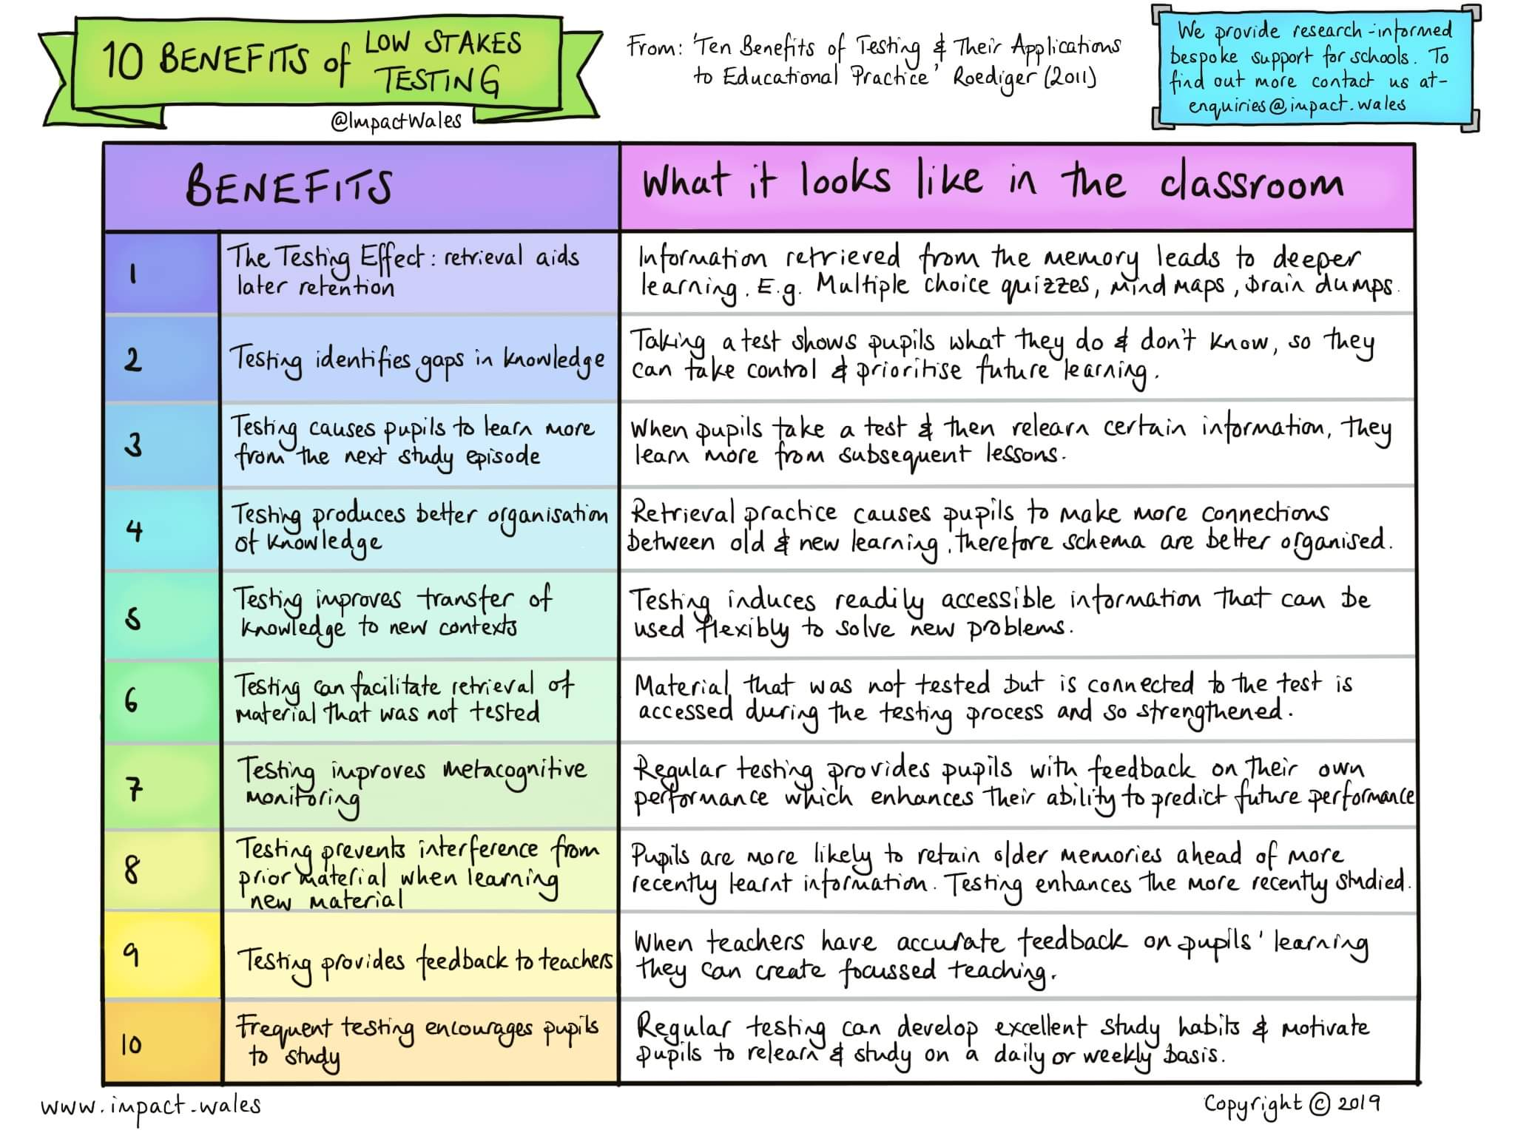
SO … low stakes testing is a good option when you’re trying to learn and remember things … after all … how do you KNOW what you know? …
Without having to worry about not knowing it …

Slide 10
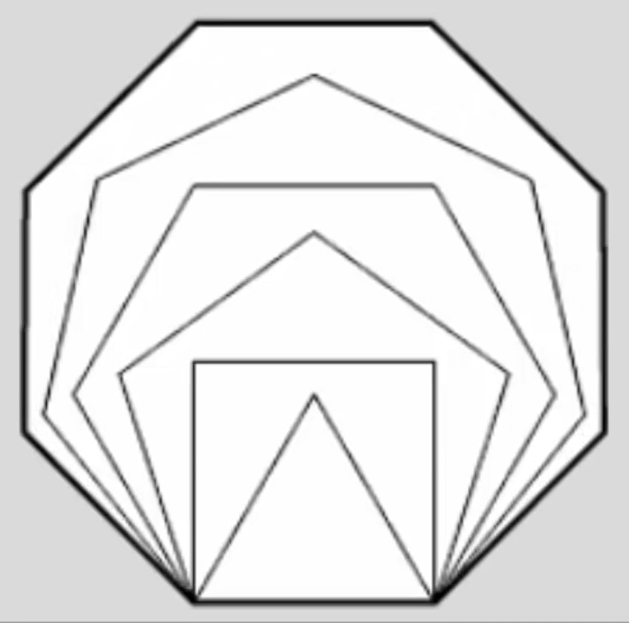
SO if you need a minute to gather your thought and collect some things …
For the next part of the lesson you will need …
KNOWLEDGE … choose a partner … one of you does English and the other does Science
English – Dr Jekyll & Mr Hyde
Science – Particles
EQUIPMENT …
A3 paper
Lined paper
Felt tips
A CHUNK of information to focus on … choose your focus from the information sheets …
Lined paper to write 3 questions on
Listen to this …
https://www.youtube.com/watch?v=em2F5J60Lik
Watch this …
https://www.youtube.com/watch?v=Wdbbtgf05Ek

Slide 11
TO DO …
Working with a partner … Choose between you who is doing science and who is doing English
Look at what you’ve got and choose a CHUNK to learn (and teach)… (5 mins)
Use A3 paper and pens to produce a VISUAL and COLOURFUL revision poster … (15mins)
EXPERIENCE the information by teaching it to your partner … (10mins … 5mins each)
Once you’ve taught it … write out 3 questions about your information on lined paper … (5 mins) … writing questions is a memorable experience in itself!
Give your questions to your partner … and have a go at your partner’s low stakes test … (8mins)

Slide 12
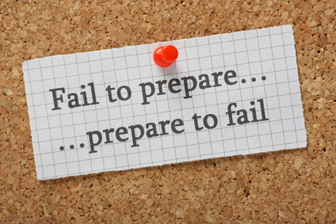
SO how was it for you?
This lesson you’ve focussed on how YOU can reduce the stakes when you’re being tested … which helps you keep stress at an optimal level
YOU are in control of this … don’t sell yourself short
Be ready and be in control

