Slide 1


Know Yourself
Aims for this session:
To know your own work habits …
… and understand the impact they have.
To think about WHY you are doing all of this work in school and what outcomes you want.
Be honest with yourself
How can you achieve your personal best?

Slide 2
You’ve learned a LOT this term about how you learn … but to make these lessons useful to you, you need to think about what you’re going to do with this information …
Time for a little game called “Never have I ever …”
The rules …
State a bad habit like this … “Never have I ever picked my nose …”
IF you HAVE done it … you need to put your hand up …
… you’ll be surprised by how many hands go up … this should show you that you’re not alone in some work habits

Slide 3
“Never have I ever …”
Known about a test for two or three weeks and crammed revision the day before the test …
Rolled my eyes when a teacher has said “this mock / test is important” (forget about other subjects for now)
Completely forgotten there was a test, done no revision and hope for the best …
Left work / revision to the last minute and told myself “I work better under pressure so there’s no point starting too early!” and then got stressed about the exam the day before
Said to yourself “It’s fine, it’s only a mock … I’ll work harder / be more ready for the real thing …”
Got the result back from my test and felt a bit disappointed but maybe not completely surprised
Gone into a test feeling a bit sick / nervous because I KNOW I haven’t done enough revision to be properly ready for it …
Sat up really late (past midnight)to revise and then felt too tired the next day to do well in the exam.

Slide 4

If you put your hand up … what does it mean???
It doesn’t mean you’re a terrible student and you’re going to fail everything …
It means that you’re a normal human teenager … we’ve ALL done it!
It means you maybe need to get a bit more organised and (in the words of Nike) … just do it!
It’s worth thinking about WHY … is you know (your) why, it make sit easier to do it …

Slide 5
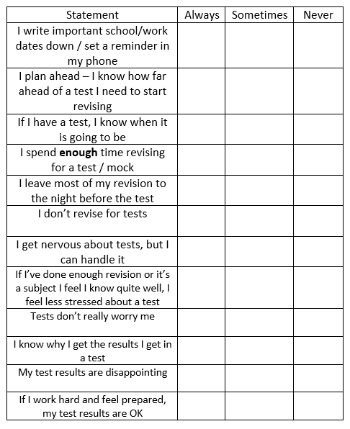
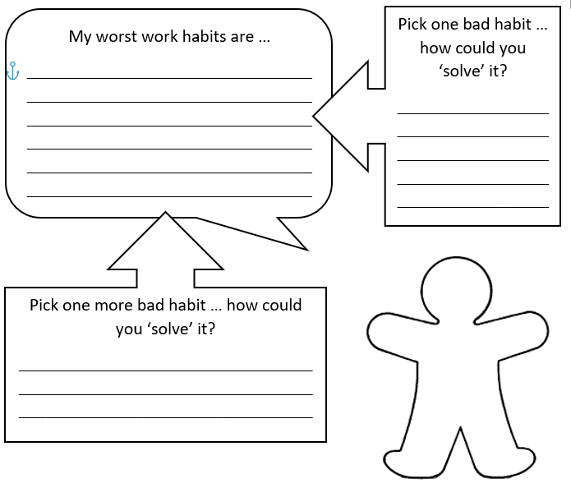
Have a go … how well do you know yourself?

Slide 6

Finding your WHY … why are you doing all this work in school?
Do you know what you want to do / be in the future?
If you do … that’s amazing … not everyone does …
If you don’t / can’t name it … don’t let that stop you … think about what you do / don’t want in the future … do you want to … travel … make your Mum proud of you … do a practical job … be in charge of other people … own your own home … work alone / with other people … be outside / inside when you work … work with animals / kids etc.
What you want to be / do will change a lot over time and as life moves on and changes … but try to hang on to WHY you do things

Slide 7
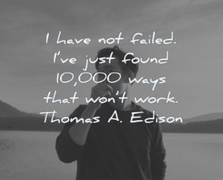
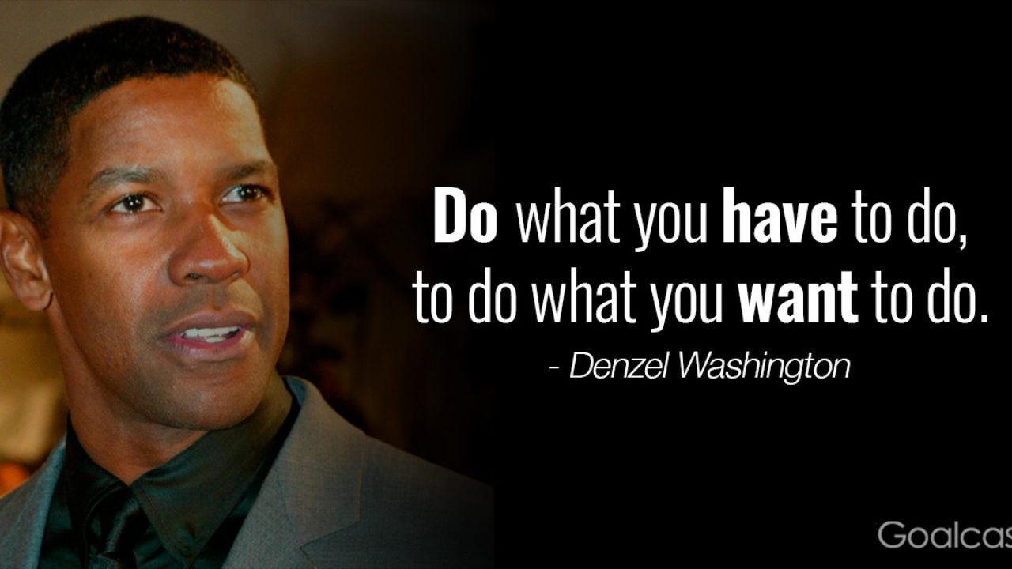
https://www.youtube.com/watch?v=0FB9i7P9Zs4
Working hard … works … so what are you going to do with what you have?
Don’t know who Denzel Washington is?
Denzel Washington paid for Black Panther star Chadwick Boseman to study at Oxford
https://www.cnbc.com/2018/03/02/denzel-washington-paid-for-chadwick-boseman-to-study-at-oxford.html
Boseman didn’t speak to Denzel Washington about this until he’d become a success, so he could thank Washington for his help, without Washington thinking he wanted something more.
Boseman accepted the help and was determined to be the very best he could be to honour the help he had received.

Slide 8
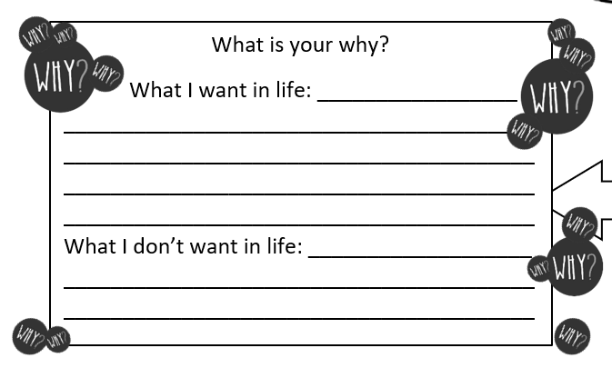
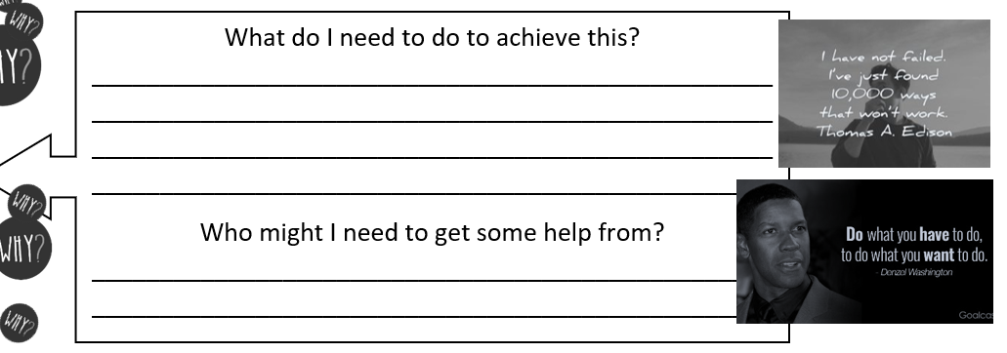
Finding your WHY … what do you want and what do you need to do to make it happen?
Aims for this session were:
To know your own work habits …
… and understand the impact they have (now and potentially in the future).
To think about WHY you are doing all of this work in school and what outcomes you want.

