Slide 1
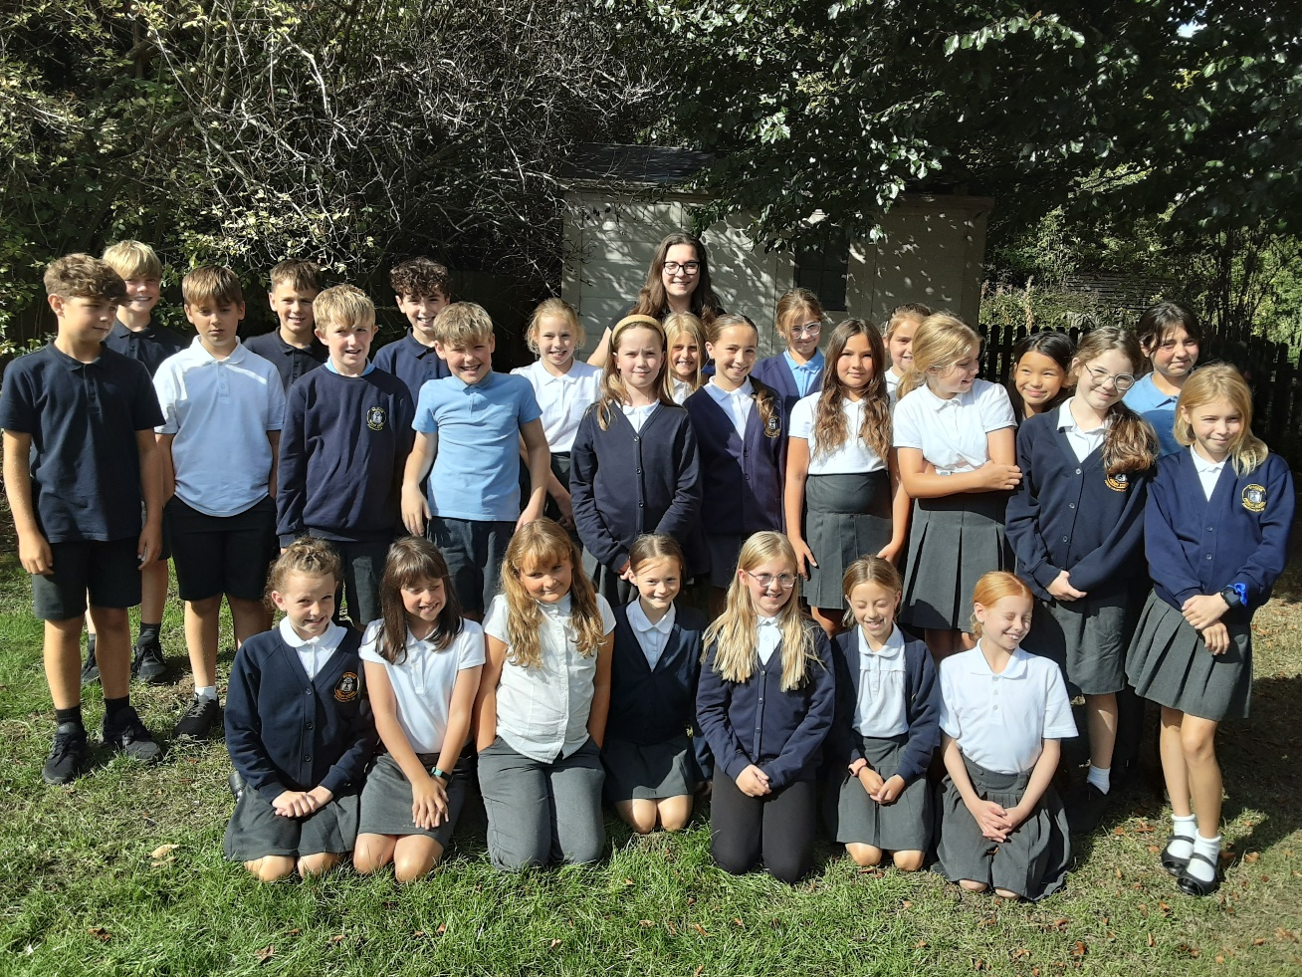

Welcome to Class 6! Parent Information Session

Slide 2
Everyday Information
Doors open at 8:50am and will close at 9:00am.
Messages to the teacher – planner, staff welcoming children in the morning, email or phone call to the office.
Water bottles – named and appropriate size.
Taken home each day and returned.
Snacks
All children can bring in a piece of fresh fruit or vegetable as a snack for morning break.
School finishes at 3:25pm
Notes:
Remind parents that you may not get back to them immediately, but they will get back to you in a reasonable amount of time.

Slide 3
Everyday Information: Walking Home
Consent forms
Mobile phones – safe in classroom cupboard
Children are representing the school, and we would ask you to remind them of this if you are giving that responsibility.

Slide 4
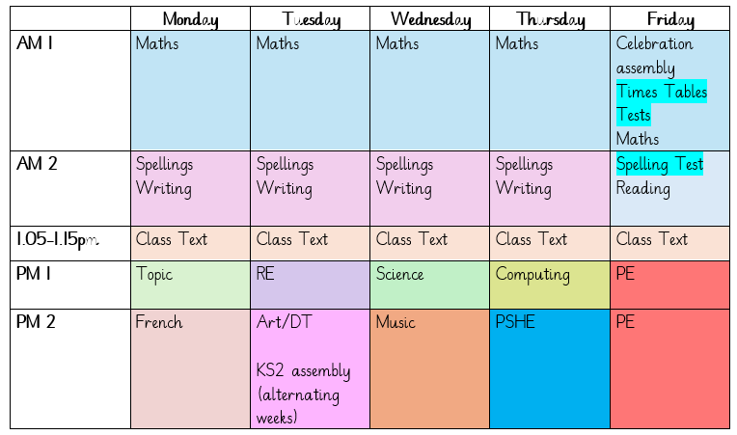
A typical week in our class

Slide 5
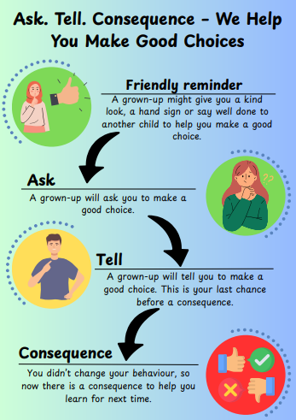
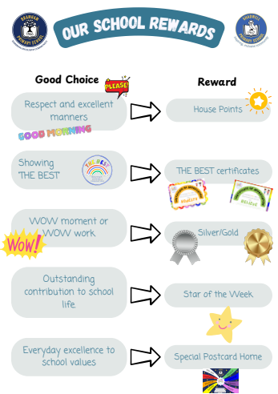

Slide 6
PE
Our PE day is on Friday.
On PE day, children are to wear PE kit all day.
Just a reminder our school PE kit is:
House-colour plain t-shirt (no logos) - these can be purchased via the school office.
Black or navy shorts or tracksuit bottoms.
Trainers
Dark-coloured (navy or black) fleece, jumper or jacket.

Slide 7
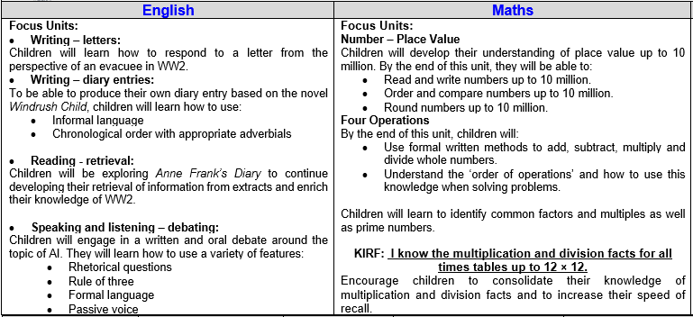
Curriculum Newsletter
Notes:
Share with parents the following:
Maths and English will outline explicit objectives for the half term. In KS2, if you child has a tutor, for example, this could be given to the tutor to let them know what we are focusing on.
Curriculum – what we are learning and the key elements of learning.
Vocabulary – this is specialist vocabulary that we want children to be confident with, it would be very helpful if you could use it or talk about it at home to build confidence.

Slide 8

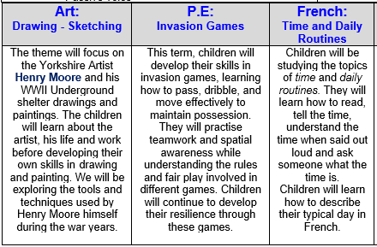

Slide 9
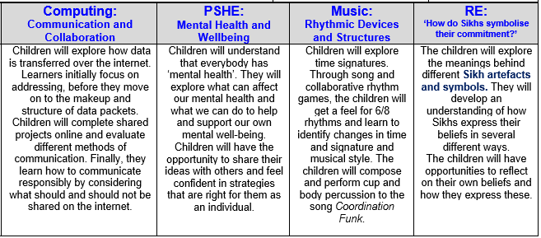

Slide 10
Homework (KS2)
Homework is given out on a Thursday and returned on a Tuesday.
Any homework given will be to revise previous learning (for example year previous refresher) or consolidate recent learning.
We would encourage children to complete homework independently.
Homework presentation should be given the same care as it would be schoolwork.
If a child is stuck, encourage them to come and ask for help on either a Friday or a Monday.
Notes:
Teacher to explain to parents that homework shouldn't take children longer that 30 minutes and shouldn't cause upset and distress at home.

Slide 11
Reading Books
Two types of reading books coming home:
Scheme Books: Learning to Read
Levelled books targeted at current reading level.
Please listen to your child read to you and support.
Ideally, read the same book more than once to build fluency.
Keep in bag daily for regular return.
Children should be reading daily and recording this in their planners (due to arrive soon).
If your child is a ‘free reader’, they can either choose a book from the reading corner or bring one from home.
Joy Books: Learning to LOVE reading
Free choice from the reading corner every Friday (or home if children prefer).
Might be trickier to read, may need help or could read together.
Notes:
Explain to parents that we say typically on this day because for example with RWI book, we only send them home when we are confident they are fluent – so if takes an extra day of of reading, we will delay if necessary.

Slide 12
Dates for your Diary
Flu Vaccinations – Tuesday 23rd September
Thursday 25th September – WW2 Evacuee Day
Monday 29th September – Class Photos
Parents Evenings: Tuesday 21st and Thursday 23rd October
Yorkshire Air Museum trip: Thursday 13th November
SATs Week: Monday 11th – Thursday 14th May
Residential: Wednesday 18th – Friday 20th March
RSE information sessions: dates to be confirmed

Slide 13

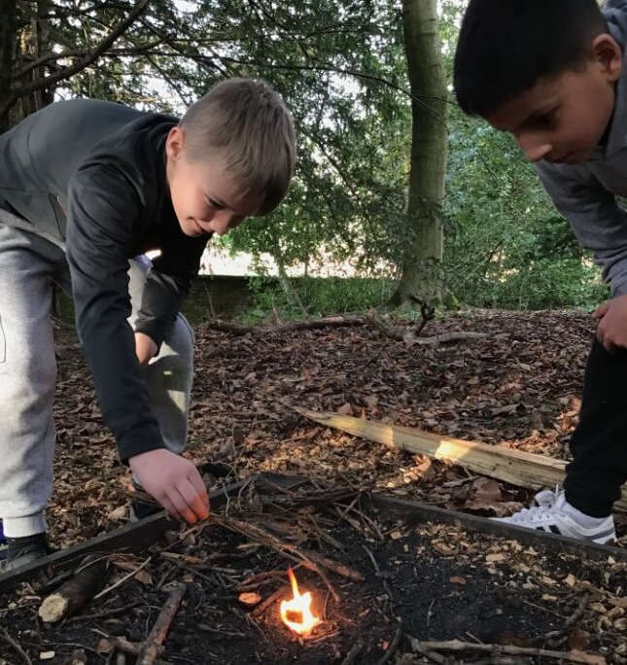
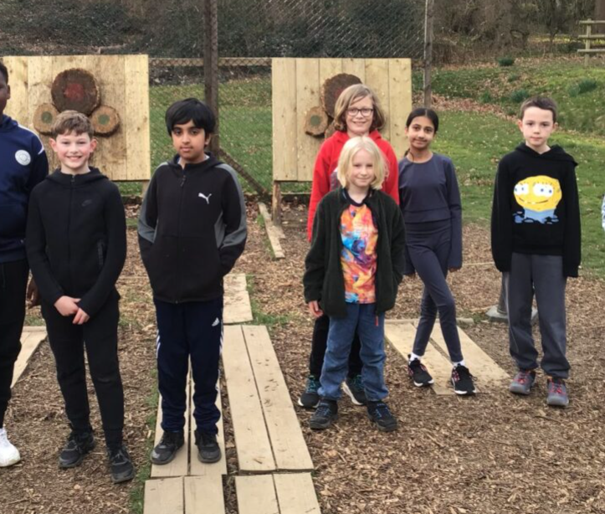
Residential 2026: Willersley Castle
Wednesday 18th March – Friday 20th March 2026
Inclusive venue – we can look at support to ensure all children join us!
£253.59 includes:
Two nights accommodation within Willersley Castle
9 adventure activities
meals
Coach transport
Payment plan available if needed.
Parent information talk in the new year!

Slide 14
Life in Year 6
WW2 Topic, including Evacuee Day and Yorkshire Air Museum trip, as well as a visitor coming in to tell us about the Dambusters mission!
Creating an electrical board game
Global Economy Day, including designing their own products based on a budget
Residential
Buddies
SATs booster sessions
SATs week
Writing inspired by short films
Production
High School Transition
Leavers Assembly

Slide 15

Thank you! Any questions?

