Slide 1
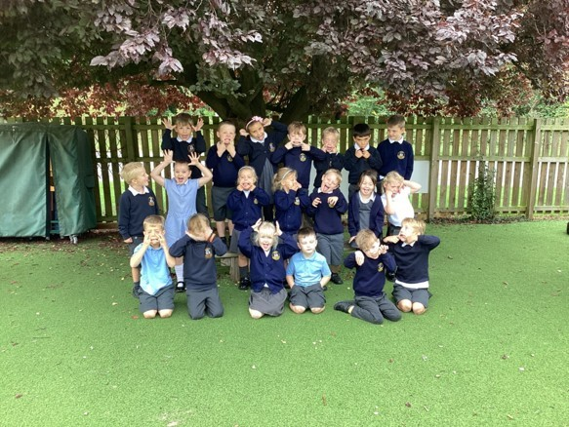

Welcome to Class One
Parent Information Session

Slide 2

Everyday Information
Doors open at 8:50am and will close at 9:00am.
Messages to the teacher –staff welcoming children in the morning, email or phone call to the office.
Water bottled – named and appropriate size.
  Taken home each day and returned.
Snacks
  Reception and KS1 are provided with an afternoon snack.
  All children can bring in a piece of fresh fruit or vegetable as a snack for morning break.
School finishes at 3:25pm
Notes:
Remind parents that you may not get back to them immediately, but they will get back to you in a reasonable amount of time.

Slide 3
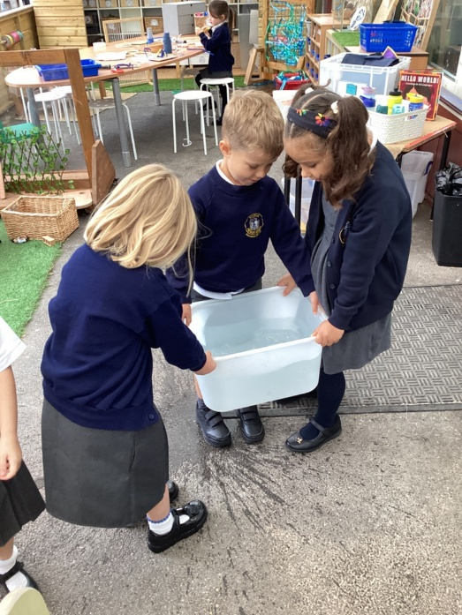
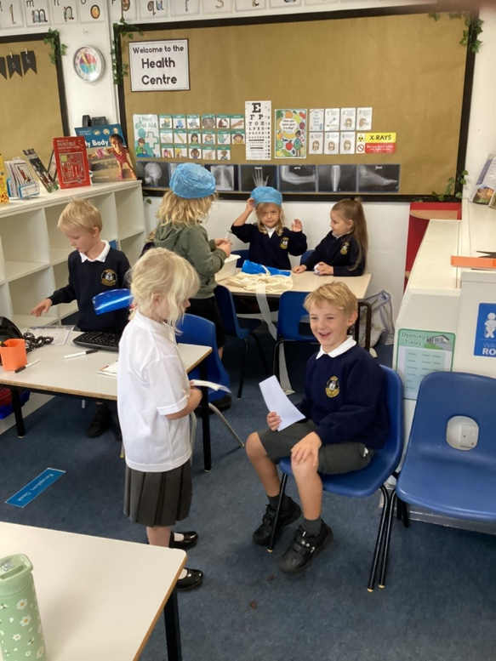
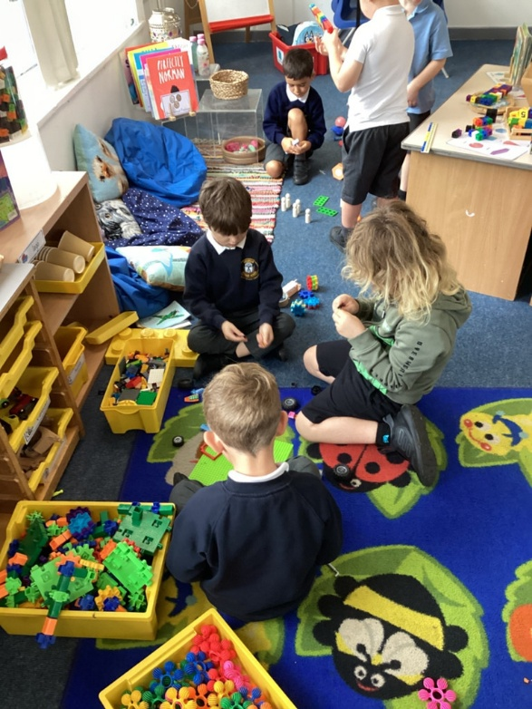
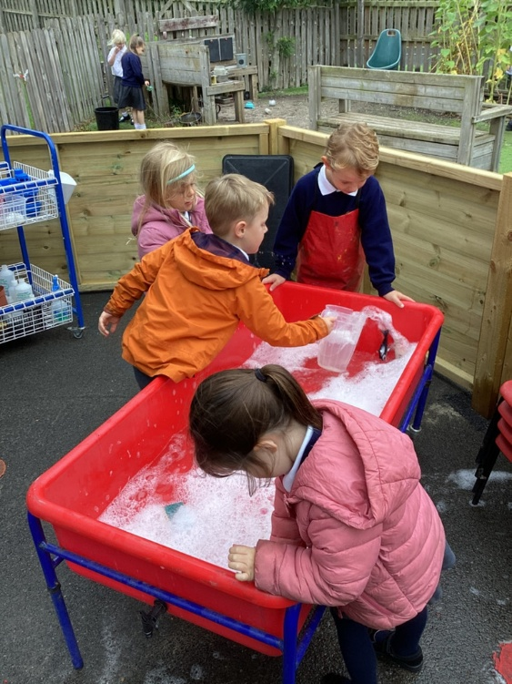
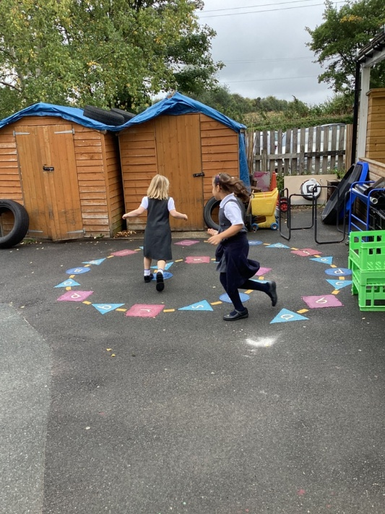
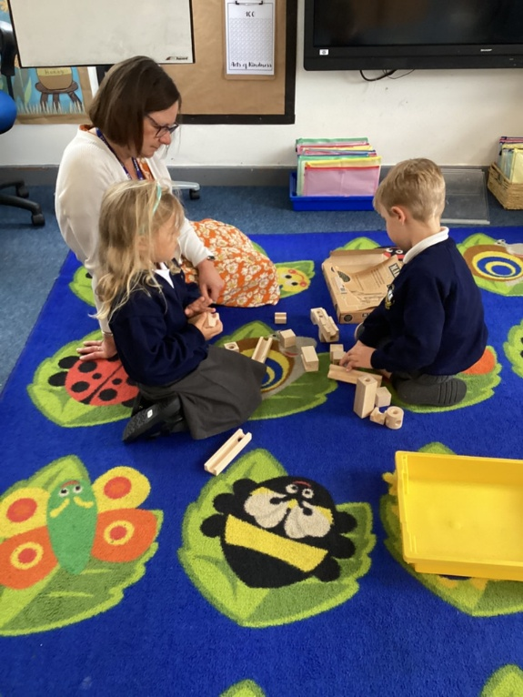
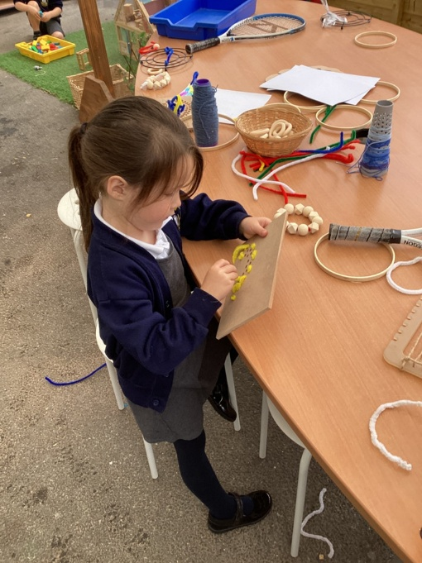
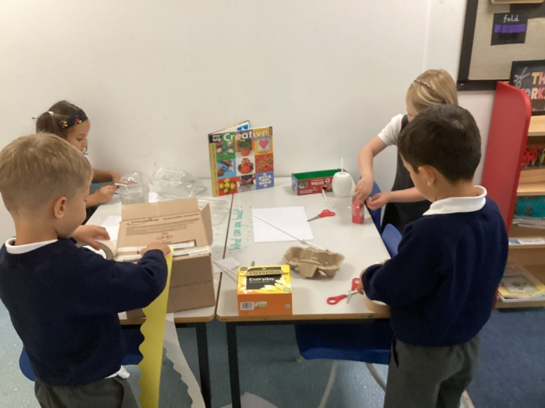
Continuous Provision in Year 1

Slide 4
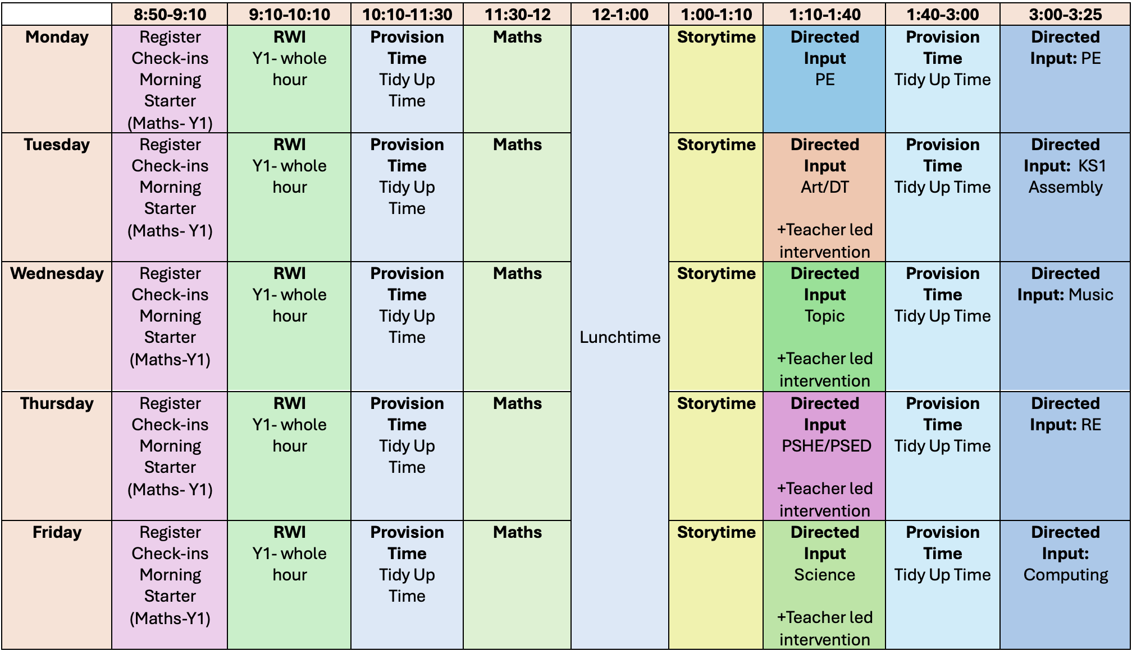
A typical week in our class

Slide 5

PE
Our PE day is on Monday.
On PE day, children are to wear PE kit all day.
Just a reminder our school PE kit is
  House-colour plain t-shirt (no logos) - these can be purchased via the school office.
  Black or navy shorts or tracksuit bottoms.
  Trainers
  Dark-coloured (navy or black) fleece, jumper or jacket.

Slide 6
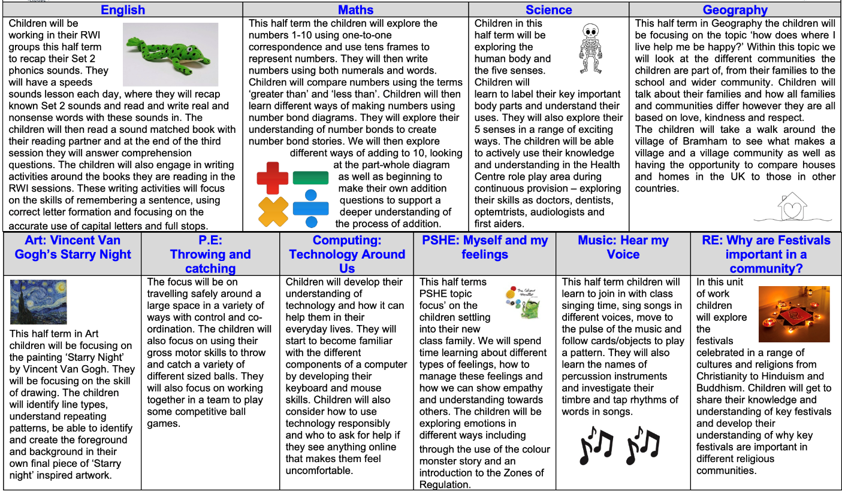
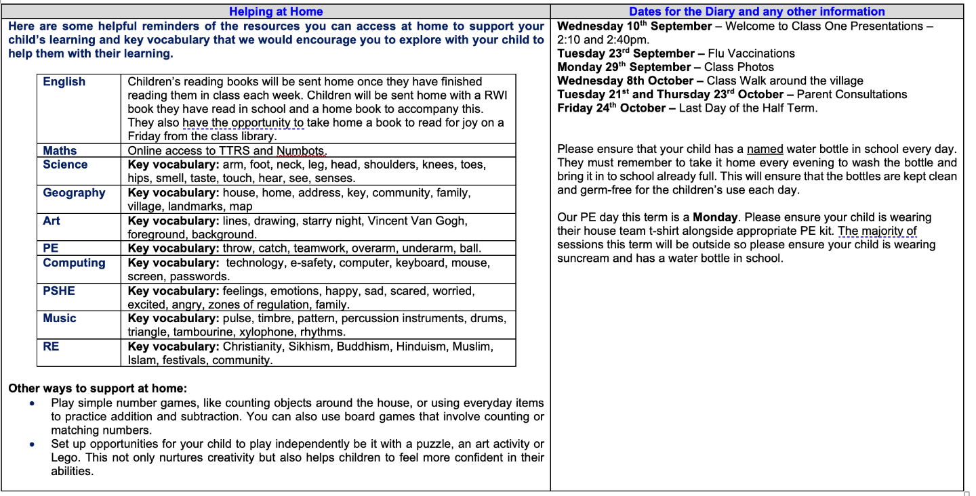
Curriculum Newsletter
Notes:
Share with parents the following:
Maths and English will outline explicit objectives for the half term. In KS2, if you child has a tutor, for example, this could be given to the tutor to let them know what we are focusing on.
Curriculum – what we are learning and the key elements of learning.
Vocabulary – this is specialist vocabulary that we want children to be confident with, it would be very helpful if you could use it or talk about it at home to build confidence.

Slide 7

Tapestry
Please check your child’s permissions. Photos will no longer be used on twitter, any social media or the school website, only internally through Tapestry and potentially in the headteachers newsletter.
We will upload wow moments regularly and encourage you to upload the exciting things your child achieves and does at home- we love to see these!
If you have any issues using Tapestry please let us know.

Slide 8

Homework KS1
Reading
Please aim for a little and often approach; 5 – 10 minutes most days is ideal!
Please feel free to upload anything you do at home to Tapestry- we’d love to see it!
Numbots – We will send your child home with the log in in the front of their reading record to access these maths games that help to build maths fluency.

Slide 9

Reading Books
Two types of reading books coming home:
Scheme Books: Learning to Read – typically sent home every three days.
- Levelled books targeted at current reading level.
Please listen to your child read to you and support.
Ideally, read the same book more than once to build fluency.
Keep in bag daily for regular return
Joy Books: Learning to LOVE reading
Free choice from the reading corner every Friday (or home if children prefer).
Might be trickier to read, may need help or could read together.
Notes:
Explain to parents that we say typically on this day because for example with RWI book, we only send them home when we are confident they are fluent – so if takes an extra day of of reading, we will delay if necessary.

Slide 10
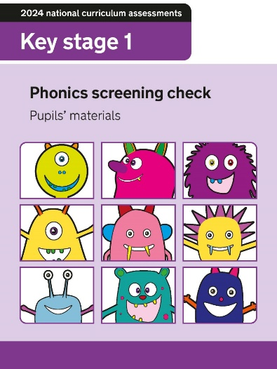
Phonics Screening Check
The phonics screening check is a government assessment for children in Year 1. Children will be asked with their teacher or a known adult to read 40 words- 20 real words and 20 alien ‘nonsense words’. There is no time limit on the assessment and it is completed in a very relaxed way for the children.
Phonics Screening Check will commence in the week beginning 8th June 2026.
Our RWI phonics scheme prepares children well for this assessment and we may also send home additional resources to help you prepare at home throughout the year.

Slide 11

Dates for your Diary
Monday 29th September – Class Photos
Wednesday 8th October – Class Walk around the village.
Tuesday 21st and Thursday 23rd October – Parent Consultations.
Friday 24th October- Last Day of the half term.
RWI workshops?

Slide 12

Life in Year 1
Using continuous provision across three classrooms
Starry Night Evening
Nativity production
Class trips
Phonics screening check

Slide 13

Thank you!
Any questions?

