Slide 1

Welcome to
Class One
Parent Information Session

Slide 2

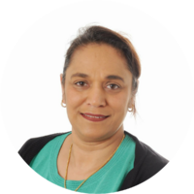
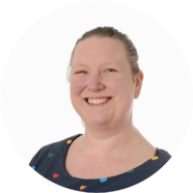
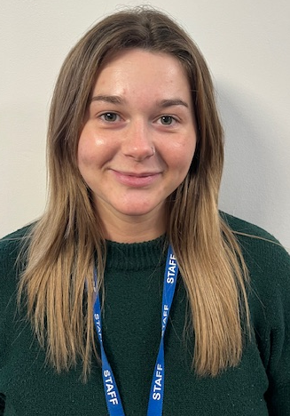
Year 1 Team
Monday | AM - Mrs Prankard | PM - Mrs Sohal (PE)
Tuesday | Mrs Prankard
Wednesday | Mrs S Walker
Thursday | AM – Mrs S Walker | PM - Mrs M Walker and Mrs S Walker (Interventions)
Friday | Mrs S Walker
Supported throughout the week by Mrs Davis, Miss Houlder, Mrs McVennon, Mrs Sohal.

Slide 3
Everyday Information
Morning drop-off: Doors open at 8:50am and close promptly at 9:00am.
Messages for the teacher: Staff will be available to welcome children in the morning and dismiss them at the end of the day. If you need to pass on a message, please speak to a member of staff, or contact the school office by email or telephone.
Water bottles: Please send your child with a named water bottle of an appropriate size. Water bottles should be taken home each day and returned to school the following morning.
Snacks:
  Year 1 children are provided with a daily snack of fruit or vegetables.
  Children may also bring a piece of fresh fruit or vegetables from home for snack if they prefer.
Home time: School finishes at 3:25pm.
Notes:
Remind parents that you may not get back to them immediately, but they will get back to you in a reasonable amount of time.

Slide 4
Moving to Class 1
In Year 1, children begin to follow the National Curriculum, with a greater focus on developing their knowledge and skills across subjects such as English, Maths, Science and Computing.
Children will still have plenty of opportunities to learn through practical activities, discussion, investigation and hands-on experiences. However, they will gradually become more independent and will be encouraged to spend longer periods focused on a particular task.
Some of the changes you may notice in Year 1 include:
A more structured school day, with lessons planned around the Year 1 curriculum.
Greater independence, such as organising belongings, following routines and completing tasks independently.
More recorded work, including writing in books and completing activities independently.
Continued support with phonics and reading, through daily Read Write Inc. lessons and regular reading.
Developing stamina for learning, with children gradually learning to concentrate for longer periods.
Building on the skills developed in Reception, ensuring that the transition into Year 1 is gradual and supportive.
Our aim is to make this transition as smooth and positive as possible, helping children to become confident, independent and enthusiastic learners while continuing to nurture their individual needs and interests.

Slide 5
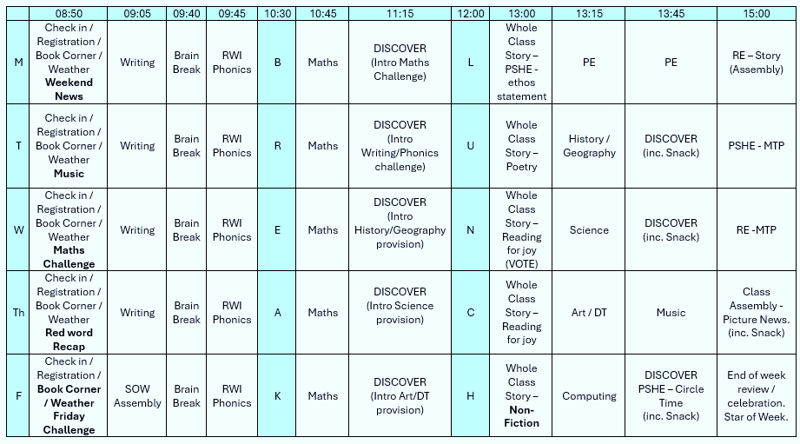
A typical week in our class

Slide 6
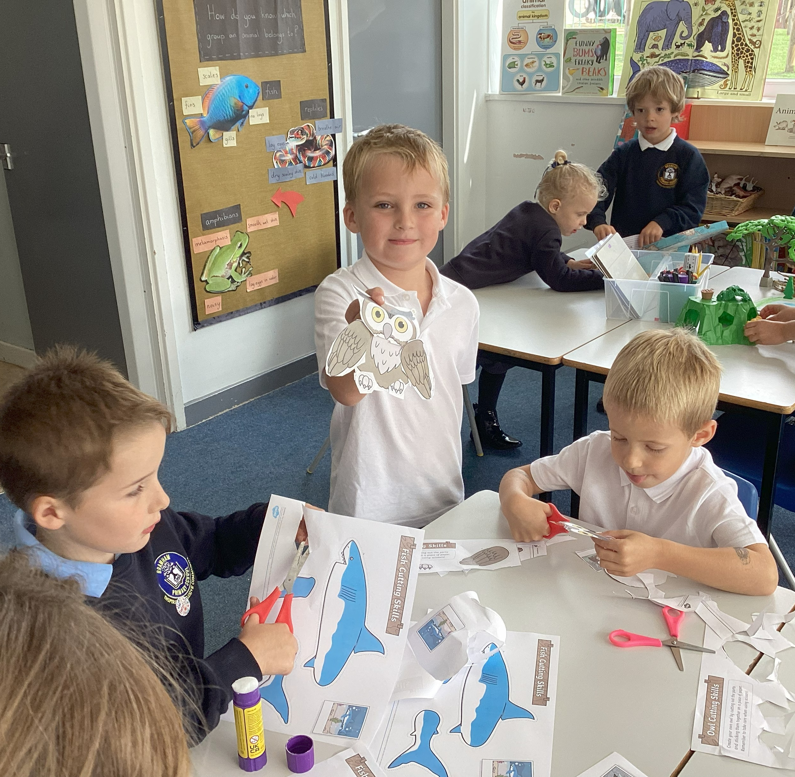
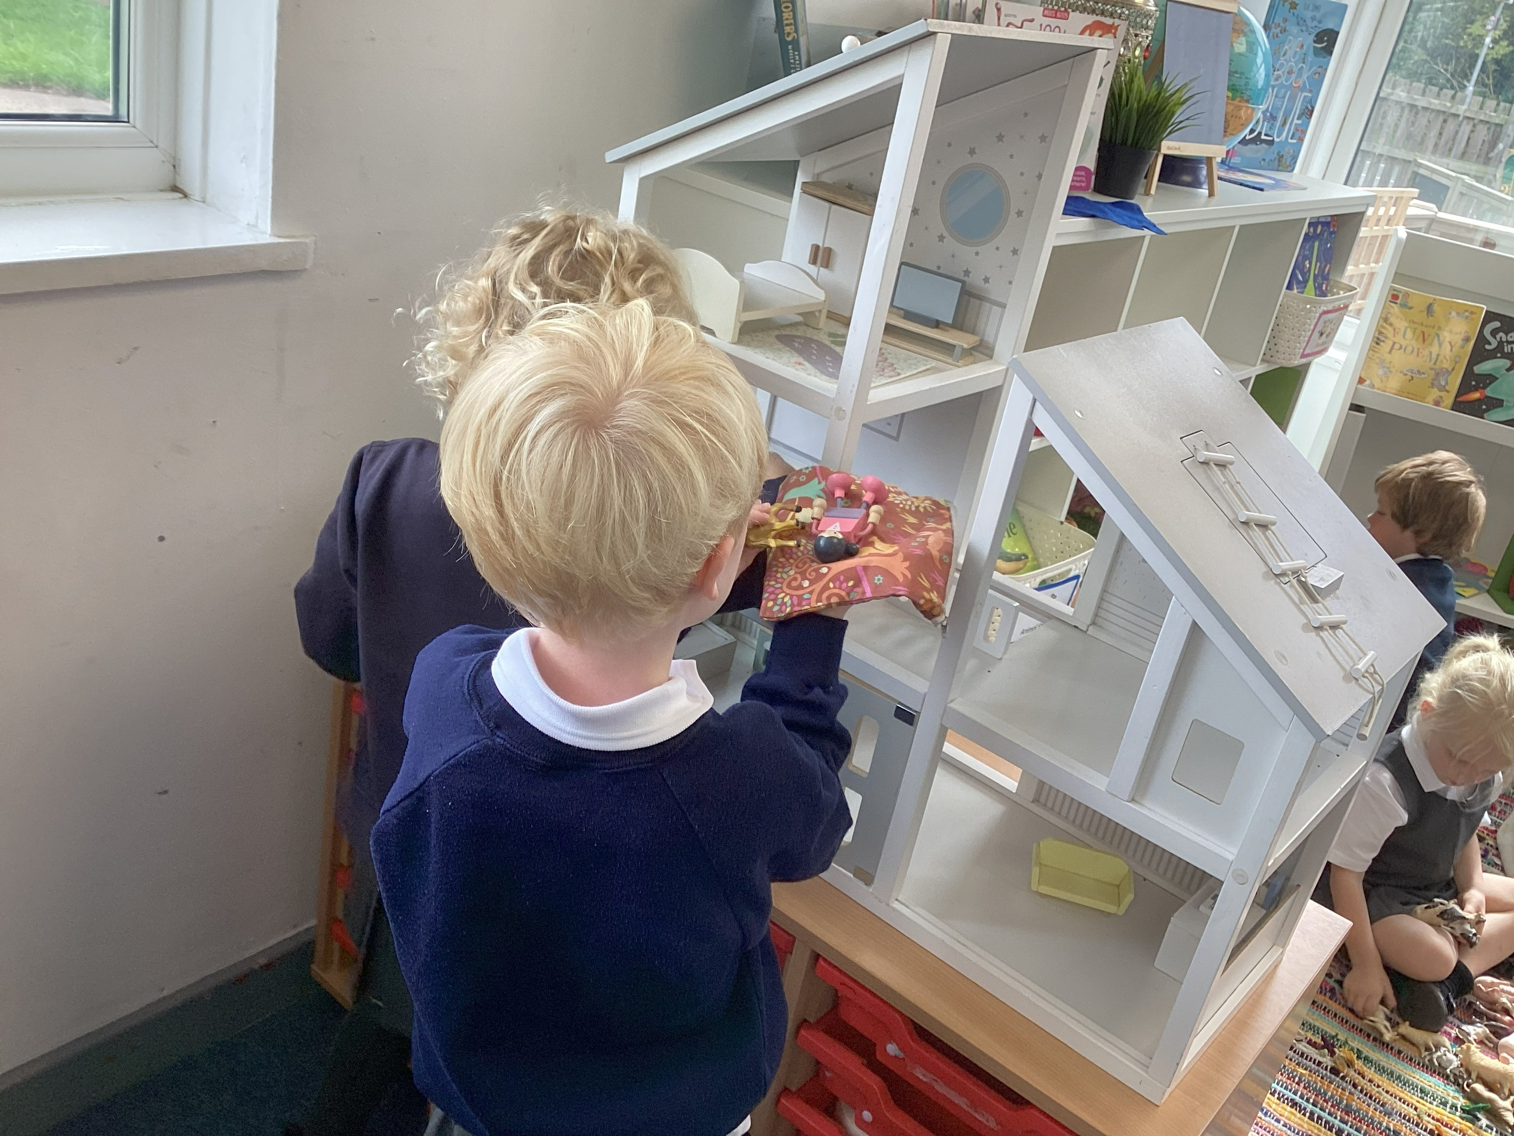
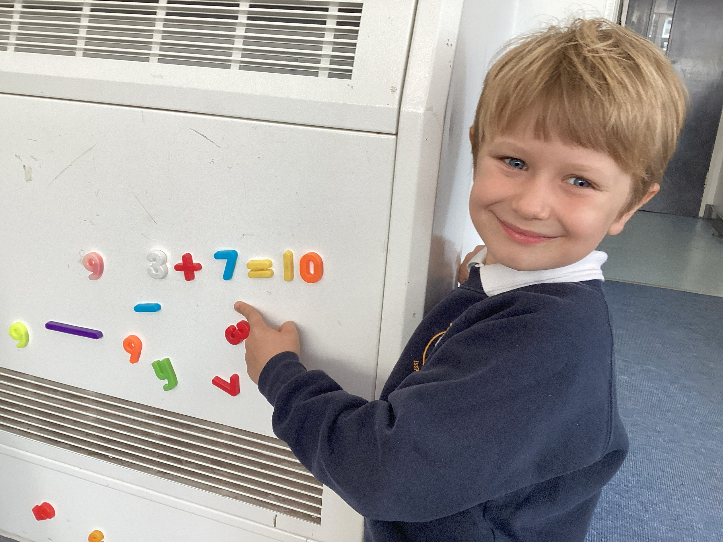
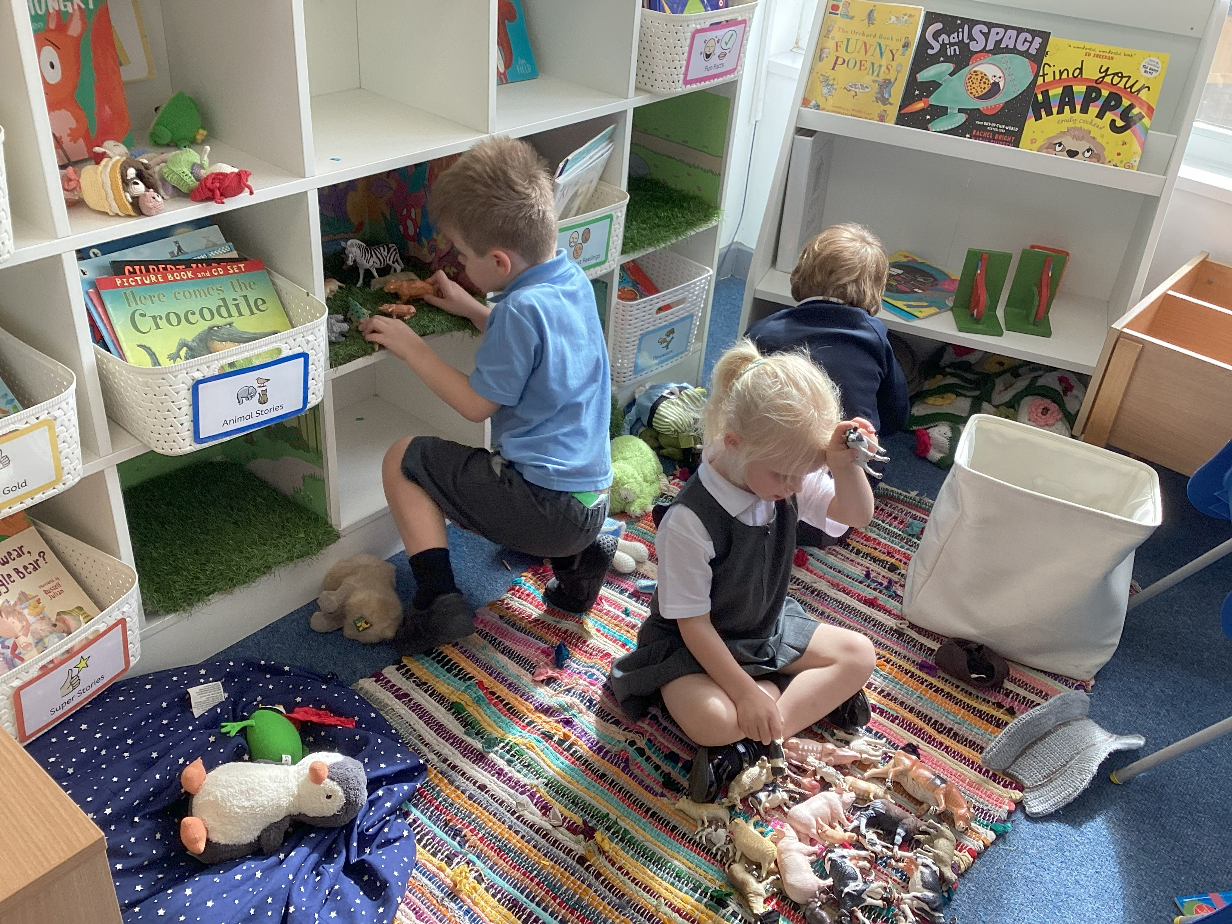
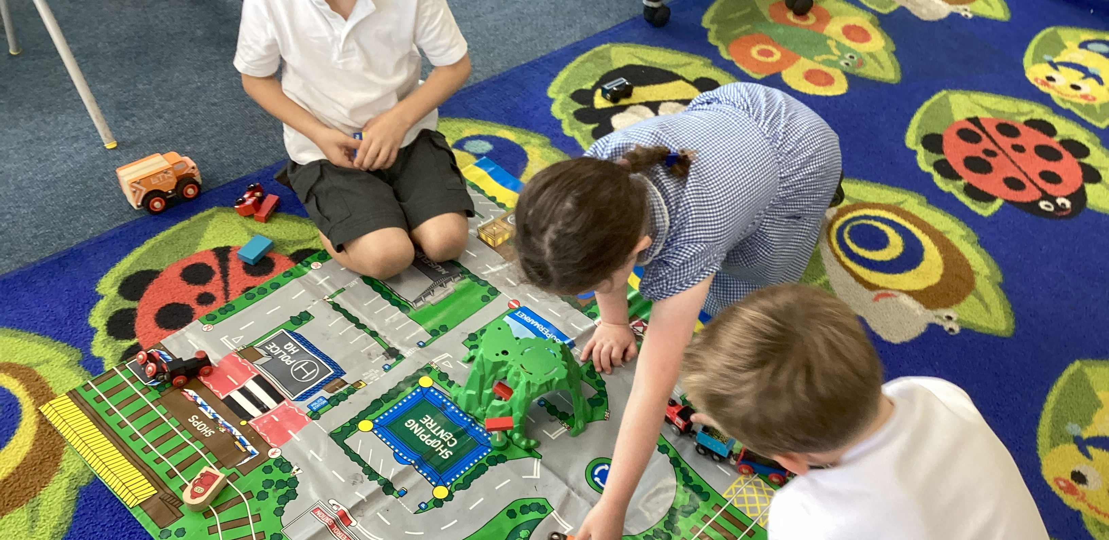
DISCOVER Time in Class 1

Slide 7

PE
Our PE day is on MONDAY.
PE will be taught by Mrs Sohal.
Children should come to school in PE kit.
Just a reminder our school PE kit is
  House-colour plain t-shirt (no logos) - these can be purchased via the school office.
  Black or navy shorts or tracksuit bottoms.
  Trainers
  Dark-coloured fleece, jumper or jacket.
PE will usually be taught outdoors, please make sure the children are dressed for the great British weather!

Slide 8





Our PSHE Curriculum
Through PSHE, we help children develop the knowledge and skills they need to be happy, healthy, safe and prepared for life.
Learning includes relationships, physical and mental wellbeing, personal safety, online safety, diversity, life changes and financial education.
Lessons are age-appropriate and interactive, with clear ground rules and plenty of discussion.
Children can ask questions safely through a Worry Box/Ask-it Basket.
Learning is enriched through assemblies and events such as Picture News, Anti-Bullying Week and Children’s Mental Health Week.
Relationships and Health Education is statutory. In Year 6, some additional non-statutory sex education is taught, and information is shared with parents beforehand.
Our PSHE and RSE policies are available on the school website. Please speak to us if you have any questions or concerns.
Notes:
PSHE stands for Personal, Social, Health and Economic Education. Its purpose is to give children the knowledge, language and practical skills they need to build healthy relationships, look after their wellbeing, stay safe and make informed decisions.
Our curriculum is carefully sequenced and appropriate to the children’s age and emotional maturity. We use high-quality and professionally approved resources such as Pol-Ed and Yasmin and Tom.
We agree ground rules so that children can contribute safely and respectfully. Children are never expected to share personal experiences. They can also ask questions privately through the Worry Box or Ask-it Basket.
We reinforce PSHE through assemblies and wider opportunities across the year, including Picture News and events such as Anti-Bullying Week and Children’s Mental Health Week.
Relationships and Health Education is a statutory part of the primary curriculum. Our PSHE and RSE policies are available on the school website. If you have any questions or concerns about the curriculum, please speak to us.

Slide 9

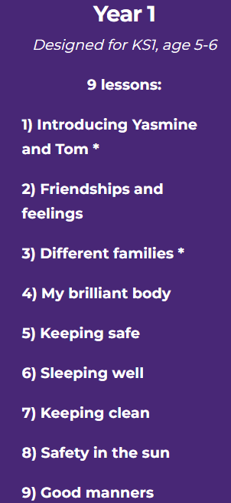
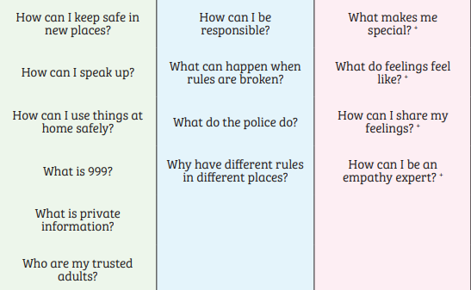
PSHE in Y1 – some of the lessons we may teach
Notes:
Use a combination of lessons
May recap but avoid duplication – select most appropriate lesson/scheme

Slide 10
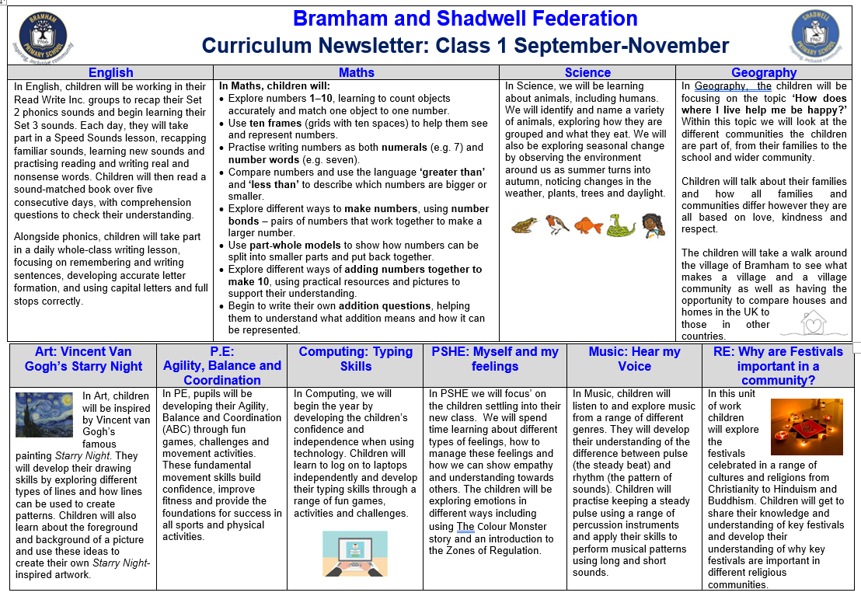
Curriculum Newsletter
Notes:
Share with parents the following:
Maths and English will outline explicit objectives for the half term. In KS2, if you child has a tutor, for example, this could be given to the tutor to let them know what we are focusing on.
Curriculum – what we are learning and the key elements of learning.
Vocabulary – this is specialist vocabulary that we want children to be confident with, it would be very helpful if you could use it or talk about it at home to build confidence.

Slide 11
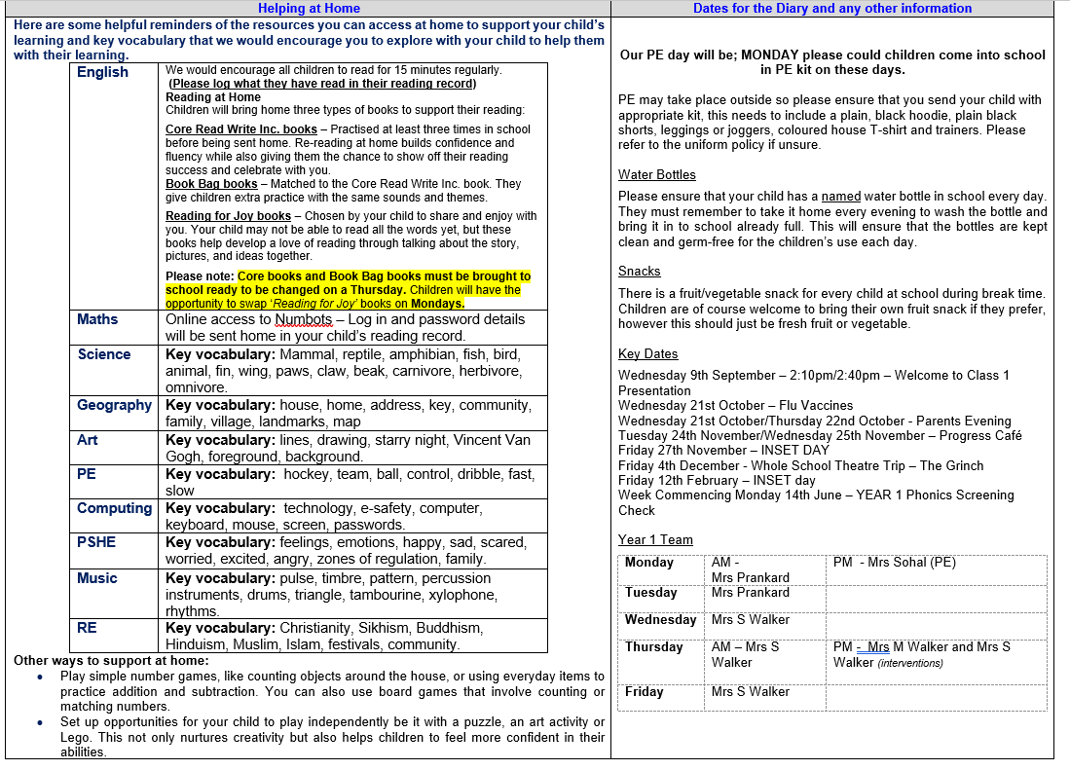

Slide 12

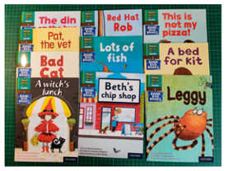



How can you help?
Reading!!
Notes:
Three types of reading books coming home:
Core Read Write Inc books - Thursday
These are practiced at least three times in school before being sent home. Re-reading at home builds confidence and fluency while also giving them the chance to show off their reading success and celebrate with you.
Book Bag books – Thursday
Matched to the Core Read Write Inc book. They give children extra practice with the same sounds and themes.
Reading for Joy books - Monday
This one is chosen by your child to share and enjoy with you. Your child may not be able to read all the words yet, but these books help develop a love of reading through talking about the story, pictures and ideas together.
Please listen to your child read to you and support.
Ideally, read the same book more than once to build fluency.
Books will be changed on Thursdays

Slide 13

How can you help?

Slide 14
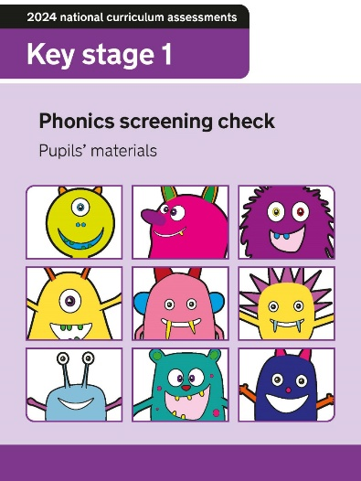
Phonics Screening Check
Taken in Year 1 (Week commencing 14th June)
40-word check
Real and nonsense words
Tests decoding skills

Slide 15
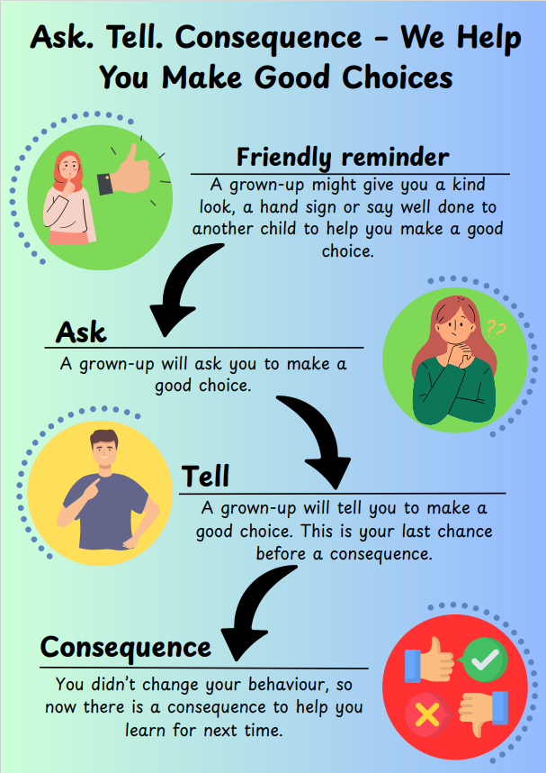

Notes:
With behaviour, we will deal with behaviours but we won’t always call unless it is really significant or a growing concern such as a regular pattern or a sudden change in behavior.

Slide 16

Dates for your Diary
Wednesday 21st October – Flu Vaccines Wednesday 21st October/Thursday 22nd October - Parents Evening Tuesday 24th November/Wednesday 25th November – Progress Café Friday 27th November – INSET DAY Friday 4th December - Whole School Theatre Trip – The Grinch Friday 12th February – INSET day Week Commencing Monday 14th June – YEAR 1 Phonics Screening Check
Monday 29th September – Class Photos
Wednesday 8th October – Class Walk around the village.
Tuesday 21st and Thursday 23rd October – Parent Consultations.

Slide 17
Thank you!
Any questions?

