Slide 1

Welcome to Class 2
Parent Information Session

Slide 2
Everyday Information
Doors open at 8:50am and will close at 9:00am.
Messages to the teacher – reading record, staff welcoming children in the morning, email or phone call to the office.
Water bottled – named and appropriate size.
  Taken home each day and returned.
Snacks
  Reception and KS1 are provided with an afternoon snack.
  All children can bring in a piece of fresh fruit or vegetable as a snack for morning break.
School finishes at 3:25pm
Notes:
Remind parents that you may not get back to them immediately, but they will get back to you in a reasonable amount of time.

Slide 3
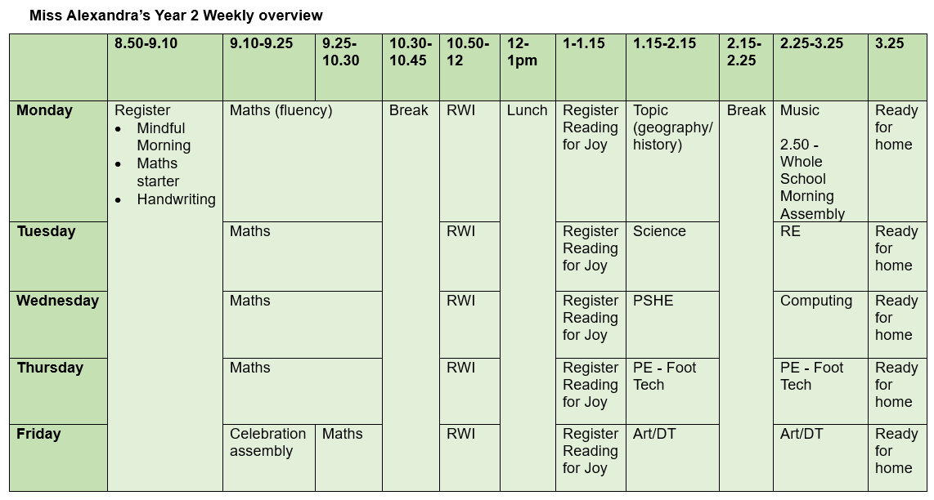
A typical week in our class

Slide 4
PE
Our PE day is on Thursday afternoon.
On PE day, children are to wear PE kit all day.
Just a reminder our school PE kit is
  House-colour plain t-shirt (no logos) - these can be purchased via the school office.
  Black or navy shorts or tracksuit bottoms.
  Trainers
  Dark-coloured (navy or black) fleece, jumper or jacket.

Slide 5


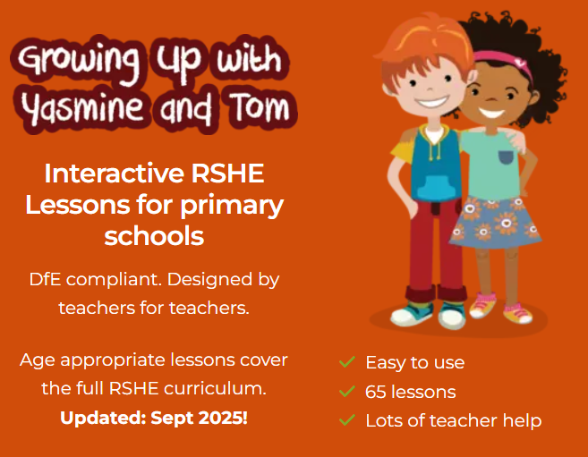


Our PSHE Curriculum
Through PSHE, we help children develop the knowledge and skills they need to be happy, healthy, safe and prepared for life.
Learning includes relationships, physical and mental wellbeing, personal safety, online safety, diversity, life changes and financial education.
Lessons are age-appropriate and interactive, with clear ground rules and plenty of discussion.
Children can ask questions safely through a Worry Box/Ask-it Basket.
Learning is enriched through assemblies and events such as Picture News, Anti-Bullying Week and Children’s Mental Health Week.
Relationships and Health Education is statutory. In Year 6, some additional non-statutory sex education is taught, and information is shared with parents beforehand.
Our PSHE and RSE policies are available on the school website. Please speak to us if you have any questions or concerns.
Notes:
PSHE stands for Personal, Social, Health and Economic Education. Its purpose is to give children the knowledge, language and practical skills they need to build healthy relationships, look after their wellbeing, stay safe and make informed decisions.
Our curriculum is carefully sequenced and appropriate to the children’s age and emotional maturity. We use high-quality and professionally approved resources such as Pol-Ed and Yasmin and Tom.
We agree ground rules so that children can contribute safely and respectfully. Children are never expected to share personal experiences. They can also ask questions privately through the Worry Box or Ask-it Basket.
We reinforce PSHE through assemblies and wider opportunities across the year, including Picture News and events such as Anti-Bullying Week and Children’s Mental Health Week.
Relationships and Health Education is a statutory part of the primary curriculum. Our PSHE and RSE policies are available on the school website. If you have any questions or concerns about the curriculum, please speak to us.

Slide 6

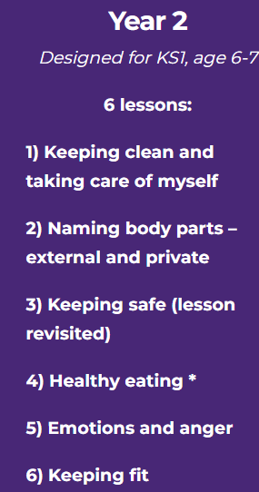
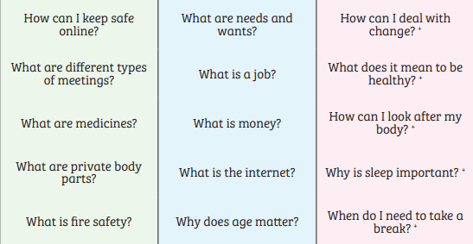
PSHE in Y2 – some of the lessons we may teach
Notes:
Always use scientific names for body parts – ensures consistency across school and is a safeguarding necessity
The correct names of body parts, including the penis, vulva, vagina, testicles, scrotum, nipples. Pupils should understand that all of these parts of the body are private and have skills to understand and express their own boundaries around these body parts.

Slide 7
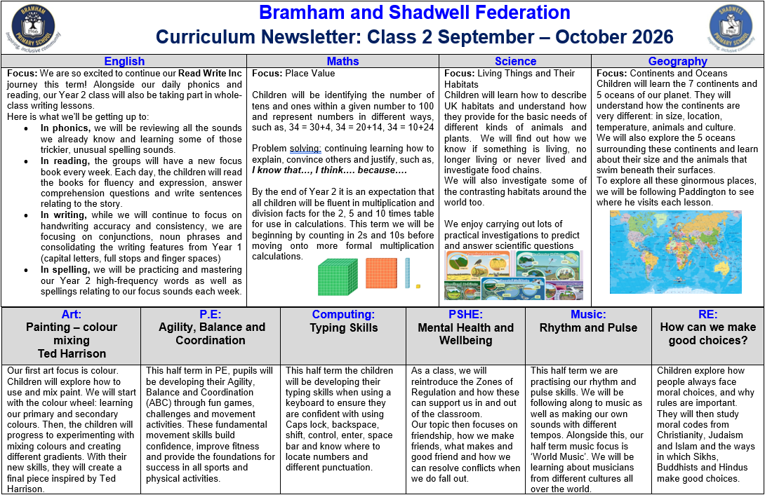
Curriculum Newsletter
Notes:
Share with parents the following:
Maths and English will outline explicit objectives for the half term. In KS2, if you child has a tutor, for example, this could be given to the tutor to let them know what we are focusing on.
Curriculum – what we are learning and the key elements of learning.
Vocabulary – this is specialist vocabulary that we want children to be confident with, it would be very helpful if you could use it or talk about it at home to build confidence.

Slide 8
Life in Year 2
We will have another Christmas Nativity!
We will have school trips this year which link to our learning.
History topics include The Great Fire of London, The Royal Family and Florence Nightingale and Mary Seacole.
In science, we are learning about animals and their habitats, materials and plants.
In music, we are learning to play the recorder!
We are also learning joined handwriting soon!

Slide 9
Homework KS1
Numbots and TT rockstars (Year 2)
Reading
The purpose is help with fluency of basic skills.
Please aim for a little and often approach; 5 – 10 minutes most days is ideal!

Slide 10
Reading Books
Three types of reading books coming home:
Core Read Write Inc books
These are practiced at least three times in school before being sent home. Re-reading at home builds confidence and fluency while also giving them the chance to show off their reading success and celebrate with you.
Book Bag books
Matched to the Core Read Write Inc book. They give children extra practice with the same sounds and themes.
Reading for Joy books
This one is chosen by your child to share and enjoy with you. Your child may not be able to read all the words yet, but these books help develop a love of reading through talking about the story, pictures and ideas together.
Please listen to your child read to you and support.
Ideally, read the same book more than once to build fluency.
Books will be changed on Thursdays
Notes:
Explain to parents that we say typically on this day because for example with RWI book, we only send them home when we are confident they are fluent – so if takes an extra day of of reading, we will delay if necessary.

Slide 11
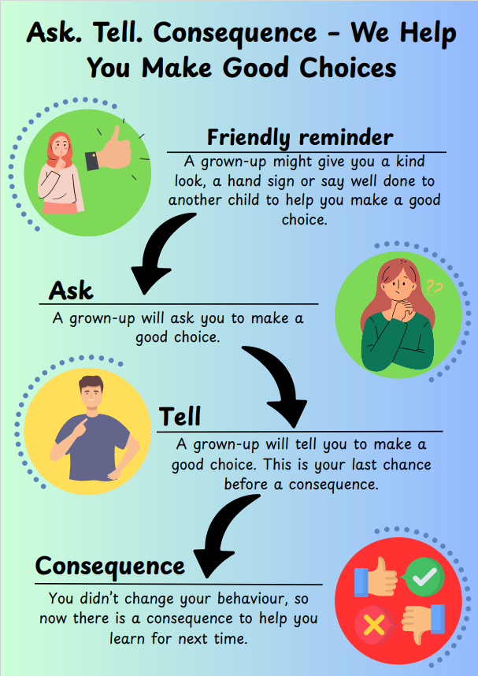
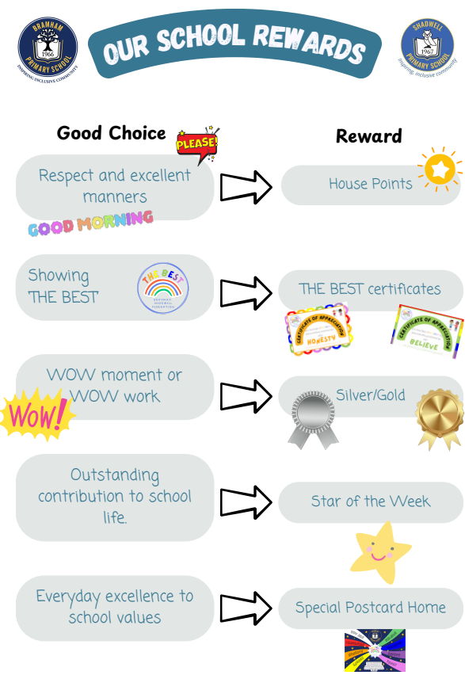

Slide 12
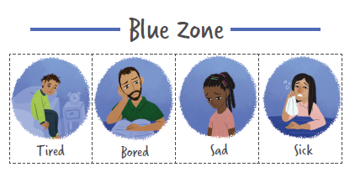
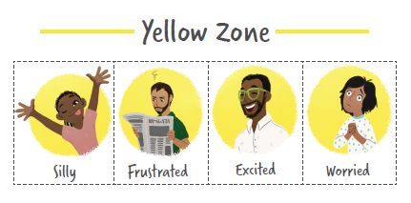
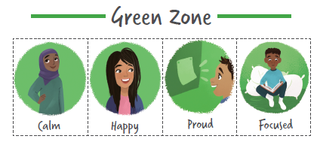
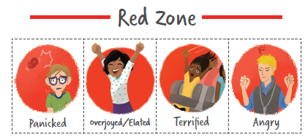

Slide 13
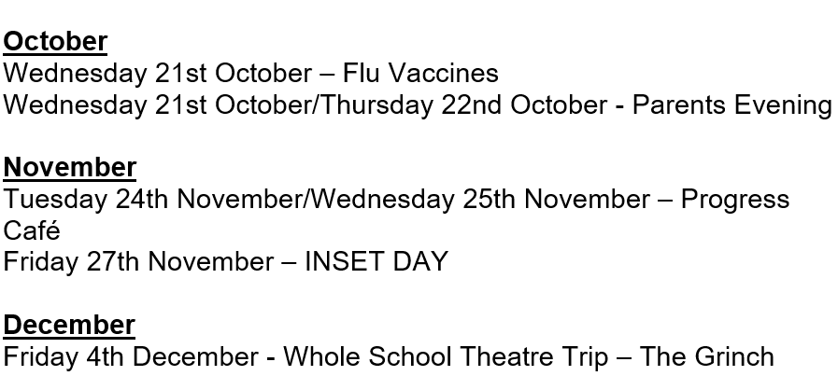
Dates for your Diary

Slide 14
Thank you!
Any questions?

