Slide 1

Welcome to Class 3
Parent Information Session

Slide 2
Everyday Information
Doors open at 8:50am and will close at 9:00am.
Messages to the teacher – staff welcoming children in the morning, email or phone call to the office.
Water bottled – named and appropriate size.
  Taken home each day and returned.
Snacks
  All children can bring in a piece of fresh fruit or vegetable as a snack for morning break.
School finishes at 3:25pm. If there is late collection, children will be sent to the office or to afterschool club.
Notes:
Remind parents that you may not get back to them immediately, but they will get back to you in a reasonable amount of time.

Slide 3
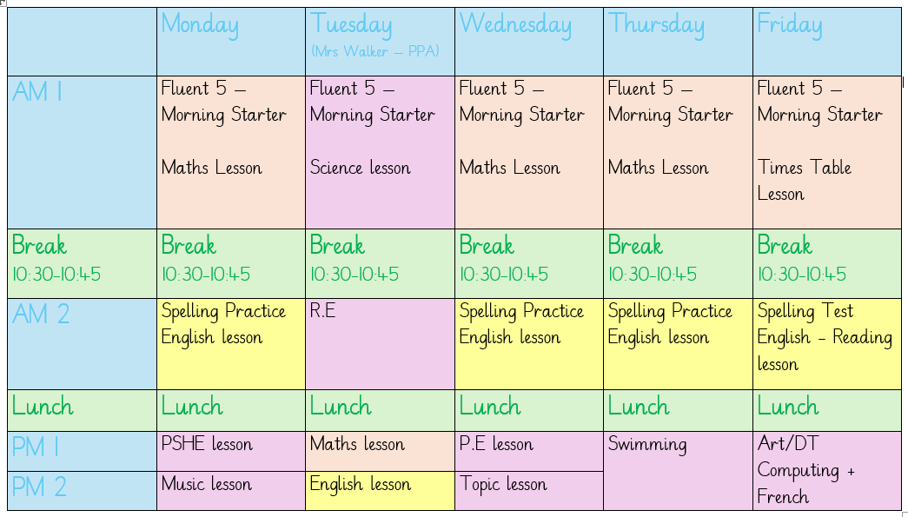
A typical week in our class

Slide 4
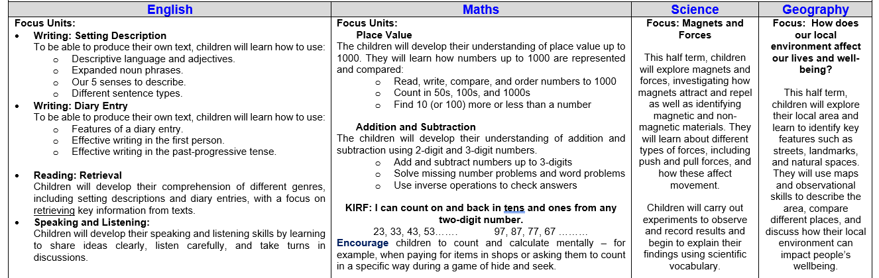
Curriculum Newsletter
Notes:
Share with parents the following:
Maths and English will outline explicit objectives for the half term. In KS2, if you child has a tutor, for example, this could be given to the tutor to let them know what we are focusing on.
Curriculum – what we are learning and the key elements of learning.
Vocabulary – this is specialist vocabulary that we want children to be confident with, it would be very helpful if you could use it or talk about it at home to build confidence.

Slide 5
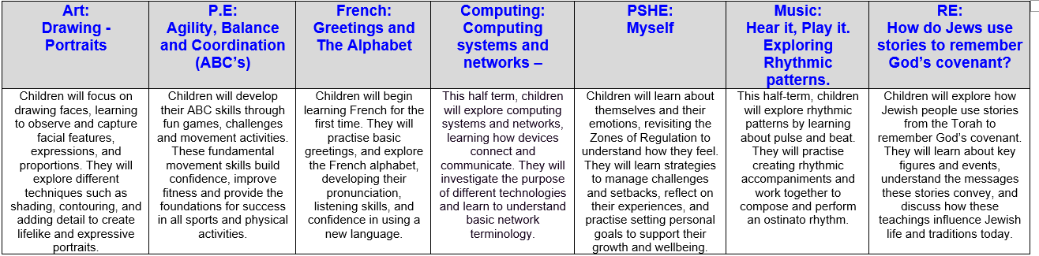
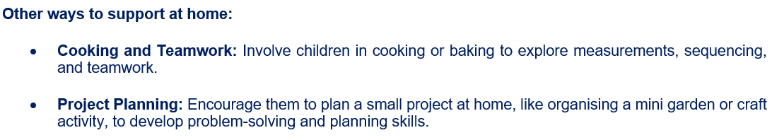
Curriculum Newsletter
Notes:
Share with parents the following:
Maths and English will outline explicit objectives for the half term. In KS2, if you child has a tutor, for example, this could be given to the tutor to let them know what we are focusing on.
Curriculum – what we are learning and the key elements of learning.
Vocabulary – this is specialist vocabulary that we want children to be confident with, it would be very helpful if you could use it or talk about it at home to build confidence.

Slide 6
PE
Our PE day is on Wednesday! I am teaching class PE this year ☺
On PE day, children are to wear PE kit all day.
Just a reminder our school PE kit is
  House-colour plain t-shirt (no logos) - these can be purchased via the school office.
  Black or navy shorts or tracksuit bottoms.
  Trainers
  Dark-coloured (navy or black) fleece, jumper or jacket.

Slide 7

Swimming – Y3
Class 3 will be going swimming this year, which will start on Thursday 17th September and be for the full Autumn Term.
Please ensure your child brings the following items each week:
A suitable swimming costume/trunks
A towel
A swimming cap
A waterproof bag for wet items
Any questions please ask!

Slide 8





Our PSHE Curriculum
Through PSHE, we help children develop the knowledge and skills they need to be happy, healthy, safe and prepared for life.
Learning includes relationships, physical and mental wellbeing, personal safety, online safety, diversity, life changes and financial education.
Lessons are age-appropriate and interactive, with clear ground rules and plenty of discussion.
Children can ask questions safely through a Worry Box/Ask-it Basket.
Learning is enriched through assemblies and events such as Picture News, Anti-Bullying Week and Children’s Mental Health Week.
Relationships and Health Education is statutory. In Year 6, some additional non-statutory sex education is taught, and information is shared with parents beforehand.
Our PSHE and RSE policies are available on the school website. Please speak to us if you have any questions or concerns.
Notes:
PSHE stands for Personal, Social, Health and Economic Education. Its purpose is to give children the knowledge, language and practical skills they need to build healthy relationships, look after their wellbeing, stay safe and make informed decisions.
Our curriculum is carefully sequenced and appropriate to the children’s age and emotional maturity. We use high-quality and professionally approved resources such as Pol-Ed and Yasmin and Tom.
We agree ground rules so that children can contribute safely and respectfully. Children are never expected to share personal experiences. They can also ask questions privately through the Worry Box or Ask-it Basket.
We reinforce PSHE through assemblies and wider opportunities across the year, including Picture News and events such as Anti-Bullying Week and Children’s Mental Health Week.
Relationships and Health Education is a statutory part of the primary curriculum. Our PSHE and RSE policies are available on the school website. If you have any questions or concerns about the curriculum, please speak to us.

Slide 9

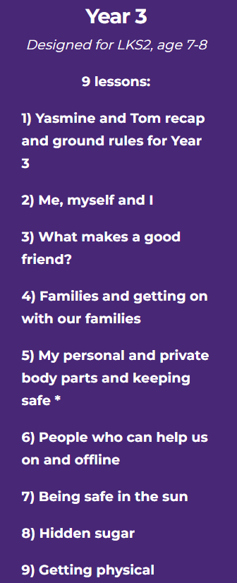
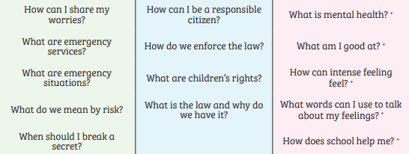
PSHE in Y3 – some of the lessons we may teach

Slide 10
Homework (KS2)
Homework is given out on a Thursday and returned (marked) on a Tuesday.
Any homework given will be to revise previous learning (for example year previous refresher) or consolidate recent learning.
We would encourage children to complete homework independently.
Homework presentation should be given the same care as it would be schoolwork.
If a child is stuck, encourage them to come and ask for help on either a Friday or a Monday.
Notes:
Teacher to explain to parents that homework shouldn't take children longer that 30 minutes and shouldn't cause upset and distress at home.

Slide 11
Reading Books
Two types of reading books coming home:
Scheme Books: Learning to Read. Changed daily.
Levelled books targeted at current reading level.
Please listen to your child read to you and support.
Ideally, read the same book more than once to build fluency.
Keep in bag daily for regular return.
Joy Books: Learning to LOVE reading
Free choice from the reading corner every Friday (or home if children prefer).
Might be trickier to read, may need help or could read together.
Notes:
Explain to parents that we say typically on this day because for example with RWI book, we only send them home when we are confident they are fluent – so if takes an extra day of of reading, we will delay if necessary.

Slide 12
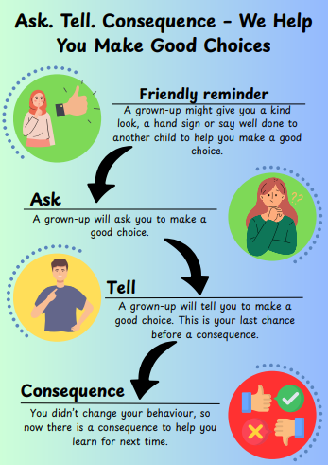
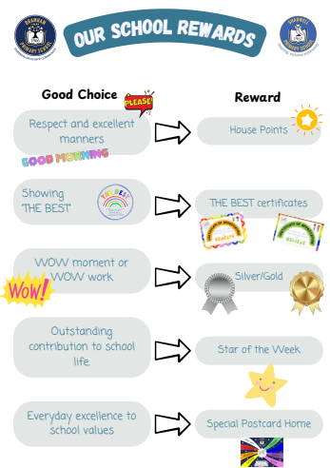

Slide 13
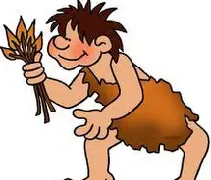

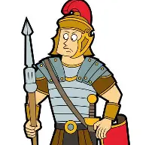
Life in Year 3
Things we are looking forward to:
Our amazing history topics (The Stone Age, The Egyptians, The Romans)
Swimming in Year 3

Slide 14
Dates for your Diary
Wed. 9 Sep.
2:10pm/2:40pm – Welcome to Class 3 Presentation
Wed. 21 Oct.
Flu Vaccines
Wed. 21 Oct. – Thu. 22 Oct.
Parents Evening
Tue. 24 Nov. – Wed. 25 Nov.
Progress Café
Fri. 27 Nov.
INSET DAY
Fri. 4 Dec.
Whole School Theatre Trip – The Grinch
Fri. 12 Feb.
INSET DAY

Slide 15
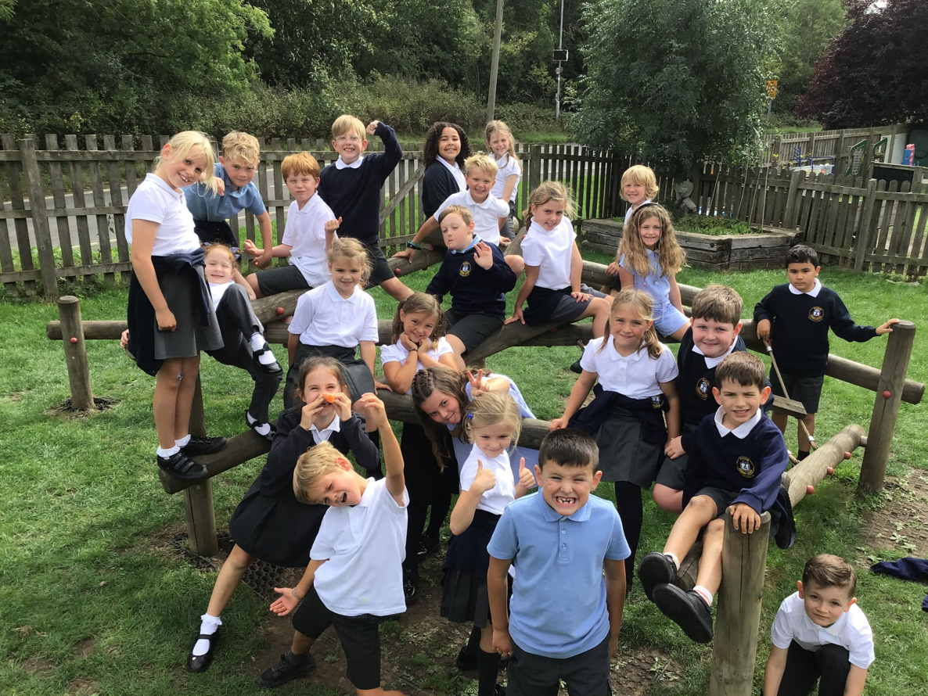
Thank you!
Any questions?

