Slide 1

Welcome to Class 6!
Parent Information Session

Slide 2
Everyday Information
Doors open at 8:50am and will close at 9:00am.
Messages to the teacher – reading journal, staff welcoming children in the morning, email or phone call to the office.
Water bottles – named and appropriate size.
  Taken home each day and returned.
Snacks
  All children can bring in a piece of fresh fruit or vegetable as a snack for morning break.
School finishes at 3:25pm
Notes:
Remind parents that you may not get back to them immediately, but they will get back to you in a reasonable amount of time.

Slide 3
Everyday Information: Walking Home
Consent forms
Mobile phones – safe in classroom cupboard
Children are representing the school, and we would ask you to remind them of this if you are giving that responsibility.

Slide 4
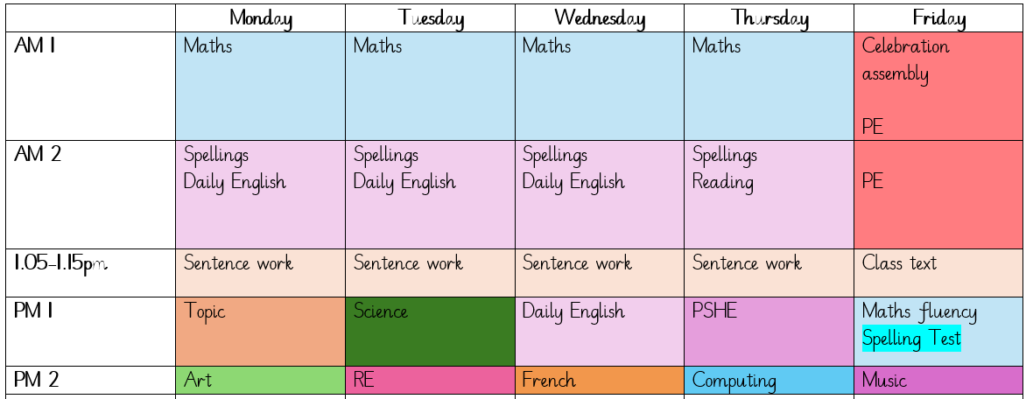
A typical week in our class

Slide 5
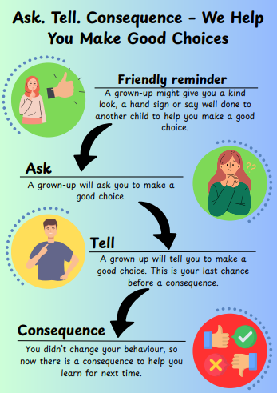
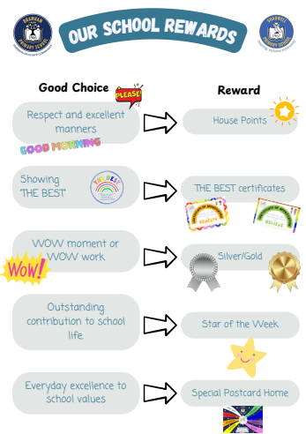

Slide 6
PE
Our PE day is on Friday.
On PE day, children are to wear PE kit all day.
Just a reminder our school PE kit is:
  House-colour plain t-shirt (no logos) - these can be purchased via the school office.
  Black or navy shorts or tracksuit bottoms.
  Trainers
  Dark-coloured (navy or black) fleece, jumper or jacket.

Slide 7





Our PSHE Curriculum
Through PSHE, we help children develop the knowledge and skills they need to be happy, healthy, safe and prepared for life.
Learning includes relationships, physical and mental wellbeing, personal safety, online safety, diversity, life changes and financial education.
Lessons are age-appropriate and interactive, with clear ground rules and plenty of discussion.
Children can ask questions safely through a Worry Box/Ask-it Basket.
Learning is enriched through assemblies and events such as Picture News, Anti-Bullying Week and Children’s Mental Health Week.
Relationships and Health Education is statutory. In Year 6, some additional non-statutory sex education is taught, and information is shared with parents beforehand.
Our PSHE and RSE policies are available on the school website. Please speak to us if you have any questions or concerns.
YEAR 5/6 Relationship, Health, Sex Education Virtual Meeting on
Wednesday 4th November.
Notes:
PSHE stands for Personal, Social, Health and Economic Education. Its purpose is to give children the knowledge, language and practical skills they need to build healthy relationships, look after their wellbeing, stay safe and make informed decisions.
Our curriculum is carefully sequenced and appropriate to the children’s age and emotional maturity. We use high-quality and professionally approved resources such as Pol-Ed and Yasmin and Tom.
We agree ground rules so that children can contribute safely and respectfully. Children are never expected to share personal experiences. They can also ask questions privately through the Worry Box or Ask-it Basket.
We reinforce PSHE through assemblies and wider opportunities across the year, including Picture News and events such as Anti-Bullying Week and Children’s Mental Health Week.
Relationships and Health Education is a statutory part of the primary curriculum. Our PSHE and RSE policies are available on the school website. If you have any questions or concerns about the curriculum, please speak to us.

Slide 8
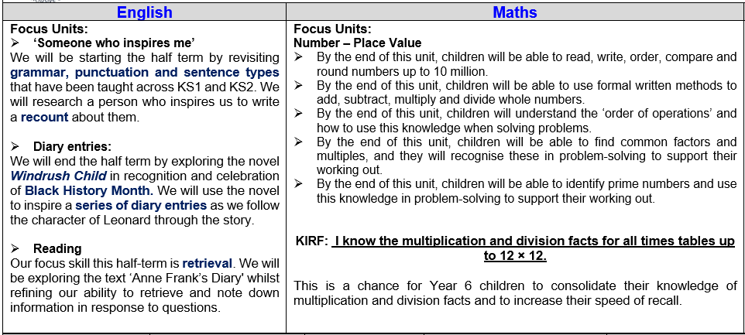
Curriculum Newsletter
Notes:
Share with parents the following:
Maths and English will outline explicit objectives for the half term. In KS2, if you child has a tutor, for example, this could be given to the tutor to let them know what we are focusing on.
Curriculum – what we are learning and the key elements of learning.
Vocabulary – this is specialist vocabulary that we want children to be confident with, it would be very helpful if you could use it or talk about it at home to build confidence.

Slide 9
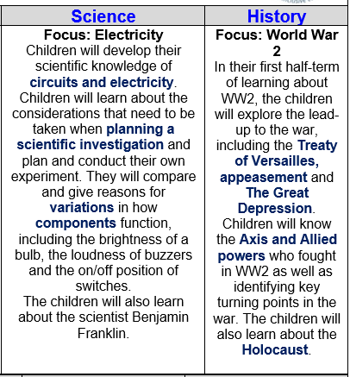
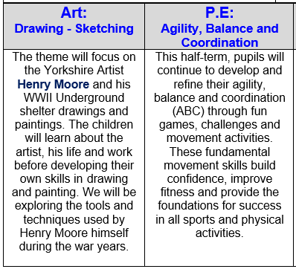

Slide 10
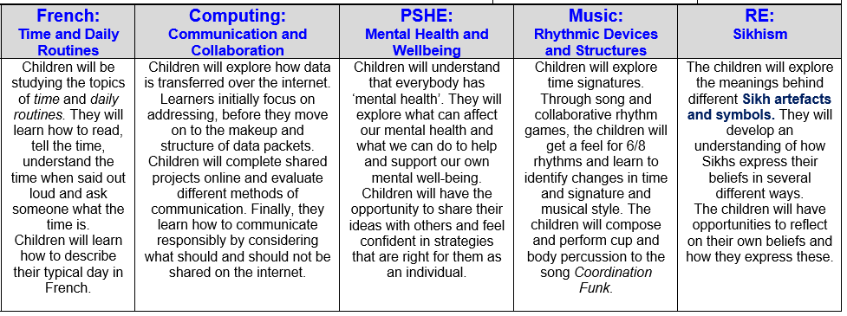

Slide 11
Homework (KS2)
Homework is given out on a Thursday and returned on a Tuesday.
Any homework given will be to revise previous learning (for example year previous refresher) or consolidate recent learning.
We would encourage children to complete homework independently.
Homework presentation should be given the same care as it would be schoolwork.
If a child is stuck, encourage them to come and ask for help on either a Friday or a Monday.
Notes:
Teacher to explain to parents that homework shouldn't take children longer that 30 minutes and shouldn't cause upset and distress at home.

Slide 12
Reading Books
Two types of reading books coming home:
Scheme Books: Learning to Read
Levelled books targeted at current reading level.
Please listen to your child read to you and support.
Ideally, read the same book more than once to build fluency.
Keep in bag daily for regular return.
Children should be reading daily and recording this in their planners (due to arrive soon).
If your child is a ‘free reader’, they can either choose a book from the reading corner or bring one from home.
Joy Books: Learning to LOVE reading
Free choice from the reading corner every Friday (or home if children prefer).
Might be trickier to read, may need help or could read together.
Notes:
Explain to parents that we say typically on this day because for example with RWI book, we only send them home when we are confident they are fluent – so if takes an extra day of of reading, we will delay if necessary.

Slide 13
Dates for your Diary
Flu Vaccinations: Wednesday 21st October
Parents Evenings: Wednesday 21st and Thursday 22nd October
Yorkshire Air Museum trip: Thursday 12th November
SATs Week: Monday 10th – Thursday 13th May
Residential: Wednesday 17th – Friday 19th March
Progress Cafés: Tuesday 24th/Wednesday 25th November
RSE parent information session (virtual): Wednesday 4th November

Slide 14
SATs
In May, children will complete national tests in:
  English reading
  English grammar, punctuation and spelling
  Mathematics: one arithmetic paper and two reasoning papers
  Writing is assessed by teachers using children’s work from across the year.
Our approach:
Later in the year, we will introduce some focused revision and opportunities to become familiar with the test format.
We want every child to try their best and feel proud of what they achieve. SATs are an opportunity for children to demonstrate their learning, but they are only one part of their education.
We will prepare children carefully while continuing to prioritise their confidence, happiness and wellbeing.
We want children to do well; not to feel under pressure.
How You Can Help at Home
Support at home does not need to involve hours of additional work. Small, regular habits make the greatest difference:
Help your child to stay on top of homework and complete it carefully.
Practise key basics, particularly times tables, mental arithmetic and spelling.
Encourage regular reading and talk about the book together.
Ask your child to explain how they worked something out—this helps to deepen their understanding.
Support good routines, including sleep, attendance and arriving at school on time.
Praise effort, perseverance and progress, rather than focusing only on scores.
Most importantly, remain positive and reassuring. We will let you know if there are particular areas your child should practise.

Slide 15
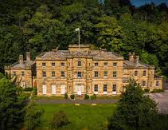
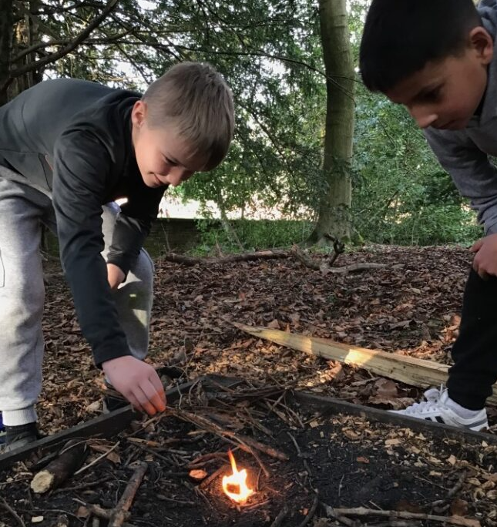
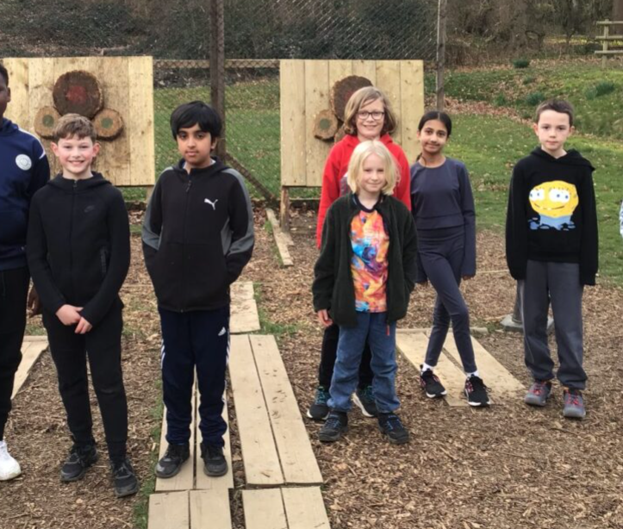
Residential 2027: Willersley Castle
Wednesday 17th March – Friday 19th March 2027
Inclusive venue – we can look at support to ensure all children join us!
Pricing TBC includes:
  Two nights accommodation within Willersley Castle
  9 adventure activities
  meals
  Coach transport
Payment plan available if needed.
Parent information talk in the new year!

Slide 16
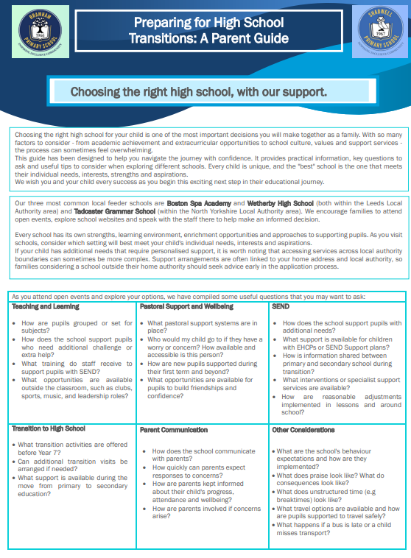
High School and Transition
Choosing a secondary school
We have produced a guide containing helpful questions and points to consider when visiting and comparing secondary schools. We encourage families to attend open evenings and choose the school that best meets their child’s individual needs.
Supporting a smooth transition
Once secondary school places are confirmed in the spring, we work closely with each child’s new school. This may include:
  sharing relevant information;
  meetings with secondary transition teams;
  transition days and visits;
  additional support for children who may find transition more challenging;
  opportunities to discuss questions or concerns.
Our aim is for every child to feel informed, confident and positive about their move to secondary school.

Slide 17
Life in Year 6
WW2 Topic, including Evacuee Day and Yorkshire Air Museum trip, as well as a visitor coming in to tell us about the Dambusters mission!
Global Economy Day, including designing their own products based on a budget
Make £5 Grow project
Residential
Buddies
SATs booster sessions
SATs week
Production
High School Transition
Leavers Assembly

Slide 18
Thank you!
Any questions?

