Slide 1
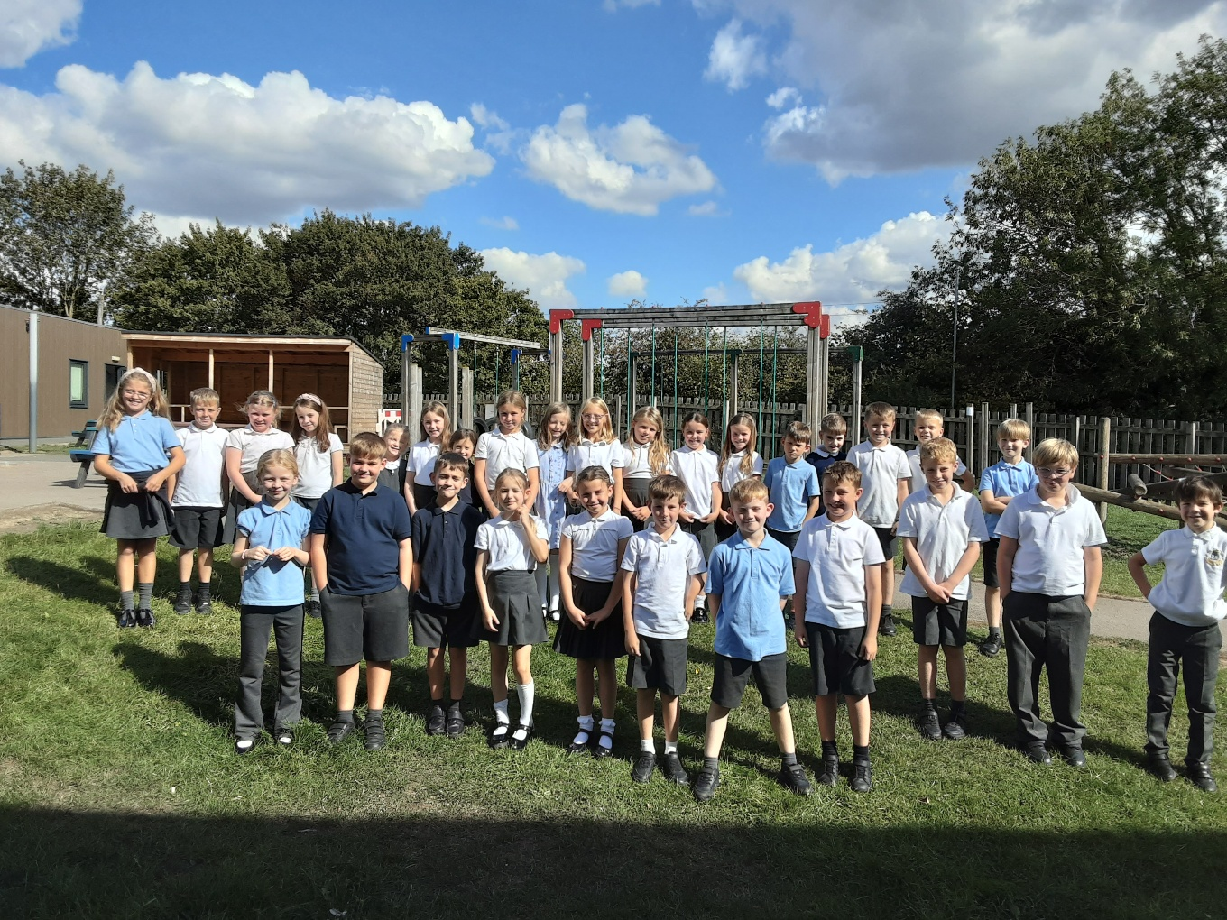

Welcome to Class
4
Parent Information Session

Slide 2
Everyday Information
Doors open at 8:50am and will close at 9:00am.
Messages to the teacher – planner, staff welcoming children in the morning, email or phone call to the office.
Water bottled – named and appropriate size.
  Taken home each day and returned.
Snacks
  Reception and KS1 are provided with an afternoon snack. (KS2 teachers delete this)
  All children can bring in a piece of fresh fruit or vegetable as a snack for morning break.
School finishes at 3:25pm
Notes:
Remind parents that you may not get back to them immediately, but they will get back to you in a reasonable amount of time.

Slide 3
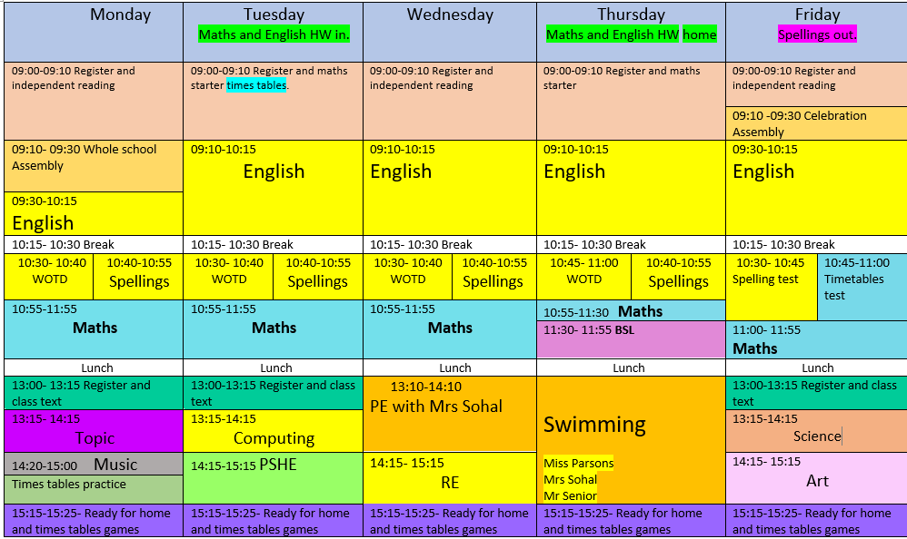
A typical week in our class

Slide 4
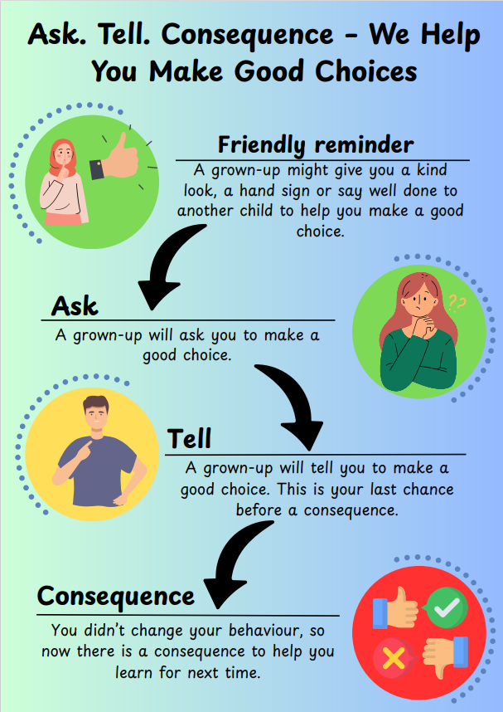
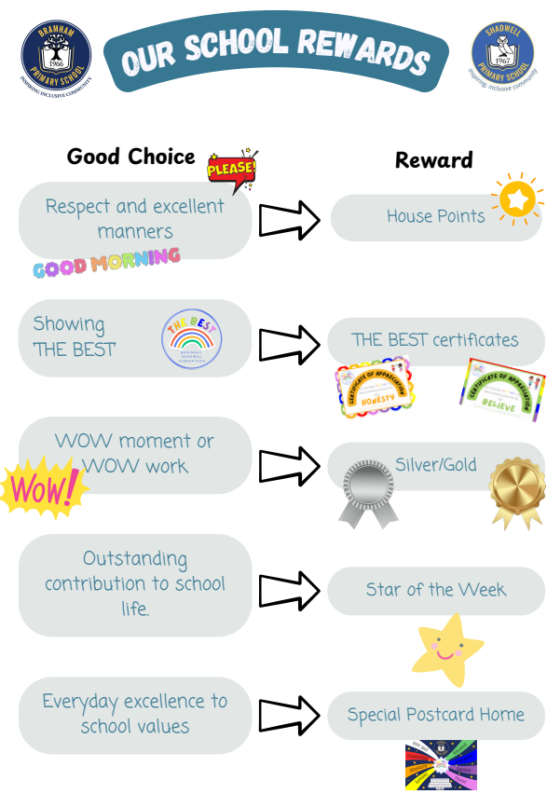

Slide 5
PE
Our PE day is on Wednesday
On PE day, children are to wear PE kit all day.
Just a reminder our school PE kit is
  House-colour plain t-shirt (no logos) - these can be purchased via the school office.
  Black or navy shorts or tracksuit bottoms.
  Trainers
  Dark-coloured (navy or black) fleece, jumper or jacket.

Slide 6
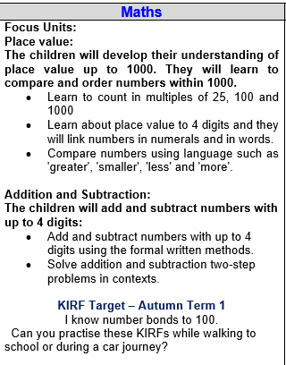
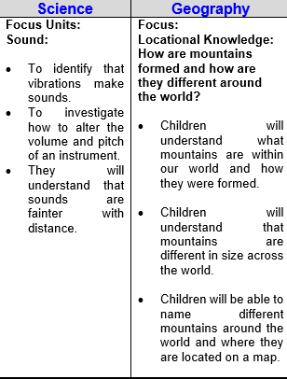
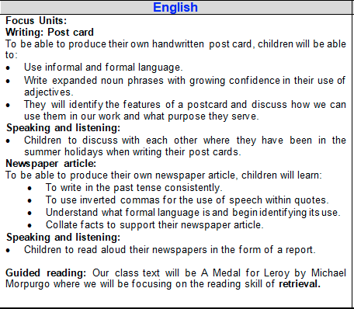
Curriculum Newsletter
.
Notes:
Share with parents the following:
Maths and English will outline explicit objectives for the half term. In KS2, if you child has a tutor, for example, this could be given to the tutor to let them know what we are focusing on.
Curriculum – what we are learning and the key elements of learning.
Vocabulary – this is specialist vocabulary that we want children to be confident with, it would be very helpful if you could use it or talk about it at home to build confidence.

Slide 7
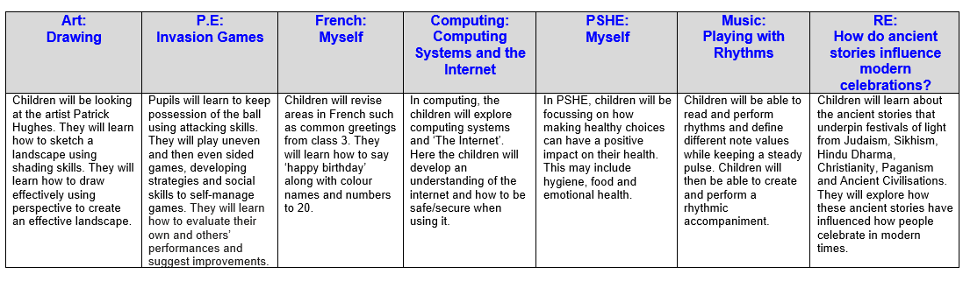
Curriculum Newsletter
.
Notes:
Share with parents the following:
Maths and English will outline explicit objectives for the half term. In KS2, if you child has a tutor, for example, this could be given to the tutor to let them know what we are focusing on.
Curriculum – what we are learning and the key elements of learning.
Vocabulary – this is specialist vocabulary that we want children to be confident with, it would be very helpful if you could use it or talk about it at home to build confidence.

Slide 8
Homework (KS2)
Homework is given out on a Thursday and returned on a Tuesday.
Any homework given will be to revise previous learning (for example year previous refresher) or consolidate recent learning.
We would encourage children to complete homework independently.
Homework presentation should be given the same care as it would be schoolwork.
If a child is stuck, encourage them to come and ask for help on either a Friday or a Monday.
Notes:
Teacher to explain to parents that homework shouldn't take children longer that 30 minutes and shouldn't cause upset and distress at home.

Slide 9
Reading Books
Two types of reading books coming home:
Scheme Books: Learning to Read – typically sent home on a Tuesday and Friday Levelled books targeted at current reading level.
Please listen to your child read to you and support.
Ideally, read the same book more than once to build fluency.
Keep in bag daily for regular return
Joy Books: Learning to LOVE reading
Free choice from the reading corner every Friday (or home if children prefer).
Might be trickier to read, may need help or could read together.
Notes:
Explain to parents that we say typically on this day because for example with RWI book, we only send them home when we are confident they are fluent – so if takes an extra day of of reading, we will delay if necessary.

Slide 10
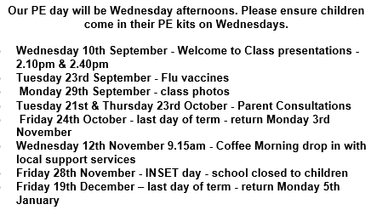
Dates for your Diary

Slide 11
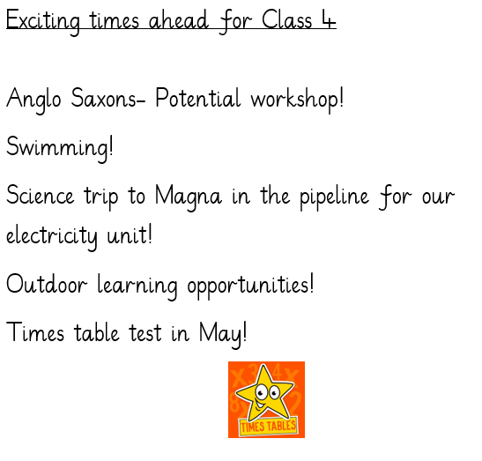
Life in Year 4

Slide 12
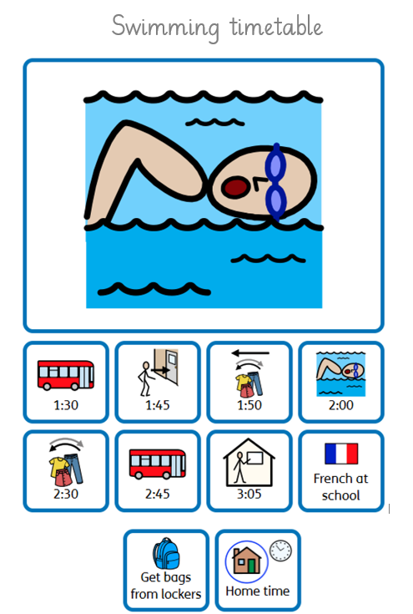

Slide 13

Thank you!
Any questions?

