Slide 1

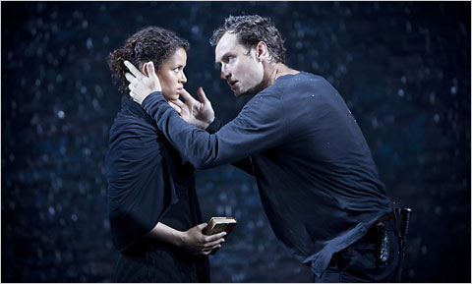

BRGS Drama & Theatre A-level
Introductory Lesson 2021

Slide 2

At BRGS
Undeniably, Drama & Theatre Studies at A-level is consistently one of the leading subjects at BRGS with students consistently achieving grades in the very top 20% of the UK.

Slide 3
A-level Drama
Over the past 10 years, the number of candidates taking A-level Drama nationally has more than doubled.
This is in harmony with the proliferating number of job opportunities within the creative sector, and the need for pupils to gain drama education has never been greater.
Indeed the Creative Industries sector is growing significantly faster than the economy as a whole. (The Creative Industries grew by an average of 7% per annum between 2008 and 2018. This compares to an average of 2% for the whole of the economy over this period.) In the summer of 2018, creative employment totalled around 6 million jobs- significantly more than the financial sector.

Slide 4



In Response:
At BRGS, from Sept 2013, ALL Year 7, 8 and 9 pupils receive Drama lessons separate from English. Drama will continue to be offered at GCSE and A-level with greater vigour as it is now regarded as a very desirable academic and creative subject by Oxbridge and ALL Russell group universities.

Slide 5
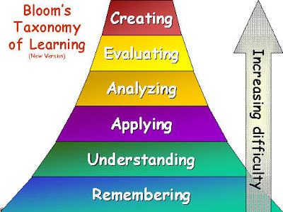

Slide 6
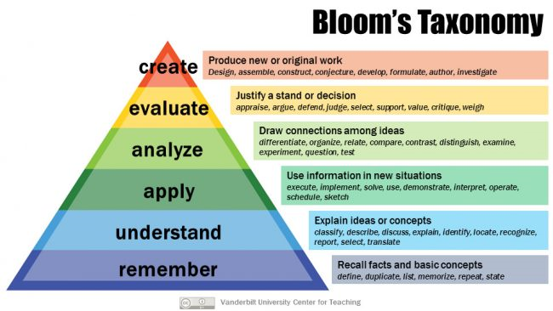
Bloom’s Taxonomy

Slide 7

Benefits for Life
No matter what your career, to communicate at your best is absolutely vital, whether it's to one person, a group or an entire audience. But most people get nervous, forgetful and too fearful to express themselves .Drama will help you redefine that fear and use it to your advantage. Drama will explore the dynamics of communication, the essence of common respect, and training your mind to communicate at your optimum level!

Slide 8
Job Opportunities
Lawyer/solicitor
Teacher
Radio
Media
PR (Public Relations)
Actor
Journalist
Writer
TV/Radio Presenter
Management/Leadership
Designer
Stage Managers
Art Administrators
Film Industry
Director
Interviewer
Drama Therapy
Producer
Advertising/Sales Manager

Slide 9
Alumni: former BRGS students who have gone on to drama school

Slide 10
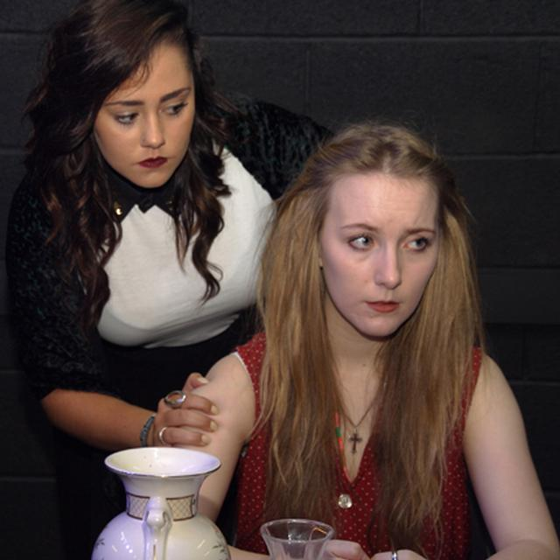
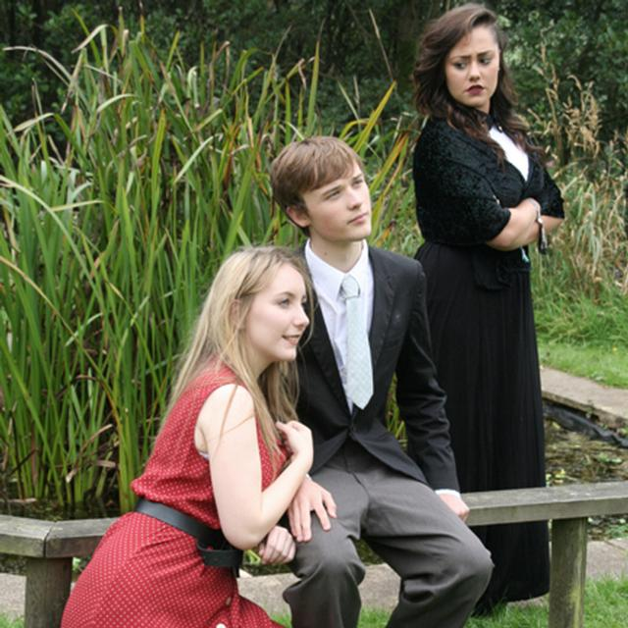
Mariella Giomarelli, George Brown, Greg Hull

Slide 11

George Bury

Slide 12



Slide 13
Has a special fate been calling you and you’re not listening? Is there a secret message right in front of you and you’re not reading it? Is this your last best chance? Are you going to take it? Or are you going to the grave with unlived lives in your veins?

Slide 14

Benefits of Drama
Overlaps with English – bring stories to life
Builds confidence and communication skills
Encourages independent learning and higher-order thinking skills
Develops sensitivity, empathy and understanding
Think creatively & critically (engage personal creativity & work in group)

Slide 15
The AQA Drama Course
For A-level

Slide 16


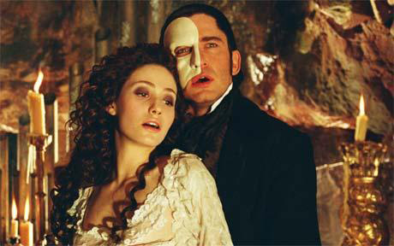

Live Performance (10%)

Slide 17

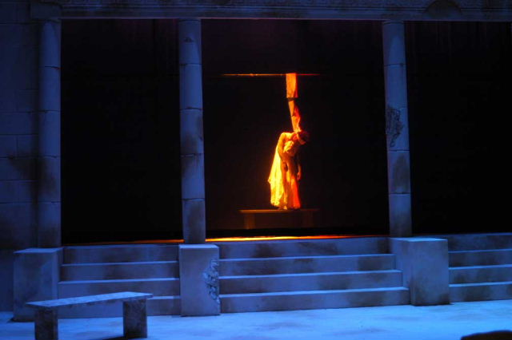
Explore two plays (30%)

Slide 18
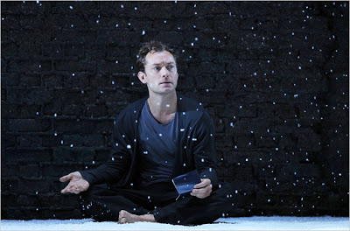

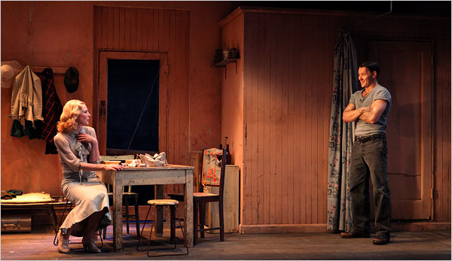
Perform a Play (30%)

Slide 19
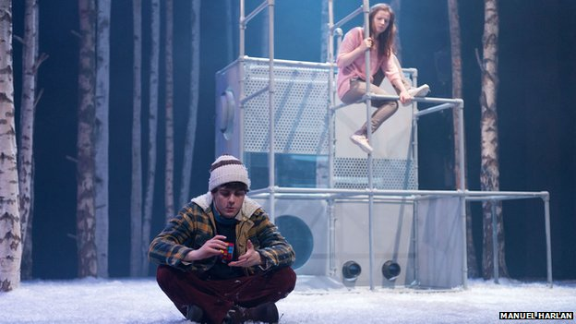
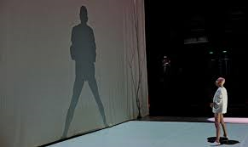
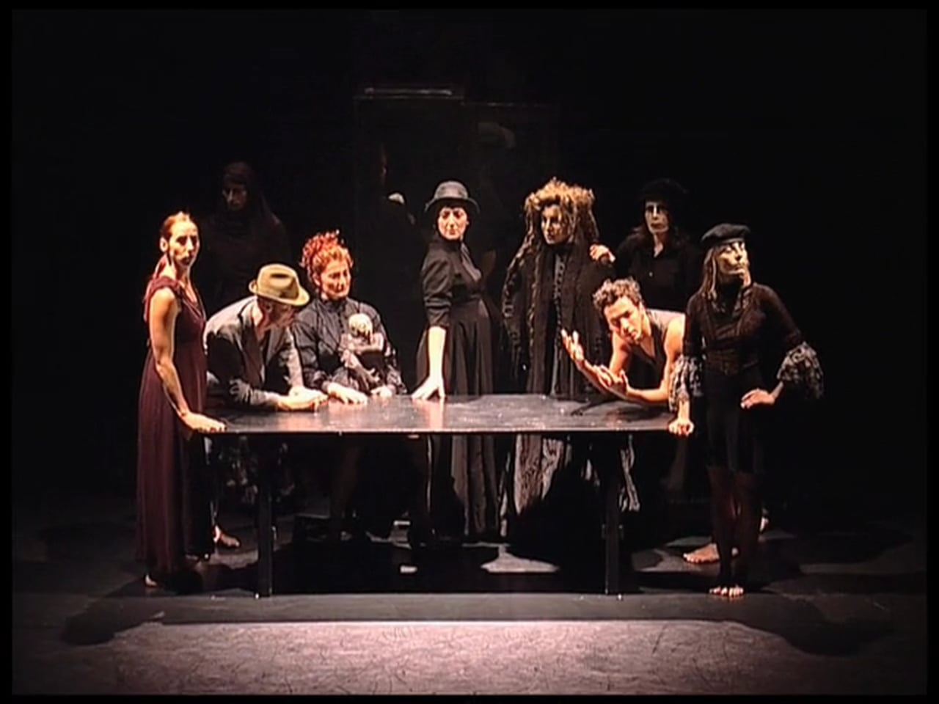
Devise a Piece (30%)

Slide 20
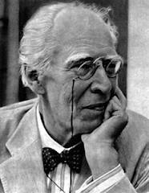
Stanislavski

Slide 21
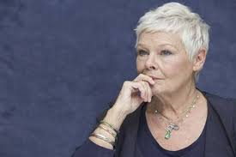

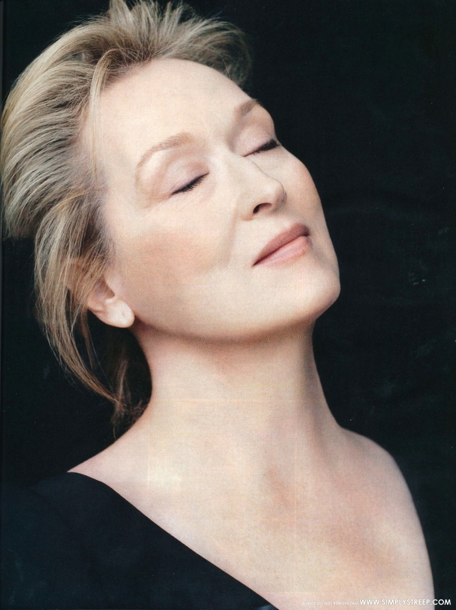
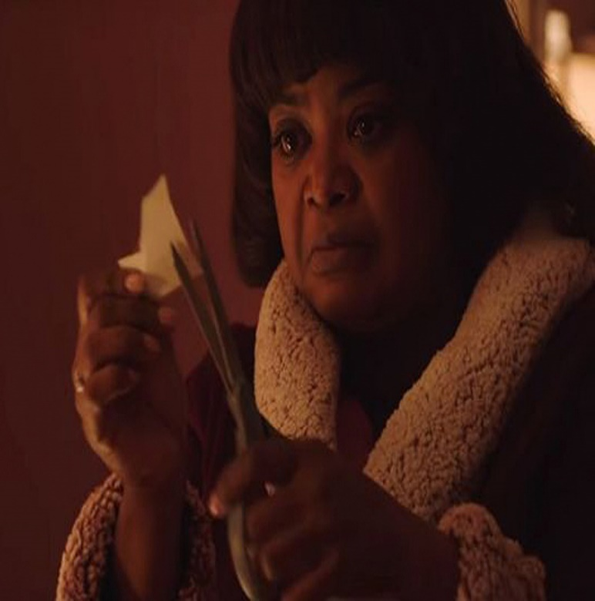

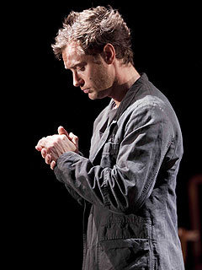
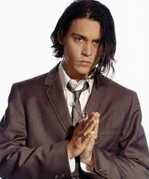
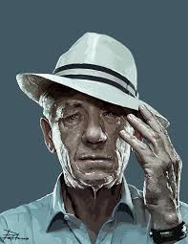

Slide 22
QUESTIONS?????? mpn@brgs.org.uk

Slide 23

Drama is Life
Make it your life!
Thank you for coming and, as always, have a nice day!

