Slide 1

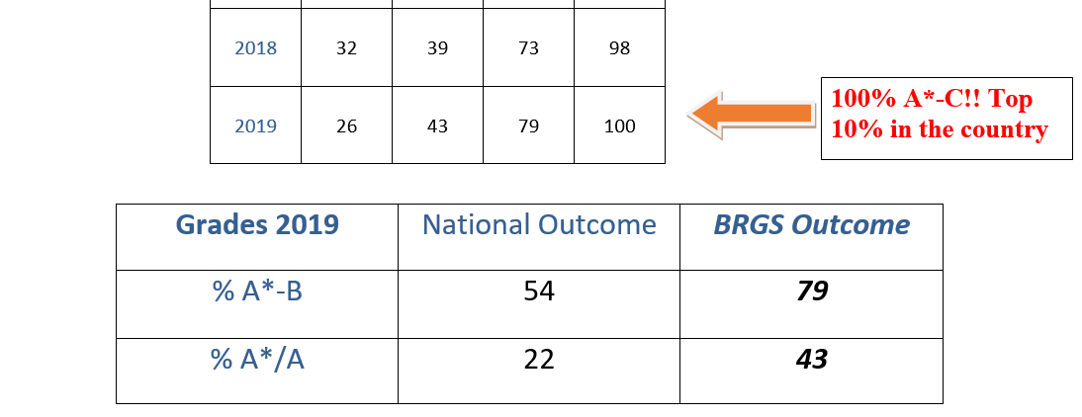
History A-Level Results:
The papers we study:
1C The Tudors: England, 1485–1603
2Q The American Dream: reality and illusion, 1945–1980

Slide 2
STAFF AND TEACHING
Mrs. G Grehan, Head of History (America)
Mr. K Grehan, 2nd in Department/Head of year 9 (Tudor)
Miss. C Gore-Ward (Tudor)
Mr. R Peat (America)
Each class has 9 one-hour lessons per fortnight (5 American and 4 Tudor in year 12)
Two teachers share each class
Classes work on exam knowledge and skills and coursework with both teachers

Slide 3
ASSESSMENT
Component 1: Breadth study
What's assessed The study of significant historical developments over a period of around 100 years and associated interpretations.
Assessed written exam: 2 hours 30 minutes three questions (one compulsory) 80 marks 40% of A-level
Questions two sections Section A – one compulsory question linked to historical interpretations (30 marks) Section B – two from three essays (2 x 25 marks)
Component 2: Depth study
What's assessed The study in depth of a period of major historical change or development and associated primary evidence.
Assessed written exam: 2 hours 30 minutes three questions (one compulsory) 80 marks 40% of A-level
Questions two sections Section A – one compulsory question linked to primary sources or sources contemporary to the period (30 marks) Section B – two from three essays (2 x 25 marks)
Component 3: Historical investigation
What's assessed A personal study based on a topic of student's choice. This should take the form of a question in the context of approximately 100 years. It must not duplicate the content of options chosen for Components 1 and 2.
Assessed 3500–4500 words 40 marks 20% of A-level marked by teachers moderated by AQA

Slide 4
What you will study:
1C The Tudors: England, 1485–1603
Henry VII, 1485–1509
Henry VIII, 1509–1547
Instability and consolidation: 'the Mid-Tudor Crisis', 1547–1563
The triumph of Elizabeth, 1563–1603
2Q The American Dream: reality and illusion, 1945–1980
Truman and Post-war America, 1945–1952
Eisenhower: tranquillity and crisis, 1952–1960
John F Kennedy and the 'New Frontier', 1960–1963
The Johnson Presidency, 1963–1968
Republican reaction: the Nixon Presidency, 1968–1974
The USA after Nixon, 1974–1980
Powers of the monarchy?
How effectively was England governed?
Relations with foreign powers change and security of the succession?
Changes in society and economy and with what effects?
Development of intellectual and religious ideas?
How important was the role of key individuals and groups and how were they affected by developments?

Slide 5
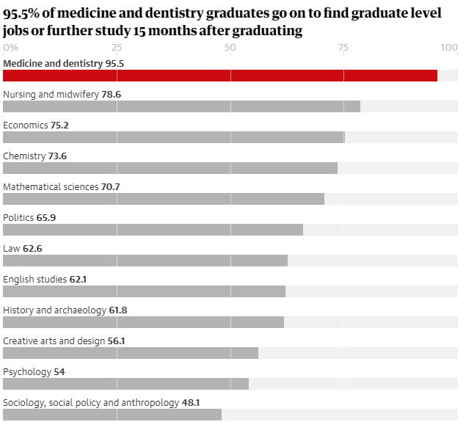

Future study/career
Many of our History students go on to study:
Medicine
Law
History
Geography
Business Studies
Economics
Languages
Marine Biology
Science
Sports Psychology
Psychology
History is a well regarded ‘facilitating’ subject and all universities value the subject for the skills it develops.

Slide 6
The good news…
…is that every student who begins A-Level History will start from the same place; whether you gained a GCSE Level 9 or didn’t study the subject at GCSE.
We are open to everyone and we achieve the best.

Slide 7
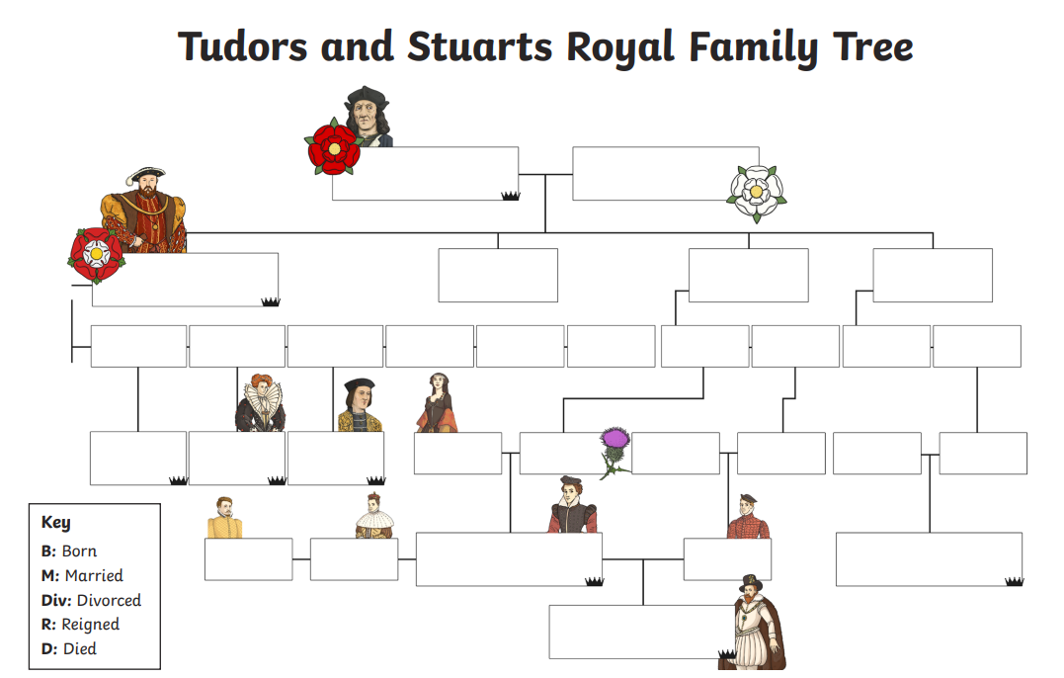
Can you complete the Tudor family tree?

Slide 8
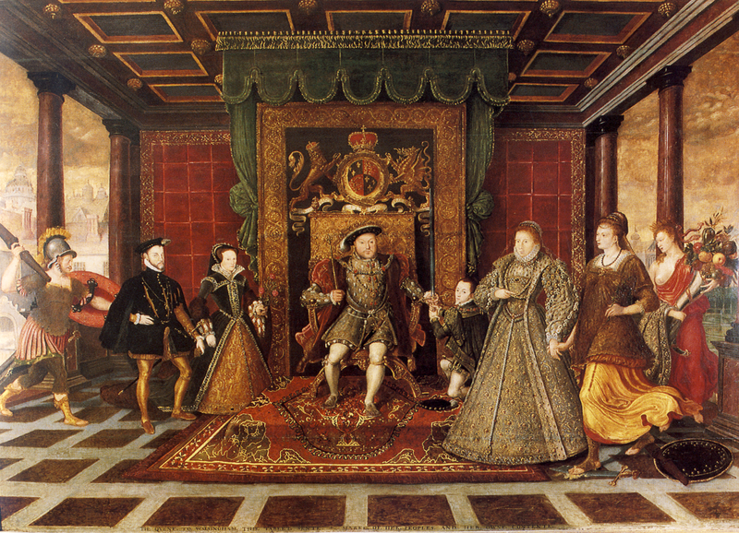
What seems strange about this painting?

Slide 9
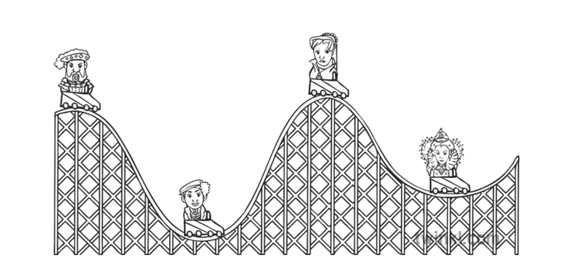
Can you complete the Tudor religious rollercoaster?
Who is missing?

Slide 10
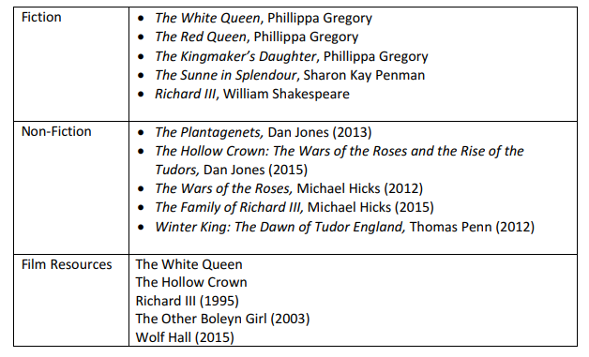
Suggested reading/watching for the Tudors:

Slide 11
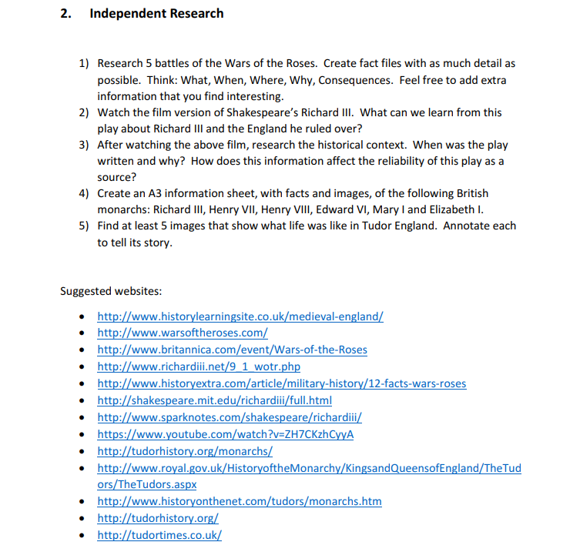

Slide 12
Tudor resources:
https://www.thestudentroom.co.uk/revision/history/tudors-power-of-parliament-and-power-of-the-monarchy
http://www.hodderplus.co.uk/myrevisionnotes/a-level-history/henry-viii/index.asp
https://filestore.aqa.org.uk/resources/history/AQA-70411C-70421C-RL.PDF

Slide 13

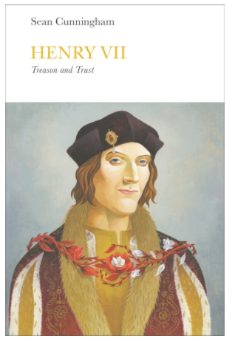

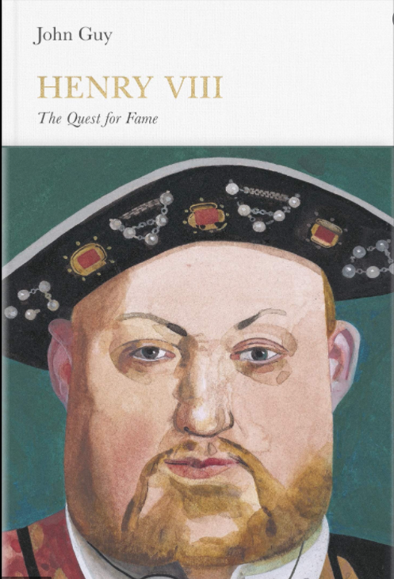
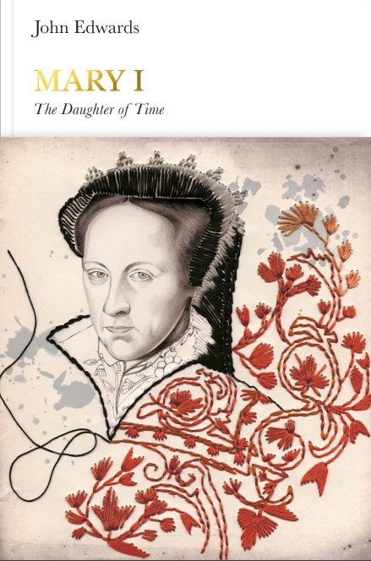
Penguin Monarchs series

Slide 14
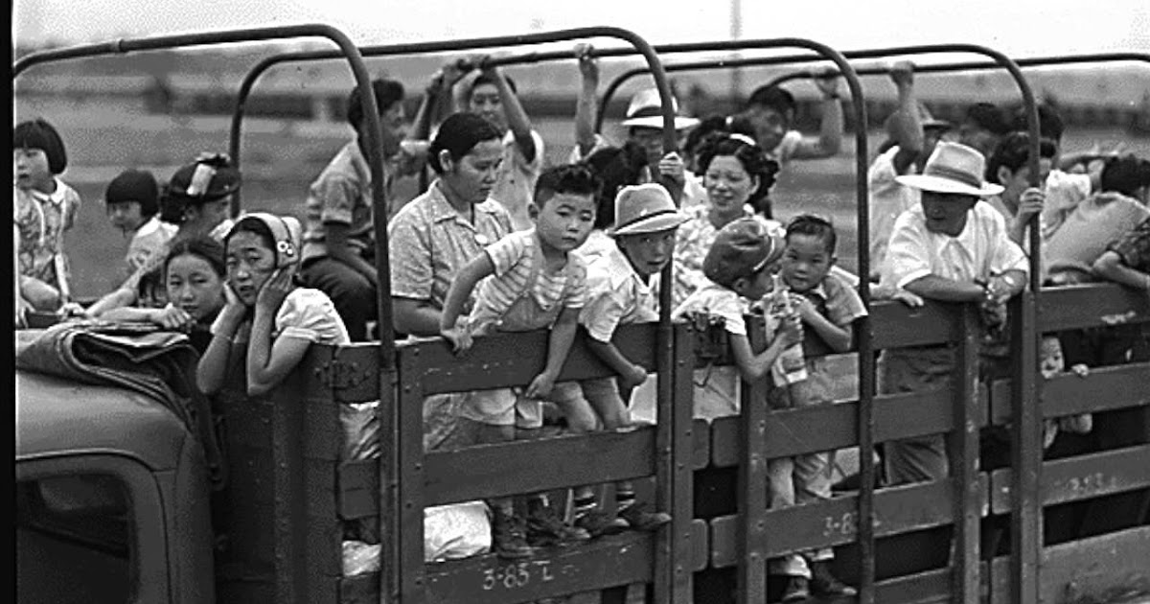
The American course starts with America after Truman drops the nuclear bombs over Japan.
The internment of Japanese Americans in the United States during World War II was the forced relocation and incarceration in concentration camps.

Slide 15
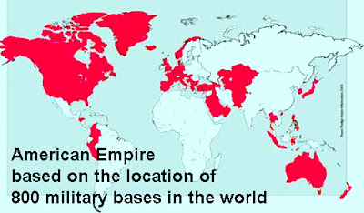
America claims they hate empire building- do you agree?

Slide 16
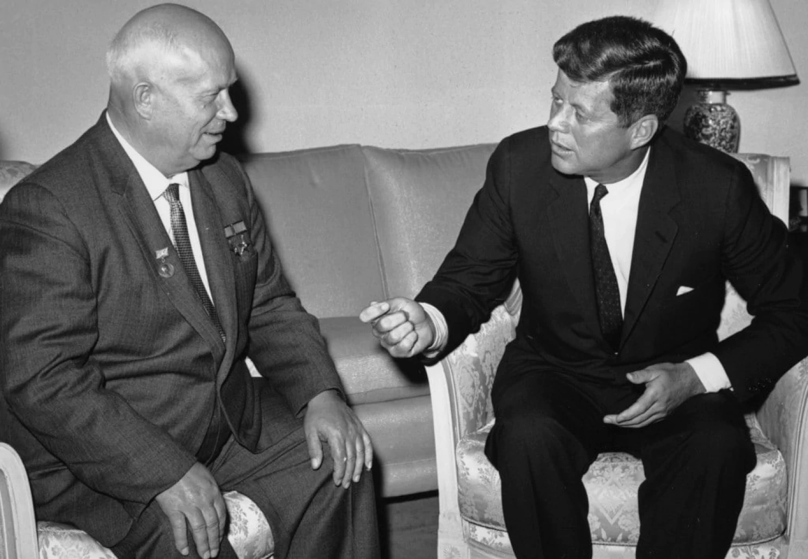
JFK is one of the most popular Presidents of all time – but did you know he passed NO civil rights legislation, escalated the war in Vietnam, did almost nothing for the poorest in America and was riddled with STDs and other medical problems (such as explosive diarrhoea)!

Slide 17
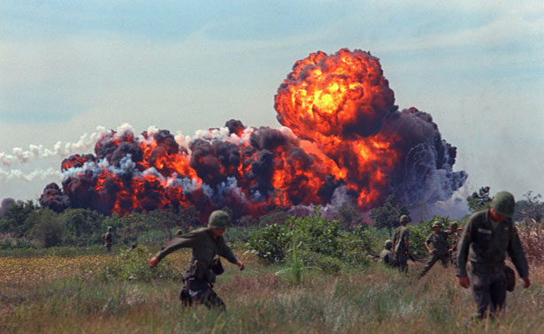
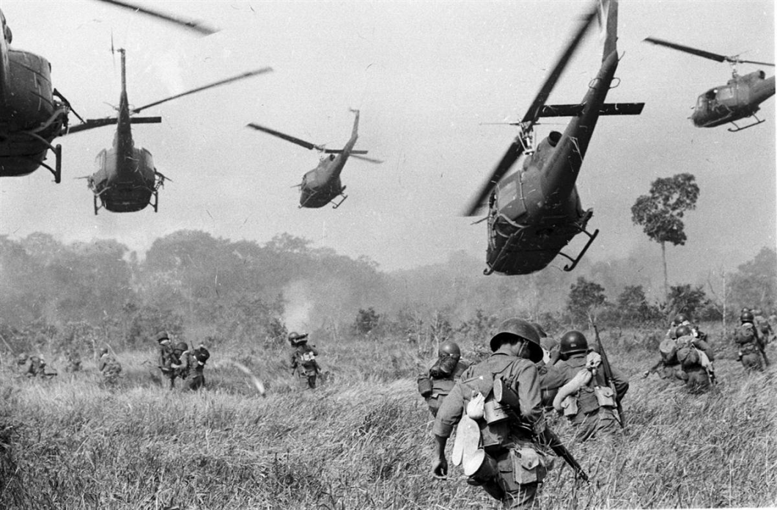
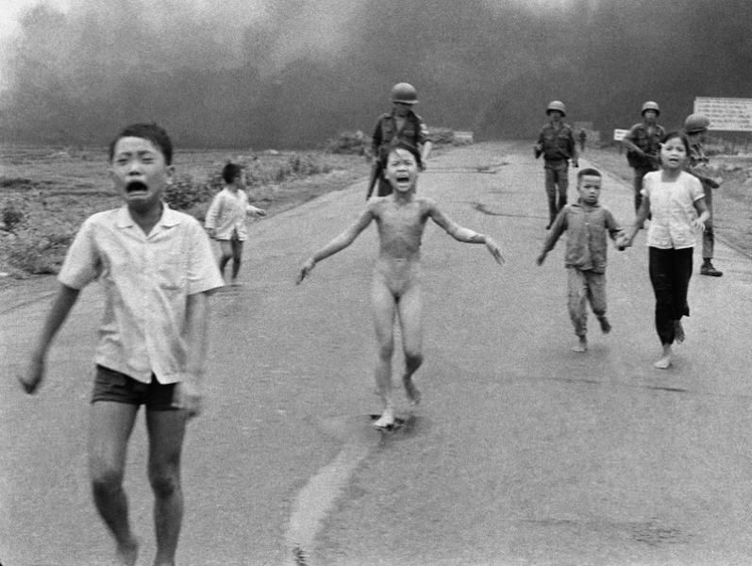
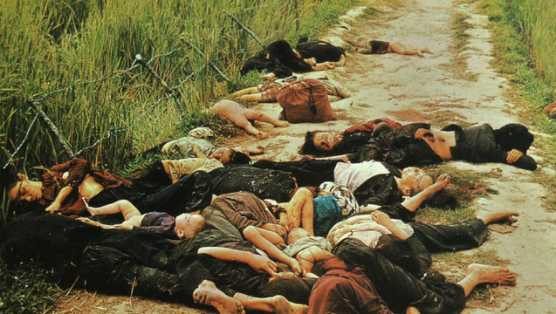
We study the war in Vietnam throughout the course, from Eisenhower denying South Vietnam the right to free elections in 1956 to Ford officially stating in 1975 “the war in Vietnam is finished as far as America is concerned.”
Notes:
Vietnam

Slide 18
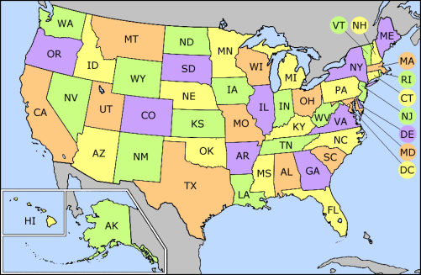
Can you identify all the States?

Slide 19
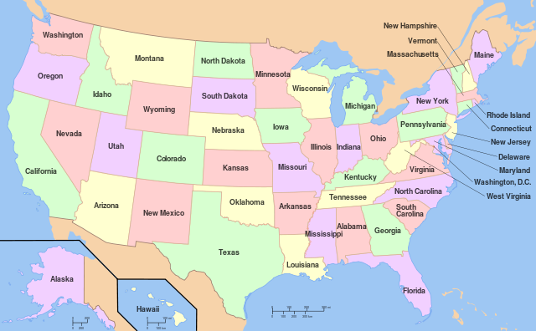

Slide 20
Extra points if you can name the 13 original colonies (the stripes on the US flag)
1. Delaware
2. Pennsylvania
3. New Jersey
4. Georgia
5. Connecticut
6. Massachusetts Bay
7. Maryland
8. South Carolina
9. New Hampshire
10. Virginia
11. New York
12. North Carolina
13. Rhode Island and Providence Plantations.

Slide 21

WHO IS AN ‘AMERICAN’?

Slide 22
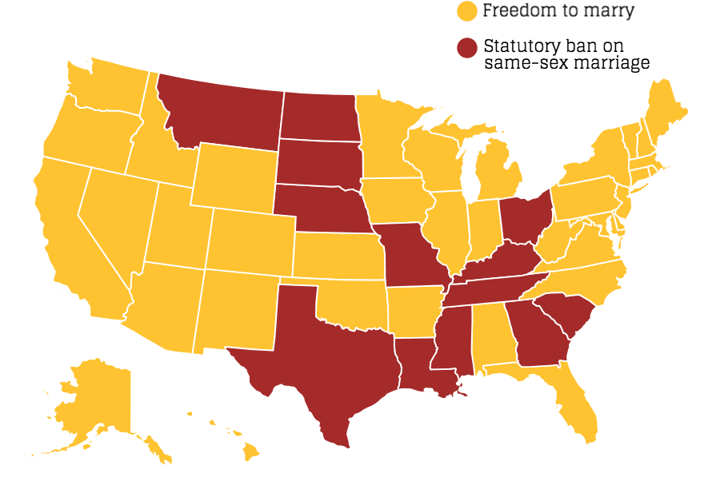
From this image can you guess where the ‘Bible Belt’ states are in America?

Slide 23
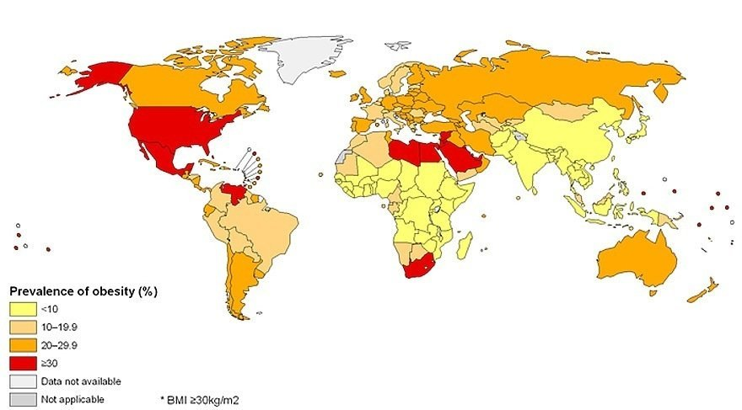
Why does the USA have an obesity problem?

Slide 24
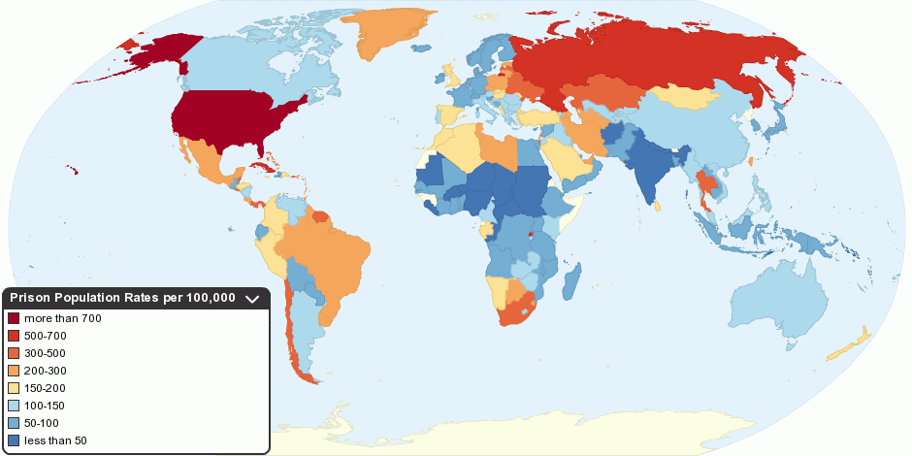
Why is the prison population in the US so high and which section of society do you think makes up the prison population? Hispanic? White? African-American?

Slide 25

What is each state famous for?

Slide 26
Bridging the Gap GCSE to A Level History Project
Task 1: Political Parties:
Research the Republican and Democrat political parties. Find out what principles each party holds, what sorts of policies they would agree with and which party any Presidents you are already familiar with belonged to (E.g. Obama/Trump).
Task 2: The Presidents:
Below is a list of Presidents who were in power between 1945-1980. You need to research which party they belonged to and find out at least one interesting piece of Political information about them. (This may be a policy they introduced, political scandal etc).
Harry S. Truman (1945-1953)
Dwight D. Eisenhower (1953-1961)
John F. Kennedy (1961-1963)
Lyndon B. Johnson (1963-1969)
Richard M. Nixon (1969-1974)
Gerald R. Ford (1974-1977)
Jimmy Carter (1977-1981)
Ronald Reagan (1981-1989)

Slide 27
Task 3: WWI and WWII:
You will need to know about American involvement in WWII. Research to find out who the US was allied with in the war, and the popularity of the war for ordinary Americans.
Task 4: The Influence of Communism:
The development of Communism in the East had a large impact on the USA. For A Level you need to know quite a bit about the Cold War.
McCarthyism: Watch a documentary on McCarthyism. Note down what McCarthyism was and research what The HUAC was. Then research to find a couple of famous people (it was mostly artists) who were questioned by HUAC.
The Korean War: Watch this Korean War Documentary: (1hr 25) https://www.youtube.com/watch?v=r9AOyrwkQAg
The Vietnam War: Watch this Vietnam War Documentary: (25mins) https://www.youtube.com/watch?v=7tNTh6KlXXU
Do you think that the USA should have interfered in Vietnam? Use the internet to find out why this war was known as ‘the TV war’.

Slide 28
Further film/DVD/Online: America
www.ushistory.org/us/
http://www.jfklibrary.org/ http://www.lbjlibrary.org/ http://www.trumanlibrary.org/ http://www.eisenhower.archives.gov/ http://www.nixonlibrary.gov/ http://www.fordlibrarymuseum.gov/ http://www.jimmycarterlibrary.gov/
The Help
Mississippi Burning
The Long Walk Home
Ali
Malcolm X
JFK
Milk
Thirteen Days
Platoon
Hamburger Hill
Full Metal Jacket
Forrest Gump
Born on the Fourth of July
Frost/Nixon
54
Bobby
Reading:
C Bragg, Heinemann Advanced History: Vietnam, Korea and US Foreign Policy 1945-75, Heinemann, 2006
O Edwards, Access to History: The USA and the Cold War 1945-63, Hodder, 2002
D Murphy, Flagship History - United States 1917-2008, Collins, 2008
M Hall, The Vietnam War (Seminar Studies in History), Routledge, 2008
M Scott-Baumann, Civil Rights and Social Movements in the Americas, CUP, 2012
V Sanders, Civil Rights in the USA 1945-68, Hodder, 2008
J de Pennington, Modern America: 1865 to the Present, Hodder, 2005
https://filestore.aqa.org.uk/resources/history/AQA-70412Q-70422Q-RL.PDF

Slide 29
Hip Hughes has some excellent clips on various aspects of American History, including for our course:
https://www.youtube.com/user/hughesDV/videos
History Rocks is also great:
https://anchor.fm/historyrocks
We are very excited to meet you and welcome you in to the History Department.
Please make sure you get in touch if you have any questions – we’ll be glad to answer them!
G Grehan: glg@brgs.org.uk
K Grehan: kmg@brgs.org.uk

