Slide 1

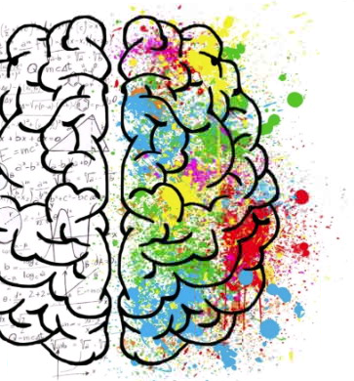
Introductory tasks
Have a go at the following activities to gain a ‘snap-shot’ of the fascinating subject of Psychology.
More specific details about the course content can be found in the Preview Booklet.

Slide 2


Do some research…
Nature v Nurture is a key debate in psychology and concerns the issue of whether human characteristics such as personality, intelligence and abnormality are the result of innate factors (nature) or are the result of learning and the environment (nurture).
It is now accepted that both play a role and psychologists are concerned with how they interact.
Task
Choose one of the links below:
1. Read an article from the BBC which proposes that ‘Exam grades 'more nature than nurture'’ discussing the fact that genetic influence explain almost 60% of the variation in GCSE exam results according to twin studies.
2. A BBC article discussing if nature is responsible for addiction ‘Brains may be wired for addiction’.
What does this research tell us about the nature nurture debate?

Slide 3

Quick Quiz
One of the topics we study in psychology is Forensic Psychology. To get you thinking about criminal behaviour, have a go at the following quiz.
Quiz
Decide whether each of the following are legal or illegal. The answers are on the next slide
You go to a cash point to draw out £20 and the machine gives you £40 in error. You decide to keep the money.
You take some paperclips home from work for your own use.
At a family celebration at your house, your parents give your 6 year old brother a small glass of lager.
You enter the house of commons wearing a suit of armour.
You hear your neighbours’ 3 year old girl screaming from inside her house, you look inside and she is lying on the floor injured. You cant see anyone else in the house so you smash the window to get inside to help her

Slide 4
Quick Quiz
Quiz answer
Illegal
Illegal
Legal – any child aged 5 or over can drink in the home!
Illegal
Illegal

Slide 5
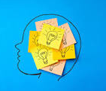
Do an experiment
Psychologists use the experimental method to gather data in psychology. Have a go at the experiment on the next slide which investigates memory.
Memory is a topic studied by Cognitive Psychologists. Cognitive psychology is a branch of psychology that studies conscious mental processes including how people think, perceive, learn and remember.

Slide 6
Instructions
In the following demonstration, look at the list of words below for two minutes. Memorise as many words as you can in this amount of time.
Next, turn off your computer monitor and get out a sheet of paper. Give yourself two minutes to write down as many words from the list as you can.

Slide 7
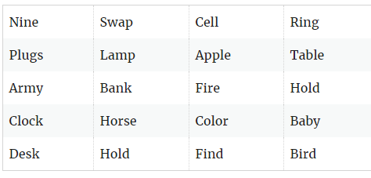

Slide 8
Instructions
Write down as many of the words as you can in two minutes and then click on the next slide to see how well you did.

Slide 10
What does this experiment tell us about memory?
This experiment is designed to test the capacity of short-term memory.
According to researcher George A. Miller, the typical storage capacity for short-term memory is seven plus or minus two items. This means that if you scored between 5 and 9, your short-term memory is within the average range. Don’t worry if you didn’t as we are all very different.
However, memory rehearsal strategies such as chunking can significantly increase memorization and recall.
Because these items can be easily grouped based on category, you can probably remember far more of these words. Clustering can be a useful memorisation strategy that can improve the retention and recall of information.

Slide 11
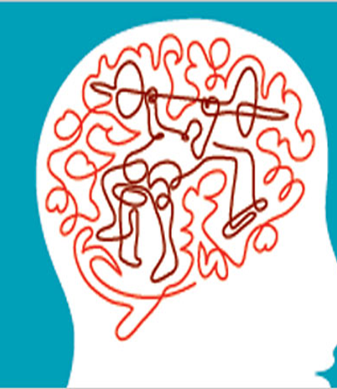
Have a go at the activity on the next slide to see what we mean by long term memory.

Slide 12
Task
Draw both sides of a 10 pence piece!!
After you have finished, click on the next slide to see how well you did!
Do not cheat!

Slide 13

So, how well did you do?
Studies into long-term memory suggest that we only remember the basic gist of information we take in and not the fine detail.
You might have been able to visualise some aspect of the coin but not exactly what was on each slide.
In real life, we do not remember everything we take into long-term memory, for example, you would not be able to explain a book you read word-for-word, but you probably could give an overall gist of what happened.

